Slide 1
Support to National REDD+ Action:
Global Programme Framework 2011-2015 (SNA)
Work Plan and Budget 2015
Information and Knowledge Sharing Sessions
Twelfth Policy Board meeting
Lima, Peru
7 July 2014

Slide 2
SNA Work Plan and Budget 2015
OUTLINE
Part 1
Part 2
Part 3
BACKGROUND
OBJECTIVES and
PROCESS
2015
WORK
PLAN
2015
BUDGET

Slide 3
BACKGROUND
Aims at providing the underlying structure for the UN-REDD Programme provision of support to countries
Scoped to advance understanding and implementation of REDD+ at all levels
Includes different categories of support - International Support Functions, Country Specific Support and Secretariat for ensuring delivery of technical support countries
Contributes to global knowledge on REDD+.
Provides more flexible approaches of delivery that complement National Programmes, and addresses evolving country specific needs.
Notes:
Full text:
SNA has become a more flexible support modality complementing National Programmes (and Tier 2)
Support across levels (national, regional and global) through its categories of support - International Support Functions, Country Specific Support and Secretariat
Increased country specific support - through requests for targeted support (31 requests approved) and backstopping to more than x countries in total.
Provision of funding for country or regional needs assessments for further tailoring of support
Knowledge, learning and good practices synthesised and shared and south to south exchange

Slide 4
CATEGORIES OF SUPPORT
SNA
Categories of support
International support functions
Country specific support
Secretariat
Targeted support
Backstopping
Development of approaches, guidelines, tools, methodologies promoting increased expertise on REDD+; South-south cooperation
Support to PB, delivery of UN-REDD Programme services and results (reports etc); Results-based management; KM & Communications

Slide 5
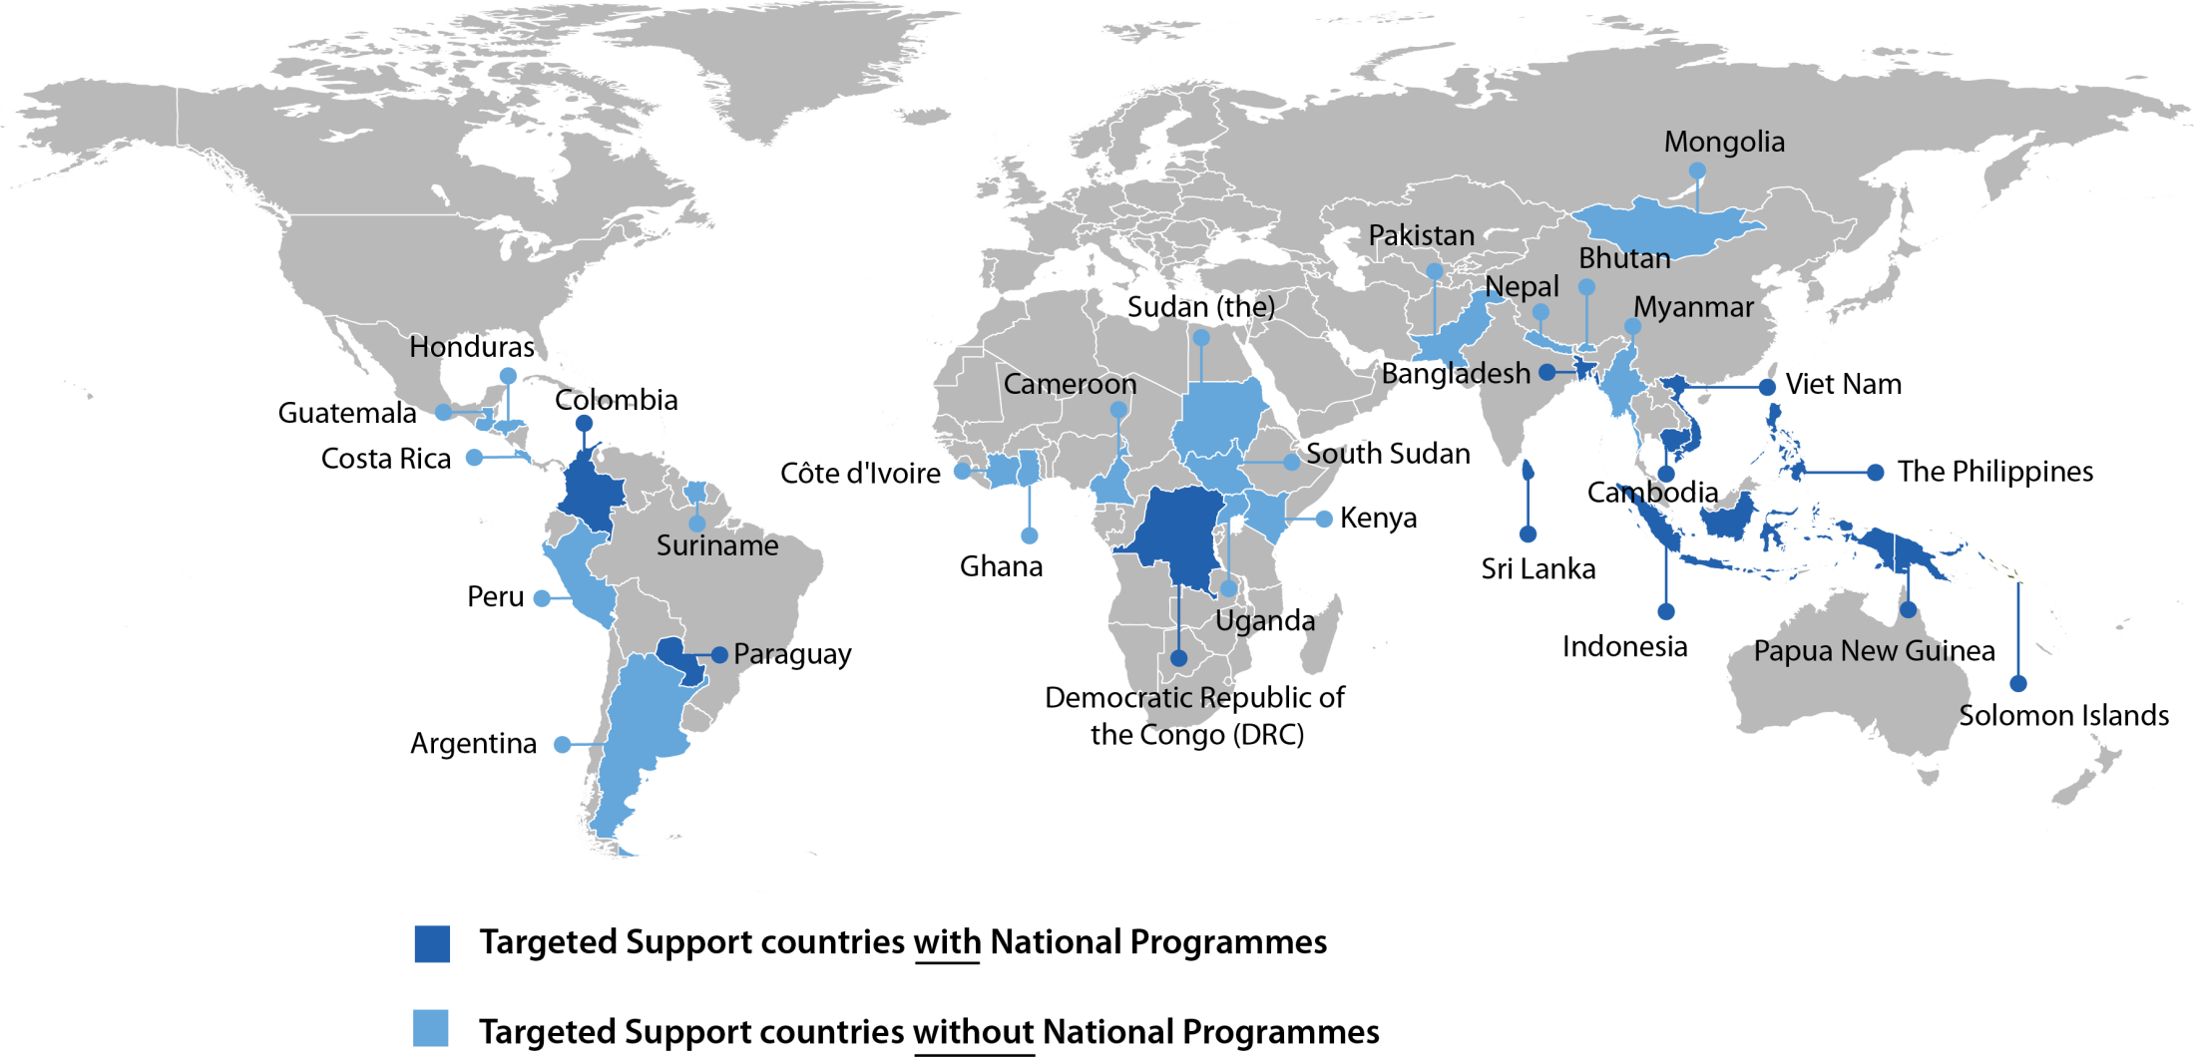
BACKGROUND
Growing demand for country-specific support:
29 countries receiving targeted support
In 2013 37 countries received backstopping

Slide 6
    SNA Work Plan and Budget 2015:
    PROCESS
    Policy Board invited to provide guidance on priorities to consider.
    Guidance from the Board sent to the Secretariat 80 working days prior to the Policy Board meeting.
    Draft SNA work plan and budget, with a response matrix circulated to the Policy Board 35 working days before the meeting.
    The Secretariat organized an Information Session prior to the meeting for consideration of budget proposal by Policy Board.
Notes:
Roadmap for addressing longer term issues:

Slide 7
SNA Work Plan and Budget 2015:
CONTEXT
Countries are in different phases of REDD+ readiness
Multiple and growing number of actors technically and financially involved and supporting REDD+ readiness
There is a more clear guidance from the UNFCCC on the implementation of REDD+
Some countries are moving to demonstration activities and performance based payment
Stronger demand for inclusion from indigenous peoples, local communities and civil society at national level

Slide 8
SNA Work Plan and Budget 2015:
KEY OBJECTIVES
Consolidate the objectives of the UN-REDD 2011-2015 Strategy while bridging with a future post 2015 strategy
Focus on supporting and implementing core elements of REDD+ readiness in accordance with UNFCCC decisions and methodological guidance, especially the Cancun Agreements and the Warsaw Framework for REDD+
Strengthen the coordinated delivery of readiness support at country level

Slide 9
SNA Work Plan and Budget 2015:
SPECIFIC OBJECTIVES
Maintain the operational function of the SNA to deliver expected normative work in supporting countries
Secure the Programme's technical infrastructure and continuity of delivery
Provision of country specific support: tailoring the support according to the specific needs and circumstances in countries
Sustain the Programme’s knowledge management platform building on lessons learned and South-South cooperation;
Maintain the provision of Secretariat services, including meeting Policy Board needs and requirements

Slide 10
SNA WORK PLAN 2015
SNA RESULTS FRAMEWORK
Outcomes and Outputs remain the same + 2 additional outputs
1. MRV and Monitoring (1 new output)
NATIONAL
REGIONAL
GLOBAL
LEVELS
2. Governance (1 new output)
3. Deferred and integrated to others
4. Stakeholder engagement
5. Safeguards and multiple benefits
6. Green economy
7. Knowledge and capacity
8. Secretariat

Slide 11
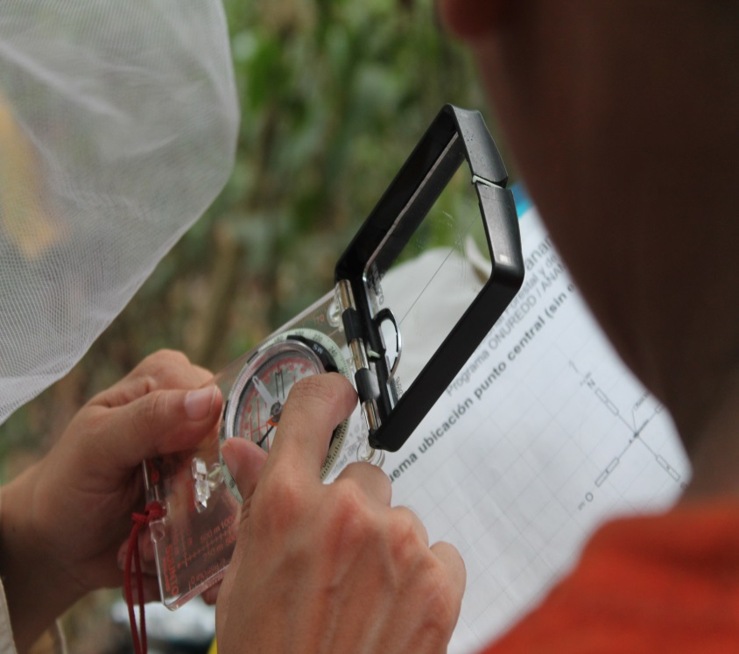
SNA 2015 WORK PLAN
Focus Per Outcome
Outcome 1. MRV and Monitoring
New Output “National preparation of Forest Reference Emission Levels and Forest Emission Levels (FREL/FRL)“
Revised scope and planned activities based on Warsaw decisions on RLs/RELs, NFMS and MRV
Support will be driven by the UNFCCC context
Expect to allow countries to access financial support under the Green Climate Fund and other funding options
Strong emphasis on south-south exchange
Proposed budget for Outcome 1: US$ 5,740,245

Slide 12
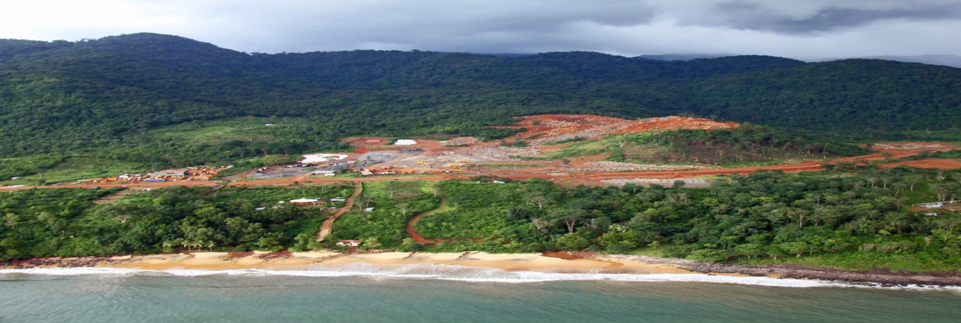
SNA 2015 WORK PLAN
Focus Per Outcome
Outcome 2. Governance
New Output - analysis of relevant REDD+ activities and support to all elements of national REDD+ strategies.
Increasing focus on drivers of deforestation
In addition to standard setting activities, growing demand to provide more support in line with country specific needs and priorities
Proposed budget for Outcome 2: US$ 5,848,859
Notes:
Outcome 3. National systems for transparent, equitable, credible and accountable management of REDD+ funding
Some Outputs absorbed by Outcome 2 as per major review approved at PB9
Two Outputs deferred

Slide 13

SNA 2015 WORKPLAN
Focus Per Outcome
Outcome 4.
Stakeholder engagement
Stregthened stakeholder engagement around REDD+
Focus on sustained support for ensuring sustainable impact
Increased support to private sector engagement
Proposed budget for Outcome 4: US$ 3,039,211

Slide 14
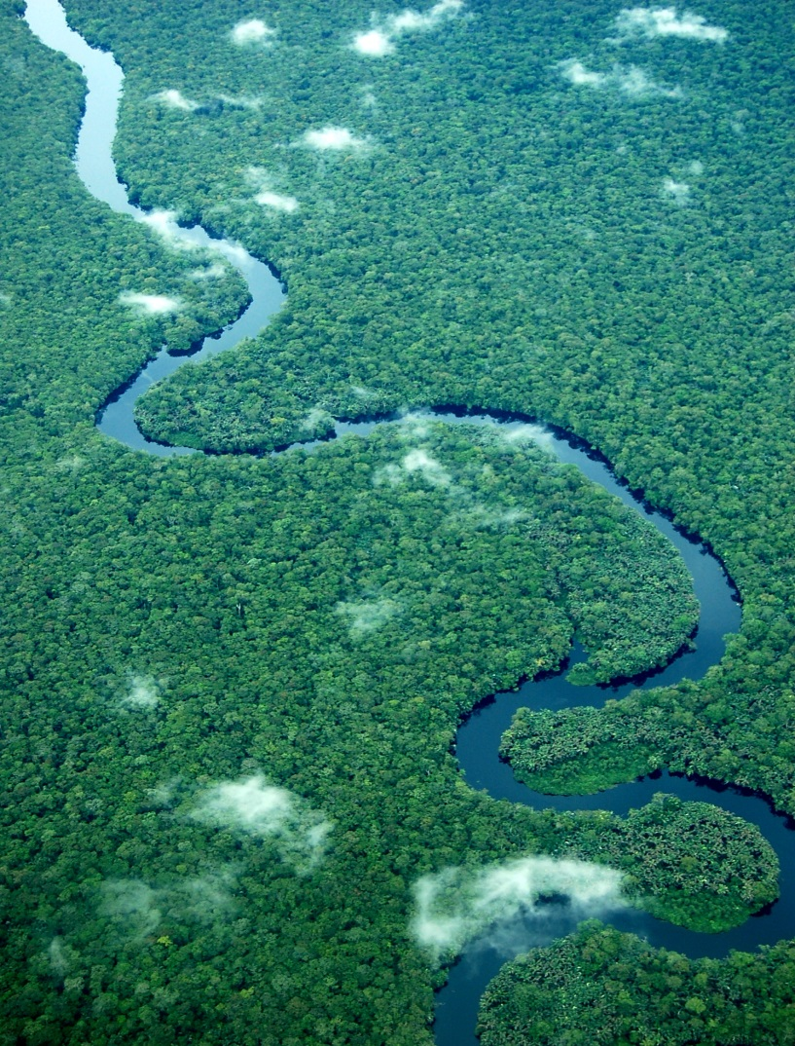
SNA 2015 WORK PLAN
Focus Per Outcome
Outcome 5.
Safeguards and Multiple Benefits
Support progress towards results-based payments with proper consideration and information of safeguards through activities focusing on:
Improving application of REDD+ safeguards and SIS at national level
Linking safeguards and multiple benefits activities with drivers of deforestation
Supporting land-use planning and build capacity in spatial planning for REDD+.
Proposed budget for Outcome 5: US$ 3,763,830

Slide 15

SNA 2015 WOR KPLAN
Focus Per Outcome
Outcome 6. Green Economy
Growing interest in linking REDD+ with a wider transition to Green Economy
Support on various aspects of Green Economy to increasing number of countries that are entering the implementation and investment phase
Proposed budget for Outcome 6: US$ 1,376,235

Slide 16
SNA 2015 WORK PLAN
Focus Per Outcome
Outcome 7. Knowledge Management
Sustain activities for robust knowledge management platform building on lessons learned and South-South cooperation.
Build strategic knowledge partnerships with other multilateral institutions and organizations working on REDD+ to leverage collective experience, generate a multiplier effect and to broker knowledge in support of countries
Proposed budget for Outcome 7: US$ 1,140,685
Outcome 8. Secretariat
Maintain service to the Policy Board and support to the Programme in accordance with the Secretariat’s Terms of Reference
Ensure availability of funds to respond to increasing number of partner countries and decisions of the Policy Board
Provide for continuous advancement on monitoring and reporting framework
Proposed budget for Outcome 8: US$ 3,523,878

Slide 17
SNA Budget 2015:
PROPOSED ALLOCATION
Outcomes | Budget allocation (US$)
1. REDD+ countries have systems and capacities to develop and implement MRV and monitoring | 5,740,245
2. Credible, inclusive national governance systems are developed for REDD+ implementation | 5,848,859
4. Indigenous peoples, local communities, civil society organizations and other stakeholders participate effectively in national and international REDD+ decision making, strategy development and implementation | 3,039,211
5. Safeguards are addressed and respected and multiple benefits of REDD+ are realized | 3,763,830
6. Green economy transformation and REDD+ strategies and investments are mutually reinforcing | 1,376,235
7. UN-REDD Programme knowledge is developed, managed, analyzed and shared to support REDD+ efforts at all levels | 1,140,685
8. Timely and effective UN-REDD Programme Secretariat services provided to the UN-REDD partner countries, Policy Board and the UN agencies | 3,523,878
Total | 24,432,943

Slide 18
SNA Budget 2015:
PROPOSED ALLOCATION IN %

Slide 19
ALLOCATION PER SNA OUTCOME

Slide 20
SNA Work Plan and Budget 2015
IN A NUTSHELL
Based on lessons learned from the implementation of the UN-REDD delivery modalities
Guided by the UNFCCC decisions, especially the Cancun Agreements and Warsaw Framework for REDD+
Takes into account the evolving REDD+ landscape
Designed to ensure the continued support to Partner Countries in their progress towards REDD+ readiness
Focused on maintaining the operational function and established capacity for technical support of the UN-REDD Programme.
Proposed budget : US$ 24,432,943

Slide 21
DECISION PROPOSED
The Policy Board approves the revised work plan and budget for Year 4 (2015) of the ‘Support to National REDD+ Action: Global Programme Framework 2011-2015’ (SNA) and allocation of US$ 24,432,943 as per the submission form.

Slide 22
Thais Linhares-Juvenal
Thais.Juvenal@un-redd.org
Thank You
Website: http://www.un-redd.org

Slide 23
EXTRA SLIDES

Slide 24
    SNA Work Plan and Budget 2015:
    PROCESS
    Budget priorities: Comments received (CSO Representative, PNG and Norway) and responses
Capacity building for MRV/NFMS in countries, including indigenous peoples and local communities where appropriate
MRV & M support alignments with UNFCCC provisions and IPCC guidelines and guidance
CSOs and indigenous peoples engagement in National Programmes evaluations
Linkage of REDD+ into transformational green economy
REDD+ Academy (regional design workshops - ‘bottom-up’ approach).

Slide 25
    SNA Work Plan and Budget 2015:
    PROCESS
    Budget priorities: Comments received and responses, cont.
Programme commitment to limit the printing and minimize the environmental impact
Opportunity for country or regional needs assessments to better scope the provision of support to specific needs
Importance of Evaluation Report findings and recommendations (draft at the time, adjustments may be needed for a proposal to PB13)
Part in country specific support out of total budget
Process for Work Plan and Budget preparation as agreed at PB11.

