Slide 1


Overview of National GHG Inventory Systems
Latin American Workshop on National GHG Inventories Systems
Santiago, Chile
Kimberly Todd
UNDP/UN-REDD
15 May 2013

Slide 2
Presentation Outline
What is an National Inventory System?
What is a sustainable National Inventory System?
Streamlining the Inventory Process
Institutional, procedural and legal arrangements
Conclusions

Slide 3
What is a National Inventory System (NIS)?
A national inventory system incorporates all the elements necessary to:
  Estimate, report and archive GHG emissions and removals for energy, industrial processes, solvents, agriculture, LULUCF, waste
Institutional arrangements
Legal arrangements
Procedural arrangements
High quality GHG inventory that meets needs of policy-makers, researchers and public

Slide 4
What is a Sustainable NIS?
Ability to develop high quality inventory at regular intervals (e.g., annually, every 2-4 years, etc)
  Continually improve emissions and removals estimates
  Focus resources on most significant key sources
  Sources of data: identify, appropriately archive and make regularly accessible
  Transparently document inventory process
      an expert should be able to reproduce
A complete and accurate inventory is the foundation for analysis of a range of energy and environmental issues, as well as MRV

Slide 5
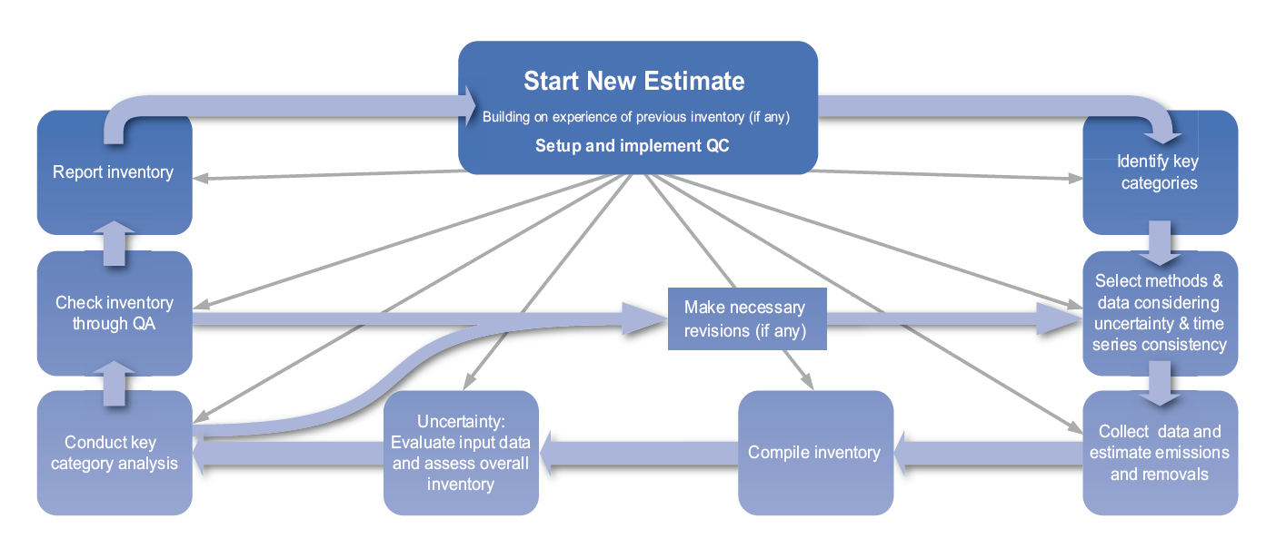
Inventory Production Cycle
IPCC 2008

Slide 6
An Effective NIS can streamline the three main phases of inventory process
1. Inventory planning
General rules of procedure
Source-specific rules of procedure
Workplan, budget, timeline
Guidance manual
Elaborating a QA/QC plan
Inventory improvement strategy
2. Inventory preparation
National inventory report
Updated improvement strategy
QA/QC
3. Inventory management
Documentation
Archiving
Reporting to UNFCCC
Awareness raising (national level)

Slide 7
Institutional Arrangements
Consist of a set of formal arrangements (e.g., regulations, MoUs, etc.) that rules the flow of resources, data, information, among elements of the NIS
Objectives:
  To provide the financial and human resources as well as legal authority to ensure that NIS functions will be entirely and efficiently performed
  To set up the framework of provisions which rule those functions

Slide 8
Why are legal arrangements
(e.g., Act, decree) needed?
To ensure resources are budgeted
To define responsibilities (legal entity) and designate a single entity responsible for inventory management
To establish a system for collecting data and allow for timely acquisition of all necessary data
      esp. from national statistical agencies, private companies, other key sources
To ensure access to inventory data for inventory compilers

Slide 9
An Illustrative Example of Institutional and Procedural Arrangements
Lead institution
Cooperating institutions
Team coordinator
Data providers
Data providers
Sectoral experts
QA/QC manager
Database manager
Universities
Consultants
Research institutions
Strategy / workplan in place
QA/QC plan developed
Documentation and Archiving system in place
Reporting system in place

Slide 10
Conclusions
National inventory systems are foundation for complete and rigorous inventories
Results can be achieved by different strategies
  National circumstances need to be taken into account
Documentation and archiving are critical success factors for the sustainability of the system
  Resources should be focused on key sources
  Important to appoint coordinators at IPCC sectoral level
Inventory process should be transparently documented – an expert should be able to reproduce
  Inventory development is iterative process – improving over time

Slide 11
Useful Resources
Handbook: Managing the National GHG Inventory Process (UNDP-GEF, 2005)
  http://ncsp.undp.org/document/managing-national-greenhouse-gas-inventory-process
US EPA Template Workbook: Developing a National GHG Inventory System
  www.epa.gov/climatechange/Downloads/EPAactivities/Complete-Template-Workbook.doc
WRI MAPT National GHG Inventory Case Study Series
  https://sites.google.com/site/maptpartnerresearch/national-ghg-inventory-case-study-series

Slide 12


Thank you! Questions?
Kimberly Todd
kimberly.todd@undp.org

