Slide 1
Nigeria
REDD+ Readiness Programme
UN-REDD Policy Board
Da Lat, VietNam, 21-22 March 2011
Salisu Dahiru, National REDD+ Coordinator, Nigeria
Odigha Odigha, Chairman, Forestry Commission, Cross River State, Nigeria

Slide 2
Chronology and context
2009: Nigeria engages in REDD+ and joins the UN-REDD Programme.
2010: Nigeria lays the foundations for REDD+, including:
    Preliminary Assessment of the Context for REDD in Nigeria; plus others.
    Political commitment built.
    Stakeholder engagements and dialogue, and community training.
    REDD+ coordinating structures created (Federal & Cross River State)
    UN-REDD scoping mission (October 2010)
    Nigeria’s REDD approach presented at Cancun climate summit.
In November 2010, the 5th UN-REDD Policy Board “invited Nigeria to submit a full National Programme for consideration by the Policy Board at its sixth meeting in March 2011”(UN-REDD PB-5 report, #14).
Since PB-5, Nigerian stakeholders, with UN-REDD support, have worked intensively to prepare, consult & validate a national REDD+ readiness programme.

Slide 3
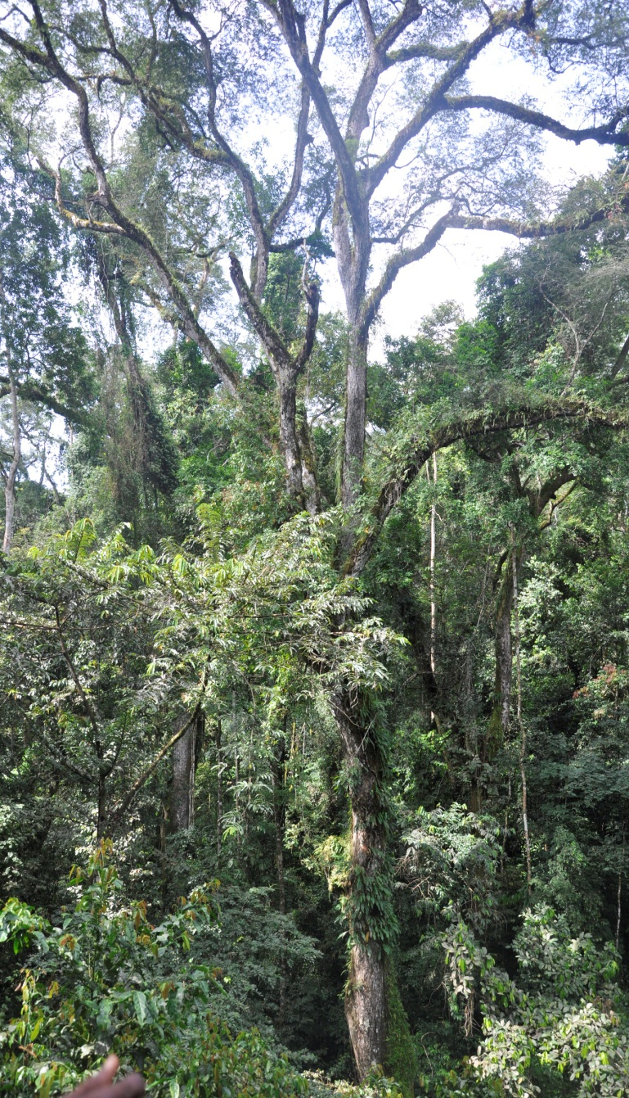
Nigeria’s forest & climate change policy context
Deforestation rate at 3.7% , one of the highest in the world.
Cross River State (CRS) hosts over 50% of remaining tropical high forests in Nigeria.
Initial, bold actions taken:
  Ambitious nationwide reforestation programme with indigenous trees
  Moratorium on timber extraction in Cross River State
  Engagement in REDD+ since 2009
Political awareness that curbing deforestation depends on community engagement and enhancing local livelihoods.

Slide 4
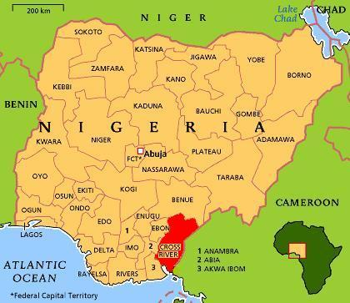
NIGERIA: a two-track approach to REDD+ readiness
Federal Level: Capacity-building & strategic framework for REDD+ [national level]
Cross River State: Intense REDD+ readiness & demonstration model for the country
  [sub-national level]

Slide 5
Programme architecture
GOAL: To enable Nigeria to contribute to climate change mitigation through improved forest conservation and enhancing sustainable community livelihoods.
OBJECTIVE: To build the REDD+ mechanism in Nigeria, using Cross River State as a demonstration model.
OUTCOMES:
Improved institutional & technical capacity at the national level
Framework for REDD+ expansion across Nigeria prepared
Institutional and technical capacity for REDD+ in Cross River State strengthened
REDD+ readiness demonstrated in Cross River State

Slide 6
Programme description
4 outcomes, 14 outputs and 80 core/indicative activities
Key readiness components addressed both at Federal level and in Cross River State.
Federal level: focus on key structures and a strategy for engaging new states.
Cross River State: intense REDD+ readiness, with grassroots engagement, to provide models and best practices for the rest of Nigeria.
A harmonised federal-state structuring for REDD+.
Budget: US$ 4 million
Timeline: 2011-2013 (2 ½ years)
The Programme is comprehensive, covering all REDD+ readiness components (co-financing to be mobilised as required).

Slide 7
Synopsis of Nigeria REDD+ Readiness Programme

Slide 8
Overview of REDD+ readiness in Nigeria

Slide 9
Outcome 1. Improved institutional & technical capacity at the national level

Slide 10
Outcome 2. Framework for REDD+ expansion across Nigeria prepared

Slide 11
Outcome 3. Institutional & technical capacity for REDD+ in Cross River State strengthened

Slide 12
Outcome 4. REDD+ readiness demonstrated in Cross River State

Slide 13
Synthesis of budget allocations per outcome and per UN-REDD agency (US$)
UN-REDD agency | Outcome 1 | Outcome 2 | Outcome 3 | Outcome 4 | Programme cost | Indirect support cost (7%) | Total
FAO | - | 395,000 | 662,000 | - | 1,057,000 | 73,990 | 1,130,990
UNDP | 645,000 | 90,000 | 953,318 | 555,000 | 2,243,318 | 157,032 | 2,400,350
UNEP | 80,000 | - | - | 358,000 | 438,000 | 30,660 | 468,660
TOTALS | 725,000 | 485,000 | 1,615,318 | 913,000 | 3,738,318 | 261,682 | 4,000,000

Slide 14
Conformity with international REDD+ readiness components

Slide 15
Institutional arrangements
Federal
National Advisory Council on REDD+
National Technical Committee on REDD+
Federal Ministry for Environment
Special Climate Change Unit (SCCU)
Federal Department of Forestry
REDD+ Secretariat
Federal stakeholders REDD+ platform (under creation, February 2011)
Cross River State (CRS)
CRS Climate Change Council (chaired by Governor)
CRS Forestry Commission
CRS REDD+ Unit
CRS REDD+ Technical Committee
CRS Stakeholders Forum on REDD+

Slide 16
INSTITUTIONAL AND IMPLEMENTATION ARRANGEMENTS

Slide 17
Stakeholder engagement
> 20 years of community forest management in CRS.
Community interest and expectations on REDD+ (e.g. community carbon assessments).
Community participation in REDD+ readiness planning.
High stakeholder turn out at REDD+ events.
3 outputs entirely devoted to community & stakeholder engagements (outputs 1.2, 3.2 and 4.1).
Stakeholder platforms for REDD+ created at all levels.
Private sector interest in REDD+ expressed.
Regional stakeholder engagements anticipated (ECOWAS).

Slide 18
Technical Dimensions
Drivers of deforestation (outputs 2.1 and 3.3)
National MRV framework (output 2.2)
Forest monitoring in Cross River State (output 3.4)
Legal and institutional assessment and reforms (outputs 1.3 and 3.3)
Preliminary National strategy for REDD+ (output 2.3)
CRS REDD+ strategy (output 3.3)
Coordination of experimental initiatives (output 4.1)

Slide 19
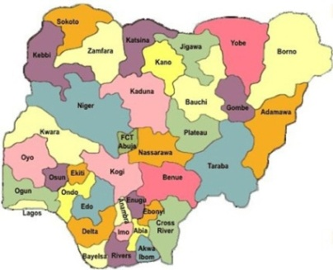



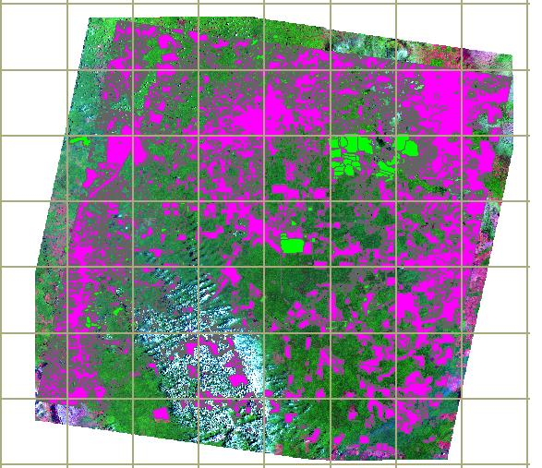
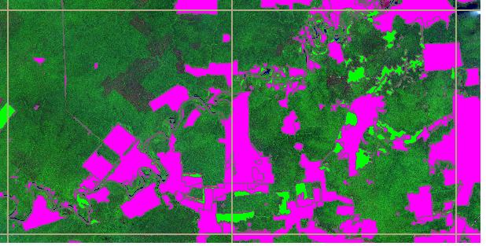
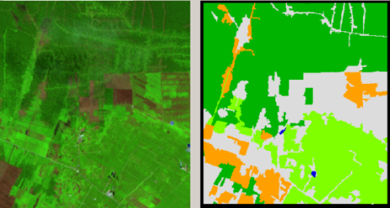

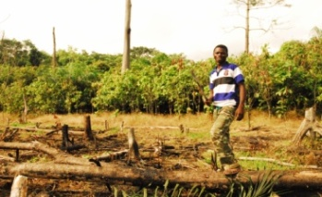




Proposed monitoring system for forest cover and forest cover changes
Aiming at a REDD+ results-based mechanism (phase 2)
Federal Level
Development of the system
Independent review
Management of the data
State level
2005
Interpretation
Community level
DETECTION OF CHANGES in FOREST COVER AND USES
Verification

Slide 20
Social & Environmental dimensions
Social & environmental safeguards (outputs 3.3 and 4.3)
Carbon Rights and Land Tenure (outputs 1.3 and 3.3)
Multiple ecosystem benefits (output 4.3)
FPIC and Recourse Mechanisms (output 3.3)
Participatory Governance Assessments (output 3.3)
Community initiatives for REDD+: Technical advice, coordination and creation of a fund (output 4.1)
Knowledge management & dissemination of best practices: CRS as a centre of excellence on REDD+ (outputs 2.3 and 4.3)

Slide 21
Management of REDD+
Joint Federal & State management of the REDD+ programme
Intense coordination, capacity-building and public awareness, at all levels (outputs 1.1, 1.2, 3.1, 3.2 and 4.3).
Strategy for expanding REDD+ in all the states (output 2.3).
Transition to a low-carbon development path (outputs 2.3 and 4.2).
Triggering Phase 2 and REDD+ investments (output 4.2).
Additional resource mobilisation (outputs 2.3 and 4.2).

Slide 22
Drafting process for the Nigeria REDD+ Readiness Programme
Preliminary Assessment on REDD+ (2010) plus other studies provided the basic information and assessments.
UN-REDD Scoping Mission in October 2010.
Stakeholder consultations, trainings, international events.
Joint Federal-CRS drafting committee created.
UN-REDD Appraisal Mission in February 2011.
Stakeholder appraisal & validation events, both in Cross River State and at Federal level (official stakeholder statements on pp. 7-9 of the document).
The proposal has been officially submitted by the UN Resident Coordinator, in draft form, together with minutes of the validation events.

Slide 23
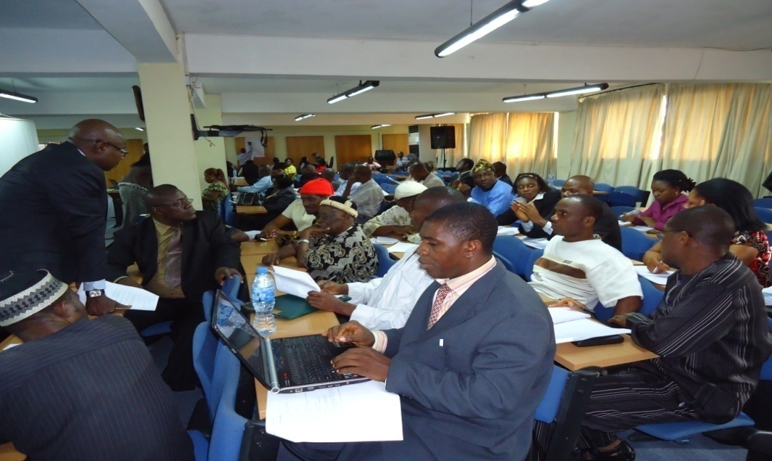
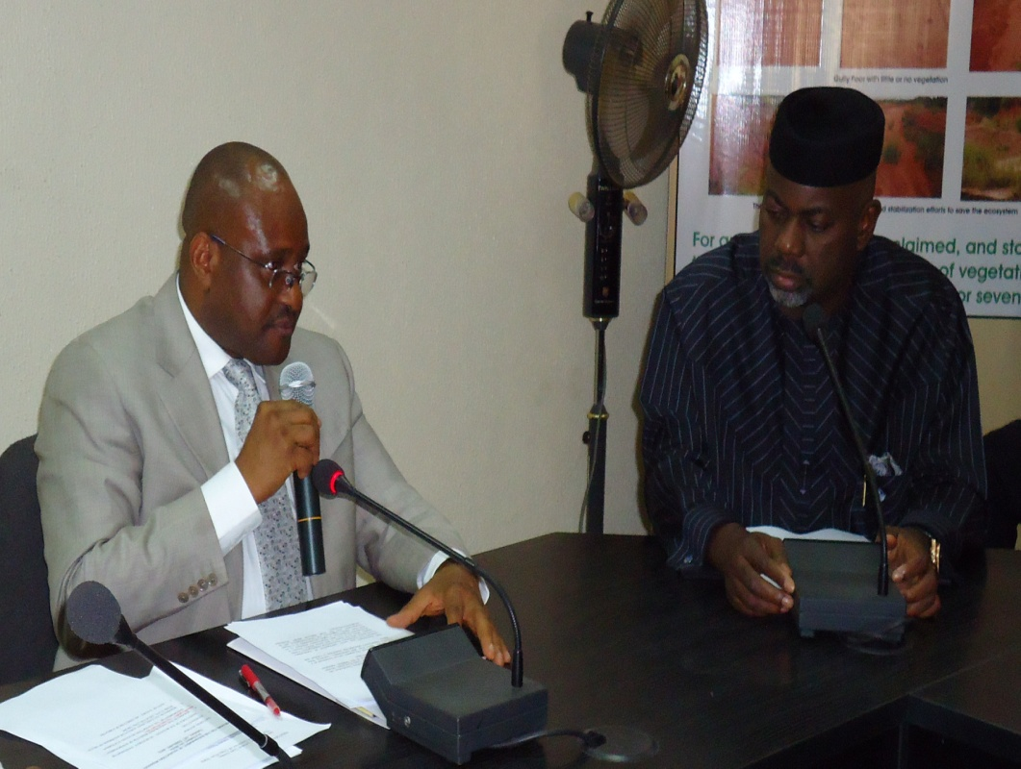

Slide 24
NEXT STEPS (March-April 2011)
A final round of comments for improvement on the draft is available:
    UN-REDD Policy Board discussions (21-22 March)
    UN-REDD Independent Technical Review (16-23 March)
    Additional in-country consultations (throughout March)
    International stakeholders’ comments (by 15th April)
The joint Nigeria & UN-REDD Team will integrate comments received and produce the final version (25th April 2011).

Slide 25
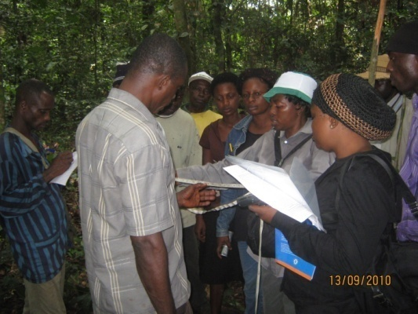
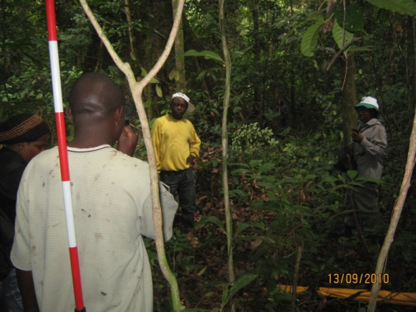
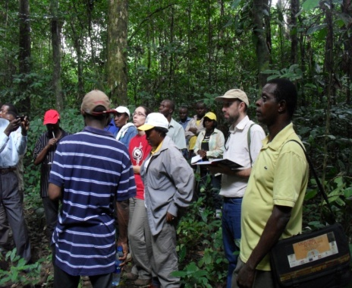
Concluding remarks
Nigeria will appreciate the Policy Board to provide comments on progress made to date and on the proposed programme.
Nigeria is ready to start implementing its REDD+ Readiness Programme in order to have an active REDD+ process at the time of COP-17 in South Africa.
The UN-REDD Programme is the only international platform for REDD+ support in Nigeria.
Therefore Nigeria requests the UN-REDD Policy Board to consider its REDD+ readiness programme.
THANK YOU

