Slide 1
VIETNAM FOREST PROTECTION & DEVELOPMENT FUND – KEY CHARACTERISTCS OF THE NATIONAL REDD+ FUND
Pham Van Trung
Trung.fssp@hn.vnn.vn
Vietnam Forest Protection & Development Fund (VNFF)
Ministry of Agriculture & Rural Development (MARD)
South-South Knowledge Exchange on National REDD+ Funds Management
Lima, Peru, Saturday, July 5th 2014

Slide 2
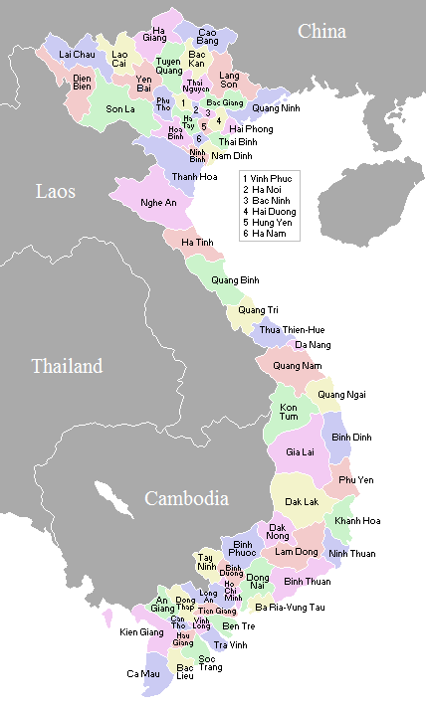
CONTENT
I. Viet Nam Forest Protection & Development Fund (VNFF)
Background;
Mobilization of the PFES payments;
Utilization of the Fund;
II. Key characteristics of the National REDD+ Fund (NRF)
Legal basic;
Funds establishment;
Objective of the NRF;
Interim structure;
Board of directors;
Relationship between key stakeholders;
Governance arrangement;
Sources of funding;
Channeling funds to sub-national level;
Payments & disbursements;
M&E;
Program & project cycles;
Key messages.

Slide 3
I. VNFF - Background
Vietnam Forest Development Strategy 2006 – 2020/ 05.02.2007;
Forest Developments & Protection Funds (FPDF), Decree 05/ 14.01.2008;
Decision 380, on payments for forest environmental services, 10/04/2008 (Piloted in Lam Dong & Son La);
Payment on Forest Enviromental Services (PFES), Decree 99/ 24.09.2010.

Slide 4
I. VNFF - Background
Board of Directors
VNFF Control Unit (CU)
MARD
VNFOREST
VNFF Management Unit (MU)
Central Level
VNFF
TFF
799 REDD+
02/14 VCF
Provincial
FPDF’s
Provincial
FPDF’s
TFF
MU
REDD+
MU
VCF
MU
Provincial
FPDF’s
Provincial
FPDF’s
Provincial
FPDF’s
Projects
Projects
Projects

Slide 5
I. VNFF - Mobilization of the PFES payments
Payment
sources
User of the Ecosystem
Hydropower
20 VND/KwH
~ 98%
Water supply
40 VND/m3
~ 2 %
…ongoing
Industrial production
Tourism
1% - 2%
Annual income
~ 0.1 %
Carbon sequestration, Aquaculture…
…ongoing

Slide 6

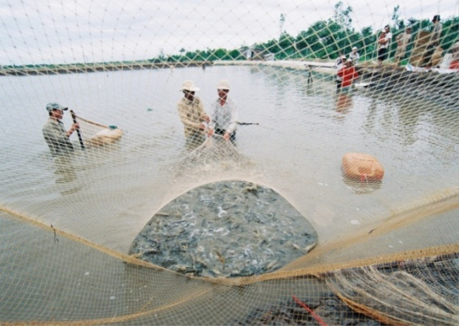
I. VNFF - Mobilization of the PFES payments
PFES Revenue
Year | Hydropower | Clean water | Tourism | Total (USD)
2009 | 5,950,302 | 327,655 | 14,535 | 6,292,492
2010 | 3,323,580 | 530,120 | 17,242 | 3,870,942
2011 | 12,728,523 | 689,514 | 31,708 | 13,449,745
2012 | 54,889,864 | 803,547 | 41,431 | 55,734,842
2013 | 49,574,948 | 1,136,482 | 52,234 | 50,763,664
2014 (QI) |  |  |  | 17,323,580

Slide 7

VNFF - Utilization of the Fund
PFES Users
100%
VNFF
(Keep 0.5%
administration costs)
100%
Utilization procedure
99.5%
Provincial FPDFs
(Keep maximum 10% administration costs + 5% contingency)
85%
PFES SUPPLIERS (FOREST OWNERS)
ORGANIZATIONS
(deduct 10% for administration costs)
HOUSEHOLDS, INDIVIDUALS (can use 100% of received amount)

Slide 8
II. NRF – Legal basic
Decision 18, 05/02/2007 on the Viet Nam Forestry Development Strategy 2006-2020;
Decree 05, 14/01/2008 on the Forest Protection & Development Fund;
Decree 99, 24/09/2010 on the Payments for Forest Environmental Services;
Decision 2139, 05/12/2011 on the National Action Program on Climate Change; Decision 1775, 21/12/2012 approved a proposal for GHG emissions management;
Decision 799, 27/06/2012 on the National REDD+ Action Program (NRAP) for 2011-2020, & specifics the establishment of the NRF as a trust fund under the VNFF at the central & provincial level;
Notification 1682 of MARD informing the conclusion of the task of establishing a VRF by the Minister.

Slide 9
II. NRF – Funds establishment
Option1: National fund only
National REDD+ Fund belongs to VNFF but has separate Board of Directors & Fund Management Unit.
Advantages:
  Response quickly to the donor requests;
  Low transaction costs because of fewer intermediaries;
  Ability to focus REDD+ financing without distractions & create favourable conditions for program management.
Disadvantages:
  Can lose direct support of international partners at the local level;
  Can be difficult for national level fund to distribute directly to local communities or organizations;
  Does not fully meet Decision No. 799/QD-TTg dated on 27/06/2012 of PM.

Slide 10
II. NRF – Funds establishment
Option 2: National & Provincial funds
National REDD+ Fund belongs to VNFF but has separate Board of Directors & Fund Management Unit;
Provincial REDD+ Fund belongs to Provincial VNFF, with an organizational structure decided by the Chairman of PPC.
Advantages:
Advantages of the receipt, management & use of REDD+ revenues from national & provincial levels;
Appropriate with Decision No. 799 dated on 27/06/2012 of PM;
Provincial funds may be better placed to deal with small or local-level funding recipients.
Disadvantages:
Provincial funds are not guaranteed the financial sources to ensure long-term operations;
The large structure can be inflexible & difficult to adapt to changing donors’ requests;
It may be more difficult to ensure transparency when funding is managed by a large number of entities.

Slide 11
II. NRF - Objectives
The main objective:
Implementation of REDD+ activities in compliance with the specific guidance on result based action & result based finance from UNFCCC;
Implementation of the NRAP & the PRAP;
Contribute to the achievement of the MARD GHG emission reduction target by 20% by 2020 & to implementation of the National Forest Protection & Development Plan in line with the National Forest Development Strategy & of the National Climate Change Strategy & National Green Growth Strategy.
2. The specific objectives:
Mobilize & receive contributions & grants provided by foreign countries, organizations or individuals for REDD+;
Manage & disburse REDD+ payments for: (i) Operation of REDD+ (NFMS, SIS…); (ii) national policies & measure in line with the NRA; (iii) development of new PRAPs; (iv) Implementation of existing PRAPs; & (iv) others (ER program, support government research, operation cost of the NRF)

Slide 12
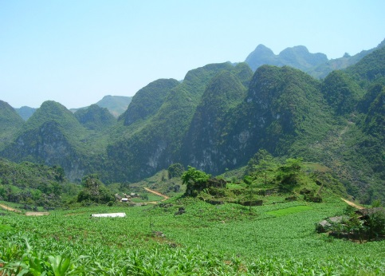
II. NRF – Interim structure
Interim arrangements & capacity building for transition with participation of donors & multilateral organizations
Board of Directors: donors (Co-chair), UN & World Bank;
Management Unit – international expert(s) with knowledge of REDD+ to work with & build capacity of national staff in investment planning, program management, M&E, safeguards, results-based payments for REDD+ etc.
Technical Advisory Panel – international consultants & quality assurance by UN-REDD, FCPF etc.
Trustee – interim trustee arrangements until national trustee is identified .
When interim arrangements are decided, a capacity development & transition plan will be prepared including the following information: Objectives (outputs & outcomes); Activities; Timing; Milestones & indicators; Costs; Input; Implementation; responsibility; Risks & risk management actions.

Slide 13
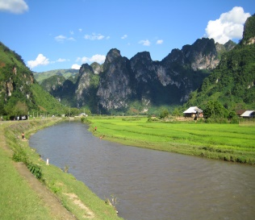
II. NRF – Board of Directors
Multi-stakeholder Board of Directors including a representative of international donors as a co-chair, & civil society representative.
Vice Minister of Agriculture & Rural Development (MARD) in charge of Forestry – (as chair);
A representative of international donors as a Co-chair (when the fund has more than one international donors, the donor constituency format will be used)
A Deputy Director General of the Viet Nam Administration of Forestry VNFOREST;
A DG of MARD Finance Department;
A DG of MARD’s International Cooperation Department;
A DG or d/DG from the Ministry of Natural Resources & the Environment;
A DG or d/DG from the Ministry of Finance;
A DG or d/DG from the Ministry of Planning & Investment;
A DG or d/DG from the Ministry of Industry & Trade;
A representative from CSO – self nomination;
UN RC;
World Bank/FCPF representative ;
A representative from private sector.

Slide 14
II. NRF – Relationships between key stakeholders
UNFCCC
Data
Donor communities
(bilateral & multilateral agreement)
(GCF, FCPF etc.)
Payment
Bank
(financial management)
Reports via MONRE
Signs agreement
Makes payments
Reports
MARD
(VRO/NRSC)
Fund establishment
Reports
MARD/MPI
NRF
Reports
Reports
VNFF
Entities with access
Data
Signs grant agreement
Agreement
Fund transfer
Reporting/ data
Financial & non-financial incentives
Beneficiaries

Slide 15
II. NRF – Governance arrangements
Board of Director
Instructs
Trustee
Recommends, Submits
Make payments
Approves
Submit proposals
Management Unit
Entities with access
Technical Advisor Panel
Recommends

Slide 16
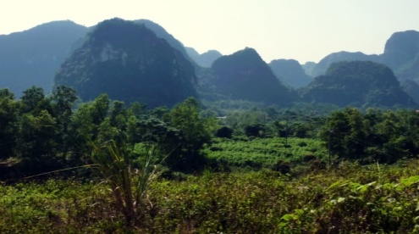
II. NRF – Sources of funding
VRF may mobilize a variety of resources including:
International contributions that do not follow Vietnam’s ODA management regulations such as REDD+ payments for emission reduction titles transferred;
International grants that follow Vietnam’s ODA management regulations;
Voluntary grants from domestics entities.
By targeting diverse funding sources the objective is to access Carbon Fund, Green Climate Fund & become designated entity under UNFCCC to receive results-based payments

Slide 17
II. NRF – Channeling funds to sub-national level
The NRF will channel funding directly to the entities with access to the NRF are those that sign agreements with the NRF & consequently have financial & programmatic responsibilities for the implementation of the funds received;
Provincial agencies will not have fund allocation role at the provincial level but will receive funding to directly implement specific activities identified in the PRAPs. This funding will not commingled with regular budgetary resources;
The mandate of the provincial VNFF will be expanded to receive funding for PRAP implementation in accordance with NRF regulations;
Contributions to specific provinces can be accommodated by the earmaking in the subaccounts of NRF.
Sub-accounts: Separate subaccounts can be created for (i) The different sources of funding (international contributions, grants, voluntary grants from domestic resources & domestic carbon market) (ii) Contributions earmarked for specific provinces (or programs / projects / activities)

Slide 18
II. NRF – Payments & Disbursements
Mainly disburses results-based payments for verified GHG emission reductions to entities with access with some advance payments:
In accordance with UNFCCC decision 9/CP.19, the NRF will mobilize results based finance for the full implementation of REDD+ activities. Results will be measured against the national forest reference emission levels and/ or forest reference levels & be expressed in tones of carbon dioxide equivalent per year;
In addition, the NRF may also mobilize financial resources to alternative policy approaches not measured in ton CO2 equivalent;
The disbursement of payments at the national level will be based on: (i) results as per UNFCCC terminology; (ii) other outcomes & outputs leading directly or indirectly to emission reductions & removals (proxies) & defined by the M&E framework; & (iii) other non-carbon results defined by the M&E framework;
Payments at the national level may be made ex ante & ex post based on the approved budget & financial plans of the proposals.

Slide 19
II. NRF – Payments & Disbursements
The NRF has 3 disbursement windows & corresponding appraisal, monitoring & evaluation cycles:
Disbursement windows & modalities Types of activities | Window 1: Strategic government mandate | Window 2: Competitive results based window | Window 3: Small grants | Others (small government research, CF benefit sharing plan & operation costs)
Operation & management of the National REDD+ program (MRV, NFMS, SIS) | X
Support to policy changes, solutions | X | X
Development of PRAP | X
Implementation of PRAF | X | X | X | X
Implementation of ER program benefit sharing plan |  |  |  | X

Slide 20
II. NRF – Proposed M&E
Because of results-based payments M&E mainly based on the National Forest Monitoring System & the Safeguards Information System’s data
External mechanisms
Internal mechanisms
Fund level
External Evaluation
Consolidated annual report
External audits
NRIS
(National Redd+
Infomration System)
Internal audits
Program level
Financial reports
Grievance
mechanism
Narrative reports
Financial M&E
Programmatic M&E

Slide 21
II. NRF – Programe & project cycles
Approval of proposal & entity
YEAR 1
Entity with
access
NRF BOD
Instructs Trustee to
Bank
(Fund management)
$
Entity with
access
Proposal
Make
payments
Inputs by entities
MRV (NFMS & SIS) &
other sources
Data
NRAP & PRAPs
YEAR 2 & MORE
Monitoring date on inputs & results
Inputs by entities
Bank
(Fund management)
Entity with
access
NRF BOD
$
Instructs Trustee to make payments

Slide 22
II. NRF – Key messages
In Viet Nam Phase 1 of REDD+ has been completed & Phase 2 is being implemented. After 2015, Viet Nam aims to be eligible to receive results based payments & set up a lead organization to receive this funding;
The National REDD+ Fund is an important part of the NRAP. A REDD+ Fund will be established & receive financial contributions & grants from partners & international donors for the emission reductions achieved in Viet Nam;
In recent years, Viet Nam has actively prepared for REDD+ readiness through the adoption of several high-level decisions;
Viet Nam has successfully implemented a pilot policy for payment for forest environmental services (PFES), & currently the policy is implemented at the national scale. Some experiences from PFES can be applied to REDD+;

Slide 23
II. NRF – Key messages
The Vietnam Trust Fund for Forests (TFF) has operated effectively for many years & some experiences may be applied to the NRF;
Mainly disburses results-based payments for verified GHG emission reductions to entities with access with some ex ante payments;
Multi-stakeholder Board of Directors including civil society representative;
No provincial REDD+ branches but use provincial VNFF to avoid comingling with state budget for PRAP; no grant-making by provincial VNFF;
9. Interim arrangements & capacity building for transition with participation of donors & multilateral organizations.

Slide 24
Many thanks!
Pham Van Trung
Trung.fssp@hn.vnn.vn
Vietnam Forest Protection & Development Fund (VNFF)
Ministry of Agriculture & Rural Development (MARD)

