Slide 1
Transition to Green Economy in Kenya: Enabling Conditions
Dr. Charles Mutai
Ministry of Environment and
Mineral Resources

Slide 2
Presentation Outline
Introduction;
Rationale for Green Economy;
Green Economy Scoping Study in Kenya;
Enabling Conditions for Green Economy.

Slide 3
Introduction
What is Green Economy / Growth?
Green economy - Improved human well-being and social equity, while significantly reducing environmental risks and ecological scarcities (UNEP 2010). It is a low carbon, resource efficient, and socially inclusive.
Green growth - Maximizing economic growth and development while avoiding unsustainable pressure on the quality and quantity of natural assets (OECD 2011);
A Green Economy can be thought of as an alternative vision for growth and development, one that can generate growth and improvements in people’s lives in ways consistent with sustainable development (WRI 2010).

Slide 4
Introduction (2)
Why transition to Green Economy?
Economic vehicle for sustainable development;
Strategies to end the persistence of poverty;
New economic paradigm - can drive growth of income and jobs, while reducing environmental risk and scarcity;
Driven by public and private investments;
Sector findings and opportunities in UNEP (2011) Report “Towards a Green Economy: Pathways to sustainable development and poverty eradication”.

Slide 5
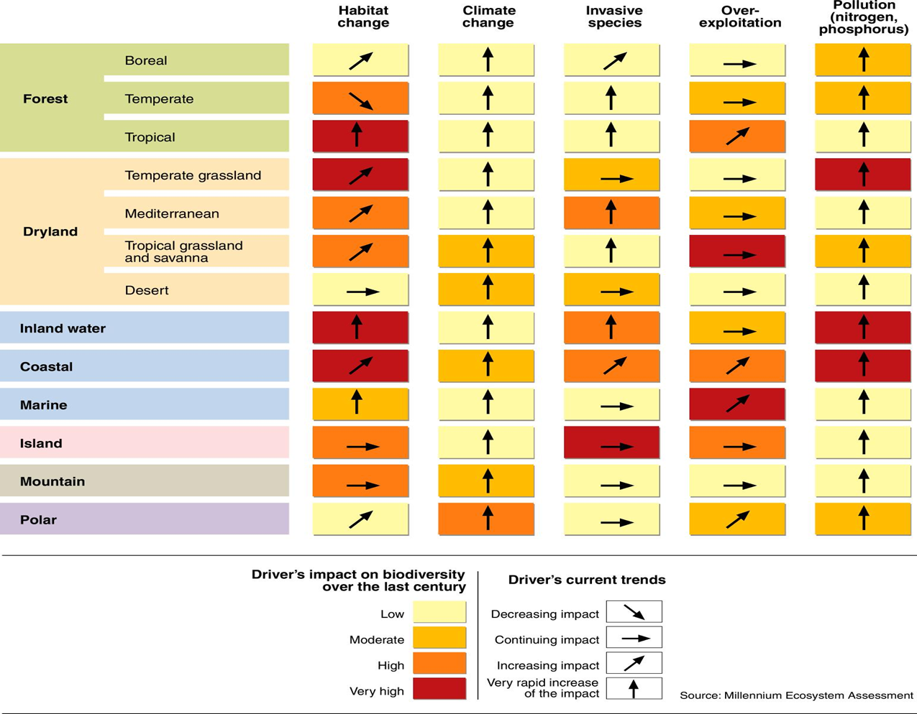
Global Crises: Sustaining life-support Systems

Slide 6
Rio+20 Outcome on Green Economy
Rio+20 places “Green Economy as an important tool for achieving sustainable development and poverty eradication” on global development agenda:
  Transition to Green Economy is a common undertaking for all countries;
  Policies for achieving national and international development goals:
    National - poverty eradication, inclusive growth, involvement of marginalized groups, sovereignty, sustainable consumption and production, etc
    International - MDGs

Slide 7
Green Economy / Growth in Africa
Transition to Green Economy / Growth is taking shape:
Development of National Green Economy Strategies
Green Economy Advisory Services: UNEP, UNDP, UN DESA
Green jobs evaluation: ILO
Green Growth Strategy: AfDB
Africa Green Economy Partnership (AGEP): AMCEN Flagship Project
Partnership for Action on Green Economy (PAGE): UNEP

Slide 8
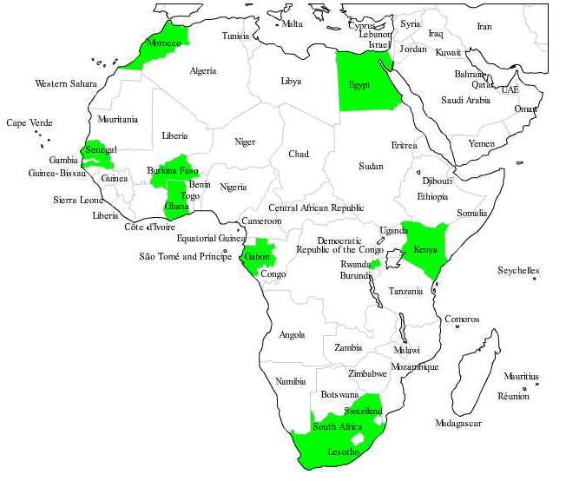
UNEP Green Economy Advisory Services in Africa
Currently supporting 7 countries
  Providing green economy assessments and policy support
Project being extended to other countries

Slide 9
Green Economy Scoping Study (GESS)
in Kenya

Slide 10
Overview of GESS in Kenya
Main objective –Assessment of the opportunities and challenges related to transitioning to a green economy in Kenya;
Coordinated by MEMR in partnership with UNEP through support from the European Union and Netherlands;
Multi-Stakeholder consultation and participation – Government Ministries/Agencies; Private Sector, Academia, and CSOs;
Inter-Ministerial Committee on Green Economy - provides technical support and policy interface.

Slide 11
Overview of GESS
Macro- and socio-economic profile;
Ecological footprint - About 42% of GDP derived from natural capital based: agriculture, forestry, wildlife tourism, mining, water and energy
Enabling policies;
Model (T21) Greening Scenarios

Slide 12
Enabling Conditions for Green Economy
in Kenya

Slide 13
Enabling Conditions for Green Economy
Constitution of Kenya (2010):
    Article 42 recognises a clean and healthy environment as a right;
    Article 60 (c) sustainable and productive management of land resources;
    Article 69 [(a)-(h)]:- sustainable, exploitation, utilisation, protection of genetic and biological diversity and establishes system for environmental impact assessment. Strives to achieve a tree cover of at least 10% of land area of Kenya.

Slide 14
Enabling Conditions for Green Economy (2)
Kenya Vision 2030:
    aims to achieve the status of a middle income industrializing country by 2030 in a clean and secure environment;
    Overreaching vision and overall policy framework for sustainable development;
    Implementation of flagship projects through MTP:
      Restoration of ecosystems including rehabilitation and protection of water towers (Mau, Aberdares, Mt. Kenya, Mt. Elgon and Cheraganyi);
      Renewable energy Feed-in-Tariffs Policy (Geothermal, solar, Wind, Biomass, and Small Hydro power) electricity generation;
      Pollution control and waste management systems;
      Promotion of sustainable production and consumption;
      Clean technological production;
      Environmental planning and governance.

Slide 15
Enabling Conditions for Green Economy (3)
  National Climate Change Response Strategy (2010)
  Kenya Climate Change Action Plan (www.kccap.info)
  Low Carbon Climate Resilient Development Pathway;
  Enabling Policy and Regulatory Framework;
  National Adaptation Plan (NAP);
  Nationally Appropriate Mitigations Actions (NAMAs);
  National Technology Action Plan;
  National Performance and Benefit Measurement;
  Knowledge Management and Capacity Development; and
  Climate Finance.
            Contribute Green Economy

Slide 16
Enabling Condition for Green Economy (4)
The Agriculture (Farm Forestry) Rules 2009 - promotion and maintenance of farm forest cover of at least 10 per cent of every agricultural land;
Forestry Policy (2005) - reservation, protection and sustainable exploitation of forests;
National REDD+ Strategy
Water Act 2002 - Water resource management and prohibition of water pollution;
Environmental Management and Coordination Act (EMCA 1999);
Draft National Environment Policy;
Greening Kenya Initiative (GKI)
Climate Innovation Center – launched in 2012;

Slide 17
T21 Model Greening Scenarios for Kenya
Transition to Green Economy in Kenya shows a positive economic returns by 2030:
  Positive economic returns expected after approx 7-10 years;
  Average annual real GDP growth rate of 5% , as compared to 3.7% under BAU;
  Population below poverty line reduced by about 3%;
  Reduced CO₂ emissions by 15%lower than BAU;
  Increase agricultural production by at least 23% than BAU;
  Energy saving reach 1,800GWh in 2030, or 2%;
  Labour productivity – increases due to higher GDP

Slide 18
GDP growth rate for Kenya under GE Scenarios
re
a
l
gdp m
p grow
t
h ra
t
e
8
6
Percent
4
2
0
1980
1990
2000
2010
2020
2030
T
i
m
e
(Y
e
a
r)
re
a
l
gdp m
p grow
t
h ra
t
e
:
G
E
2%_
re
a
l
gdp m
p grow
t
h ra
t
e
:
BA
U
2%
re
a
l
gdp m
p grow
t
h ra
t
e
:
BA
U

Slide 19
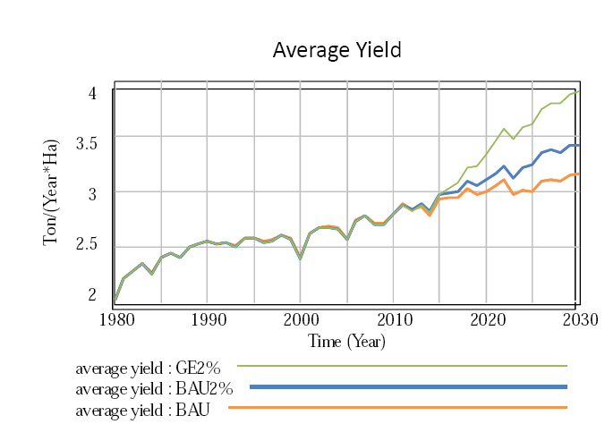
Average Agricultural Yield under GE scenarios

Slide 20
Conclusion
Requirements for Green Economy:
Sustainable investment in natural capital;
Promotion of resource and energy efficiency;
Creation of enabling conditions.

Slide 21
Enabling Conditions for Green Economy
Capacity Building & international cooperation
Pricing Instruments
Sustainable Public Procurement
Favoring
Green over Brown
Prioritize green investments
Policy and regulatory
frameworks
  Skills for green jobs
  Capacity for policy reforms
  Entrepreneurship and business development
  Incentivize green investments and correct negative externalities
  Create and stimulate markets for green goods and services
  Government policies and infrastructure can encourage private sector to invest in environmentally sustainable ventures
  Development strategies
  Laws and standards
  International policy architecture
Notes:
Innovative and imaginative public policies will be vital to generate enabling conditions that, in turn, can unleash markets and direct private sector investments into a Green Economic transition. These include:
Sound regulatory frameworks, a prioritizing of government spending and procurement in areas that stimulate green economic sectors and limits on spending that deplete natural capital.
Removing subidies could save 1-2% of global GDP a year, open fiscal space and makes room for public and private investment for a green economy transition
Taxation and smart market mechanisms that shift consumer spending and promote green innovation.
Public investments in capacity building and training, alongside a strengthening of international governance.
For example, in 2005 the government of Ghana used the findings of a Poverty and Social Impact Analysis which demonstrated that petroleum subsidies go predominantly to higher income groups to initiate a public and parliamentary debate on reforming such subsidies. In parallel to reducing petroleum subsidies, Ghana eliminated fees for attending primary and junior-secondary school, and made available extra funds for primary health care and rural electrification programs (IMF 2008).
21

Slide 22
Thank You!

