Slide 1
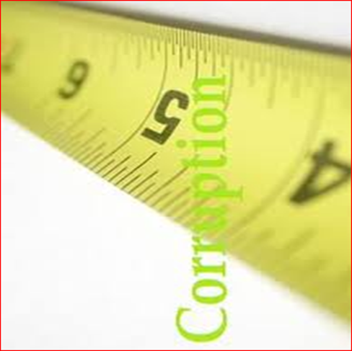
Measuring and Assessing Corruption: UNDP’s Experience
Lusaka, Zambia
April 2012

Slide 2
The Dilemma of Measuring Corruption
How do you measure something which differ across societies in terms of its definition, perception, scope, manifestations and impact; but needed to be measured for evidence-based policy making?
  “Not everything that counts can be counted, and not everything that can be counted counts.”
  “What gets measured, get managed”
Notes:
Citizens of developing countries are demanding better performance from governments, and they are increasingly aware of the costs of poor management and corruption. Corruption has been one of the main topic for government electoral campaigns (politicians increasingly use curbing corruption as a campaign promise), citizens’ movements (Arab spring – governance deficit and its manifestation through corruption, inefficiencies, etc., the wall street movement in the US against unfair practices in the financial sector, Lock pal bill in India, the list is long)

Slide 3
What’s the value addition of measuring corruption?
We need actionable data to guide decisions
To give corruption a face
To quantify and qualify corruption
To inform reforms
To direct policy
To monitor prevalence & costs of corruption
To monitor and evaluate anti-corruption interventions

Slide 4
The mushrooming industry of indicators: Trying to measure perception, impact, existing gaps, integrity, enabling environment, etc.
Are there enough tools & methodologies?
World
Governance
Assessment
Global
Accountability Report
Gender
Empowerment
Measure
Press
Freedom
GAPS in
Workers’ Rights
BEEPS
Global Integrity
Index
Index of
Bribe Payers Index
East Asia
Economic
Barometer
Freedom
Opacity
Commitment to
Index
CIRI
Development
Governance
Human Rights
Eurobarometer
Global
Matters
Database
Competitiveness
Afrobarometer
Polity
Index
CPIA
International Country
Corruption Perception
Bertelsmann
Freedom in the
(
WB
Transformation
World
)
Risk Guide
Index
Media
Index
Open
Journalists
Sustainability
Budget
killed
Index
Index
1974
76
78
80
82
84
86
88
90
92
94
96
98
00
02
04
06

Slide 5
What’s the problem with the tools and methodologies, then?
Comparison problem: Almost all tools/methodologies not suitable for cross-country comparison ( see next slide)
Practitioners want actionable data, and existing global indicators are inadequate
Perception-based data are too vague to be useful for policy reform (although frequently used as advocacy tools)
Different tools seems to be assessing the different concepts
Many tools are not customized to country specificities and thus are not useful and not seen as more ‘credible’ by policymakers
Lack of pro-poor, gender sensitive indicators
Notes:
That provide insights into where reforms should be made. Well-known int’l perception datasets prove too vague to be helpful.
To put it plainly, there is little value in an anti-corruption measurement if it does not tell us what needs to be fixed.
Ex: WB – V & A indicator - broad conceptual construct like “accountability” .
Rather, Are law enforcement officials paid appropriately? Are civil servants hired based on their qualifications and merits? Answers to these questions lead naturally to a discussion of possible points of intervention.
2. perception: frustrating disconnect btw important steps toward fighting corruption, and popular opinion. “perceptions change slowly, so huge gap btw our actions and int’l evaluations” (frustrating when aid tied to such indicators)
3. Indicators customized to national / sub-national needs have advantage of being designed from the beginning to yield actionable data.
Typically enjoy better credibility with sceptical govt policymakers.
Also difficult for NGOs that are actively collaborating with govts to use such findings – better to focus on the concerns expressed from within countries – from national govt’s & citizens.
4. Corruption is such a complex phenomenon, a single number will not be able to uniquely measure corruption.
Drawback of qualitative assessment such as NIS country studies: bulky, hard to summarize, difficult to compare across countries. Still, mix is ideal.

Slide 6
What is each index measuring, and what data sources are used?
Corruption in public sector as perceived by “experts”
Existence, effectiveness and citizen access to anti-corruption mechanisms, assessed by national experts
Corruption in public & private sector (+ some indicators at household level) as perceived by “experts” + opinion polls (incl. NGO experts)
Notes:
Measurement tools with similar ‘labels’ may in fact be assessing very different concepts. It is therefore important to “dig underneath” by asking: What are the underlying questions or component indicators that have gone into generating the index score?
6

Slide 7
What’s UNDP Position on measuring corruption then?
UNDP doesn’t prescribe any one methodologies, but provides guidance on their use, because:
  No methodology is perfect and thus standard
  All have advantages and disadvantages
  Depends on the purpose of the measurement
UNDP’s focus is on country-based and nationally owned corruption measurement and assessment:
  Results from a country-led assessments could feed into policy-making processes (e.g., reforms)
  Nationally-owned process help develop national capacity on measurement and assessment
The assessment/measurement should engage multi-stakeholders at the country level

Slide 8

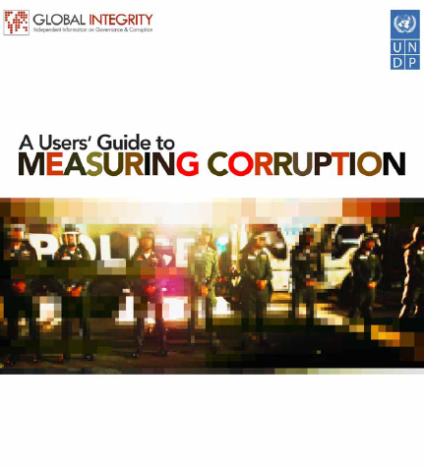
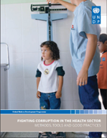
What kind of support is available from UNDP?
UNDP Oslo Governance Centre: Provides support (both advisory and financial) for nationally owned assessments
UNDP Global Programme on Anti-Corruption for Development Effectiveness:
  Has reviewed the tools, methodologies and good practices on anti-corruption in sectors
  Will provide support to AC agencies to conduct “Integrity assessment”.
Notes:
8

Slide 9
Participatory Governance Assessments for REDD+ (PGAs)
A PGA is a participatory approach to develop governance data
The PGA for REDD+ will contribute to the development of national systems providing relevant information on how safeguards are promoted, addressed and respected as recommended in the Cancun Agreement
In 2011, four PGAs launched in Indonesia, Vietnam, Ecuador and Nigeria
  Anti-corruption strategy for REDD+, one of the thematic focus areas

Slide 10
Lessons:
Know what you want to measure or benchmark, and find the appropriate measurement tool
Look for actionable data
  Disaggregated indicators are one of the more effective methods to operationalize corruption data.
Consider using existing data sources to construct Indicators
Whenever possible, combine quantitative data with qualitative assessments
Gravitate toward locally generated assessments
Transparency of methodology is crucial

Slide 11
Thank you!

