Slide 1
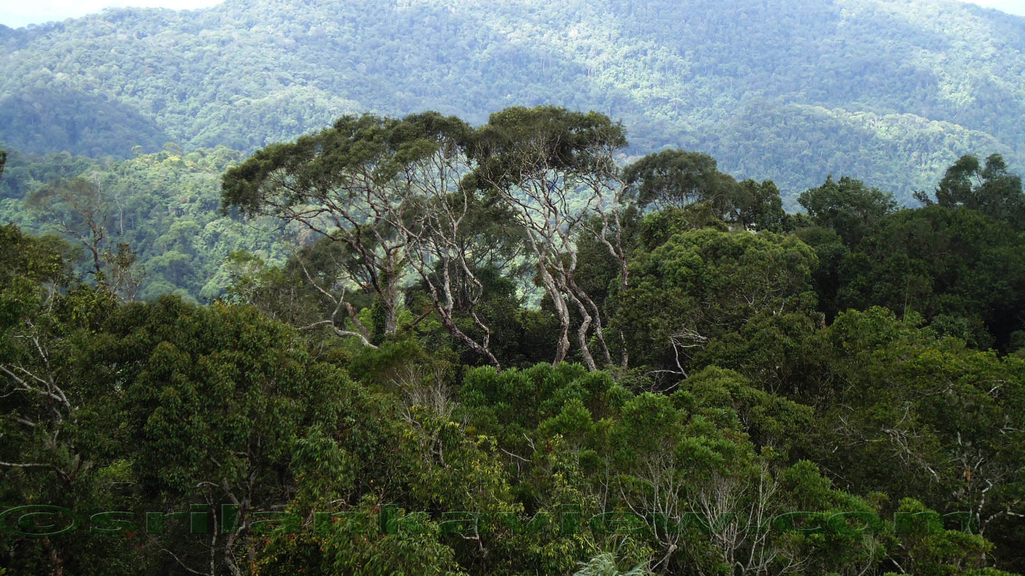
Sri Lanka UN-REDD Programme
Fourth PEB Meeting
Sri Lanka Foundation
Independence Square
Colombo 07.
17th September 2014

Slide 2
Co-chairs Today
Mr. B.M.U.D. Basnayake
Secretary, Ministry of Environment & Renewable Energy
And
Ms. Beth S. Crawford
FAO Representative in Sri Lanka and the Maldives

Slide 3
Welcome Address
Ms. Beth Crawford
FAO Representative in Sri Lanka and the Maldives

Slide 4
Opening Remarks
Mr. B.M.U.D. Basnayake
Secretary, Ministry of Environment & Renewable Energy

Slide 5
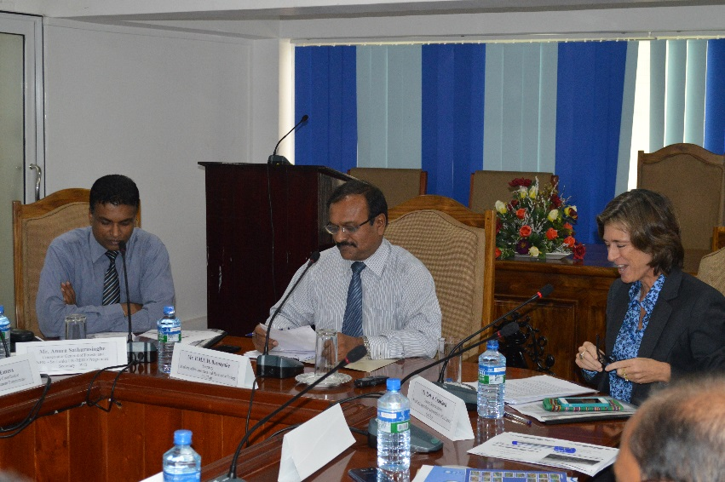
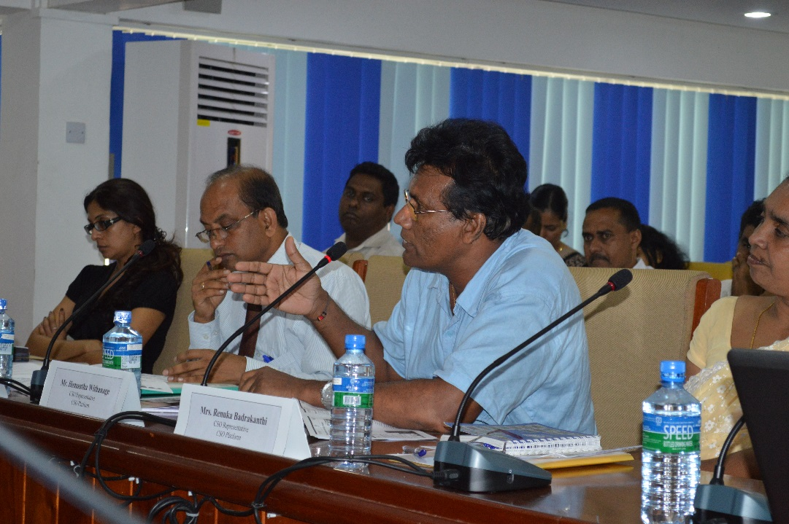
Progress Against Last PEB Decisions/Actions
Nalin Munasinghe
National Programme Manager
Sri Lanka UN-REDD Programme

Slide 6
 | Decision/Action | Status
1 | Progress to be reported against targets and indicators A sample format on this to be shared with PMU | Sample format was received and hereafter, the progress will be reported against targets and indicators
2 | The PEB consent for 8 Points raised by the IP representative received. Responses to be followed and the progress to be reported. | Responses for 8 points were further followed up. PMU met the respective government counterparts and arranged several steps to help IP community with their land and water issues. PMU to further facilitate the process. CBR+ programme will be able to handle 4 other points and the discussions are underway. PMU is also handling the last 2 points related to capacity building and knowledge sharing through its communications component.

Slide 7
3 | Correct procedure of getting visa for UN passport holders (especially international staff of the UN-REDD Programme) to be informed | The relevant government circular on this is available. It says that diplomatic/official visas are issued on gratis basis, after obtaining prior approval from Ministry of External Affairs in Colombo and in consultation with the Department of Immigration and Emigration in Colombo.
4 | Concept note on developing climate change adaptation action plan to be shared among the membership | As UNDP Country Office (from their other budgetary sources) took over to sponsor the development of climate change adaptation action plan, PMU didn’t further follow up.
5 | Initial discussions with the Private Sector plantation companies to be initiated and reported. | A private sector engagement specialist was recruited and the consultant has already had several meetings with relevant private sector partners including plantation companies. Progress will be reported.

Slide 8
6 | 2 FD officials to be nominated for training on REDD+ negotiations | 2 officials each from FD and CCS have been nominated for training on REDD+ negotiations. They are to be considered for next UNFCCC negotiations as per the budget availability.
7 | All PEB documents to be translated into Sinhala and also to Tamil when sharing with other stakeholders. | Through an open and a transparent procedure a pool of translators for all 3 languages was selected. They are now been used for required translations activities of the PMU. Major documents of the PEB meeting have been translated into Sinhala.
8 | Improve translation facilities for the IP Representative and those who required during the PEB Meeting | Simultaneous translation facility has been introduced from this PEB meeting onwards.

Slide 9
Progress Since Last PEB Meeting of
22 May 2014
17 September 2014, Colombo
Anura Sathurusinghe
Conservator General of Forests
National Programme Director – Sri Lanka UN-REDD Programme

Slide 10
Journey since 3rd PEB Meeting
Communications Strategy finalized
Institutional Review completed
Data sharing agreement finalized
CBR+ initiated

Slide 11
Progress Against
Annual Targets/Indicators since 3rd PEB Meeting

Slide 12
Instructions
Progress will be reported against the original annual target as per the Government approved National Programme Document.
Further, the progress will be reported under the outputs covering the Q 3 of 2014
‘Traffic light system’ is used here as an easy way of capturing the progress
Red means indicator not met and limited progress
Yellow means indicator partly met/in progress
Green means indicator met (by now)

Slide 13
Output 1.1: Broad-based, multi-stakeholder national REDD+ advisory group established
Ou
Annual Targets/Indicators | Progress
Two workshops per year Four meetings (of RPMCC) per year | PEB decision obtained to postpone the establishment of the RPMCC 23-member PEB may be converted into RPMCC Hence no workshops and meetings of the RPMCC 3 PEB meetings have been already conducted
Terms of reference endorsed by the Ministry of Environment and members of the RPMCC appointed Number of coordination workshops and meetings conducted | The ToR for the Task Force on Public Policies and Strategies finalized Letters with Secretary’s signature sent out to the proposed membership. There is a proposal that this body might also constitute a precursor to the RPMCC

Slide 14
Output 1.2: National legal, procedural, institutional and capacity needs arrangements for sectors relevant for REDD+ reviewed (i.e. Agriculture, forestry and other land uses)
Annual Targets/Indicators | Progress
Within 12 months, recommendations are prepared based on reviews and consultations. | Review completed and key findings and recommendations are available
Strategic directions available for effective implementation of REDD+ Programme in Sri Lanka

Slide 15
Output 1.3: National REDD+ Roadmap prepared
Annual Targets/Indicators | Progress
Within 9 months, a draft roadmap available for public review and comments. Within 12 months, the Roadmap officially adopted and guiding further REDD+ readiness process. | A concept note for the Roadmap developed and approved The ToR for a national consultant prepared and approved. The consultant has been recruited Initiation of the roadmap development work got delayed as completion of the institutional/PLR review took place late
A set of well-structured REDD+ Readiness strategies and activities for those strategies agreed by all relevant stakeholders

Slide 16
Output 2.1: UN-REDD Programme implementation arrangements established
Annual Targets/Indicators | Progress
Two meetings/workshops (of Task Forces, Technical Working Groups, PMU staff and implementing partners) for coordination and capacity building are held monthly | One MRV TF meeting held Initial discussions were held for TF on national policies and strategies 3 monthly progress review meetings held 10 weekly meetings conducted One PEB meeting conducted
Level of PMU staffing, and participation status of TFs and TWGs % of annual targets of the programme met Number of multi-stakeholder meetings/workshops held for coordination and capacity building

Slide 17
Output 2.2: Capacity Building Action Plan developed for REDD+ (linked to Output 1.2)
Annual Targets/Indicators | Progress
Within 10 months, a REDD+ management structure, institutional arrangements and required competencies are identified and approved by RPMCC. Within 12 months, a CBNA completed | Draft TOR for the CBNA exercise was developed Further work delayed until 2015 pending results of the institutional review work (Output 1.2) Expected results of the institutional review will set the foundation on which to develop a CBNA.
A REDD+ management structure, institutional arrangements, and required competencies for institutions (Output 1.2) approved by RPMCC A stakeholder endorsed capacity building action plan

Slide 18
Output 3.1: Strategic communication and consultation plan prepared
Annual Targets/Indicators | Progress
Within 6 months, communication strategies are designed and adopted Within 9 months, the website and media platform disseminating information, lessons and receiving feedback | Communications strategy was finalized within 14 months Web developer has been selected and work initiated Team of journalists, to establish a media platform, already identified and establishment of a media platform and awareness raising sessions planned.
A set of well-structured communication strategies and activities for those strategies agreed and approved by the RPMCC REDD+ web site developed

Slide 19
Output 3.2: Stakeholder engagement in REDD+ readiness process enhanced (incl. FPIC, the private sector engagement)
Annual Targets/Indicators | Progress
Within 8 months appropriate stakeholder forums, including indigenous peoples and women and other key stakeholders, identified and receive sufficient capacity building to contribute to REDD+ decision making | 2 awareness raising sessions organized for senior officials of the government departments and CSOs 4 CSO Convening Committee meetings held ToR for a private sector engagement consultant was prepared and the consultant was recruited ToR for national stakeholder engagement officer was prepared and advertised.
Representative stakeholder forums identified/ developed, and contributions of the forums are considered by the PEB/RPMCC in its decision making. National FPIC Guidelines developed and piloted Grievance handling mechanism operational

Slide 20
Output 4.1: Drivers of deforestation and forest degradation, and legal and policy alignment needs identified
Annual Targets/Indicators | Progress
Within 8 months, an analysis of drivers of deforestation and forest degradation is completed Within 10 months, an opportunity cost assessment for REDD+ and implementation framework for addressing drivers are completed | The drivers of deforestation & forest degradation study was awarded and in progress. Work was delayed due to poor initial response to call for expressions of Interests (EOI) and consequent re-advertisement. First draft to be out in mid September 2014
Drivers and causes of deforestation and forest degradation fully identified Integrated spatial and economic analysis completed Legal and policy gaps identified to be aligned for REDD+ A set of policy recommendations and action plans identified and supported by stakeholders

Slide 21
Output 4.3: Options for addressing deforestation and forest degradation at sub-national level identified
Annual Targets/Indicators | Progress
Within 28 months, at least 70% of identified options are considered in the preparation of the National REDD+ Strategy (Output 4.5) | CBR+ work initiated National Consultant to develop the country plan selected CBR+ NSC confirmed EOI for developing proposals for capacity building and monitoring called
Number of options for addressing drivers of deforestation and forest degradation, stakeholder engagement, technical approaches at sub-national level identified

Slide 22
Output 5.1: MRV process initiated
Annual Targets/Indicators | Progress
Within 12 months, a national forest definition is adopted, training on GHG inventory for the forestry sector are provided and the national central database is developed. | Work on adopting national forest definition will be done after the LCCS training planned in September 2014. Training in GHG inventory for the stakeholders conducted The development of the National Central Database will take place only in the first half of the second year as the data required for the database are still being collected.
A set of technical guidelines/instruction manuals available

Slide 23
Output 5.2: National forest monitoring systems established
Annual Targets/Indicators | Progress
Within 15 months, at least 5 trainings on Remote sensing and GIS are provided. | A five day comprehensive training on Remote Sensing & GIS was conducted to key MRV stakeholders Digitization of past land use map data is in progress (by the Survey Department)
National forest monitoring system available A set of pre-tested technical guidelines/instruction manuals available Technical officers are capable of handing the equipment efficiently and effectively producing required info Reference forest map developed

Slide 24
Output 5.3: National forest inventory designed
Annual Targets/Indicators | Progress
Within 12 months, one training on tree allometric equation is provided | One comprehensive 5 day training programme on tree allometric equations conducted for the key stakeholders Collection of data on tree species completed
National Forestry Inventory is designed, field inventory manuals are developed and adequate technical tools are developed to assess emission factors

Slide 25
Delivery

Slide 29
Anura Sathurusinghe
npd.redd.sl@gmail.com
Thank You
Website: http://www.un-redd.org

Slide 30
Key findings and recommendations of the Institutional Review
Mr. R S Kulatunga
Additional Conservator General of Forests
(Protection, Operation & Management)
Presentation

Slide 31
Open discussion
Chair – Ms. Beth S. Crawford
FAO Representative in Sri Lanka and the Maldives

Slide 32
Issues for PEB Decisions
Chair – Mr. B.M.U.D. Basnayake
Secretary, Ministry of Environment & Renewable Energy
Presenter – Mr. Nalin Munasinghe
National Programme Manager
Sri Lanka UN-REDD Programme
Internal Review
Revision of activities under output 4.3 and reallocation of funds
Appointing a full-time Chief Technical Advisor (CTA)

Slide 33
Internal Review - Reasons for postponement
Further discussion required on role of consultant
Insufficient time to prepare and conclude activities before PEB meeting
Further discussion required on the need for independent review, or whether the task can be done internally
Scope of the review: to include management issues only, or include assessment of performance and delivery

Slide 34
Revision of activities under output 4.3 and reallocation of funds
The scope of CBR+ overlaps with Output 4.3
Received an additional USD 400,000
The proposed revision is to best utilize this additional investment and to take strong ownership at the grassroots level by the NP
freed-up amount of US$ 95,000 will be used to ensure strategic coordination and alignment between CBR+ and NP (through Output 4.3)
These activities will ensure full integration of CBR+ investments into the national REDD+ readiness process
Hence, the following adjustments and restructuring are proposed

Slide 35
Revision of activities under output 4.3 and reallocation of funds
Activity led by UNDP | Current Budget (US$) | Proposed Revision (US$) | Justification
Activity 4.3.1. Resolve conflicts with local people related to available guidelines/ legal boundaries with the locals to clarify forest boundary disputes where necessary. | 130,000 | 15,000 | Not cost-effective or strategic for the NP as CBR+ is available. Best to be explored and more practical to address this through CBR+. Resources should be allocated to support the collation of existing knowledge on the subject areas by FD and DWC if deemed necessary to supplement grassroots efforts. In addition the FD has got another source of funding for boundary demarcation and resolving boundary disputes.
Activity 4.3.2. Review and readdress potential impacts in human/wildlife conflicts through REDD+/SFM activities | 15,000 | 15,000 | No revision is proposed
Activity 4.3.4. Assess opportunity cost of alternate livelihoods/land uses | 23,000 | 0 | This is no longer relevant to REDD+ in Sri Lanka.
Activity 4.3.8. Assess potential for private sector engagement in REDD+, including tea and other plantation industries | 10,000 | 50,000 | The original budget was too small for the planned work on private sector engagement. This is very relevant to NP.
Activity 4.3.9. Develop an approach for mainstreaming REDD+ into Provincial/District level planning processes | 15,000 | 25,000 | This will be an important task for NP to upscale the implementation of the national REDD+ strategy later on.
Activity 4.3.10. Analyze lessons from participatory models in the forest sector | 7,000 | 0 | Low priority for the NP
Total | 200,000 | 105,000
Freed up amount | 0 | 95,000

Slide 36
Proposed reallocation of the freed up amount
Activity | Service | Amount (US$)
CBR+ Country Plan preparation | Chief Technical Advisor (CTA) of PMU and one national consultant plus costs of consultation including basic awareness to CSO community | 20,000
Stakeholder engagement and coordination with CBR+ | 1 programme staff (multi-year) | 55,000
Knowledge uptake and integration into policy processes | 1 national consultant (part-time on an as needed basis) plus travel and other related costs. | 20,000
Total |  | 95,000

Slide 37
Appointing a full-time Chief Technical Advisor (CTA)
To facilitate greater integration between different outcomes and outputs
To provide more consistent and timely support to PMU and implementing partners in-country
To ensure effective role as focal point for all technical backstopping by UN agencies

Slide 38
Date and venue of the next PEB meeting
&
Any Other Business
Chair - Mr. B.M.U.D. Basnayake
Secretary, Ministry of Environment & Renewable Energy

Slide 39
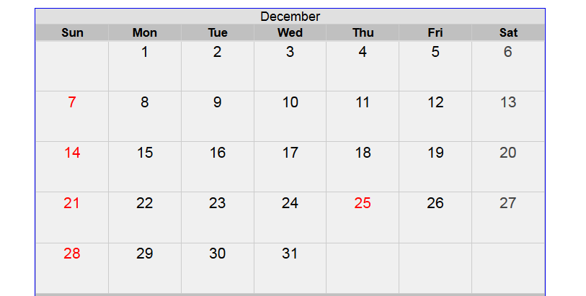

Slide 40
Wrap Up and Closing Remarks
Chair – Ms. Beth S. Crawford
FAO Representative in Sri Lanka and the Maldives

Slide 41
End of the Meeting

