Slide 1

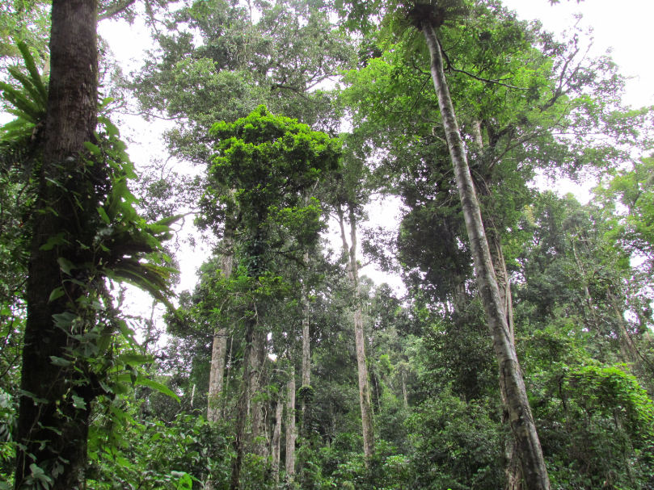
Lessons learned from FGM workshop held on 12.-13. Jan 2012
Tani Höyhtyä, 6.3.2012

Slide 2
FGM workshop, 12.-13. Jan 2012
Government of Viet Nam (MARD) requested assistance from FAO to intergrate forest governance into national level forest monitoring systems
FGM is currently FAO financed acvitity within the framework of ”National Forest Assessment” Project
61 participants from different stakeholder groups in workshop
  National, province, communes, university, industry, NGO’s, projects
Outcomes of consultancy study was presented in the workshop
  Present status of FGM in Viet nam
  Next steps to strengthen FGM in Viet Nam

Slide 3

overview of FGM monitoring
(Pillars and principles)
FOREST GOVERNANCE MONITORING
Transparency
Accountability
Policy, legal, institutional and
Regulatory framework
Planning & decision
making process
Implementation, Enforcement
and compliance
Effectiveness
Participation
Fairness/Equity
Efficiency

Slide 4
The most important ISSUES in fgm
(Results of three working groups on 1st day)
Decision-making
  verify participation in development of laws and regulations
  verification by third parties
  participatory approaches at local level
Land tenure
Forest land/forest allocation and rental with clear boundary and landmarks in the field
  including boundaries of the 3 types of forest in map and field
Timber harvesting from natural forests.
Timber harvesting, benefits
Benefits sharing
Role of forest owners/managers
Staff capacity/capability

Slide 5
ISSUES and concerns
(Results of working groups on 2nd day)
Leadership, institutional enbedding
Participation

Slide 6
1) leadership, institutional enbedding
FGM should be integrated into existing monitoring systems
Leadership in FGM
  Central level: VNFOREST
  Provincial level: DARD
  District level: District agriculture and rural development and district forest protection sections
  Commune level: commune forest ranger
Types of monitoring
  Self-monitoring
  Monitoring from outside
  Top-down, participatory, sectoral monitoring
Monitoring to be carried out by:
  DARD (technical), PPC, DPC, CPC, NGO’s, third parties

Slide 7
2) participation
How to create favourable conditions for communities to participate?
  Capasity building by training and information sharing
  Ensure the access rights for information and transparent policy implementation
Role of FGM stakeholders outside Government and their means to influence the FGM process
  Government should seekd for feedback from outside to improve FGM
  How to engage local people in discussions and actual monitoring work?
  Local involvement is needed to develop parameters and indicators
Awaraness raising of managers and leaders at local level is important
  Transparency, accountability and fairness, awareness raising and implementation needed

Slide 8
Conclusions and next steps
Translation of Forest Governance Monitoring into Vietnamese is not very clear, needs improvement
Clearly clarified FGM leadership and implementation responsibilities are crusial for future success and avoidance of duplicate work by different agencies / initiatives
Workshop report with executive summary (after approval) will be presented to highest level of VNFOREST and MARD to create ownership and get guidance for the next steps of implementation
Project proposal for strengthening of FGM in Viet Nam is to be prepared by VNFOREST working group where NFA project should participate (working group is not yet established)

Slide 9
FGM Project proposal
Project proposal should include the following topics:
  Clear definition and concept of FG anf FGM in Viet Nam
  Identification of all needs for FGM in Viet Nam
  Identification of FGM pilot provinces
  Indicators to address all identified need of FGM in Viet Nam to be developed and institutionalized
  Capacity building programme for implementing / applying the indicators in practice
  Awareness raising, among other topics, on transparency, accountability and fairness.
  Co-operation modes and integration between different initiatives like PGA should be addressed (shared interests like participation and benefit sharring)
2) Project proposal will be submitted for international donors, until project launch activities can be carried out within NFA framework

Slide 10
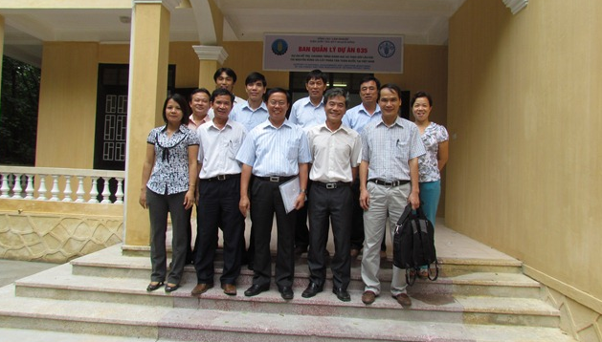
Thank you!

