Slide 1
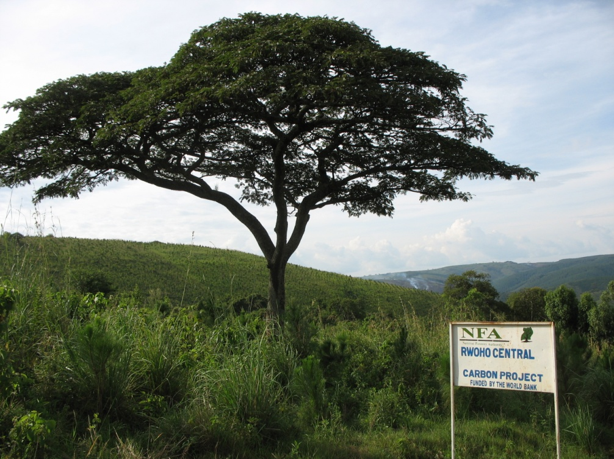
Linking REDD+, broader sustainable development and good governance
Leo Peskett
Overseas Development Institute
Forest Day Learning Event 13 Dec 2009

Slide 2
Overview
Focus on national level
Brief insights on the reality of the challenges of linking REDD+ with broader sustainable development and governance
Policy approaches for enhancing linking and their challenges

Slide 3
How are ‘international’ and ‘national’ REDD+ linked to ‘local’ livelihoods?
International buyers/funders
$ and carbon
National governments??
3. Induced effects
Changes in exchange rates and exports
‘REDD sector’
Human resources development
1. Direct effects
Government spending
Poor households in REDD ‘projects’
Induced effects
Non-poor households
Poor households outside REDD ‘projects’
2. Indirect effects
Non-REDD sector
Changes in prices and wages
Infrastructure and transport
Diversification
Natural Assets
SME development
Notes:
Key points:
Diagram is adaptation of a framework for understanding the contribution of sectors to poverty reduction
Only theoretical but helps to highlight some of the main pathways through which benefits from REDD+ may or may not be transmitted
Three main pathways:
Direct benefits: payments for carbon; employment
Indirect benefits: impacts of REDD+ sector on other parts of the rural sector
Induced effects: connected much more to broader issues in sustainable development – e.g. value added of REDD+ in terms of human resources development etc.
Would argue that REDD+ needs to be considered from this breadth of focus if it really is to link into the broader sustainable development agenda
What issues does this raise?
Institutional arrangements that would see this happen: harmonisation
Crucial issues surrounding coordination
What benefit sharing means in this context?
But also requires us to ask some questions about what REDD+ and livelihood benefits really are
Should it be seen as an additional tool in the forestry sector, e.g. for advancing specific forestry policies, or something broader? I.e. breadth of focus
How do we use lessons learnt from projects to inform national programme development?

Slide 4
REDD+ realities: the challenges
Realities from eight countries
Institutions and links to ongoing processes
  New institutions (steering committees, national working groups and councils for climate change) and fast pace of change
  Standardised planning processes
  Levels of ‘harmonisation’ with national development strategies
  Parallel project and national approaches
Coordination and commitment
  Degree of high level commitment
  Differences across government (and levels of government)
  State vs. non-state actors (NGOs; donors; private sector)
  ‘Ownership’ of REDD+ processes
  Long term vision
Benefit sharing and participation
  Government vs. non-government structures
  Level of understanding of benefits (and costs) and sharing
  Emphasis on forests and PES
  Representativeness of participatory processes
  Implementation barriers: politics of land; workable criteria; regulations being followed; investment risks
Source: Peskett and Brockhaus 2009; REDD-net 2009
Notes:
Realities from eight countries
Institutions and links to ongoing processes
New institutions (steering committees, national working groups and councils for climate change)
Standardised planning processes
Lack of ‘harmonsation’ with national development strategies (e.g., Indonesia vs. Bolivia)
Parallel project and national approaches
Coordination and commitment
Lack of high level commitment?
Differences across government (and levels of government)
State vs. non-state actors (NGOs; donors; private sector)
‘Ownership’ of REDD+ processes?
Long term vision
Benefit sharing and participation
Government vs. non-government structures
Lack of understanding of benefits (and costs) and sharing
Emphasis on forests and PES
Representativeness of participatory processes
Implementation barriers: politics of land; workable criteria; regulations being followed; investment risks

Slide 5
National guidelines and standards
National (procedural) guidelines and standards:
  Establishing public consultation procedures at national level;
  Strengthening local organisations and groups that represent the interests of IPs and LCs;
  Training staff in local regulatory and funding agencies;
  Developing social impact assessments and involving IPs and LCs in assessments.
  Civil society advisory boards
Challenges:
  Primarily procedural
  May not be feasible at international level
  Level of enforceability (mandatory or voluntary?)
Notes:
conditional land rights have been used as a payment to landholders instead of cash in
the Sumberjaya PES project in Indonesia
Only a few of the approaches listed
might be appropriate in all circumstances given their cost, skill and technological
requirements.
The World Bank Group, for example, has the externally-housed Inspection Panel and Compliance Advisor Ombudsman (CAO) accountability mechanisms. Lessons from these mechanisms could inform the design of similar mechanisms for international forest carbon programs. For example, the CAO keeps procedures for filing complaints very simple to make the mechanism accessible to the target population. It also allows complaints to be filed before harm actually occurs so that interventions can be made pro-actively, while 14
projects are still being designed.45 However, concerted effort to make project-affected people aware of their right to seek recourse with accountability mechanisms is still important. Deadlines for processing complaints may be needed to make sure complaints are handled efficiently.
The impact of such guidelines in other international
processes has been mixed.55 Nonetheless, guidelines for
IP and LC participation in REDD should be developed
as soon as possible to help ensure participation from an
early stage. Guidelines could be strengthened through
provision of financial support for participation at the
international level and/or by making delivery of REDD
finance contingent on them being met.

Slide 6
Design of benefit sharing systems
Recognition of rights and benefits in national legislation:
    Recognition of ecosystem service rights in national legislation. (e.g., Costa Rica)
    Specifying benefit types in national legislation, e.g., revenue sharing rules (e.g., as in Indonesian regulations), subsidies or tax credits, local development projects, loans,
    Criteria for prioritising smaller landowners (e.g., CR <300Ha but >2Ha); exemption of indigenous territories from complying with land ownership regulations (e.g. CR);
    Participation in monitoring, reporting and verification systems
Transparency
    Revenue transparency mechanisms , e.g., through (1) citizen and parliamentary oversight, (2) clear guidelines on expenditure, and (3) public disclosure of external audits
Enforcement and dispute resolution
  Strengthening regulatory structures (e.g., env and social impact assessment)
  Support for intermediaries/collective action (e.g., bundling)
  (e.g., World Bank Safeguards)
Challenges:
  Perverse effects of participatory approaches (e.g., strengthened enforcement)
  Targeting the poorer community members
  Viability of alternative livelihood strategies
  Lack of data
Notes:
Design of benefit sharing systems:
Revenue sharing agreements specified in national laws (e.g., as in Indonesian regulations)
Recognition of ecosystem service rights in national legislation. (e.g., Costa Rica recognises GHG mitigation)
Specifying benefit types in national legislation, e.g., fixed terms or royalties linked to market prices, subsidies or tax credits, education and capacity building, local development projects, loans, debt swaps and employment opportunities
Criteria for prioritising smaller landowners (e.g., CR below 300Ha but above 2Ha) and exemption of indigenous territories from complying with land ownership regulations (e.g. CR); contracts with specific household members (e.g., women household heads as in some existing C projects and Bolsa Floresta, Brazil)
Strengthening existing approaches, where these are used for REDD+ (e.g., community based forest management in Tanzania)
Strengthening regulatory structures (e.g., env and social impact assessment)
Support for intermediaries/collective action (e.g., bundling)
Revenue transparency mechanisms , e.g., through (1) citizen and parliamentary oversight, (2) clear guidelines on expenditure, and (3) public disclosure of external audits
Dispute resolution (e.g., World Bank Safeguards)
Challenges:
Perverse effects of participatory approaches (e.g., strengthened enforcement)
Targetting the poorer community members
Viability of alternative livelihood strategies

Slide 7
‘Mainstreaming’ REDD+
Aligning with other development strategies (Bass 2009):
  Entry points in policy cycles (esp. concerning safeguards, prioritization and investment choices)
  Drivers with resources and vision to act (e.g., finance and planning ministries where these are concerned about critical prioritisation questions of budget and policy)
  Continuous improvement approach
  Linking to other key sectors (e.g., agriculture and minerals)
Challenges:
  Political commitment towards REDD+
  Overcoming potentially competing more mainstream development strategies
  Ensuring that development strategies are pro-poor
  Breadth of vision
  Time horizons
Notes:
1. Providing information
2. Planning and organisation
3. Deliberation and engagement
4. Management
5. Voluntary and indigenous approaches
6. Other approaches

Slide 8
Recommendations
Get the balance right: time horizons; breadth of REDD+; what is funded; links to performance
Make sure tools are used: Existing experience; core principles

Slide 9

Thank you
Leo Peskett l.peskett@odi.org.uk
www.odi.org.uk/ccef
www.redd-net.org

