Slide 1
REDD+ Safeguards:
How UN-REDD supports development of country approaches
Tokyo, 7 October 2013
Valerie Kapos, UNEP-WCMC

Slide 2

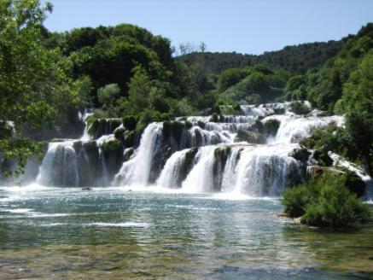
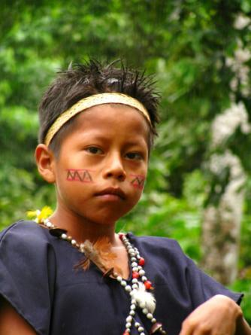
REDD+ May Deliver Multiple Benefits Beyond Carbon
Environmental
  Contributing to biodiversity conservation
  Securing ecosystem services
    Climate regulation through reduced GHG emissions
    Regulating water quantity and quality
    Soil conservation & sedimentation control
    Provision of timber and NTFPs
    Pollination
    . . .
Social
    Improved livelihoods
    Clarified rights to resources
    . . .

Slide 3
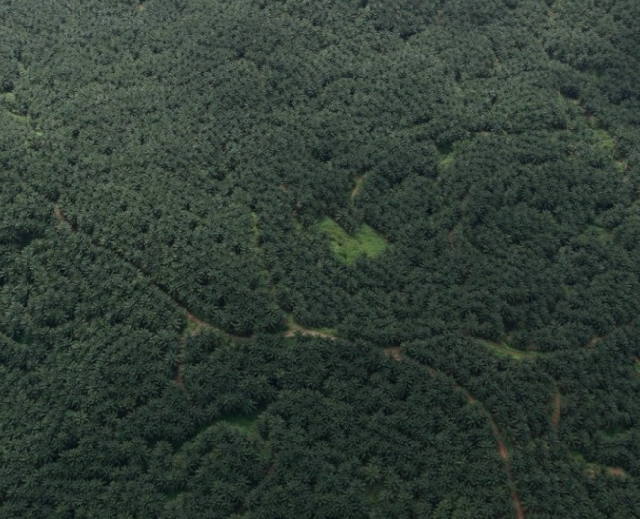
REDD+ also has risks
Environmental
  Replacement of natural forest with plantation
  Displacement of pressures to locations and systems of conservation importance
Social
  Reduced access to resources
  Limited participation
  Poor governance
Notes:
The displacement point is one of the main reasons for REDD+ being a national mechanism – a country could very effectively conserve a particular park or patch of forest, but lose everything else. The question is one of net balance. Even so, there are worries about international leakage. Leakage or ILUC presents serious challenges for measurement

Slide 4

UNFCCC Safeguards
Address Benefits & Risks of REDD+
Countries have agreed to promote and support them
Formulation is (necessarily) general – countries need to decide how to apply them
Some concerns that, especially through emphasis on benefits as well as risks, they:
  Broaden the agenda
  Place additional burdens on countries
Notes:
Recognising that benefits and risks of REDD are potentially very important, the UNFCCC discussed them at length and in 2010 adopted a set of safeguards. These are quite general and countries are variously asked to promote & support them or ‘address and respect’ them – it is not yet clear how binding they are

Slide 5
Cancun safeguards
(2010)
Including:
“[REDD+] Actions are consistent with the conservation of natural forests and biological diversity, ensuring that actions referred to in paragraph 70 of this decision are not used for the conversion of natural forests, but are instead used to incentivize the protection and conservation of natural forests and their ecosystem services, and to enhance other social and environmental benefits”
Cancun Agreements:
FCCC/CP/2010/7/Add.1 Appendix I
Notes:
These are vital

Slide 6
The UN-REDD Programme
United Nations collaborative initiative on Reducing Emissions from Deforestation and forest Degradation in developing countries
UNDP, UNEP, FAO
Supports nationally-led REDD+ processes
46 Partner countries, supported through:
  Direct support to implementation of national programmes
  Developing common approaches, analyses, methodologies, tools, data and best practices
Notes:
The UN-REDD Programme is the United Nations collaborative initiative on Reducing Emissions from Deforestation and forest Degradation (REDD) in developing countries. The Programme was launched in 2008 and builds on the convening role and technical expertise of the Food and Agriculture Organization of the United Nations (FAO), the United Nations Development Programme (UNDP) and the United Nations Environment Programme (UNEP). The UN-REDD Programme supports nationally-led REDD+ processes and promotes informed and meaningful involvement of all stakeholders, including Indigenous Peoples and other forest-dependent communities, in national and international REDD+ implementation.
The Programme supports national REDD+ readiness efforts in 46 partner countries, spanning Africa, Asia-Pacific and Latin America, in two ways: (i) direct support to the design and implementation of UN-REDD National Programmes; and (ii) complementary support to national REDD+ action through common approaches, analyses, methodologies, tools, data and best practices developed through the UN-REDD Global Programme. By July 2012, total funding for these two streams of support to countries totaled US$117.6 million.

Slide 7
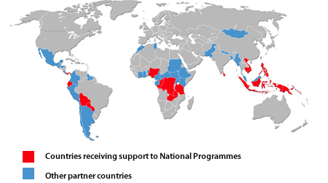
UN-REDD Programme
UN collaborative initiative (FAO, UNDP, UNEP) supporting nationally-
led REDD+ readiness processes in 47 countries:
  Design and implementation of UN-REDD National Programmes (16 countries)
  Targeted support for partner countries

Slide 8
UN-REDD Global Work Areas
  Global work on common approaches, analyses, methodologies,
  tools, data and best practices:
MRV and monitoring
National governance systems
Accountable management of REDD+ funding
Participatory decision making, strategy development and implementation
Safeguards and multiple benefits
Green economy and REDD+
Knowledge management

Slide 9
Objectives of UN-REDD Work on Safeguards
To address social and environmental issues in UN-REDD National Programmes and other UN-REDD funded activities
To support countries in developing country approaches to safeguards in line with the UNFCCC

Slide 10
Themes of UNFCCC ‘Cancun’ Safeguards
Broad statements that cover:
  Consistency with national objectives and international undertakings
  Transparent forest governance structures
  Respect for indigenous peoples and local communities
  Effective participation of relevant stakeholders
  Conservation of natural forests and biodiversity
  Enhancement of social and environmental benefits
  Permanence of REDD+ actions
  Displacement of emissions

Slide 11
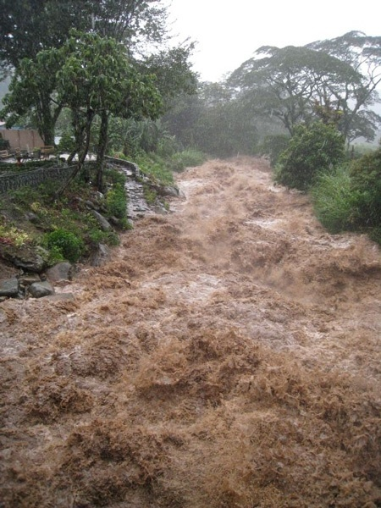
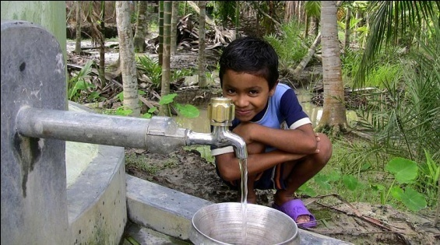

Safeguards
REDD+ safeguards are needed to reduce potential risks
from REDD+ and enhance potential benefits
Vary with REDD+ activity and spatially
multiple benefits work

Slide 16
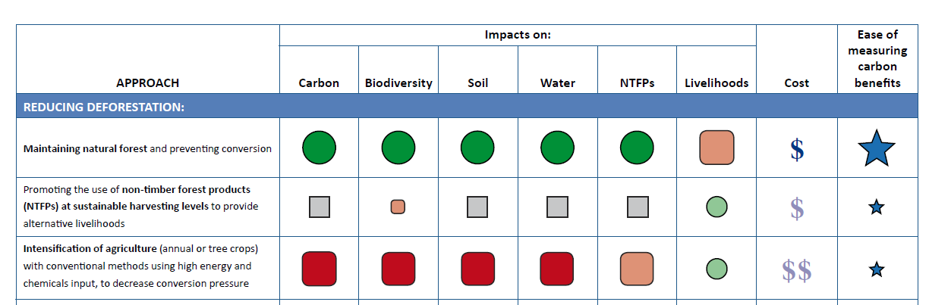
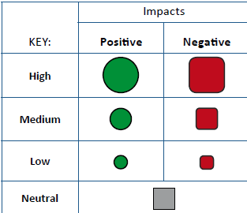
REDD+ activity benefits and risks

Slide 17
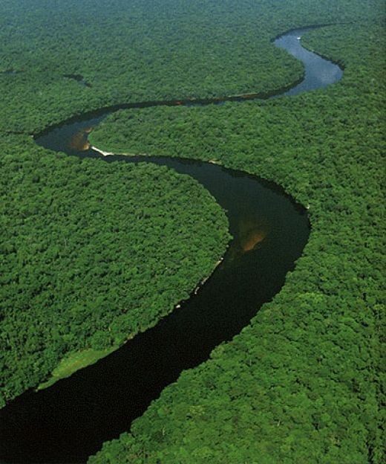
Development of a Country Approach to Safeguards
No fixed, linear path
Steps to take will depend on:
  what is in place
  objectives defined by the country
Throughout the process, effective participation will be essential

Slide 18
Core Elements of a Country Approach to Safeguards
Institutions
Processes and Procedures
1.Identification/ development of relevant safeguards to be addressed and respected:
Policies, laws and regulations (PLRs), either existing or those created for REDD+
2. Safeguard Information System (SIS):
Existing or new indicators, methodologies for collecting information, and framework for provision of information

Slide 19
Generic steps for development of a country approach to safeguards
1.Gap analysis of existing systems
2.Development of indicators
3.Data collection/ information provision approaches
Institutions
Safeguards Information System
1. Defining the goals of the safeguards approach
2. Gap analysis of existing social/ environmental PLRs and procedures
3. Creation of new PLRs and procedures (if necessary)
Policies, Laws and Regulations
Processes and procedures

Slide 20
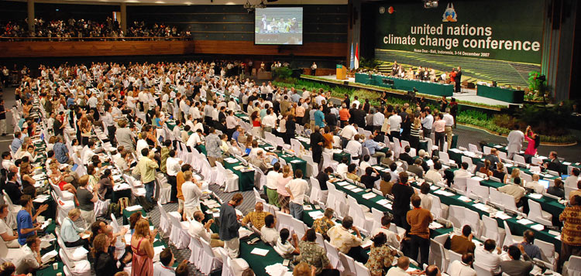

Defining the goals
Why is the REDD+ safeguards approach being established?
Interpret UNFCCC decision from country perspective and links to other processes
Consideration of social and environmental risks and benefits of activities from initial REDD+ strategy
Responding to other objectives, e.g. donor or investor policies
UN-REDD Social and Environmental Principles and Criteria (SEPC) can help add
detail to the broad principles of Cancun Safeguards

Slide 21
Social and Environmental Principles
Apply norms of democratic governance, as reflected in national commitments and Multilateral Agreements
Respect and protect stakeholder rights in accordance with International obligations
Promote sustainable livelihoods and poverty reduction
Contribute to low-carbon, climate-resilient sustainable development policy, consistent with national development strategies, national forest programmes, and commitments under international conventions and agreements

Slide 22
Social and Environmental Principles
5. Protect natural forest from degradation and/or conversion
6. Maintain and enhance multiple functions of forest including conservation of biodiversity and provision of ecosystem services
7. Avoid or minimise adverse impacts on non-forest ecosystem services and biodiversity

Slide 23
SEPC Principle 4 – policy coherence
REDD+
Adaptation
Other mitigation
National climate policy
Criterion 14 – Ensure consistency with and contribution to national climate policy objectives, including those of mitigation and adaptation strategies and international commitments on climate

Slide 24
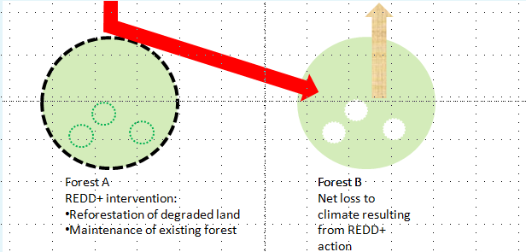
SEPC Principle 5 – natural forest degradation or conversion
Criterion 20 – Avoid or minimise indirect land-use change impacts of REDD+ activities on forest carbon stocks, biodiversity and other ecosystem services

Slide 25
UN-REDD Tools to Support Country Approaches to Safeguards
Defining goals of the country safeguards approach
UN-REDD tools | How tool can contribute
SEPC | Detailed criteria that can be used to ‘unpack’ the Cancun safeguards
UN-REDD/Forest Carbon Partnership Facility Stakeholder Engagement Guidelines | Guidance on how participation of stakeholders can be ensured in UN-REDD activities, including how to apply the principle of free, prior and informed consent (FPIC); could be used by countries in the development of REDD+ PLRs
UN-REDD FPIC Guidelines | Framework for applying the principle of FPIC at community and national levels

Slide 26
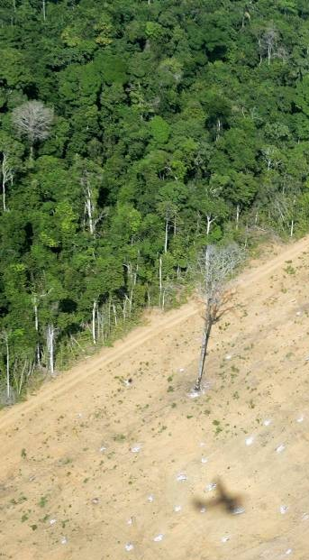
Defining/developing policies, laws, and regulations (PLRs)
Gap analysis of existing PLRs
What PLRs already address goals?
What is the effectiveness of the existing system – what processes/institutions are missing?
SEPC Benefit and Risks Tool (BeRT) draft revision:
  When considering how PLRs relate to reducing the displacement of emissions:
  Are there any agreements with neighboring countries on export of forest products?

Slide 27
Defining/developing
Policies, Laws, and Regulations (PLRs)
Development of new PLRs
What PLRs and associated processes and institutions need to be in place to achieve the goals?
  e.g. few countries have clear policies on how carbon rights are defined and protected

Slide 28
UN-REDD Tools to Support Country Approaches to Safeguards
Defining or developing safeguard policies, laws and regulations –
Gap analysis of existing PLRs
UN-REDD tools | How tool can contribute
Benefit and Risks Tool (BeRT) | List of questions drawn from the SEPC in order to assess existing PLRs
Participatory Governance Assessment | Process for participatory evaluation of governance systems relevant to REDD+
Draft Guidance on Conducting REDD+ Corruption Risk Assessment | Detailed framework for assessing corruption risks in REDD+

Slide 29
UN-REDD Tools to Support Country Approaches to Safeguards
Defining or developing safeguard policies, laws and regulations –
Development of new PLRs
UN-REDD tools | How tool can contribute
Free, Prior and Informed Consent (FPIC) Guidelines | Framework for applying FPIC at community and national levels; primarily designed for UN-REDD activities but could be adopted in REDD+ PLRs
Guidelines on Strengthening/ Establishing National-Level Grievance Mechanisms | Guidance on how to assess and strengthen existing PLRs and institutional capacity to address REDD+ related grievances
Participatory Law Development (LEG-REDD+) | Participatory approach for formulating legal and policy reforms and drafting new PLRs in response to REDD+

Slide 30
Generic steps for development of a country approach to safeguards
1.Gap analysis of existing systems
2.Development of indicators
3.Data collection/ information provision approaches
Institutions
Safeguards Information System
1. Defining the goals of the safeguards approach
2. Gap analysis of existing social/ environmental PLRs and procedures
3. Creation of new PLRs and procedures (if necessary)
Policies, Laws and Regulations
Processes and procedures

Slide 31
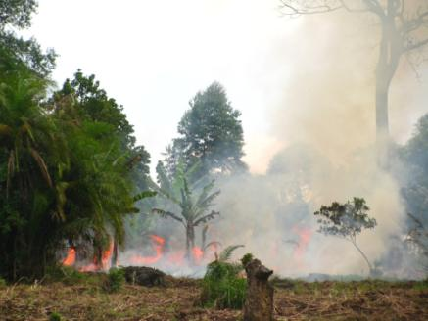
Safeguard Information System (SIS)
Approach for collecting and providing information on how REDD+ safeguards are being addressed and respected throughout REDD+ implementation
Build on existing systems
Development ideally follows goal setting and gap analysis of PLRs

Slide 32
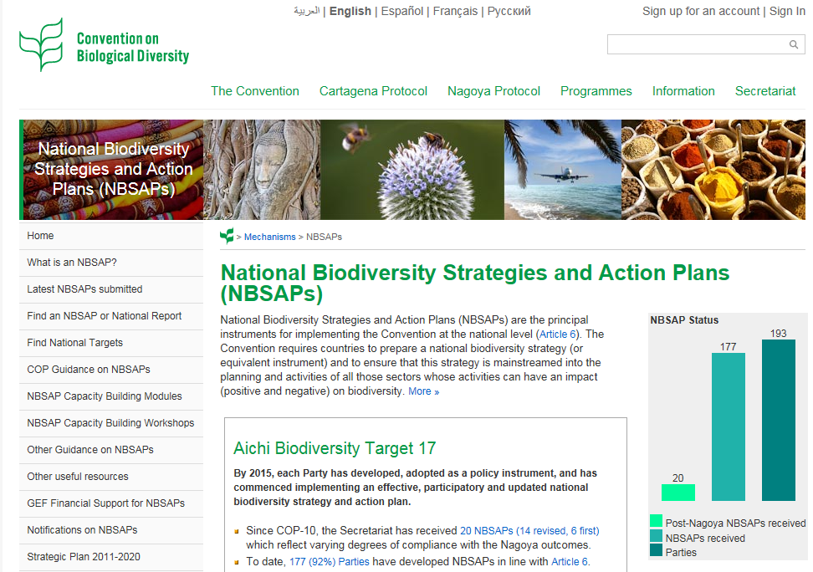
SIS – Gap analysis of existing systems
Review :
Information sources & systems related to each of the safeguards
  Indicators
  Data collection & measurement approaches
Systems supporting national implementation of other international conventions (CBD - NBSAPs)
Quality of sources/systems
Gaps
What kinds of new institutions/processes will be necessary?

Slide 33
SIS – Decisions to be taken on data collection
What data to collect (including scale considerations)
Methods to be used (e.g. household surveys; participatory approaches, such as participatory biodiversity monitoring)
Who will collect data / institutional roles
Frequency of data collection
How will information be stored
Provision of information framework (UNFCCC, country level, key stakeholders)
Quality assurance / internal evaluation process

Slide 34
UN-REDD Tools to Support Country Approaches to Safeguards
Safeguard Information Systems –
Development of indicators
UN-REDD tools | How tool can contribute
Participatory Governance Assessment | Participatory approach for developing governance indicators for REDD+ schemes
Framework for assessing and monitoring forest governance | Tool for designing robust and comprehensive sets of governance indicators

Slide 35
UN-REDD Tools to Support Country Approaches to Safeguards
Safeguard Information Systems –
Methodologies for collecting information
UN-REDD tools | How tool can contribute
Draft Guidelines for monitoring the impacts of REDD+ on biodiversity and ecosystem services | Draft guidelines useful for establishing aspects of SIS relevant to biodiversity and ecosystem services
Draft manual on the collection of forest governance data | Practical considerations, methods and available resources for collecting governance data

Slide 36
Examples of UN-REDD support to countries on safeguards
‘Targeted support’ activities in 2013
Costa Rica
Reconciling the needs of different safeguard approaches (e.g. UN-REDD, Forest Carbon Partnership Facility, REDD+ Social and Environmental Standards) within the design of a single safeguard information system
Activities include:
  Analysis of different safeguard approaches
  Stakeholder analysis
  Review of PLRs
  Developing indicators and establishing information sources

Slide 37
Examples of UN-REDD support to countries on safeguards
Ecuador (National Programme)
Proposal for a multiple benefits monitoring system as part of a national System of Information and Monitoring for Safeguards and Multiple Benefits
Activities include:
  National and sub-national consultation workshops on identification and prioritization of multiple benefits and risks
  Identification of information requirements for different safeguards
  Identification of potential indicators for priority benefits and risks

Slide 38
Examples of UN-REDD support to countries on safeguards
‘Targeted support’ activities 2013
Peru
“Design and initial implementation of a participatory monitoring
system for social and environmental safeguards.” Capacity building for
indigenous peoples on monitoring
Argentina
Reconciling the needs of different safeguard approaches (e.g. UN-
REDD, FCPF) within the design of a single safeguard information
system. Consultations in four different regions will take place.

Slide 39
Examples of UN-REDD support to countries on safeguards
Tanzania (National Programme)
Linkages between the national forest inventory and the development of spatial analyses to inform REDD+ environmental safeguards and development of an Safeguard Information System (SIS)
Activities include:
  Analysis of current forest inventory methodology to identify how the information collected can feed into an SIS
  Analysis of existing forest inventory data to derive spatial information on the potential for environmental benefits from REDD+

Slide 40
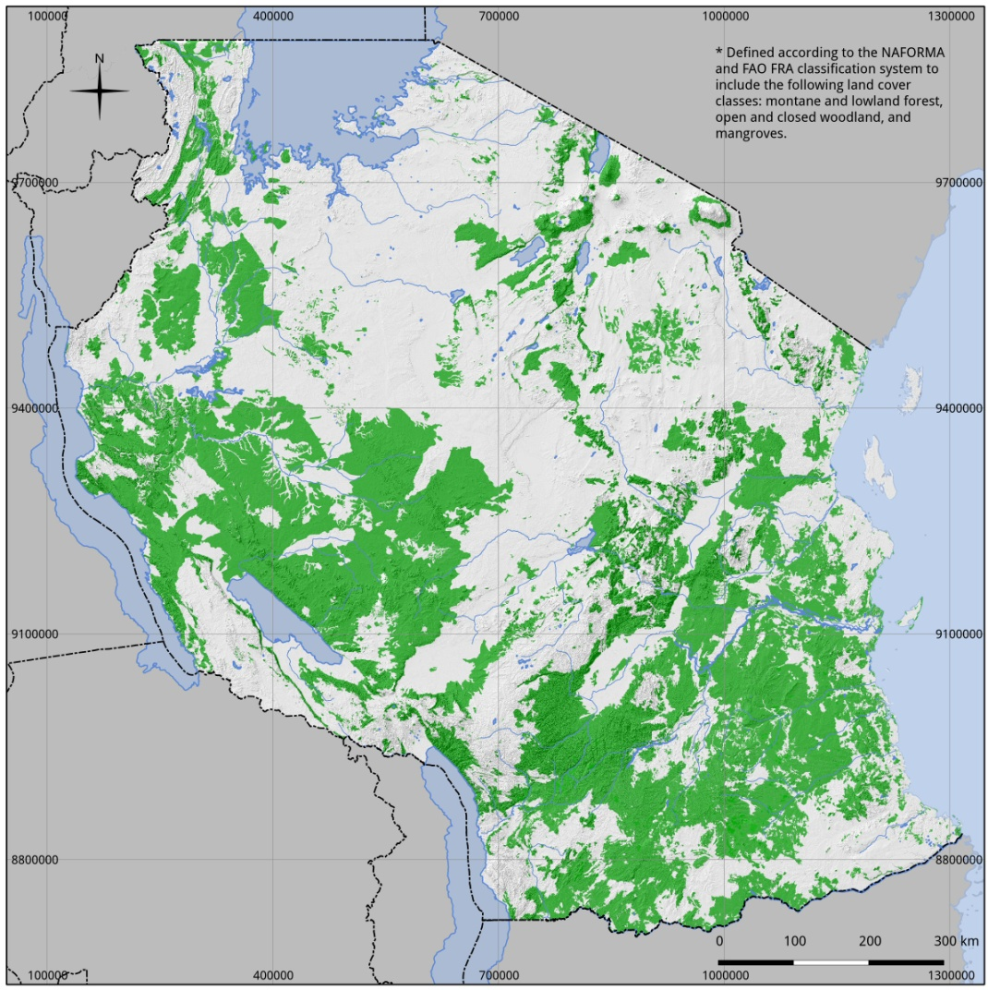
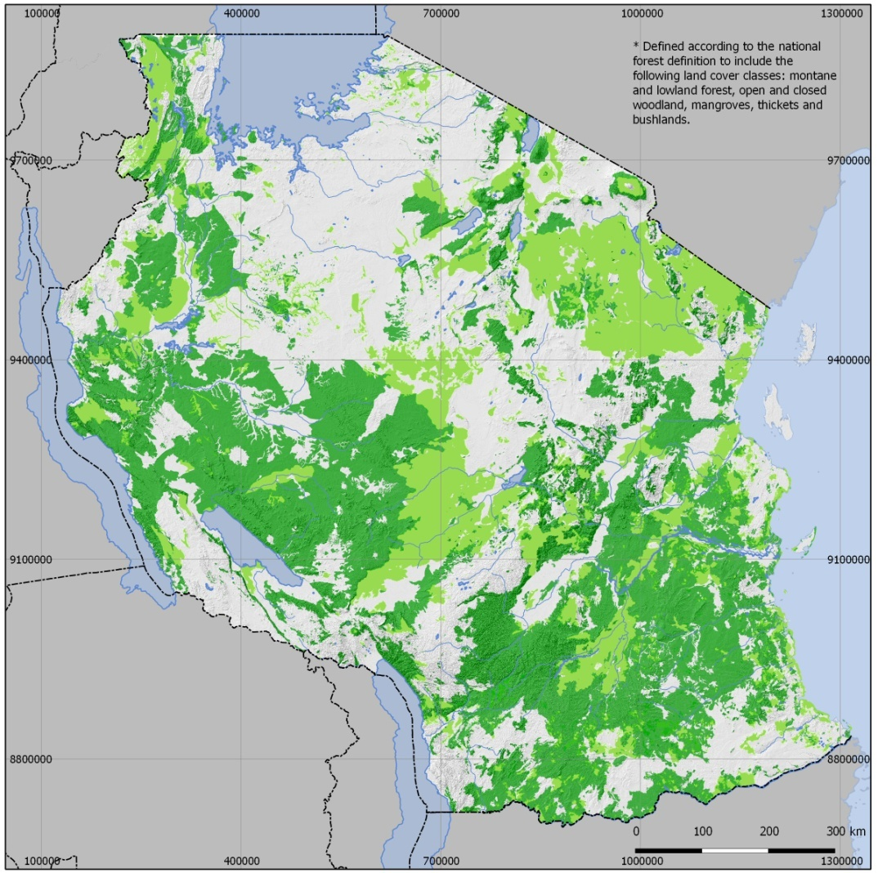
Tanzania
Natural forest estimation
National definition of forest
(10% canopy cover + 2 m height)
Montane & lowland forest
Woodland
Mangrove
Bushland (>2m)
Thickets (>2m)
FAO FRA
(10% canopy cover + 5 m height)
Montane & lowland forest
Woodland
Mangrove
Map source: Derived form landcover classes in NAFORMA landuse landcover map 2010.

Slide 41
Summing up…
Countries carrying out REDD+ will need to develop a country approach to safeguards consistent with UNFCCC guidance and that satisfies all of the country’s priorities
The UN-REDD Programme has developed general guidance for creating country approaches
For each of these steps, tools and approaches have been developed, which are available to all countries online
Partner countries to the UN-REDD Programme can also receive financial and technical support on REDD+ safeguards and multiple benefits

Slide 42
Valerie Kapos
val.kapos@unep-wcmc.org
Thank You
Website: http://www.un-redd.org

