Slide 1
WATER MASTER PLAN 2030
ENABLING ENVIRONMENT FOR ITS SUCCESSFUL IMPLEMENTATION
A Presentation to the Kenya Water Towers, Forests and Green Economy National Dialogue;
By: Eng. Philip J. Olum
CEO- Water Resources Management Authority
6th November, 2012

Slide 2
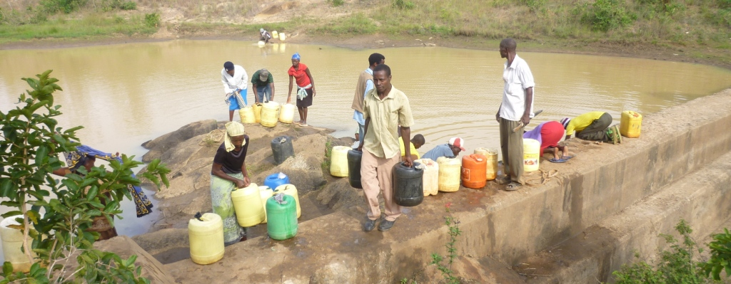

Presentation outline
Objectives of the NWMP
Water Resources Availability
Water issues and Challenges
WRMA Strategies
Development plans of the NWMP
Enabling Environment
Critical support for WRMA

Slide 3
Kenya National Water Masterplan objectives
To assess and evaluate availability, reliability, quality, and vulnerability of country’s water resources up to around the year 2050 taking into consideration climate change,
To renew the National Water Master Plan towards the year 2030 (NWMP 2030) taking into consideration climate change,
To formulate action plan for activities of WRMA up to the year 2022 to strengthen their capability, and
To strengthen capacity of water resources management.

Slide 4
Water Resources Availability
As per NWMP 1992, the estmated per capita renewable fresh water was 647 cu. Meters per capita.
The NWMP 2030 has re- evaluated (Objective 1 achieved) Surface water Resources using new assessment methods, giving a significant role to Ground water Resources than was done in 1992.
Total renewable water resources is now estimated at 1,170 cu. meters capta (2010)
Challenges in terms of varialiability both in space and time still remain

Slide 5
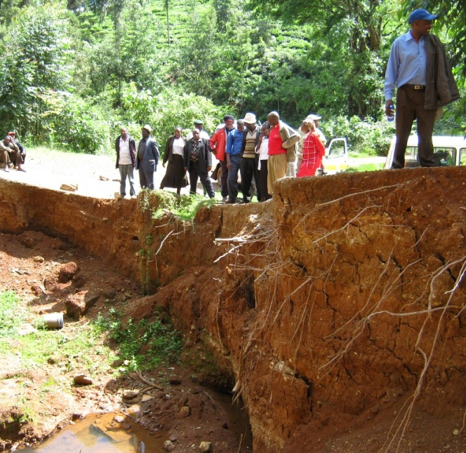
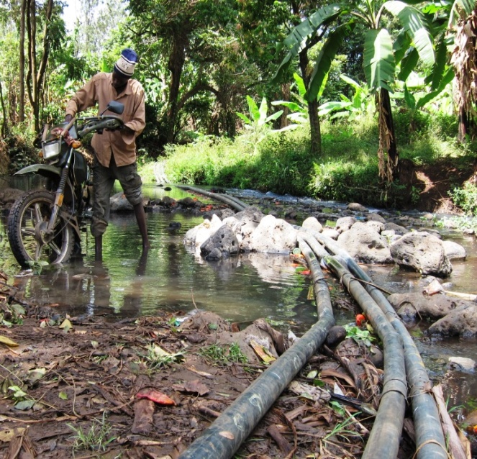
WRM issues and challenges
Catchment degradation (e.g. De-forestation) leading to erosion and high sediment loads in rivers
Illegal abstraction / Non-compliance to permit conditions
Encroachment of riparian land and wetlands
Inappropriate agricultural practices
Degradation of water resources
Inefficient water use
Water scarcity in semiarid and arid areas

Slide 6
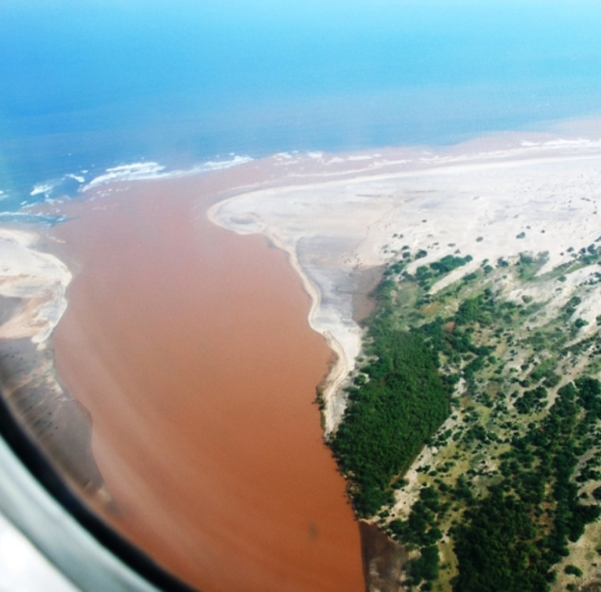
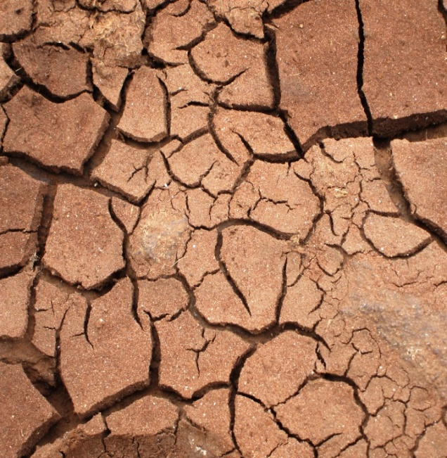
WRM issues and challenges
Lack of awareness in the public, regarding–
sustainable use of water
roles of WRMA and WRUA
legal requirements for water abstraction
Increased competing water demands
Endangered ecosystems (e.g. Tana delta)
Water resources assessment and monitoring
Inter-basin water transfer
HIV/AIDS and gender issues related to water

Slide 7
WRMA strategies and principles
Community / stakeholder participation through WRUAs and CAAC establishment,
Water as a human right: ensuring access to water and equity in allocation, giving priority to basic human needs and environmental conservation (reserve)
Water pricing and water permitting to regulate the use and to increase water use efficiency (water as an economic good)
Legislation and strategies: providing an enabling environment and a basis for regulation
Decentralized management of water resources and service provision: 6 WRMA offices.

Slide 8
WRMA strategies and principles
Collaboration and partnership: with donors, GoK institutions and other organisations for improved WRM
Awareness raising , technical assistance and capacity building of water users
Enforcement of permit conditions,
Promotion of dialogue: Reduction of conflicts between competing water users through support to WRUAs
Managing an effective water resources monitoring system for informed decision making and planning, ensuring access to information at all levels
Linking water resources to a growing economy in attaining vision 2030 through NWMP 2030

Slide 9
DEVELOPMENT PLANS
Management Plans ( six plans per region)
Water Resources Management Plan
Flood and Drought Disaster Management Plan
Environmental Management Plan ( proposes critical forest establishement to attain 10% forest cover)
Institutional Plan
Institutional Strengthening Plan for Water Resources Management

Slide 10
Enabling environment
Institutional Strengthening
The Water Resorces Management function is considered critical for equitable allocation and regulation of water resources.
Water resources will continue to be managed along river drainage basin approach.
The WRMA will be providing Water Resources Infomation to County governments.
The basis of sound WR investments since drainage basins encompass many county Goverments

Slide 11
Critical support for its implementation
Water Resources are not County Based
WRMA will require support from the County Governments to think and respect the principle of managing water resources using river basin approach.
This provides a platform for sustainable Socio-economic development within the basin, using water resources as a central enabler

Slide 12
Critical support for its implementation cont’d
Implementation of the Plan:
In the NWMP 1992, 28 dams were proposed in the water Resources Development. Of these only three have been constructed and one is under construction.
In the current plan, serious committment to implement the proposals, from each sector is therefore considered critical.
This is the only way the countrywill benefit from the National Water Master plan 2030

Slide 13
Critical support for its implementation cont’d
Water Resources Information:
WRMA will need support to create awareness to County Governments on the Cross cutting nature of water resources as a shared resource.
Currently WRMA is assembling WRM information to give advice to the planners for Isiolo County; on WRM investments and use.
We see the actvity to be crucial and would need to be replicated across all Counties

Slide 14
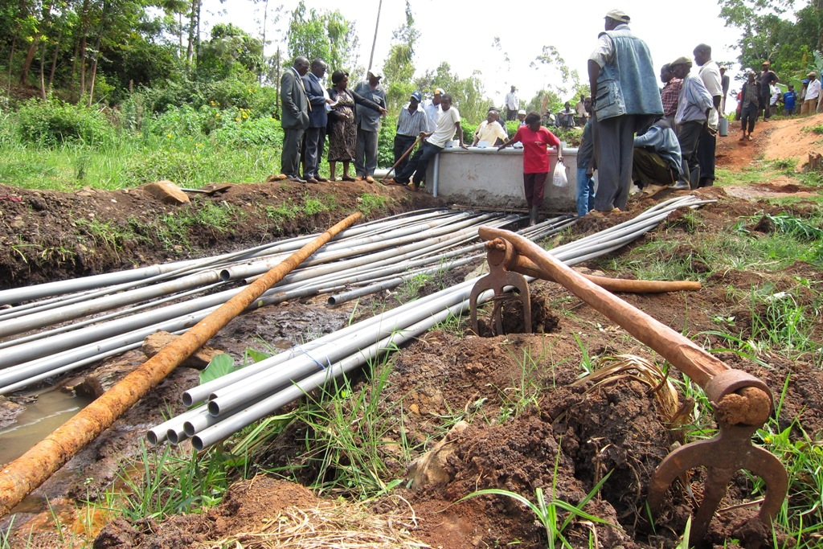
End presentation - Thanks
Best Practice: Common intake adopted for water use conflict resolution

