Slide 1

The REDD+ process in the
Democratic Republic of Congo (DRC)
Josep A. Garí
Environmental Finance Advisor & UN-REDD Programme (Africa)
UNDP - Environment & Energy Group, Dakar.
E-mail: josep.gari@undp.org
Zambia REDD+ Orientation Workshop
Lusaka, 27-29 June 2011

Slide 2
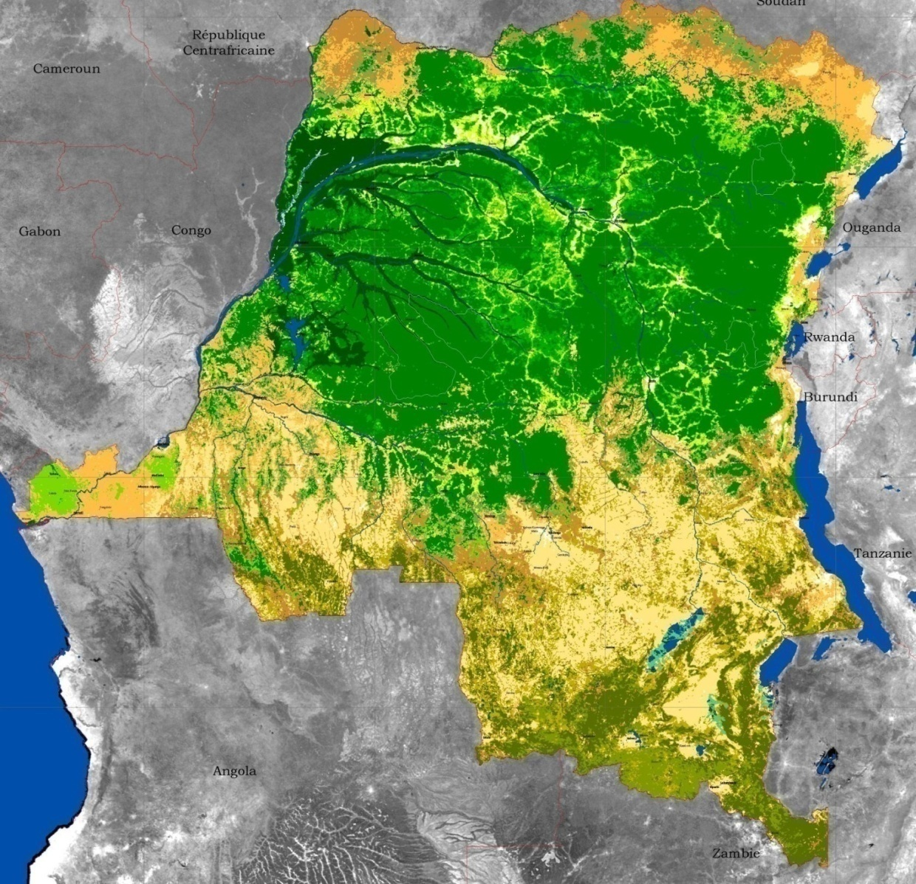

Slide 3
REDD+ readiness in the DRC
Started in January 2009
Intense process – critical mass engaged
Political will
Stakeholder dialogue, common vision/will to reach consensus
Many lessons produced and intense learning
It served to put forests, biodiversity, rural livelihoods, governance of natural resources, etc. in the centre of development debates and policy
A qualitative, decisive influence in global climate negotiations and in international aid fora
Cumulative magnet for investments and technical support

Slide 5
5 agreed principles of the REDD process:
One national process only
Participation
Transparency
Technical quality
Regional integration

Slide 6
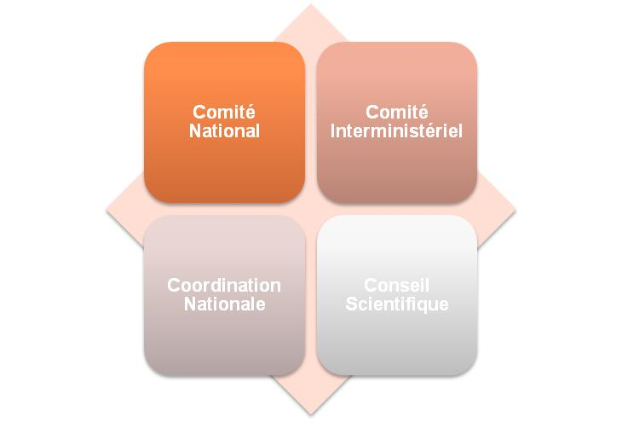

Slide 12
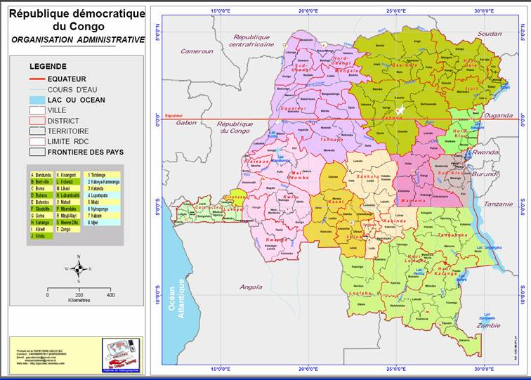

Slide 13
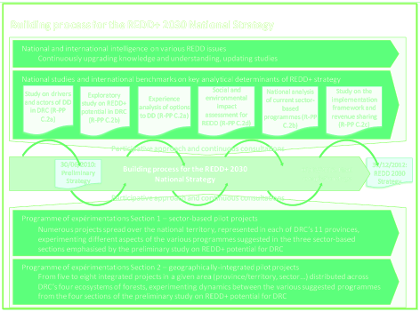

Slide 14
SECTOR-BASED OPTIONS
ENABLING OPTIONS
REDD+ options in DRC
(first overview)
Environnement et forêt
4
19
20
1
2
3
Valuation of environmental services and NTFP
Micro-zoning in forest areas
Harmonisation and land tenure security
Community-based forest management
Industrial logging
Artisanal logging and fight against illegal logging
5
6
21
22
Conservation and protected areas
Afforestation Reforestation enhancement of stocks
« Green » Microfinance
Land use planning
23
24
Good governance, anticorruption et public performance
Economic governance, trade policy and tax efficiency
Agriculture
7
8
9
10
Individual agriculture
Small-scale commercial agriculture
Intensive agriculture
Agro forestry (various models)
25
26
Law enforcement
Gender policy for REDD+
Autres secteurs
27
28
11
12
13
14
Management of demographic pressure and migrations
Rural and farming organisation
Optimisation of wood-energy industry
Small-scale alternative energies
Hydroelectrici-ty on big scale
Infrastructures and sustainable transport
15
16
17
18
29
30
Extractive and mining activities
Trade and service industries for REDD+
Transformation industry for agriculture and forest products
Urban expansion management
Valuation of traditional and endogenous knowledge
Development strategy for indigenous people

Slide 15
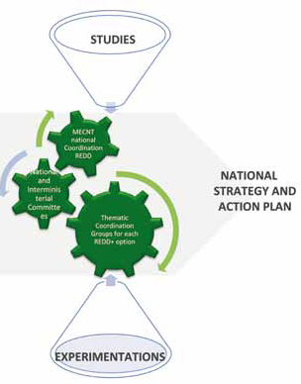
Building the
REDD+ Strategy

Slide 16
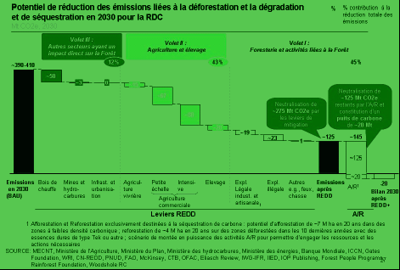
Forêt dense humide
Forêt de montagne
Forêt sèche de Miombo

Slide 17
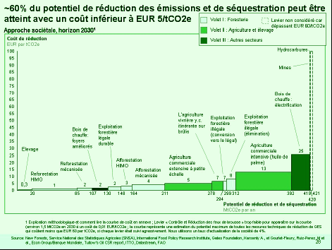
…

Slide 18
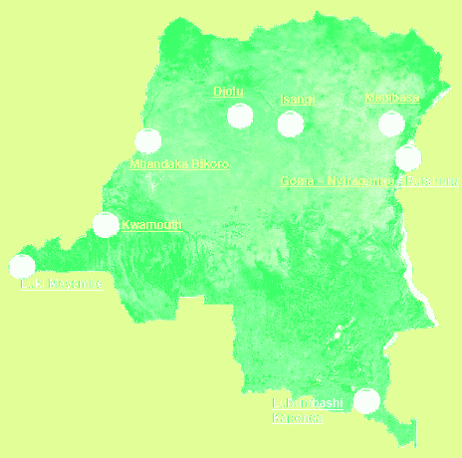
REDD+ pilot projects

Slide 19
Anticipated programmes
Starting phase 2
Zoning and
land use / planning
Land tenure
Intensification & sedentarisation
of agriculture in forest areas
Afforestation / Reforestation
In peri-urbain areas
National programme for
improved cooking stoves
Fighting
illegal timber extraction
Integrated REDD+ programme
(full district)

Slide 20
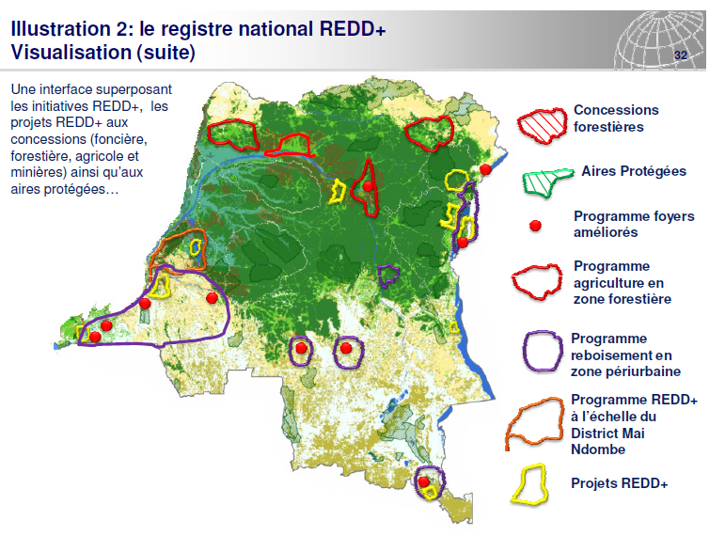
A REDD+ Registry

Slide 21
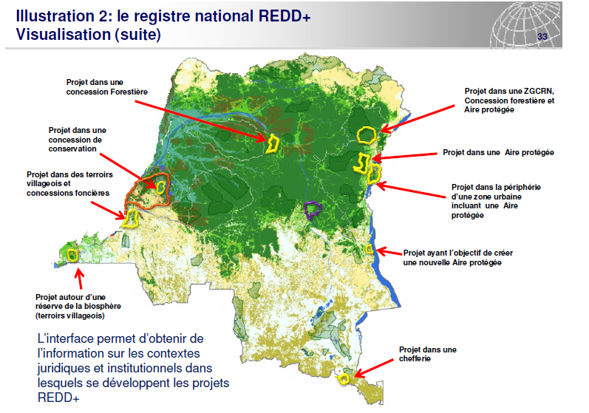
A REDD+ Registry (2)

Slide 22
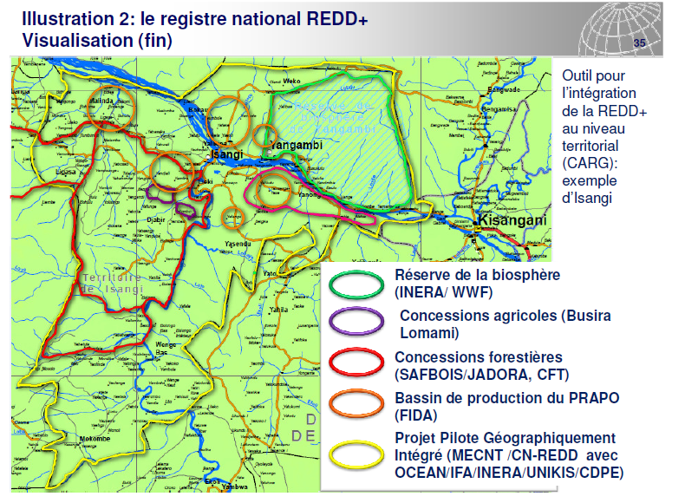
A REDD+ Registry (3)

Slide 23
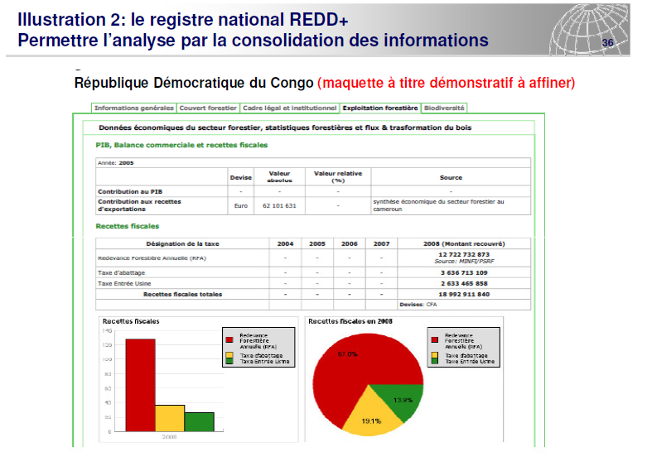
A REDD+ Registry (4)

Slide 24
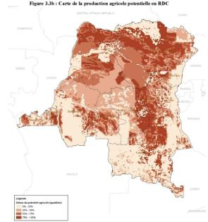
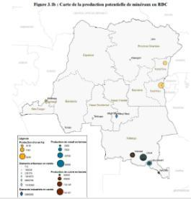
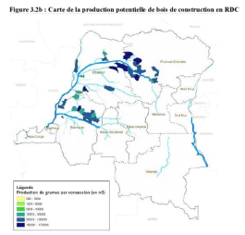
Building the reference levels:
Integrating the different potential sectors
Agricultural potential
Mining potential
Forest exploitation potential
… and also the potential for energy, biodiversity, etc.

Slide 25
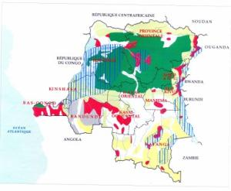
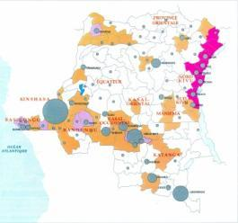
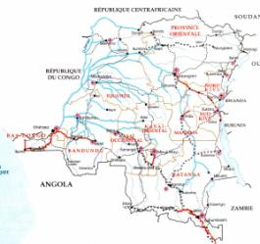
Analisys of current status and trends
Use of space and soils
Population distribution
Transport system
Major economic flows

Slide 26
MRV
plan
→ ÉLÉMENTS
→ COORDONATEURS
→ ACTIVITÉ 1
3ème trimestre 2010
→ ACTIVITÉ 2
1er trimestre 2011
→ ACTIVITÉ 3
2ème trimestre 2011
→ ACTIVITÉ 4
3ème trimestre 2011
→ ACTIVITÉ 5
1er trimestre 2012
→ ACTIVITÉ 6
2ème trimestre 2012
ACTIVITÉ FINALE
3ème trimestre 2012

