Slide 1
DEVELOPMENT OF MRV-SYSTEM & REL/RL IN TANZANIA
Presented by
Evarist Nashanda
Principal Forest Officer
Tanzania Forest Services
Ministry of Natural Resources and Tourism
P . O. Box 40832 Dar-Es-Salaam, Tanzania
Mobile: +255 789 333 168
Evarist.nashanda@gmail.com
UN-REDD 13 Policy Board
Arusha Tanzania
5 November, 2014

Slide 2
REDD+
Was agreed in Bali, Indonesia in 2007 (CoP 13) as simple and relative cheap means of mitigating CC.
Monitoring systems that allow for credible measurement, reporting and verification of REDD+ activities are among the most critical elements for the successful implementation of any REDD+ mechanism

Slide 3

Pillars for MRV System-GHG-
Emissions = AD x EF
AD = Activity Data
EF = Emission Factors
x
=
GHG Emissions/Removals (GHG Inventory)
National Forest Inventory: Pillar 2
Satellite monitoring LCLC: Pillar 1
GHG: Pillar 3

Slide 4
MRV-System in TZ
Both remote sensing and ground based data were collected to monitor forest carbon emissions.
Monitoring is essential in order to be compensated for the emissions reductions.
The focus of the work; is GHG emissions monitoring, Reference Emissions Levels , forest inventories and remote sensing

Slide 5
Tanzania MRV Plan & Progress in Construction of REL/RL
Tanzania has conducted a national wide forest inventory including trees outside forests (TOF)- This refers to NAFORMA- National Forest Resources Monitoring and Assessment.
NAFORMA is a methods for measuring biophysical and socio-economic data, a system for monitoring permanent sample plots (PSP) linked to the Global Forest Resources Assessment (FRA) process

Slide 6
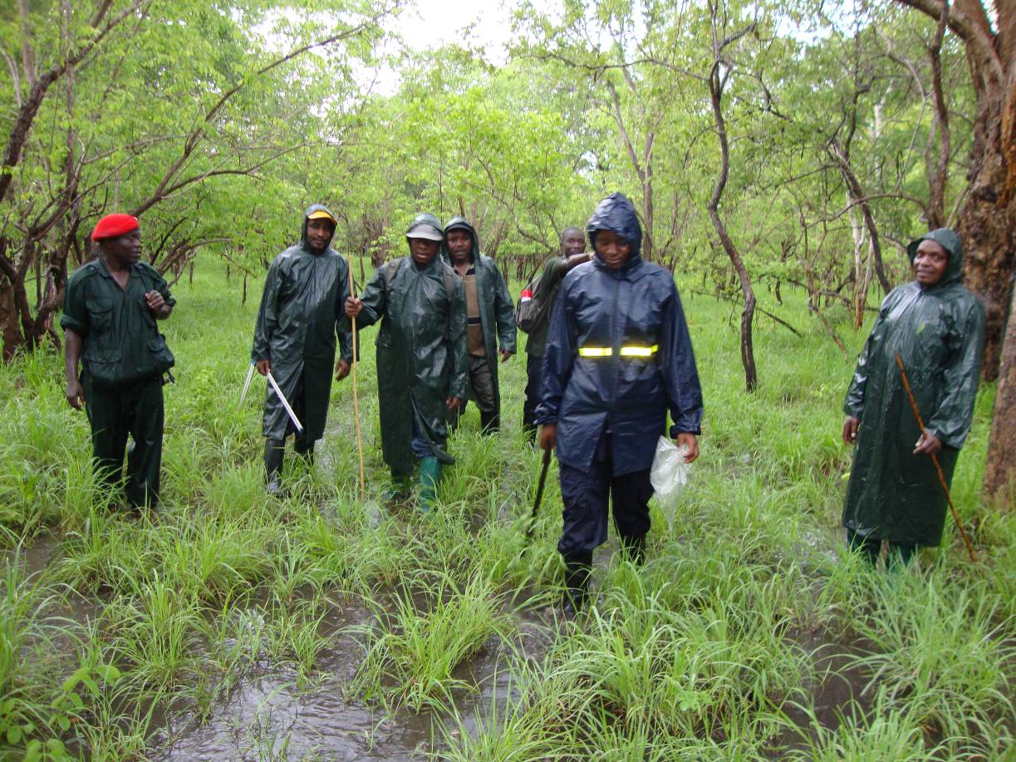
NAFORMA

Slide 7
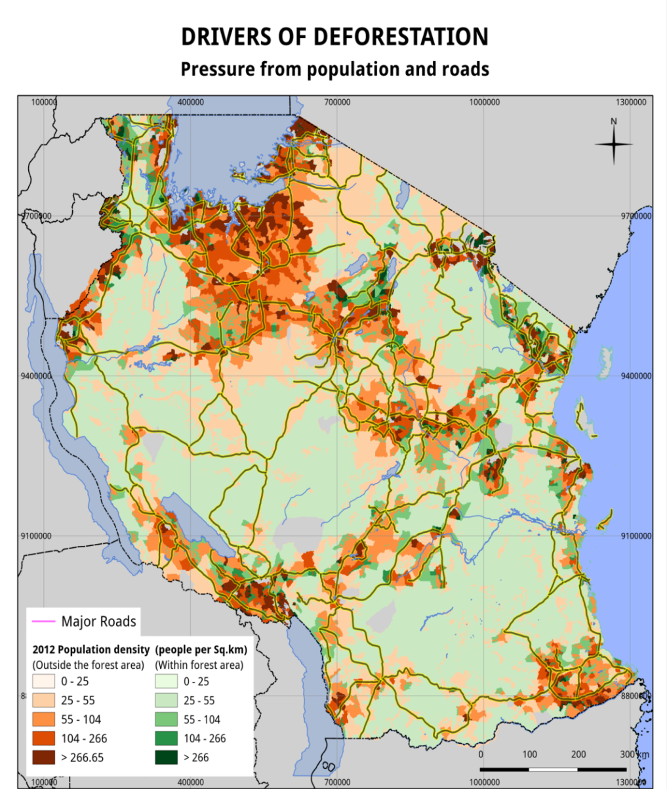
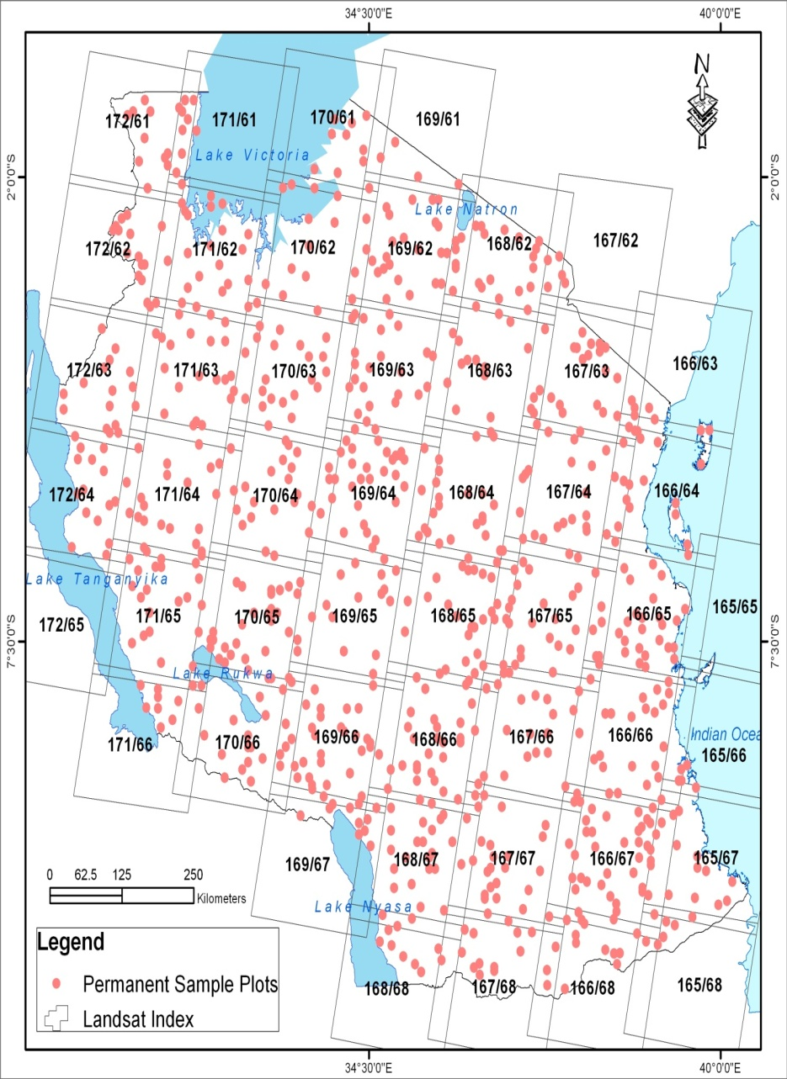
NAFORMA PSP was used to produce a map of drivers of D&D- Population and Rd network
NAFORMA Permanent clusters

Slide 8
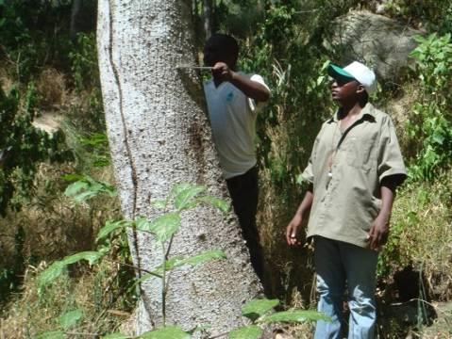
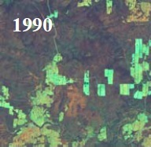
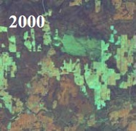
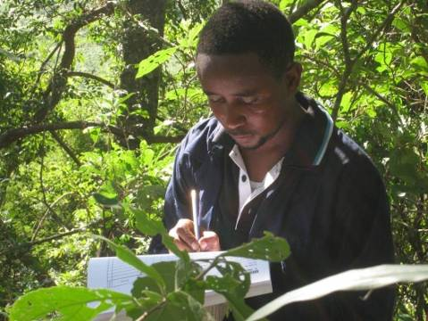
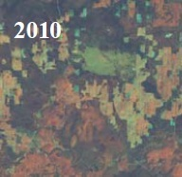
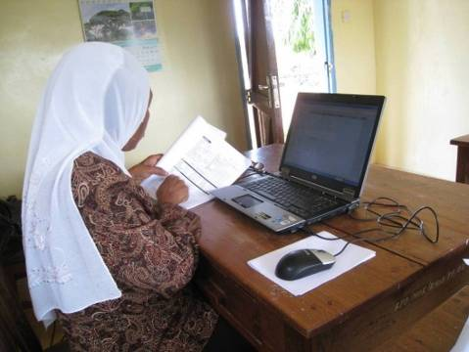
NAFORMA - backbone of REDD+
Deforestation
Forest Degradation
Land
Cover
Change
Assessment
(in cooperation with UNREDD)
Re-measurement
of permanent
sample sites
(5 year cycle)
(NAFORMA II)

Slide 9
CoP 16 decision
Encourages developing countries to develop a
“national forest reference emission level and/or forest reference level…….., in accordance with national circumstances.”
REDD+ REL/RLs provide the benchmark against
which greenhouse gas (GHG) emission reductions and removals can be measured.

Slide 10
Development of a Reference Emissions Level/Reference Level (REL/RL).
Before Tanzania embark in construction of REL/RL, prepared two Docs;
1. A roadmap to guide the development of a Reference Emissions Level/Reference Level (REL/RL), which synthesizes key issues, options and proposals to move forward;
2. A background document containing a detailed analysis of available data, relevant country experiences and expert opinions. This information guided the development of the roadmap.

Slide 11
Construction of REL/RL for TZ
REL/RL should be established transparently taking into account historic data, and adjusted for national circumstances.

Slide 12
National circumstances for TZ
Key issues to be considered in construction of REL/RL in TZ;
1. Direct Drivers- (Population, biomass demand for energy)
2. - indirect drivers- Any Unclear Land-tenure, legislation and policies
3. Future economic development plans, population growth, and other relevant public policies
    4. Potential national circumstances to be considered for the construction of Tanzania’s REL/ RL are ; Woody biomass demand (charcoal and timber), Conversion of forests to agricultural land and Forest fires

Slide 13
Availability of Data for REL/RL
TZ have Identified Capacities and Capacity Gaps Related to Drivers of Deforestation and Forest Degradation
Identified Data and Capacity Gaps in relation to IPCC Good Practice Guidelines) for LULUCF
Consideration of REDD+ Forest definition to be used in REL/RL construction is underway

Slide 14
Roadmap( Step-by-Step) for the Development of REL/RL in TZ
The country is working to define Forest under REDD+ mechanism . Definition for CDM is available to UNFCCC- website. Deference in these definitions will be explained at later stage.
2. Assessment of historic land cover and change
TZ has Completed the land cover change assessment from 1990-2000-2010 as well as the multi-source biomass map and the carbon map
3. Capacity to assess current and future emissions must be built – TFS GIS/Mapping Unit

Slide 15
Steps continue---
4. Decide how to ensure periodic re-measurements of land cover (i.e. activity data), including capacity building; suggestion from stakeholders is 5 years cycle.
5. Further assessment of options and select cost-effective methods to monitor emissions arising from degradation
6. Decide on the Scope; Develop preliminary REL/RL(s) for deforestation and enhancement of carbon stocks (non-forest to forest-land);

Slide 16
Steps cont……
7. Decide on the Scale; Develop REL/RLs at various scales including national and subnational;
8. REL/RL methodology; Develop interim REL/RL(s) based on a historical approach at national and subnational levels.

Slide 17
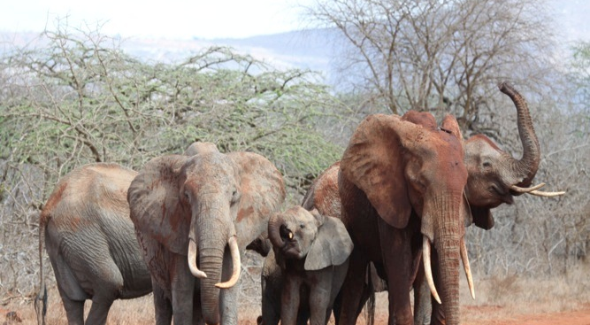
Thank you for your attention

