Slide 1

Information session
Support to National REDD+ Action:
Global Programme Framework 2011-2015 (SNA)
SNA Work Plan and Budget Revision 2015 (additional activities)
13th Policy Board meeting
Arusha, Tanzania
6-7 November 2014

Slide 2

SNA OVERVIEW

Slide 3
SNA - OVERVIEW
SNA RESULTS FRAMEWORK
NATIONAL
REGIONAL
GLOBAL
LEVELS
1. MRV and Monitoring
2. Governance
3. Deferred and integrated to others
4. Stakeholder engagement
5. Safeguards and multiple benefits
6. Green Economy
7. Knowledge and capacity
8. Secretariat
Notes:
This slide is a refresher aimed at giving an overview of the SNA Outcomes and highlight the five technical outputs.

Slide 4
SNA - OVERVIEW
SNA
Categories of support
International support functions
Country specific support
Targeted support &
Backstopping
Secretariat
CNA (1st round) launched
Launched REDD+ Academy
More focused support towards the implementation of the Warsaw Framework and other UNFCCC decisions.
Knowledge Management and Communications team started working at full capacity.
Complements National Programmes
Fills gaps
Provides more tailored and fast track support.
Increased demand for targeted support
(38% approved within 6 month period;
in total, US$ 12.6 m to 35 countries + 1 region)
1st regional targeted support approved to Pacific Islands
Support to the Policy Board and Partner Countries.
Post-2015 strategy was drafted and is being consulted with stakeholders.
Workspace upgrade is nearing completion - developing online tracking, monitoring and reporting tool.
SNA Monitoring Framework revised, reflecting budget and work plan until 2015.
Notes:
This slides explains that the 7 Outcomes are deliverd through these 3 mechanisms. Each menchanism includes regular tasks and some highlights of 2014.

Slide 5
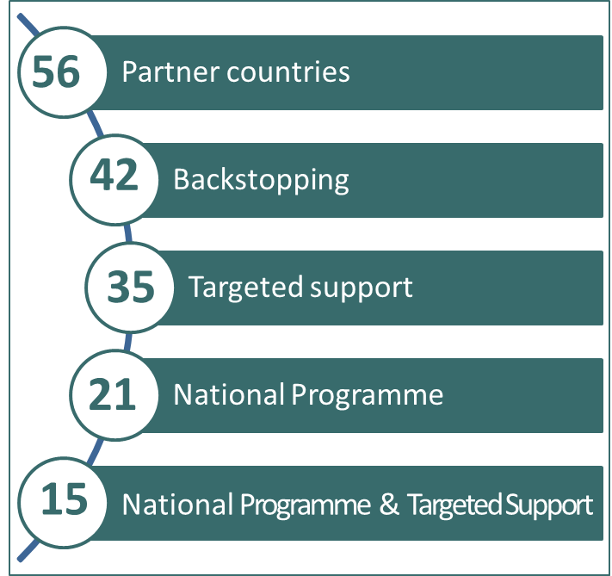
SNA - OVERVIEW
SNA and NATIONAL PROGRAMMES
SNA and National Programme modalities are mutually complementary:
Targeted Support and Backstopping help to fill the necessary gaps during development, inception, implementation and closing stages of National Programmes.
Backstopping is provided to all countries with National Programmes.
Targeted Support to 66% of the National Programme countries.
Countries without National Programmes can access Targeted Support and Backstopping for specific readiness areas.
Notes:
This slide aims to:
Explain that targeted support is not an isolated stand alone support.
That it is complementary to the other mechanisms of support of the UN-REDD Programme
The additional funding will complement and strengthen support provided through other mechanisms.

Slide 6
SNA - OVERVIEW
SNA Financial Delivery per Outcome as of 30 June 2014

Slide 7
TARGETED SUPPORT TREND
SNA - OVERVIEW
Targeted support approved amount
Number of countries supported
(incl. countries with top up amounts)
US$ 9 m
20 countries
1 region
US$ 1.1 m
13 countries
US$ 2.7 m
21 countries
US$ 12.6 m
35 countries
1 region
TOTAL
2014
(Jan – Nov)
2013
2012
Demand for targeted support is increasing
Requests are becoming more comprehensive and packaged
Moving towards increased South-South cooperation on readiness (e.g 1st regional targeted support of US$ 1.4 m to Pacific Islands)
Notes:
From this slide we start providing background to the proposed budget revision and explain why the additional funding will be deployed as targeted support.
Demonstrates that demand for targeted support is increasing by presenting (i) number of countries supported, and (ii) amount approved within the 1st half of 2014 vis-à-vis 2013 and since targeted support mechanism was introduced.
This increase is attributed to many factors among which:
Increasing number of Partner Countries
Clear procedure and more information on TS
Warsaw Framework

Slide 8
TARGETED SUPPORT TREND – support by work area / SNA outcome
Top three work areas (targeted support requested):
National REDD+ Strategy/Governance
MRV & Monitoring
Safeguards & multiple benefits
Demand reflects the four elements of the Warsaw Framework
Notes:
By highlighting the top 3 work areas on which targeted support are requested, it:
- Provides evidence that demand is in synk with the Warsaw Framework and with the direction where the Programme is going.

Slide 9
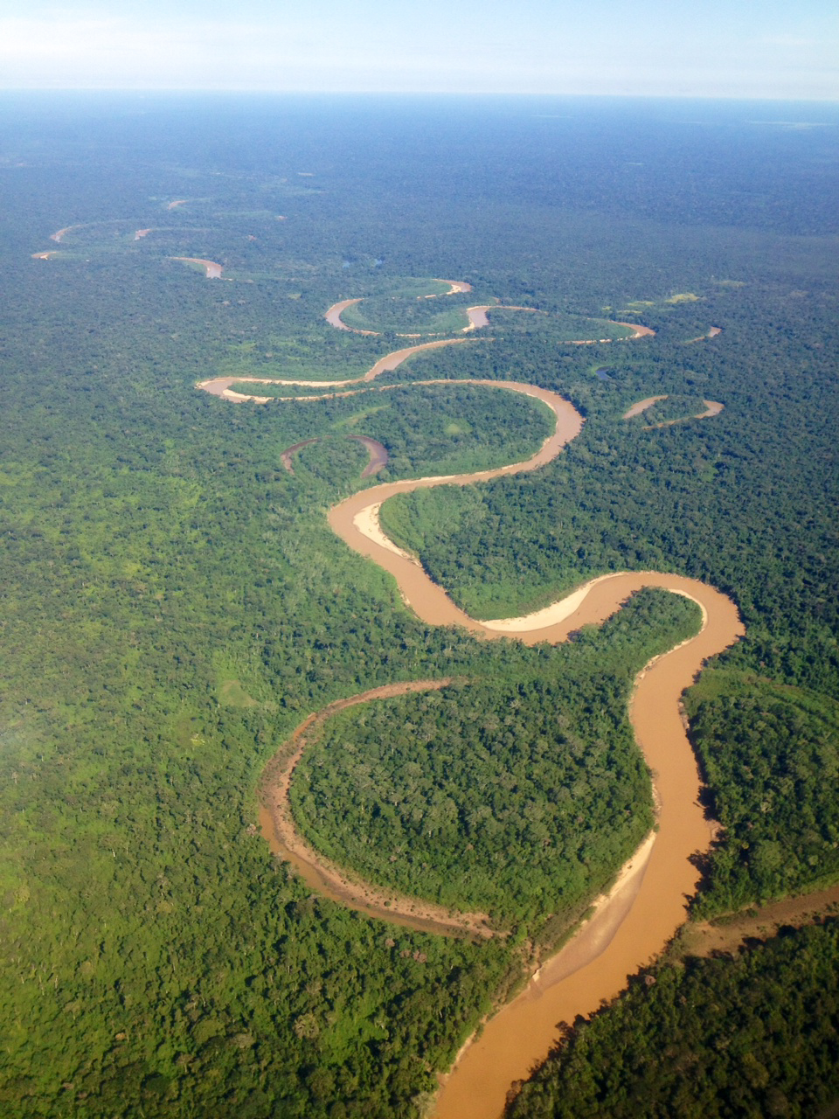
SNA 2015 Budget Revision

Slide 10
    PROCESS
SNA 2015
Budget Revision
    Policy Board invited to provide guidance on priorities to consider.
    (July 17 – 30 August)
    Guidance from the Policy Board sent to the Secretariat 80 working days prior to the Policy Board meeting. (no comments received)
    Draft SNA Work Plan and Budget circulated to the Policy Board 35 working days before the meeting. (17 September)
    The Secretariat organized an Information Session prior to the meeting for consideration of budget proposal by the Policy Board.
Notes:
Roadmap for addressing longer term issues:

Slide 11
SEQUENCE
OF REVISIONS
SNA 2015
Budget Revision
Start SNA: US$ 19,995,981 14 October 2011
Revision 1: US$ 1,440,565 Inter-sessional decision, 25 June 2012
Revision 2: US$ 47,578,767 PB9, 26-27 October 2012
Revision 3: US$ 4,380,000 PB10, 26-27 June 2013
Revision 4: US$ 24,725,978 PB11, 9-10 December 2013
Revision 5 for 2015: US$ 24,432,943 PB12, 8-9 July 2014
Requested revision for additional activities for 2015: US$ 6,955,000
2015 total budget:
US$ 31.4 m
Total revised budget: US$ 129,509,234
Notes:
This slide aims to:
give the overall picture of SNA budget history by presenting all previously approved revisions.
Introduce the proposed revision for 2015 in the context of the historical record and the preivous approved 2015 budget revision.
This will allow the audience to get a full picture of the SNA budget up to date.

Slide 12
SNA 2015
Budget Revision
OBJECTIVE
Approved budget for 2015: US$ 24,432,943 (PB12, July 2014)
planned in a conservative manner to maintain the on-going delivery of the SNA
external UN-REDD Programme Evaluation was not completed
unclear how the Warsaw Framework would influence country demands
Requested Revision for 2015: US$ 6,955,000
to respond to increasing demand for targeted support from countries
to meet UNFCCC requirements towards the Warsaw Framework and results-based phase
is proposed to be deployed as targeted support in the following work areas based on country requests:
National REDD+ Strategies
National Forest Monitoring Systems (NFMS)
Reference Levels (FREL/FRL)
Tenure
Safeguards and Safeguard Information Systems (SIS)
Drivers of deforestation
Contingent upon new funding commitments being made to the UN-REDD Programme Fund.
Notes:
This slide presents the rational behind 2 rounds of budget revisions for 2015:
1st round was planned conservative manner to maintain status quo and quality of support
2nd round responds to the need and changing circumstance (Warsaw Framework and countries focus on Warsaw Framework)
The requested budget revision will be deployed as targeted support to specific work areas that is in sink with the Warsaw Framework elements.

Slide 13
SNA 2015
Budget Revision
CONTEXT
The Warsaw Framework provides guidance to REDD+ implementation and results
Proposed Targeted Support across the SNA areas are based on:
Growing needs and demands from countries
Increasing number of countries engaging in REDD+
Based on lessons learned.
Targeted support requests are becoming more and more systematically linked to National Programmes or other national REDD+ efforts.
Countries have a better understanding and use of the Targeted Support mechanism
Recommendations of the External Evaluation of the Programme
Notes:
This slide explains further the main reasons for:
Deploying the additional fund as targeted support.
Proposing the particular set of work areas mentioned in the preivous slide (the next slide presents the work areas in detail)

Slide 14
Proposed budget increase per SNA Outcome and Output
SNA 2015
Budget Revision
Outcome 1: MRV and monitoring 3,210,000
Output 1.2: Technical support to country-level implementation and capacity development | 1,070,000
Output 1.3: Support to preparation of forest reference emission levels and forest reference levels | 2,140,000
Outcome 2: Governance and National REDD+ Strategy 1,391,000
Output 2.1: Nationally owned credible and inclusive systems of analysing, assessing and addressing governance challenges and collecting and sharing governance data | 107,000
Output 2.2 bis: Strengthened country-specific national REDD+ strategies and action plans | 535,000
Output 2.4: National capacity for performance based payments and inclusive benefit distribution systems (BDS) | 107,000
Output 2.7: Provide technical support to strengthen institutional capacity for tenure(with a view to also address drivers of deforestation and forest degradation) | 535,000
Output 2.8: Women’s participation in national REDD+ systems | 107,000
Outcome 4: Stakeholder Engagement 428,000
Output 4.3: Support for the implementation of effective stakeholder engagement practices and guidelines in REDD+ countries | 321,000
Output 4.4: Stakeholders are supported to engage in and influence national and international REDD+ processes | 107,000
Outcome 5: Safeguards and multiple benefits of REDD+ 1,070,000
Output 5.1: Tools, guidance and support to countries available to capture multiple benefits | 267,500
Output 5.2: Support to countries to address and respect safeguards | 535,000
Output 5.3: Support countries to provide information on how safeguards are addressed and respected | 267,500
Outcome 6: Green economy transformation and REDD+ strategies and investments are mutually reinforcing 856,000
Output 6.2: Technical advice in support of investment options and strategies for REDD+ | 267,500
Output 6.3: Technical advice and support for addressing drivers of deforestation and forest degradation in the context of a green economy | 588,500
Notes:
Specific Outcomes and Outputs under the SNA Framework for which the additional funding will be deployed as targeted support.
This illustrates detailed workplan for the additional funding.

Slide 15
Proposed budget
per SNA Outcome
SNA 2015
Budget Revision
Outcome | Total budget allocation for 2015 (approved at PB12, July 2014) (US$) | Proposed increase in budget (US$) | Total budget 2015 (US$)
Outcome 1: MRV and monitoring | 5,740,245 | 3,210,000 | 8,950,245
Outcome 2: Governance and National REDD+ Strategy | 5,848,859 | 1,391,000 | 7,239,859
Outcome 4: Stakeholder Engagement | 3,039,211 | 428,000 | 3,467,211
Outcome 5: Safeguards and multiple benefits of REDD+ | 3,763,830 | 1,070,000 | 4,833,830
Outcome 6: Green economy | 1,376,235 | 856,000 | 2,232,235
Outcome 7: Knowledge Management | 1,140,685 | - | 1,140,685
Outcome 8: Secretariat | 3,523,878 | - | 3,523,878
Total (US$) | 24,432,943 | 6,955,000 | 31,387,943
Notes:
Allocation for 2015 budget for the SNA:
Work areas covered under the 1st revision.
Work areas TO BE covered under the proposed 2nd revision.
This slide allows to see the 2015 SNA Budget in a consolidated manner while comparing the 2 revisions.

Slide 16
SNA CATEGORIES OF SUPPORT
Allocation of total budget 2015 (US$ 31.4 million)
SNA 2015
Budget Revision
Notes:
The proposed budget shift the allocation of budget with more allocation (in percentage) to coutnry specific support. Previously the allocations were:
2015 (with PB12 revision)
ISF 28%
Country specific support 48%
Secretariat 25%
2014
ISF 22%
CSS 64%
Secretariat 14%
2013
ISF 18%
CSS 39%
Secretariat 33%

Slide 17
SNA Monitoring Framework
SNA 2015
Budget Revision
The SNA Monitoring Framework updated to reflect period until 31 December 2015 based on SNA Work Plan and Budget revisions by time (PB11, PB12, PB13):
more ambitious support and delivery
targets updated
new developments reflected
new outputs added:
Output 1.3: National preparation of Forest Reference Emission Levels and Forest Emission Levels (FREL/FRL)
Output 2.2: Strengthened country-specific national REDD+ strategies and action plans
Output 7.3: Design, develop and deliver a REDD+ Academy with associated resources and tools for REDD+ capacity development
Output 8.7: Country Needs Assessment - Secretariat effectively provides for country leadership towards more integrated and better coordinated programmes and readiness activities

Slide 18
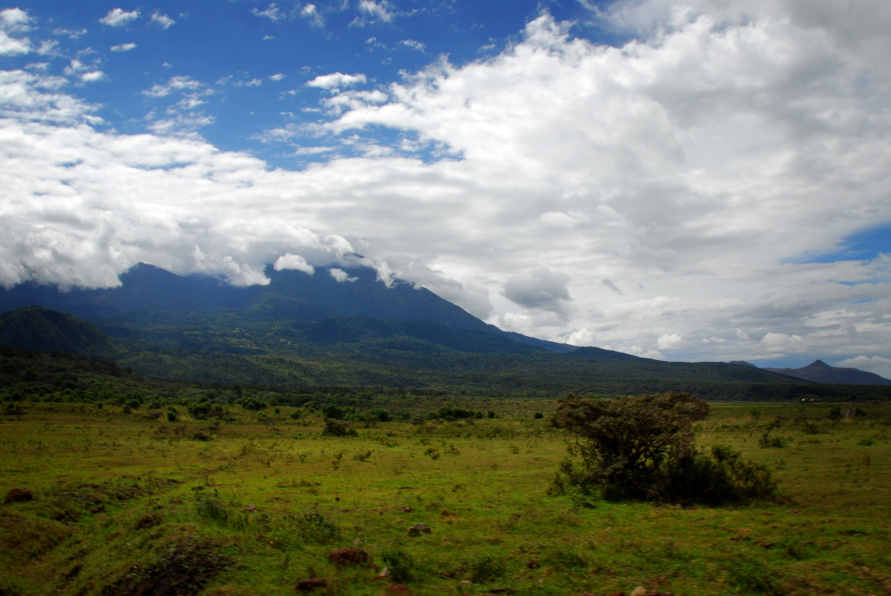
Thais Linhares-Juvenal
Thais.Juvenal@un-redd.org
http://www.un-redd.org
ASANTE SANA

