Slide 1
Tenure and REDD+:
Update and Key Messages
Information and Knowledge Sharing Sessions
13th Policy Board meeting
Arusha, Tanzania
5 November 2014
Notes:
Thank you very much for the opportunity to speak to you today about the UN-REDD Programme activities on tenure and REDD+.
It is a great honor for me.

Slide 2
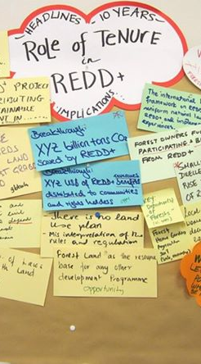
Review
Cancun Agreements
UN-REDD actions:
  Programme Strategy (Output 2.7)
  CNA
  Policy brief and assessment
  Expert meeting
  External Evaluation
  Resources
  New staff
Notes:
First, as background, I would like to review some of the milestones over the past few years.
Probably the most significant is the decision at the COP in Cancun in 2010 requesting developing country Parties…to address land tenure issues while ensuring the full and effective participation of relevant stakeholders.
UN-REDD has responded to this decision through a number of subsequent actions, including:
Including an output on tenure in the UN-REDD Programme Strategy 2011 – 2015
Assessing tenure needs of partner countries in its Country Needs Assessment in October 2012
Producing a Policy brief and an assessment on tenure issues
Organizing an Expert meeting in February 2013
Reviewing progress on tenure in the External Evaluation of the UN-REDD Programme (June 2014)
Allocating resources for targeted support and technical backstopping
Hiring new staff hired (myself) since June

Slide 3
Key Points
Clear and secure tenure:
  Is a key element for SFM and control of drivers
  provides a sense of ownership and motivation to manage forests sustainably
Recognizing customary tenure rights of communities and IPs is important for effective and equitable implementation of REDD+.
Notes:
There are a few key reasons why we believe tenure is so important to REDD+
First, clear and secure tenure:
-Is a key element for effective sustainable management of forests and for controlling the drivers of deforestation and degradation.
-It provides a sense of ownership and motivation to invest in maintaining and/or enhancing forest resources.
Recognizing and protecting the customary tenure rights of local communities and indigenous peoples is important for the effective and equitable implementation of REDD+.

Slide 4
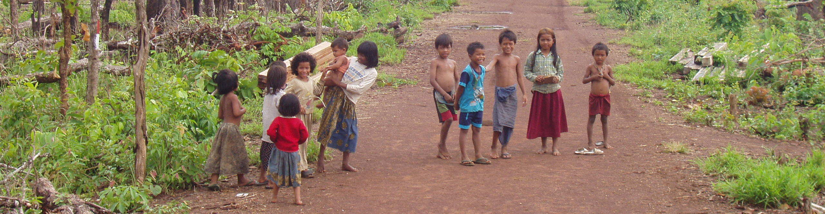
Key Points
Tenure clarity increases the legitimacy of the role and responsibility of communities in sustainable management of forests.
Easier for governments to engage and reward communities for work on the ground.
Regardless of how REDD+ evolves, investment in tenure is beneficial.
Notes:
In addition, tenure clarity increases the legitimacy of the role and responsibility of communities in sustainably managing forests
It also makes it easier for governments to engage and reward these communities for work on the ground.
It’s also important to remember that regardless of how REDD+ evolves, investment in securing tenure is widely recognized to be beneficial to communities and forests. Basically this is a win-win opportunity.

Slide 5
Opportunity of REDD+
REDD+:
encourages dialogue to develop and implement tenure strategies.
brings additional resources and attention to tenure issues
stimulates the process of tenure recognition
Notes:
We also see that REDD+ provides a new opportunity to address tenure:
It encourages dialogue to develop and implement strategies related to tenure.
It brings additional resources and attention to tenure issues
It stimulates and speeds up the process of tenure recognition - and this effect itself may be seen as a benefit of REDD

Slide 6
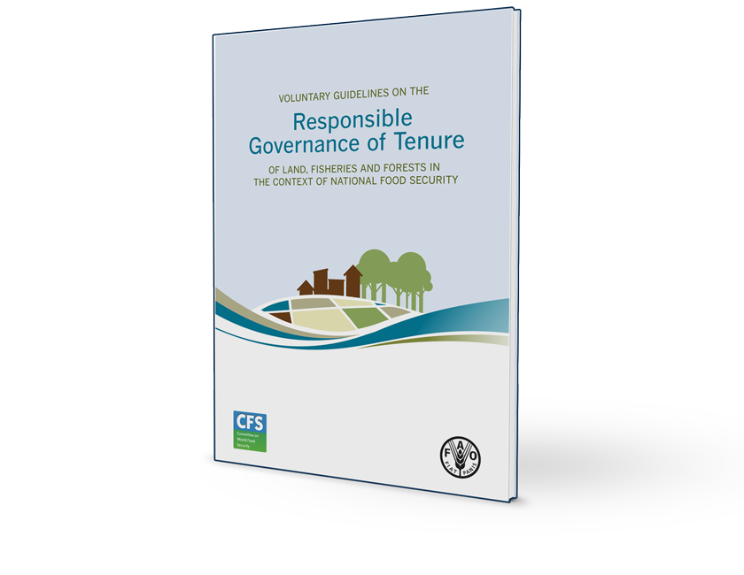
VGGT
The Voluntary Guidelines on the Responsible Governance of Tenure (VGGT) provide useful principles in process.
Notes:
Many of your are probably already familiar with the VGGT. (show of hands?)
The Voluntary Guidelines on the Responsible Governance of Tenure (VGGT) provide useful principles to guide this process.
The Voluntary Guidelines on the Responsible Governance of Tenure of Land, Fisheries and Forests in the Context of National Food Security promote secure tenure rights and equitable access to land, fisheries and forests.
Officially endorsed by the Committee on World Food Security in May 2012 with more than 130 countries participating.
Since then implementation has been encouraged by G20, Rio+ 20, United Nations General Assembly.
We have copies available!

Slide 7
Principles of VGGT
Human dignity
Non-discrimination
Equity and justice Gender equality
Holistic & sustainable approach
Transparency
Consultation & participation Accountability
Rule of law
Continuous improvement
Notes:
The VGGT promote a number of principles which countries voluntarily commit to follow. These are quite general and include:
Human dignity Non-discrimination Equity and Justice Gender equality Holistic and sustainable approach
Consultation and participation Rule of law Transparency Accountability Continuous improvement
There are also some important general Principles which can provide a useful framework for assessing and measuring progress. These include:
Recognizing and respecting all legitimate tenure right holders and their rights.
Safeguarding legitimate tenure rights against threats and infringements.
3. Promoting and facilitating the enjoyment of legitimate tenure rights (protect from forced eviction, etc.) 4. Providing access to justice to deal with infringements of legitimate tenure rights.
5. Preventing tenure disputes, violent conflicts and corruption.

Slide 8
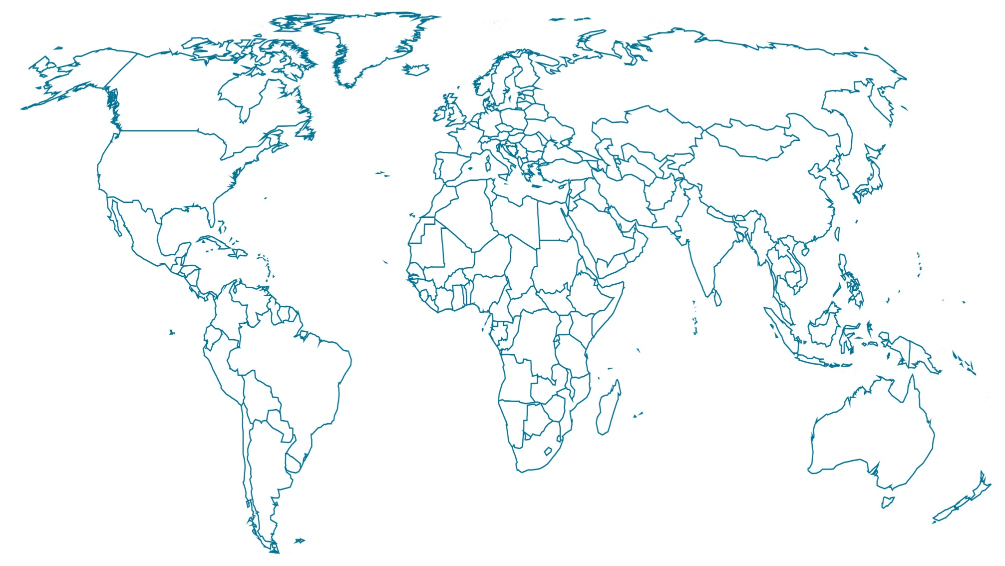
Growing Interest
Partner countries with expressed interest (13)
Notes:
More UN-REDD partner countries are expressing interest in addressing tenure issues in the context of REDD. These are highlighted with the REDD stars and include:
In Latin America…
Honduras
Guatemala
In Africa…
3. Tunisia
4. Malawi
5. Madagascar
6. Uganda
7. Kenya
8. Benin
In Asia…
9. Sri Lanka
10. Indonesia
11. Cambodia
12. Philippines
13. Pakistan
We will hear more during the panel from Malawi, Pakistan, and CS in Latin America!

Slide 9
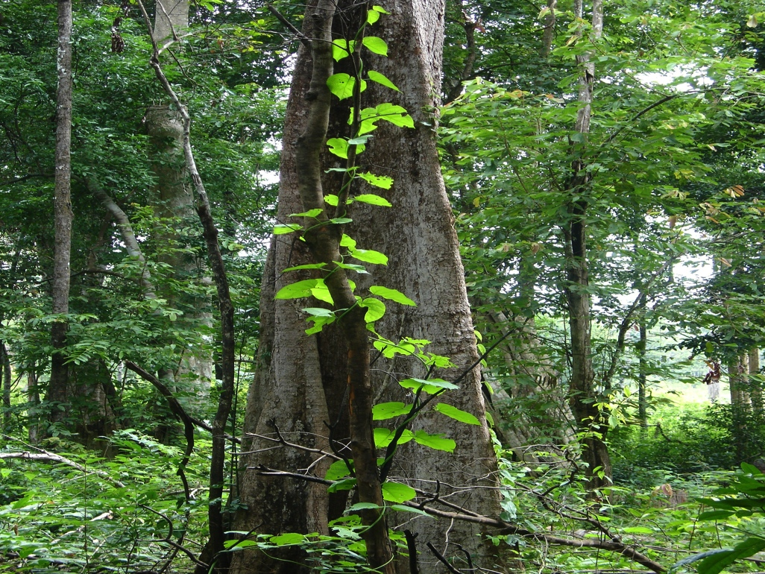
Getting Started
Step 1: Assessment of tenure regime
Review of policies laws and regulations (PLRs)
Implementation PLRs
Links to drivers
Institutional capacities
Stakeholder participation
Gender
Recommendations
Notes:
There is no blueprint for countries to address tenure. However, most countries that have not already thought deeply about these issues are advised to start with an assessment of their tenure regime in the context of REDD+. The VGGT provide a useful framework for this assessment.
The assessment could include the following elements:
A review of policies laws and regulations (PLRs) related to tenure (including not just forestry but land and other sectors
A look at Implementation of these PLRs to see what is actually happening on the ground
An analysis on the links between tenure and the drivers of deforestation and degradation
An assessment of the Institutional capacities to address tenure issues
Multi-stakeholder participation – an inclusive process involving communities and IPs
Gender dimensions
Recommendations

Slide 10
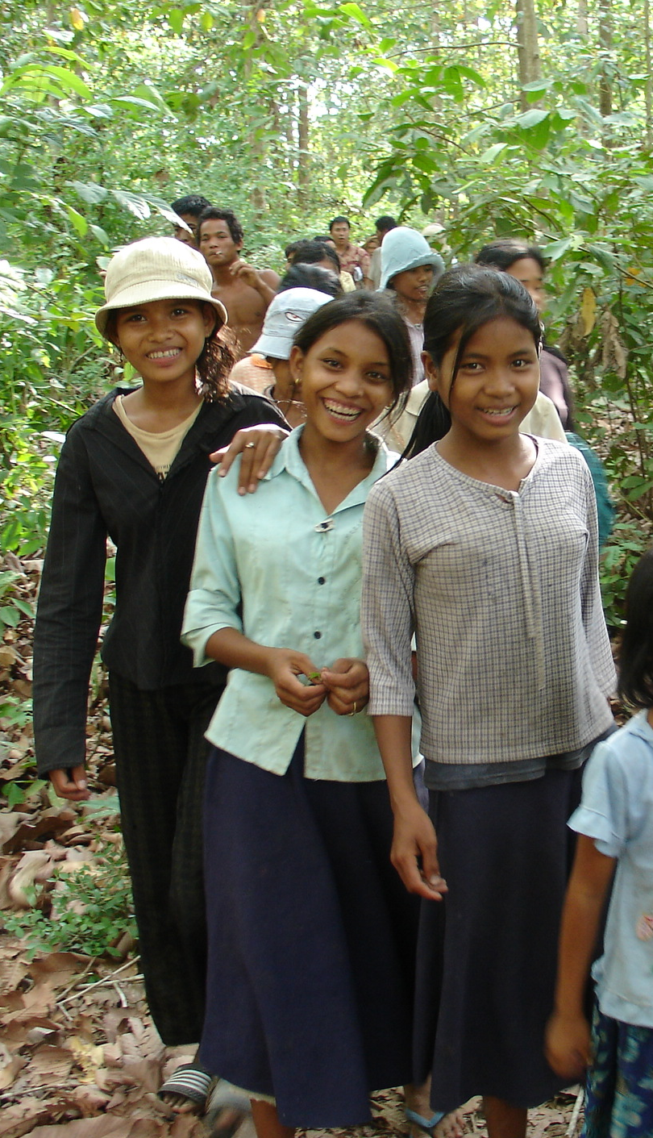
Step 2: Develop Workplan
Consider short and long-term actions
Consider integration with other land reform
Step 3: Start Implementing
Notes:
Following an assessment, most countries would typically develop a workplan.
This would consider both short and long term actions
And it would consider integration with other land reform efforts.
After that’s all that’s left is implementation.

Slide 11
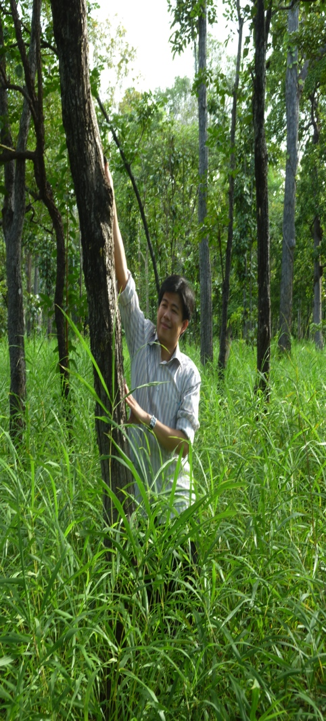
UN-REDD Outlook
Support countries in their efforts to address tenure and REDD+
Provide a forum for exchange
Document and share experience
Notes:
The UN-REDD Programme is committed to assist its partner countries in their efforts to address tenure and REDD+
We will provide a forum for exchange of information and lessons learned.
And we will also document and share experience among countries that are active on these issues.

Slide 12
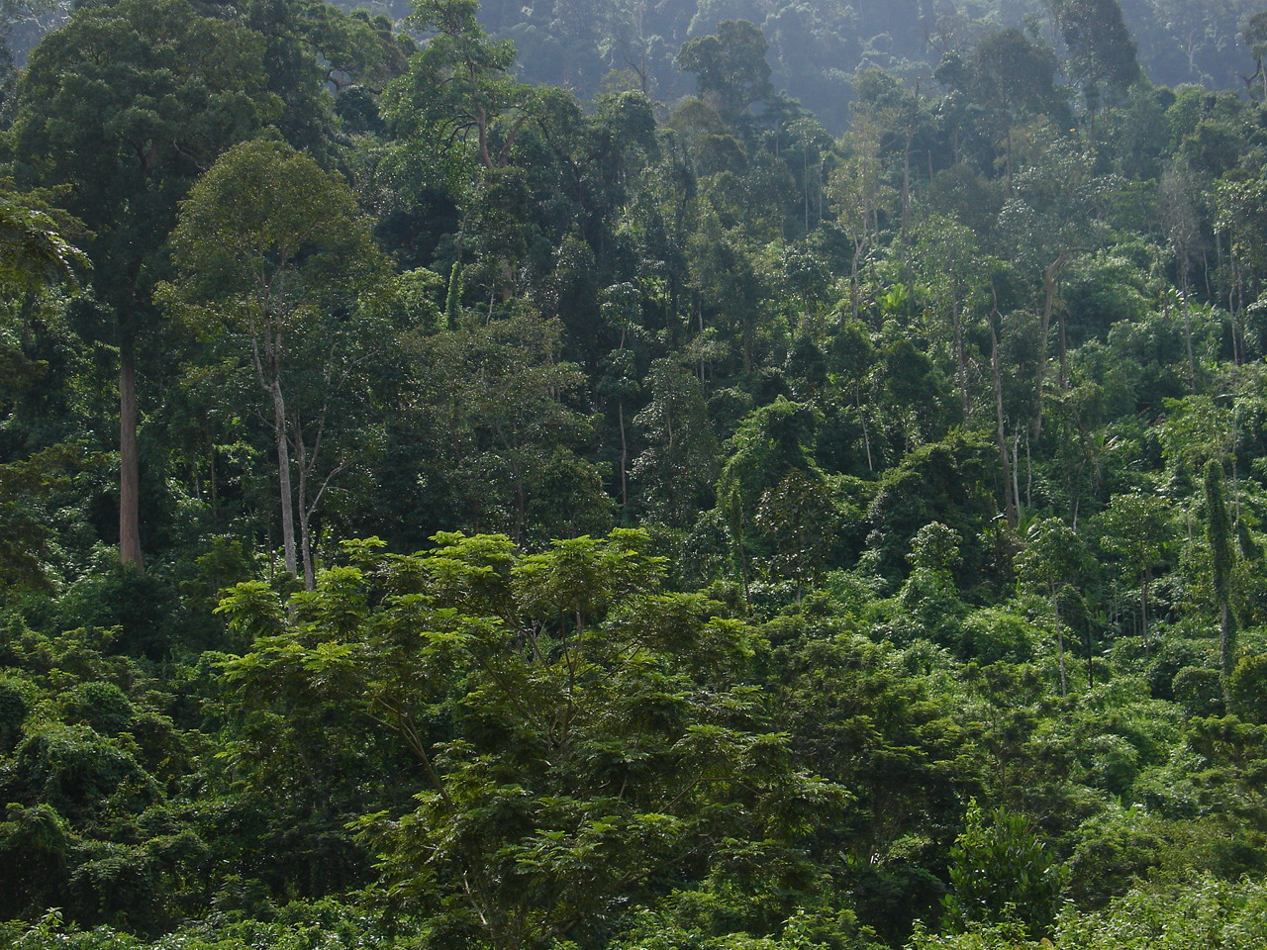
Amanda Bradley
amanda.bradley@fao.org
Thank You
Website: www.un-redd.org
Photo credits: A.Bradley in Cambodia
Notes:
Thank you very much for your attention. I’d be happy to answer any quick questions now or to speak to you after the session.

Slide 13
Panel Discussion
Why is your country’s REDD+ Programme interested to assess tenure issues in the context of REDD+?
What challenges or obstacles do you foresee in addressing tenure issues?
Notes:
Why is your country’s REDD+ Programme interested to assess tenure issues in the context of REDD+?
What challenges or obstacles do you foresee in addressing tenure issues?

Slide 14
Audience Survey Results

Slide 15
Q1. Which of the following is the biggest challenge related to tenure and REDD+?

Slide 16
Q2. What is the main reason to address tenure in the context of REDD+?

Slide 17
Q3. How important do you think addressing tenure issues is on a scale of 1 to 5?

Slide 18
Q4. When do you think it is appropriate to address tenure issues in a REDD+ process?

