Slide 1
Perspective of IPS/CSO on multi-stakeholder engagement in developing a REDD+ NS/AP
Grace Balawag
Tebtebba (Indigenous Peoples International Centre for
Policy Research and Education
Information and Knowledge Sharing Sessions
13th Policy Board meeting
Arusha, Tanzania
5 November 2014

Slide 2
Engagement of CSOs/IPOs in the Philippine National REDD Plus Strategy (PNRPS)
CSOs/IPOs were at the forefront of the debates and discussions on REDD+ since Bali
CSOs & PHL gov’t got together and agreed on the need to have a framework to develop REDD+ actions in the country. The framework was then to be embodied in a REDD+ strategy.
Committees (TWGs) were organized to work on the components of the PNRPS, which required action planning for readiness & resource mobilization
CSOS led by the NGO network CodeREDD and comprised also of POs /LCs expressed to the PHL gov’t the urgency of developing guideposts to get the country engaged in REDD+
The Philippine National REDD Plus Strategy (PNRPS) was completed and endorsed by the Dept. of Env. & Nat. Res. (DENR) to the Climate Change Commission (Phil. CCC) in 2011

Slide 3
REDD+ Implementation in the Philipines
(REDD+ Unit: FMB-DENR))
Opportunities/Strengths:
National REDD+ Strategy (Philippine National REDD Plus Strategy - PNRSP) approved in 2010
Active participation/involvement of CSOs and IPOs in the development of PNRPS and implementation of REDD+
Presence of land tenure policy – (e.g. Indigenous People’s Rights Act, Policy on Community Based Forest Management Agreement)
Presence of governance/institutional structure such as the Philippine Climate Change Commission, Cabinet Cluster on Climate Change and the REDD+ Unit of the Forest Management
Conducted a number of REDD+ readiness activities already like REDD+ orientation and IEC through REDD+ roadshow and REDD+ 101
Has draft Safeguard Framework and Guidelines, submissions on NCB, and Safeguard Information Systems developed with CSOs/IPOs
Has existing REDD+ demonstration sites

Slide 4
Redd+ Implementation In The Philippines
( with FMB-DENR)
CHALLENGES:
Different priorities between and among sectors within departments
Issues and conflict on tenure instruments: overlapping within areas
Proposed National Multistakeholder REDD+ Council which will be the policy-making body on REDD still being created
Inadequate and in some cases, lack of policy that are needed for REDD+ such as the policy on carbon rights, benefit sharing, among others
Data availability or limited data to be used in determining FREL/ RL
No concrete MRV system yet
Government sectors to be active in the REDD+ negotiation
Need to develop country-specific implementation on the different UNFCCC decisions on REDD+

Slide 5
Experience on engagement and participation of stakeholders In REDD+
Even without REDD+ mechanisms’ support, CSOs and IPOs actively engaged in developing national REDD+ strategies design, and development of guidelines for Social and Environmental Safeguards, Non Carbon Benefits, and Safeguards Information Systems
CSOs and IPOs initiated public awareness and orientation workshops on CC/REDD+ among various stakeholders at national and subnational levels
On PNRSP to be transparent and participative, have engaged stakeholders including IPs/local communities, on the role of safeguards, FPIC or grievance mechanisms in implementation frameworks etc.
IPOs actively mapping territories and resource Inventories, with community-based monitoring and information systems, to be linked with national monitoring and information systems

Slide 6
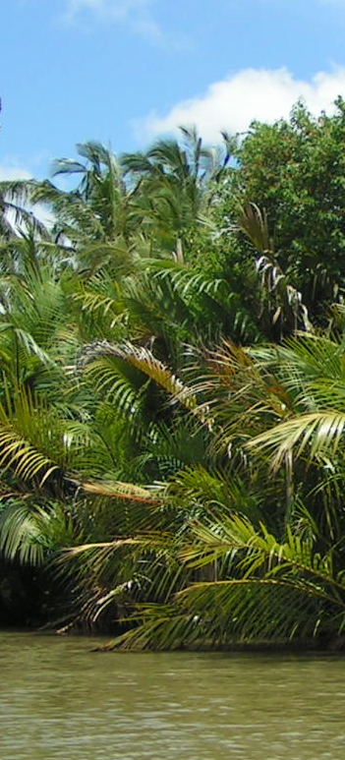
Priorities and Concerns of IPOs/CSOs
Access to information and appropriate capacity building to ensure full and effective participation of IPs/LCs and other stakeholders.
Translation and implementation of Warsaw Framework with agreed guidelines developed under various REDD+ mechanisms on the national level
How REDD+ programmes ensure that internationally agreed decisions, guidelines, safeguards, among other concerns will be implemented at national/subnational levels
Allocation of capacity building funds and engagement of stakeholders especially at subnational/community demo areas for REDD+
Recognition of customary land tenure rights and resolving conflicts on land tenure

Slide 7
Lessons Learned/Recommendations
Building partnerships among governments/INGOs with IPs/CSOs are crucial with transparent and inclusive multi-stakeholders and multi-level participatory processes
Capacity building is necessary in REDD+ national strategy and will only be effective with clear access to information and good governance measures, with the full and effective participation of indigenous peoples and forest-dependent communities
Early partnerships with government and NGOs can address negative and discriminating policies and mechanisms relating to the effective participation in the management of forest areas
REDD+ strategy and implementation should uphold the rights-based approach to development, including land tenure rights and forest management by IPs/LCs

Slide 8
Lessons Learned/Recommendations
Governments must uphold the right to FPIC of IPs for any development or REDD+ related activities in IP lands and territories including in benefit sharing schemes or arrangements.
Promote convergence and harmonization of relevant government agencies working on REDD+, climate change, and those that have jurisdiction over forests, natural resources and indigenous peoples.
National REDD+ programme should include allocation of funds to support community forestry management including participatory mapping and resource inventory, enhancement of livelihoods, forest patrolling, monitoring activities and reforestation in degraded areas and others
REDD+ strategy and program should be integrated within national/subnational sustainable development plans and poverty alleviation

Slide 9
Thank You
Website: http://www.un-redd.org

