Slide 1
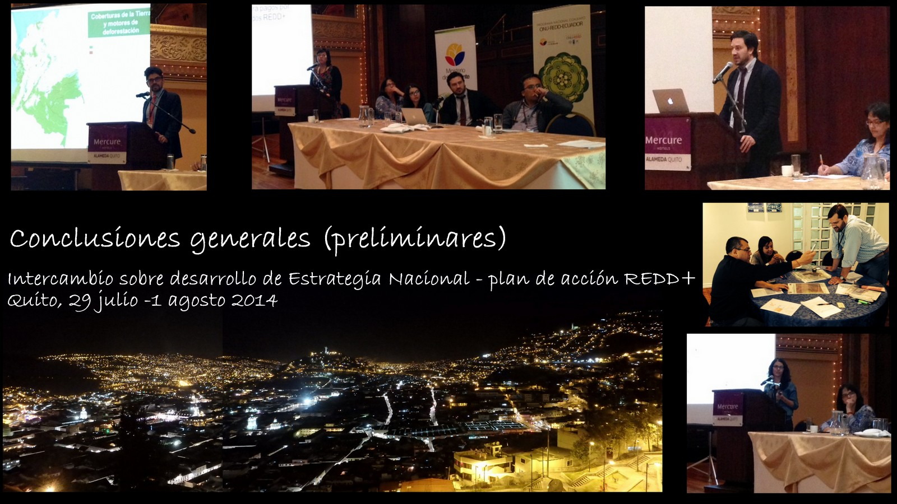
REDD+ National Strategies / Action Plans Development
General Conclusions
Quito, July 29th. – August 1st., 2014

Slide 2
South-South knowledge exchange
Developing National REDD+ Strategies
Regional event in Quito, Ecuador July 29th to and August 1st
Hosted by the Minister of Environment of Ecuador
Participation of 77 participants (34 women), from 12 of the 14 partner countries in the region + Brazil + technical experts + UN agencies
Focused on exchanging lessons among country experiences on developing National REDD+ strategies and action plan, through presentation, discussion panels and working groups
Notes:
Brazil is not a partner country of the UN-REDD Programme but participated as an special invittee

Slide 3
National Strategies/Action plans and linkage with policies
The benefits related to REDD+ go beyond “possible payments” and they begin to be acquired from the preparation phase
  Mexico (Inter-sectorial coordination→ efficient public policies)
  Ecuador (realization of national policies)
The REDD+ national strategies as a process/mean to reach national as well as international objectives
  Mexico (rural sustainable development), Brazil (Consolidate/improve deforestation policies), Costa Rica (carbon neutral)
REDD+ as a platform for inter-sectorial coordination however not all barriers can be overcome
  Brazil y Mexico (through political support at the highest levels)
Notes:
Sesión 2: Los elementos centrales de un PA o ENREDD
Sesión 3: Abriendo paso para REDD+ en las agendas nacionales
Sesión 4: Análisis de causas de la deforestación y degradación de bosques e identificación de opciones estratégicas para combatirlas

Slide 4
Legal and Institutional Frameworks
There is a need of an institutional arrangement with a mandate and budget to go ahead with the REDD+ national agenda.
  México (several supporting committees for legal framework), Costa Rica (Climate Change Committee), Guatemala (a trio of current laws)
According to the Convention the countries now have to identify the focal point/REDD+ national entity
  Once a national focal point is defined – by mandate-it should coordinate and receive information from the technical counterparts.
Several countries are preparing their financial structure to receive financing under the Convention as part of the implementation framework → acquire financing
Notes:
Sesión 2: Los elementos centrales de un PA o ENREDD
Sesión 3: Abriendo paso para REDD+ en las agendas nacionales
Sesión 4: Análisis de causas de la deforestación y degradación de bosques e identificación de opciones estratégicas para combatirlas

Slide 5
Legal and Institutional Frameworks
Need for inter-operational mechanisms: Agreements between national and international framework → harmonization and adaptation of a judicial framework to receive future support from REDD+ through the UNFCCC
In the LAC region there is already a structure of laws and several rules that REDD+ could be built on the legal base already available, adjusting it as necessary.
Clarifying the linkage between carbon rights and land tenure has been identified as a need in some countries but in others it is somewhat doubtful because the results cannot be allocated to specific actors.
Notes:
Sesión 2: Los elementos centrales de un PA o ENREDD
Sesión 3: Abriendo paso para REDD+ en las agendas nacionales
Sesión 4: Análisis de causas de la deforestación y degradación de bosques e identificación de opciones estratégicas para combatirlas

Slide 6
Financing
Financing for REDD+ are payments for performance under the UNFCCC
Due to the uncertainty over financing options, some countries see as an alternative complementary domestic and international sources to reach REDD+ objectives.
However, referring to domestic financing in negotiations could have implications over the commitments/international agreements.
Financing for REDD+ is different from the investment of countries to reach sustainability of the 4 pillars of REDD+
The importance of involving the private sector was acknowledged, taking into account that this sector includes investments in value chains and causes of deforestation to reduce emissions.
There are concerns related to setting an arbitrary price for emission reductions.

Slide 7
Implementation/Approach
Although some countries have made progress with early sub-national actions, it is essential the articulation with the national level
The REDD+ national strategy require a group of processes, technical and political inputs already available
There is a need of an initial investment to implement the strategy → the monitoring and measurement will enable the performance analysis → the reporting to the UNFCCC in order to access benefits from results of REDD+ under the UNFCCC
Considering the inter-sectorial approach of REDD+ → the anchoring of the strategy could not be with the Ministry of Environment/Forest

Slide 8
Technical Inputs
Technical inputs enable informed decision making and contribute to the validity of the national strategy or REDD+ action plan.
Preparation of technical inputs by phases, of more simple structures towards more complete structures based on national capacities and its strengthening.
Central role of the National Forest Monitoring System: to develop RELs, demonstrate the performance of the strategy, avoid inconsistencies with data reported to the UNFCCC and avoid double counting.

Slide 9
Technical Inputs
The concept of registry evolved during the negotiations → “information hub” as international registry → registry of national level as a mirror + instrument for monitoring national actions (accountability of C?)
Key to understand and analyze drivers of deforestation and degradation to design a strategy of adequate and viable intervention, and prioritize intervention areas.
Information systems: tools for future analysis as base for negotiations/powerful instrument to support inter-sectorial dialogue and identification of key areas, REDD+ measures/ NAMAs
  Importance of having and using solid national data, relevant and consistent with a national monitoring system
  Handle with care and communicate appropriately

Slide 10
Technical Inputs
Reference Levels:
Sub-national reference levels can be submitted even though they might not be perfect and ad-interim
Importance of using historical data
Feedback process with the UNFCCC
It is fundamental that the technical capacities are established in the country, since there will be a process of revision and dialogue, very close interactions between the technical team and the UNFCCC
Unique process by country

Slide 11
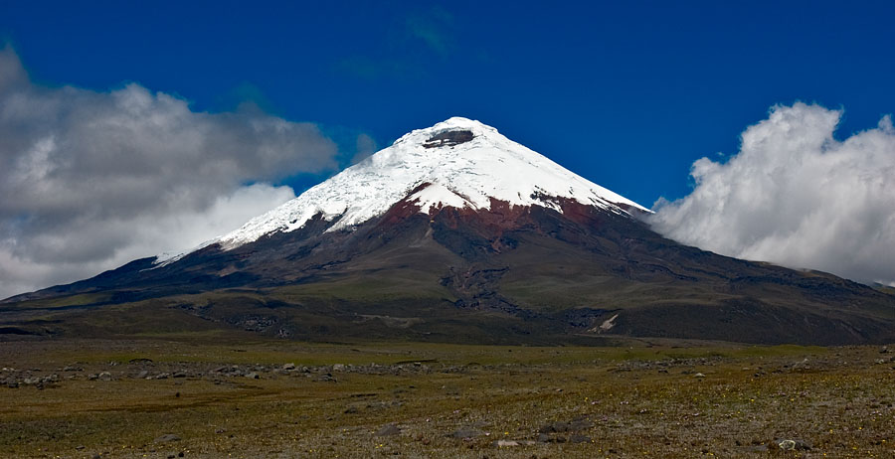
Thanks for YOUR ATTENTION

