Slide 1
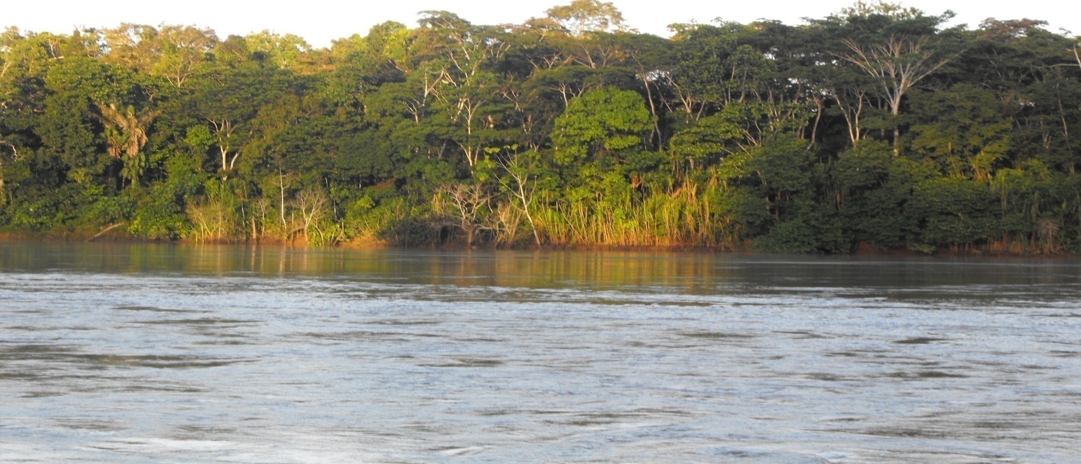
Experiences and lessons learned towards a national REDD+ strategy in Ecuador
13th Policy Board
Arusha, Tanzania
03-07 November, 2014

Slide 2
National approach ‘Ecuador’s vision for REDD+’
The need to clearly define REDD+ policy, legal and institutional framework based on DD
Policy framework
Legal framework
Institutional framework
National strategy for climate change
Climate change mitigation and adaptation as a state policy
Legal provisions for environmental services’s use to be regulated by the Government – main focus on a non market approach
Understate Secretariat for Climate Change
Ministry of Environment as – National REDD+ Authority
Notes:
Ecuador has been working for the past 4 years in Cancún’s elements for REDD+ however our national strategy is one of somethings that has gained special atention only during the last year.
This is due to the need of having technical and also legal, institutional and policy issues figured out.
This last 3, legal, policy and institutional framework and arrangements according to specific drivers of deforestation, are key elements to be considered when defining and developing a national strategy.
In Ecuador’s case, this was very important since we have specific considerations in our legal framework regarding environmental services and its use, which is basic for a REDD+ policy and its finance options

Slide 3
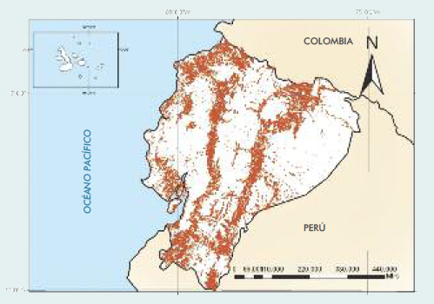
National approach ‘Ecuador’s vision for REDD+’
Strategic sectors for REDD+ performance
Forestry
Key sectors
Livestock and agricukture
Water
Food security
Biodiversity
Aim to effectively integrate a REDD+ policy in other sectors based on drivers of deforestation and social and environmental key areas
‘REDD+ not as a goal but as a vehicle to achieve national development priorities in the land sector’
Sectors | t CO₂ eq
Energy | 26.895.415,82
Agriculture* | 23.270.693,00
Waste | 8.104.730,68
Land Change, Land Use Change and Forestry | 5.415.715,00
Industrial processes | 2.754.590,34
TOTAL | 66.441.144,84
Fuentes: Mapa Histórico de Deforestación, 2012
Segunda Comunicación Nacional, 2012 y Datos revisados al 2014
Notes:
Based on that overall framework, there were other considerations, as analysis criteria, that had to be taken into account, including as a basis for our national strategy:
Identifying drivers of deforestation at local level using spatial tools
Mapping potential REDD+ measures and actions based on these drivers
geographical prioritization for the implementation of REDD+ measures and actions, considering potential limitations of REDD+ finance
Economic analysis for REDD+ costs
With all that information and analysis, national policies key for REDD+ objectives were identified:
Natural Heritage Governance Policy – including incentives policy for forest conservation and SFM (Socio Bosque)
Policy for productive transformation in the Amazon
Biodiversity and Environmental services related policies
Food security related policies
Land tenure related policies
This approach towards a national strategy for REDD+ responds to the ‘aim to effectively integrate a REDD+ policy in other sectors based on drivers of deforestation and social and environmental key areas. Thinking on REDD+ not as a goal but as a vehicle to achieve national development priorities in the land sector’

Slide 4
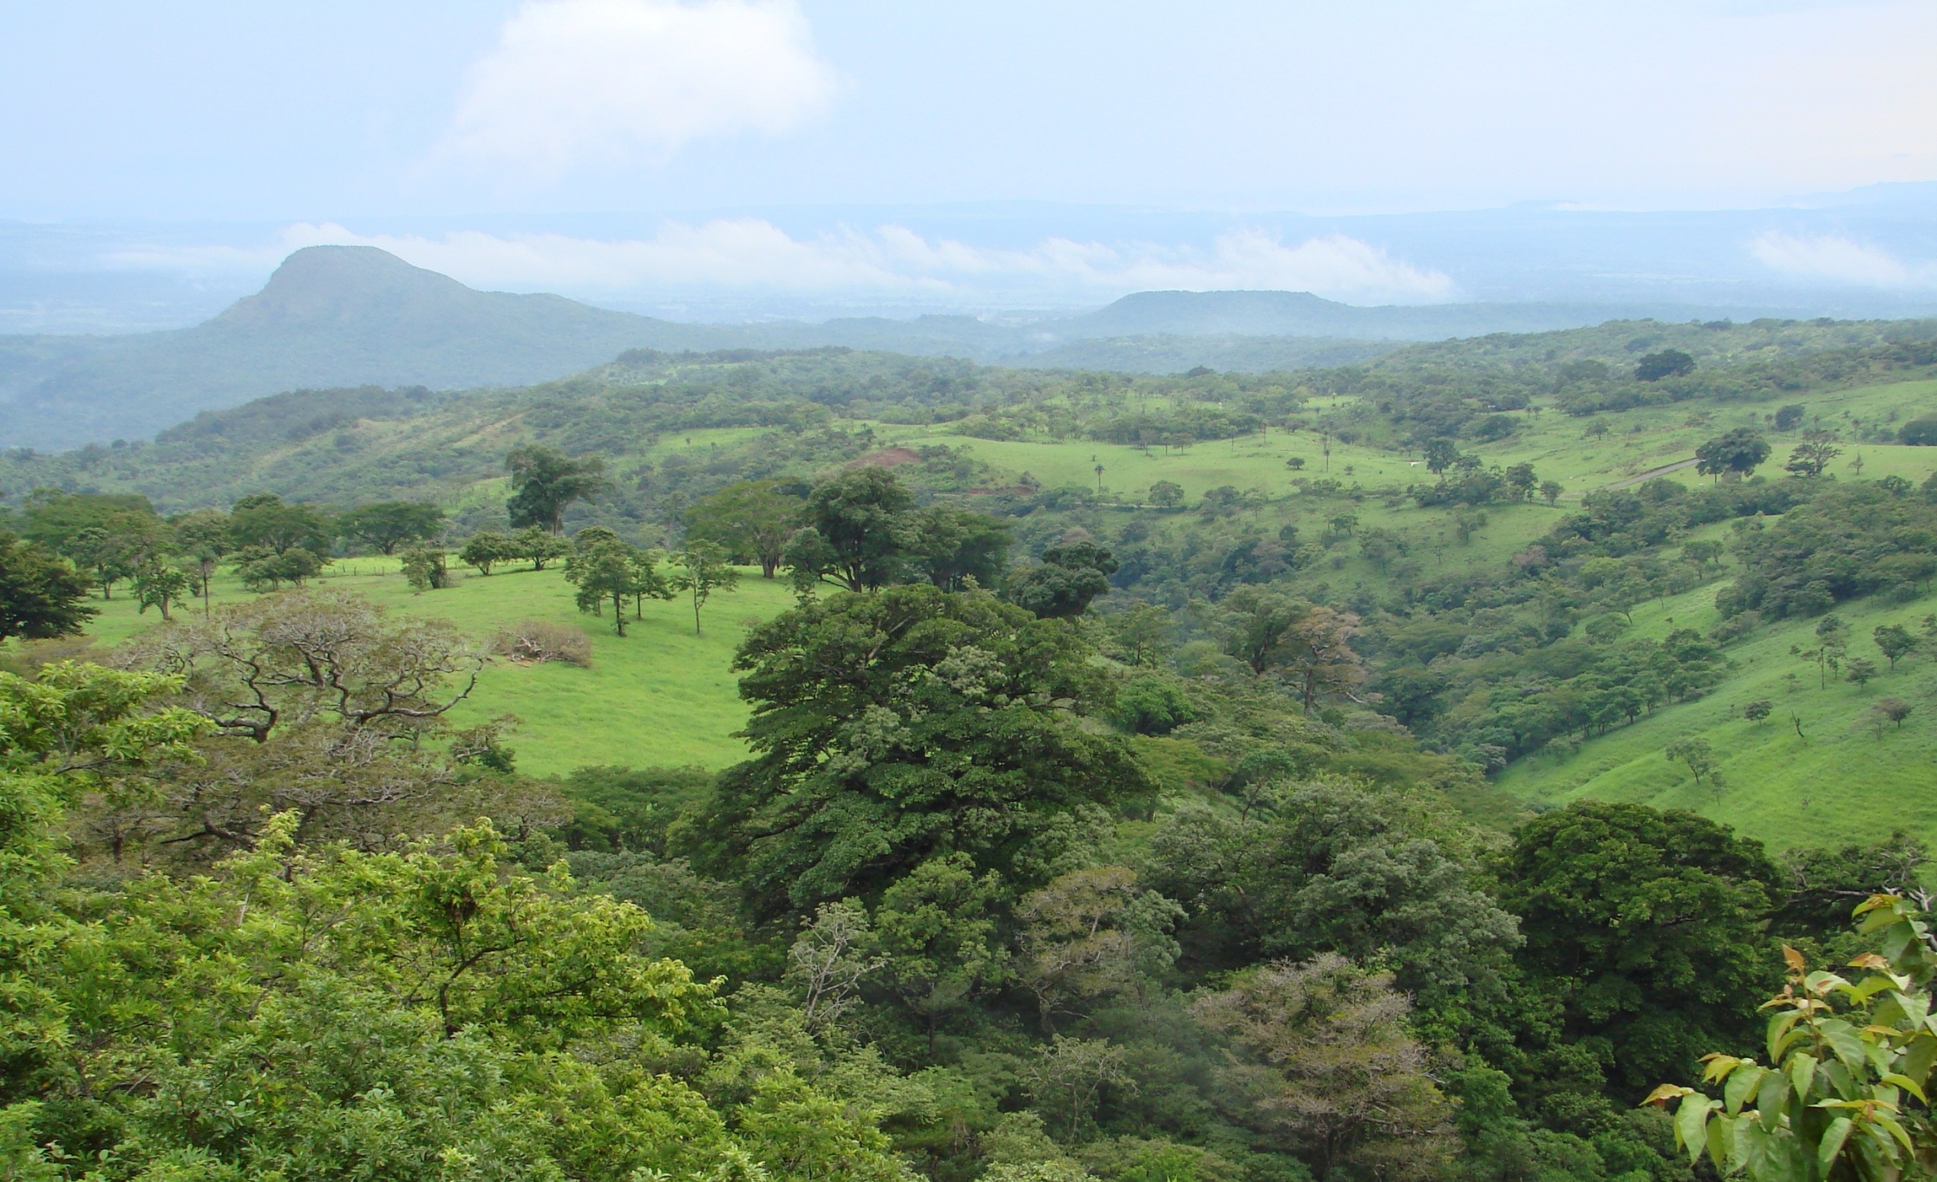
National approach ‘Ecuador’s vision for REDD+’
The need for the definition of an implementation approach towards a national strategy
REDD+ Activities to be fully measured, reported and verified at national level – national monitoring of forest coverage and changes, and emissions from deforestation
Results based finance for national performance – to be channeled using specific finance architecture for REDD+ results finance
Step wise approach for REDD+ implementation for results based activities – ‘Emissions reductions from deforestation’
Notes:
Another key element to be considered before defining a national strategy was to clearly establish the national approach for REDD+ implementation based on national technical and institutional capacities.
With that in mind, we have seen that the most adequate approach in Ecuador includes:
REDD+ Activities to be fully measured, reported and verified at national level – national monitoring of forest coverage and changes, and emissions from deforestation
Results based finance for national performance – to be channeled using specific finance architecture for REDD+ results finance
Step wise approach for REDD+ implementation for results based activities – ‘Emissions reductions from deforestation’

Slide 5
National approach ‘Ecuador’s vision for REDD+’
The need for the definition of an implementation approach towards a national strategy
Measurement, Report and Verification for Emissions Reductions from deforestation, at national level
Strengthening of sectorial policy measures
REDD+ like actions to be implemented on the ground
REDD+ results based finance to be invested in:
Climate Change Mitigation in the land sector with a landscape approach
Notes:
That said, a national MRV of results based activities would enable the country through the Ministry of Environment to access to results based payments for the national performance.
Those results based payments would be re-invested in measures and actions, where measures refer to sectorial policies strenghtening and actions at ground level to be implemented, in order to effectively tackle drivers of deforestation while contributing to sustainable development at local level, where REDD+ would be seen as a climate change mitigation policy in the land sector, with a landscape and multi-level approach

Slide 6
National approach ‘Ecuador’s vision for REDD+’
The definition of a national strategy
National REDD+ Strategy
Drivers of deforestation
Strategic sectors and development policies
Definition of an implementation approach
Economic analysis and identification of potential measures and actions
Legal, policy and institutional framework
Supported by a NFMS, SIS and a REL in the context of results based finance
Notes:
In summary, Ecuador’s national strategy for REDD+ will be developed on the basis of:
Drivers of deforestation
Legal, policy and institutional framework
Economic analysis and identification of potential measures and actions
Strategic sectors and development policies
Definition of an implementation approach
And supported by a National Forest Monitoring System, Safeguards Information System and a Forest Reference Emissions Level in the context of results based finance
EXTRA: lessons learned and challenges
The need for effective articulation of REDD+ as part of sectorial policies, to ensure a balance between REDD+ objectives and sectorial policies’ objetives – long term sustainability of a REDD+ policy
Existing uncertainties regarding actual REDD+ results based finance options – REDD+ is seen as policy that requires high inverstements and costs (ex ante)
The lack of understanding of the official REDD+ context at both national and international levels, among key stakeholders promoted high expectations on REDD+ finance but also rejection from certaian groups
The need to strengthen and build capacities (including but not limited to technical capacities) with key stakeholders and in relevant institutions related to REDD+ implementation as a national policy – key partners

Slide 7
Experiences and lessons learned towards a national REDD+ strategy in Ecuador
Patricia Serrano
pserrano@pnc-onureddecuador.org
María del Carmen García
maria.garcia@ambiente.gob.ec

