Slide 1
Session 1 - National REDD+ Strategies
Overview of REDD+ national strategies and formulation processes
Information and Knowledge Sharing Sessions
13th Policy Board meeting
Arusha, Tanzania
5 November 2014

Slide 2

Quick questionnaire (Oct/Nov 2014)
30 REDD+ countries answered
Very comprehensive picture for Africa (24 out of 26 UN-REDD partner countries in the region)
Quick “flavor” of Asia (6 out of 14 partner countries)
12 countries have received in-country support from UN-REDD
Answers were provided by REDD+ national focal points or coordinators

Slide 3
Overall progress towards REDD+ national strategy
Number of countries per level of progress
7 countries haven’t started yet
5 countries with finalized or completed NS
The average progress is 2,3
The average progress is 3,1 for countries receiving in-country support from UN-REDD

Slide 4
Overall progress towards REDD+ national strategy – regional trends
Number of countries per level of progress
More or less same number of leading countries in Asia and Africa
Larger base of lagging countries in Africa (7/7 at stage 1, 12/15 at stage 2)
The average progress is 2,1 in Africa (progressing) vs. 3 in Asia (well advanced)

Slide 5
Linking national strategies to the UNFCCC information hub
Number of countries per expected date of publication of their REDD+ strategy on the UNFCCC information hub
2 countries are ready to publicize in December 2014
11 countries plan to publicize their REDD+ strategy in 2015
11 countries haven’t determined target
7 countries at stage 1 or 2 of progress expect to publish in 2015

Slide 6
Linking national strategies to the UNFCCC information hub – regional trends
Number of countries per expected date of publication of their REDD+ strategy on the UNFCCC information hub
2 countries ready to publicize in 2014 are in Asia
The 7 “over-ambitious countries” are in Africa
10 out of 11 undetermined countries are in Africa

Slide 7
Advancing towards the UNFCCC Warsaw Framework
Number of countries per expected date of “readiness” on the 4 pillars of the UNFCCC Warsaw Framework
6 countries “well-advanced or beyond” expect to be “WF ready” in 2015 and 2016 (2 in Asia and 4 in Africa)
15 out of 30 countries are undetermined

Slide 8
Anticipated challenges and delays for submission to UNFCCC due to national reasons
14 countries don’t anticipate issues / 16 do.
Expected reasons (verbatim)
  Challenge to link information/pieces together across parallel processes
  Capacity to mobilize international partners for high level dialogue
  Lack of data to finalize technical pillars (RL, BUR…)
  Delay to access and implement readiness finance
  Delay of procurement to recruit international expertise
  Lack of capacity to meet format or content requirements (*3)
  Lack of understanding of the UNFCCC process
  Long consultation and consensus building process
  Institutional issues
  Long revision of legal implications before political endorsement
  Long national decision-making process / official political endorsement procedures (2)
  Risks of discontinuity of key staff involvement throughout the process
  Lack of fund throughout the submission process
  Disturbance due to unplanned national crisis (Ebola outbreak)
Getting the substance
Getting the format
Getting the work approved
Managing transition

Slide 9
Satisfaction towards UN-REDD assistance from countries receiving support
Perceived added value of the UN-REDD programme in improving understanding and strengthening the REDD+ strategy development process
(1 = very low / 5 = very high)
Out of 18 responses:
High level of satisfaction (4,1)
7 countries consider UN-REDD value added “very high” (all in Africa)
Africa (4,3) more satisfied than Asia (3,5)

Slide 10
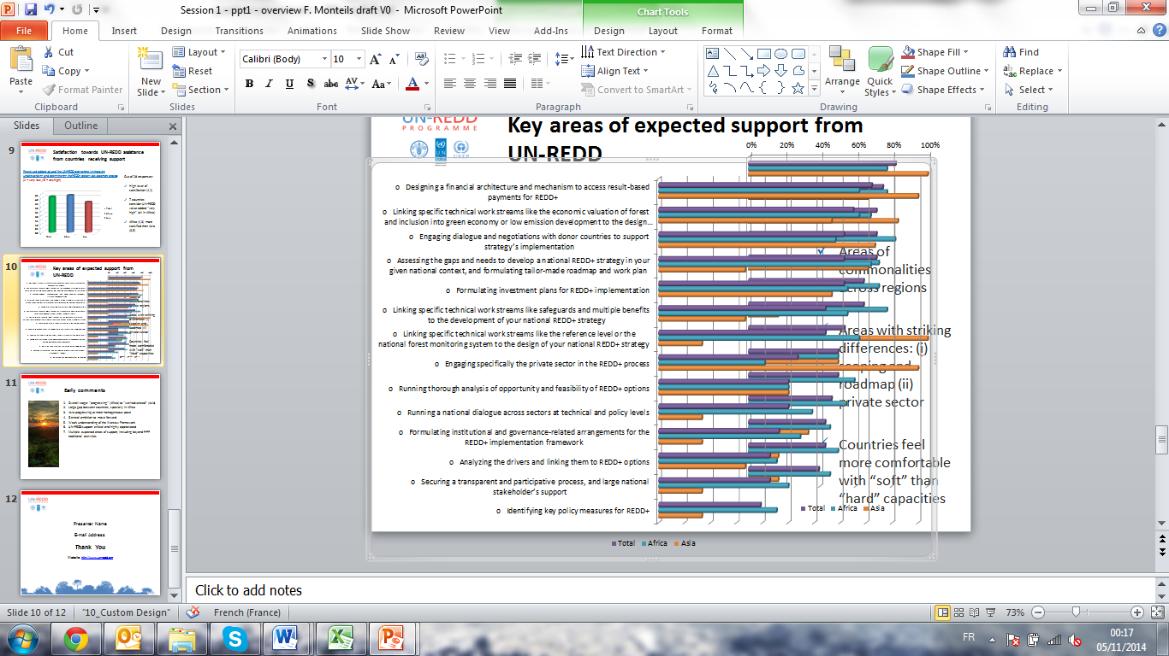
Key areas of expected support from UN-REDD

Slide 11
Early comments
Overall stage: “progressing” (Africa) to “well-advanced” (Asia)
Large gap between countries, specially in Africa
Asia progressing at more homogeneous pace
General ambition to move forward
Weak understanding of the Warsaw Framework
UN-REDD support critical and highly appreciated
Multiple expected areas of support, including beyond R-PP traditional activities
Commonalities and differences in the domain of support expected by countries in Africa and Asia

Slide 12
Fabien Monteils
Fabien.monteils@undp.org
Thank You
Website: http://www.un-redd.org

