Slide 1
Emerging approaches to Forest Reference Emission Levels and/or Forest Reference Levels for REDD+:
Trends and Challenges
By Philippe Crete
UN-REDD Regional Advisor for Africa
Information and Knowledge Sharing Sessions
13th Policy Board meeting
Arusha, Tanzania
5 November 2014

Slide 2
Outline
UN-REDD support to partner countries on FREL/FRLs
Recalling latest UNFCCC decisions on FREL/FRLs
Overview of publication “Emerging approaches to Forest Reference Emission Levels and/or Forest Reference Levels for REDD+”
Emerging Trends and Common Challenges
Questions for panellists

Slide 3
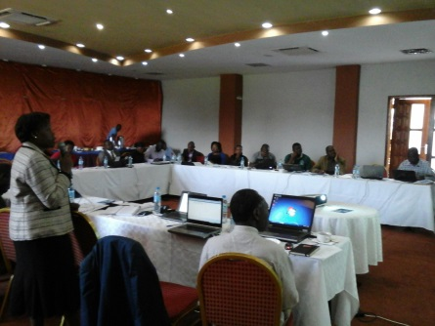
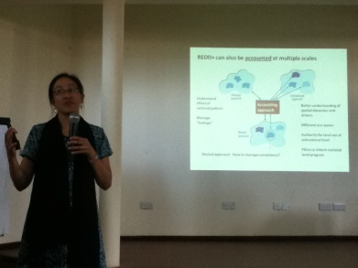
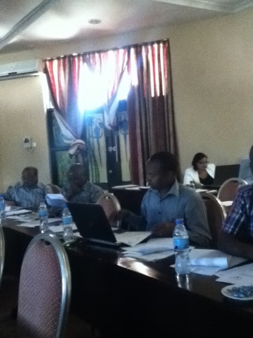
UN-REDD Support to Partner Countries
on FREL/FRLs
Support to countries in understanding UNFCCC Decisions on FREL/FRLs
  Trainings, participation to exchange meetings, workshops;
  Beneficiaries: Mexico, Peru, DRC
Assistance to countries in the construction and submission of FREL/FRLs
  Planning for the construction and submission of FREL/FRLs
  Data collection and analysis
  Beneficiaries: Tanzania, Zambia, Vietnam, Papua New Guinea, Sri Lanka, Nepal
Publications and guidance material based on country-experience
  Country examples (released this week)
  Technical guidance publication (upcoming in December 2014)

Slide 4
Key UNFCCC Decisions on FREL/FRLs
Decision 4/CP 15 “…transparently taking into account historic data, and adjust for national circumstances…”
Decision 1/CP 16 FREL/FRLs one of the 4 REDD+ elements
Decision 12/CP 17 ‘Construction guidelines’(Modalities for FREL/FRL)
Annex Information guidelines (for FREL/FRL submission)
Decision 13/CP 19 & Guidelines technical assessment
Annex Assessment procedures

Slide 5
Latest guidance provided by the Warsaw Framework
Guidance on technical assessment
Extent to which consistency with GHG-I is maintained
How historical data have been taken into account
Extent to which information was transparent, complete, consistent and accurate
Scale: What area the FREL/FRL covers
Whether a description of relevant policies and plans have been provided, as appropriate
If applicable, changes from previous submissions
Scope: pools, gases and activities included, and justification of why omitted pools and/or activities were deemed not significant
Whether the definition of forest has been provided and, if different from GHG-I or international reporting, why and how it differs
Whether assumptions about future changes to domestic policies have been included in FREL/FRL construction
Extent to which FREL/FRL is consistent with information provided
Notes:
- Countries are invited to submit their FRL/FRELs on a voluntary basis and when deemed appropriate;
- Submissions will be technically assessed in the context of results-based payments;
Assess the degree to which information provided is in accordance with the information guidelines
Offer a facilitative, non-intrusive, technical exchange on information on the construction of FREL/FRLs….with a view to supporting the capacity of developing country Parties

Slide 6
Latest guidance provided by the Warsaw Framework (con’t)
Procedures for the assessment
Assessment session organized once a year & submissions sent 10 weeks in advance;
Countries may interact with the assessment team to clarify issues or provide additional info;
The assessment team may request additional info. Countries will have up to 8 weeks to respond;
The technical assessment team will have 4 weeks to assess additional info and release a draft report.
Countries will have 12 weeks to respond (up to 16 weeks if they modify their FREL/FRLs).
The assessment team will release a final report within 4 weeks.
This final report will be released by the UNFCCC Secretariat and published on its web platform.
The final report shall include the assessed FREL/FRLs, areas for further technical improvements (if appropriate), relevant capacity-building needs, as well as the country’s response.
Notes:
- Countries are invited to submit their FRL/FRELs on a voluntary basis and when deemed appropriate;
- Submissions will be technically assessed in the context of results-based payments;
Assess the degree to which information provided is in accordance with the information guidelines
Offer a facilitative, non-intrusive, technical exchange on information on the construction of FREL/FRLs….with a view to supporting the capacity of developing country Parties

Slide 7
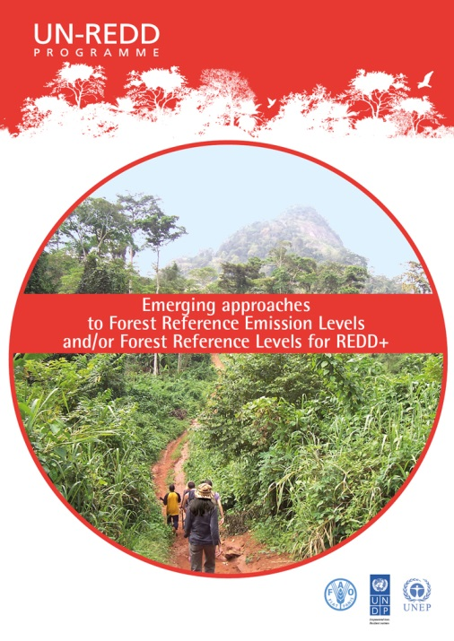
Overview of new UN-REDD publication:
“Emerging approaches to Forest Reference Emission Levels and/or Forest Reference Levels for REDD+”
Outline of the publication
What are FREL/FRLs and what purpose may they serve
Country examples: Brazil, Chile, Costa Rica, Democratic Republic of Congo, Ghana, Guyana, Mexico, Nepal, Republic of Congo, Vietnam
Examples and Analysis of:
  Construction methodology
  Scale
  Scope
  Datasets used
Emerging Trends and Common challenges
http://un-redd.org/FRELPublication/tabid/794487/Default.aspx
Notes:
Learning from country experiences
Illustrate diversity of approaches
Not prescriptive
Analysis following UNFCCC modalities and guidance for the technical assessment of FREL/FRLs
Examples based on available demonstration activities + available UNFCCC submissions

Slide 8
Emerging Trends:
Construction Approach
Historic average
Adjusted and/or projected
Other
  Brazil
  Mexico
  Chile
  Vietnam
  Ghana
  Nepal
  DRC
  Costa Rica
  Republic of Congo
  Guyana– Combined Incentives
8 out of 10 countries included were for FCPF Carbon Fund which does encourage adjustment for non HFLD countries

Slide 9
Emerging Trends:
Scale
 | Scale | Area (ha) | % of country
Brazil* | Amazon biome | 420 M | 50 %
Chile | Temperate eco-region (5 administrative regions) | 16.5 M | 22 %
Costa Rica | Mosaic– but may monitor across entire country | 0.34 M | 6.7 %
DRC | Mai Ndombe administrative region | 12.6 M | 5.5 %
Ghana | 5 eco-zones | 5.9 M | 25 %
Guyana | National | 21.5 M | 100 %
Mexico | 5 states, but not contiguous | 29.3 M | 15 %
Nepal | Terai Arc Landscape, 12 districts | 2.3 M | 15 %
Republic of Congo | Two departments | 12.4 M | 36%
Vietnam | North-Central Region, 6 provinces | 5.1 M | 16 %
* Brazil is the only UNFCCC submission in this table; scale Amazon Fund=Legal Amazon, 522Mha
Notes:
Scale Brazil’s demonstration activity (Amazon Fund) was the Legal Amazon, 520 M ha

Slide 10
Emerging Trends:
Scope
 | Reduce emissions from deforestation | Reduce emissions from degradation | Enhancement of carbon stocks
Brazil | X
Chile | X | X | X
Costa Rica | X |  | X
DRC | X | X | X
Ghana | X
Guyana | X
Mexico | X |  | X
Nepal | X | X | X
Republic of Congo | X | X
Vietnam | X | X | X

Slide 11
Emerging Trends:
Datasets used
Activity Data
Emission Factors
  Deforestation:
  Medium-resolution imagery (Landsat)
  High-resolution imagery
  Land registry (cadaster)
  Degradation:
  High-resolution imagery
  Timber records or management plans
  Fuelwood extraction statistics
  Forest Inventories (National or sub-national)
  IPCC, literature
  Stratification of EFs
  by Forest structure (primary, degraded, …)
  by Forest type
  Natural – planted
  By successional stage or age-class

Slide 12
Common challenges
Few countries have already elaborated time series to assess historical forest cover change;
Some countries tend to initially propose sophisticated approaches but then revert to a more simplified one;
Most countries initially begin with sub-national FREL/FRLs and many seek access to existing performance-based payment sources
  Many scale related decisions are not only technical. They may involve policy-related decision-making.
  National and international expertise to develop FREL/FRLs is limited
  Countries should identify early on REDD+ activities and their mitigation potential to determine whether they can perform against their FREL/FRLs
Notes:
Degradation is particularly difficult given scarce data and methodological challenges
Consistency with NFMS and GHG-I over time needs to be carefully considered;
Reflections about the need to scale up , and the implications, should occur early on
Considerations of institutional arrangements, budget allocation, forest management structures;
All countries are trying to progress simultaneously
The choice of activities to include in the FREL should be based on their “significance”, but whether or not a country can mitigate the emissions from these activities is unknown.

Slide 13
Thank You!
Philippe Crete
UN-REDD Regional Advisor for Africa
philippe.crete@fao.org
Website: http://www.un-redd.org

Slide 14
Questions for the panelists
What are the key challenges your country is facing in relation with data quality and availability for the construction of FREL/FRLs?
Is your country envisioning to use a step-wise approach to FREL/FRLs? If so, on which aspects?
Which of the REDD+ activities do you plan to include in your FREL/FRLs and why?
How are your current institutional arrangements for REDD+ influencing the construction of your FREL/FRLs?

