Slide 1

Global Fund to Fight AIDS, TB and Malaria and its partnership with UNDP
Managing Risk, Fighting Corruption

Slide 2
“Risky Business”
Corruption in the health sector
Large-scale procurement of drugs and health products
Storage, distribution, and drug theft
Implementation of activities by local partners
Training and workshop
Retention schemes
Assets

Slide 3
Global Fund
Created only 10 years ago
Innovative new-generation funding mechanism
Mean and lean, no country presence
USD 22.4 billion for 150 countries
  Saved 7.7 million lives
  3.2 million currently on ARVs
  8.2 million TB cases treated
  190 million mosquito nets distributed
Remarkable contribution to MDG6 and other health-related MDGs

Slide 4
The Global Fund Model
Raise it
Prove it
Spend it

Slide 5
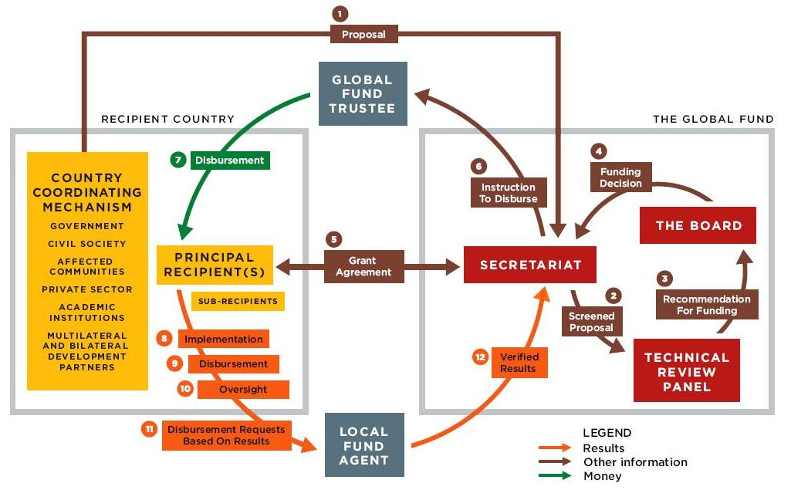
Notes:
Source: A Strategy for the Global Fund: Accelerating the Effort to Save Lives
Accompanying Notes:
The Global Fund’s overall architecture includes both the structures set up or contracted by the Global Fund itself (shown in red), and those (shown in yellow) set up by countries that receive Global Fund financing. The architecture functions as part of a broader network that includes the various partners at both the country and the global levels which play critical roles in supporting proposal development and grant implementation.
At country level, the Country Coordinating Mechanism (CCM) is a partnership composed of all key stakeholders in a country’s response to the three diseases. The CCM does not handle Global Fund financing itself, but is responsible for submitting proposals to the Global Fund (step 1), nominating the entities accountable for administering the funding, and overseeing grant implementation (step 10). The CCM should preferably be an already-existing body, but a country can instead decide to create a new entity to serve as CCM.
The Global Fund Secretariat manages the grant portfolio, including screening proposals submitted (step 2), issuing instructions to disburse money to grant recipients (step 6) and implementing performance-based funding of grants. More generally, the Secretariat is tasked with executing Board policies; resource mobilization; providing strategic, policy, financial, legal and administrative support; and overseeing monitoring and evaluation. It is based in Geneva and has no staff located outside its headquarters.
The Technical Review Panel (TRP) is an independent group of international experts in the three diseases and cross-cutting issues such as health systems. It meets regularly to review proposals based on technical criteria and provide funding recommendations to the Board (step 3).
The Global Fund Board is composed of representatives from donor and recipient governments, civil society, the private sector, private foundations, and communities living with and affected by the diseases. The Board is responsible for the organization’s governance, including establishing strategies and policies, making funding decisions (step 4) and setting budgets. The Board also works to advocate and mobilize resources for the organization.
The Global Fund signs a legal grant agreement (step 5) with a Principal Recipient (PR), which is designated by the CCM. The PR receives Global Fund financing directly, and then uses it to implement prevention, care and treatment programs (step 8) or passes it on (step 9) to other organizations (sub-recipients) who provide those services. Many PRs both implement and make sub-grants. There can be multiple PRs in one country. The PR also makes regular requests for additional disbursements from the Global Fund based on demonstrated progress towards the intended results (step 11).
The Global Fund’s Trustee manages the organization’s money, which includes making payments to recipients (step 7) at the instruction of the Secretariat. The Trustee is currently the World Bank.
Since the Global Fund does not have staff at country level, it contracts firms to act as “Local Fund Agents” (LFAs) to monitor implementation. LFAs are responsible for providing recommendations to the Secretariat on the capacity of the entities chosen to manage Global Fund financing and on the soundness of regular requests for the disbursement of funds and result reports (step 12) submitted by PRs.

Slide 6
BOARD
Reporting
Auditing and investigating
Verifying
Office of the Inspector General
Secretariat
Country Level
Country Coordinating Mechanism
Principal
Recipient
Local Fund Agent
Sub-Recipient
Sub-Recipient
Sub-Recipient

Slide 7
Funding process
Global Fund launches a Round for submission of proposals (10 rounds so far)
Country prepares grant proposals
Country Coordinating Mechanism reviews proposals and submits to Technical Review Panel
If successful, Global Fund and Principal Recipient signs grants agreement with agreed budget
Global Fund disburses funds at quarterly or six-monthly intervals
Performance-based disbursements + Phase 2 funding.
Project based, off budget
“Dual Track Funding” = both Government and NGO Recipients
3 diseases, 10 rounds, several PRs per country, 150 countries
Slowly moving towards National Strategy-based funding

Slide 8
High-Level Panel Recommendations
Board: needs to focus on strategic issues and risk management.
Secretariat: Needs major restructuring, refocusing, and introduction of risk management framework and systems
Country Coordinating Mechanisms: Reduce conflict of interest and strengthen oversight role
Principal Recipients: Up-front capacity assessments, resources allocated to strengthen capacity, risk-based disbursements
Local Fund Agents: Requires major overhaul of modality
Office of Inspector General: Mandate needs to be contained, improve conduct of teams, ensure process in finalizing and publishing reports, speed up reporting, align definition of fraudulent expenditure with standard practice, etc.
37 concrete recommendations to get the Global Fund back on track

Slide 9
UNDP-Global Fund Partnership
Principal Recipient of Last Resort
Implementation Support
  UNDP serves as interim Principal Recipient (PR) in countries facing exceptional circumstances.
  Capacity Development
  While serving as interim PR, developing the capacity of one or several national entities to take over the PR role when they are ready and as soon as circumstances permit.

Slide 10
What are ‘exceptional country circumstances’?
Capacity constraints: no national entity able to take on PR role (Chad, Togo, Niger, Tajikistan)
Conflict or post-conflict situations (DRC, Sudan, Iraq, West Bank/Gaza)
Post-disaster situations (Haiti)
Political upheaval (Kyrgyzstan) or political complexities (Bosnia)
Suspension of grants due to corruption or mismanagement by national PR (Zambia)
Institutional bottlenecks and legal dispositions that obstruct effective implementation (Uzbekistan)
Donor sanctions (Cuba, Iran, Zimbabwe)

Slide 11
Scope of UNDP’s role
Interim Principal Recipient in 30 countries facing exceptionally high risk or low national capacity
Manages 12% of Global Fund resources =
US$ 1.13 billion in signed grants
US$ 400 million through UNDP in 2010
Has exited in 13 countries
10 countries in transition phase of handing over PR role to national entities
Recently taken over grants in 5 countries

Slide 12
How does UNDP manager risk when managing Global Fund grants?
Ensure national ownership of programmes , risks, and responses to fraud.
Invest in capacity development of national partners (financial management & fiduciary control)
Strict follow-up to project audit findings – crucial risk management tool
Pooled international procurement, but use of national supply chain management systems
Prudent management of Sub-Recipients (local implementing partners) in high-risk environments
  Up-front capacity assessments of SRs, with tailor made capacity strengthening as required
  Close monitoring of financial reporting, effective M&E, and frequent spot-checks
  Smaller, more frequent advances, direct payment to vendors, or direct UNDP implementation
On-sight verification and monitoring of training activities

Slide 13
Lessons learnt
Don’t reinvent the wheel – it might turn out square
Prevention is better than treatment (Global Fund: heavy on treatment, light on prevention)
Manage transparency carefully
National ownership of the risks & the response to corruption.
Major investments in capacity development of national institutions
In high-risk environments: need implementing partner with well-established country presence to manage risk & develop national capacity
Be careful with private sector oversight and fiduciary services
Anti-corruption is about effective day-to-day implementation
Have zero tolerance for fraud, but not zero tolerance for risk

