Slide 1

Gender Equality and Women’s Empowerment – Strengthening the Sustainability of REDD+
UN-REDD Programme Ninth Policy Board Meeting
Brazzaville, Republic of the Congo, 25 October 2012

Slide 2
Why is a gender perspective important for managing forests?
Women are the primary users of forests
Women and men are holders of valuable knowledge and skills
However:
  Women are marginalized in decision-making
  Women often have access to land, but limited control over it
Notes:
Women are the primary users of forests
For example, in Sub-Saharan Africa, the commercialization of some forest products is exclusively the domain of women (Brown and Lassoie 2010).
Markets for NTFPs in the Congo Basin are organized and dominated by women who specialize in the sale of NTFPs and food crops while men specialize in the marketing of cocoa and coffee (Ndoye et al. 1997/98, Nkem et al. 2010).
A study of 25 markets in the humid forest zone of Cameroon showed that 89 percent of the NTFP traders were women (Awono et al. 2010).
Men and women often use the resource in different ways: for different crops, grazing, and gathering on land for timber, fruits, leaves, firewood, shade, or other products from trees, as well as; for irrigating, washing, watering animals, or other enterprises using water; (Meinzen-Dick et al, 1997).
Women are holders of valuable knowledge and skills in regards to forest management such as food, fodder, fuel, and medicine
However, despite the fact that women are primary users of the forests; frequently they are also the most marginalized of community members with respect to decision-making regarding forest management.
Forests provide livelihoods, subsistence and income to more than 1.6 billion of the global poor. Women constitute 70% of the poor worldwide (FAO 2007).
Although women are the primary users of the forests and have valuable knowledge in forest management, they do not have security of access to and control of land and natural resources in general.
Women in the world own less than 10% of land (FAO 2007)
Women in Africa own around just 2% of agricultural land (Centre for Public Health 2011)
I n many instances, women have access to land, but limited control over it, since they do not own it and cannot make decisions on its use (Denton 2002).

Slide 3
Why is gender a key variable for REDD+?
Men and women may experience the effects of climate change and REDD+ strategies differently
Given women’s dependence on natural resources, they may be adversely affected by climate change policies on REDD+
Gender-differentiated needs, uses and knowledge have critical influence on REDD+ strategies
Notes:
Given the gender differences, men and women may experience the effects of climate change and REDD+ policies differently. Women and men have different roles, responsibilities and priorities in communities, thus they could feel the effects of REDD+ strategies differently.
Given women’s dependence on natural resources, they may be adversely affected by climate change policies on REDD+ that may limit women’s access to forest resources (Gurung and Quesada 2009, Terry 2009).
Example: If a government institutes a REDD+ strategy without taking gender concerns into consideration, women could experience different effects on their daily livelihood activities (i.e. collecting firewood and income generating activities around NFTPs)
It is important to ensure that gender dimensions are addressed in issues of climate change, property rights, forest management and distribution of carbon benefits because gender-differentiated needs, uses and knowledge have critical influence on REDD+ policy and programming on the ground.

Slide 4
Gender roles around land tenure
Unclear or insecure tenure may itself promote deforestation because resource users may have little incentive to protect the resource if they feel they have no stake in it
In many places women do not legally own land
    Where tenure is weak, it often women who are pushed to marginal land
Notes:
Unclear or insecure tenure may itself promote deforestation because resource users may have little incentive to protect the resource if they feel they have no stake in it. Unclear or insecure tenure also makes local people (men and women) vulnerable to dispossession as land value increase (Cotula and Mayers 2009).
In many places women have little leeway to change land use because often they do not legally own land. REDD+ readiness processes must consider how strategic interventions will impact these embedded inequities. For example, where tenure is weak, it is often women who are pushed to marginal land. Moreover, REDD+ benefit distribution systems that do not take gender considerations into account could reinforce gender inequalities (IIED 2012).

Slide 5
Understanding the gender differentiated role in sustainable forest management
  The integration both men and women’s roles, responsibilities, knowledge and skills is vital to the success of REDD+
  Men and women play varying roles throughout the value chain:
    Enables a more accurate definition of the problem and who is driving deforestation, where and how
    Helps identify potential solutions
Notes:
The integration both men and women’s roles and responsibilities as well as unique knowledge, skills and experience of women is vital to successful REDD+-related initiatives (IUCN 2009).
With respect to biodiversity, for example, women’s subsistence activities and knowledge of the forest can add value to community forestry activities, such as species monitoring, soil management and forest restoration functions, and thereby contribute positively to the sustainable management of forests or enhancement of forest carbon stocks. This is particularly relevant in the context of non-timber forest products and food security (UN-REDD 2011).
In some areas of southern and West Africa (Burkina Faso) for instance, women use non-timber forest products (NTFPs) to produce high-value goods such as shea butter for the cosmetic and natural health industries. These may provide models to inform social benefits of REDD+, specifically with regards to livelihoods and poverty reduction.
Understanding the varying roles played by men and women throughout the value chain (i.e. from planting the tree, collecting forest products, processing, and commercialization) not only enables a more accurate definition of the problem — who is driving deforestation, where and how — but also helps identify potential solutions and allows interventions to be tailored to deliver ‘the right REDD+ to the right target group’ (IIED 2011).

Slide 6
Sustainable and effective REDD+
A sustainable and gender-responsive REDD+ framework would ensure that:
Women have equitable access to REDD+ benefits
Women’s rights to forests and land resources are recognized
Good practices are promoted and gender inequality between men and women are not perpetuated or exacerbated
Women’s role in REDD+ is carefully considered and reflected at every stage
Notes:
It is crucial that the REDD+ framework ensures that:
Women will have equitable access to available funds, sharing of benefits, to carbon markets for women’s entrepreneurship in green businesses
Women’s rights to forests and land resources are recognized
Good practices are promoted and gender inequality between men and women are not perpetuated or exacerbated
Women’s role as leaders, participants and beneficiaries in REDD+ is carefully considered and reflected at every stage of policy and programme development, from design through implementation and evaluation

Slide 7
How to integrate gender equality concerns into REDD+ strategies
Key entry points include:
Engaging women and men as key stakeholders in decision-making
Conducting a gender analysis
Creating gender-sensitive M&E processes
Allocating adequate financial resources to mainstream gender
Consulting technical gender expertise
Notes:
To ensure REDD+ frameworks are gender-responsive, key entry points in REDD+ activities exist to integrate gender equality and women’s empowerment concerns. When building in these concerns into REDD+ work, it is essential to ensure that women’s and men’s participation is meaningful. Rather than just including women into REDD+ activities it is making sure that such activities account for gender differences, and address equity and fairness concerns in REDD+ processes, policies, and programmes at all levels.
The key entry points include:
-Women, as well as men, must be seen as strong agents of change who possess specific knowledge and skills which can be harnessed to help promote sustainable and effective REDD+ outcomes and inform UN-REDD programmatic and policy interventions.
-Failing to target and involve both women and men equitably in REDD+ responses lessens the reach of program impacts and benefits and accordingly their success, sustainability and efficiency gains.
-As such, some basic key entry points for the integration of gender equality and women’s empowerment considerations into UN-REDD’s work and REDD+ strategies include 1) engaging women and men as key stakeholders in all phases of decision-making, at all levels; 2) conducting a gender analysis; 3) ensuring monitoring and evaluation processes are gender-sensitive; 4) allocating adequate financial resources to mainstream gender; and 5) including technical social and gender expertise in all REDD+ phases.

Slide 8
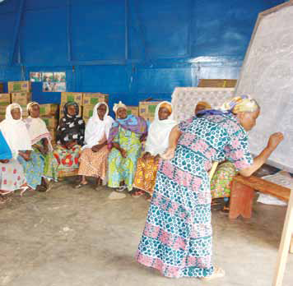
Engage women and men as key stakeholders in all phases of decision-making
Consult and seek the participation of local actors in REDD+ programmes
Broaden the reach of such consultations
Ensure women are actively involved in and can influence decision-making processes
Notes:
-Given local actors reliance on forests, it is essential that they are consulted with, effectively participate in and understand the livelihood benefits of REDD+ programmes.
Example: Consider using women-only interviews and men/women only group consultations
-Broadening the reach of such consultations can;
Inform project design to more accurately take into account the distinct needs, opinions, talents and contributions of both women and men.
Increase the likelihood of attaining REDD+ programme support, ownership and sustainability.
Improve programme efficiency and help achieve programme objectives.
Examples:
Ensure information is disseminated via multiple media outlets (in local languages) and accessible to CSO, IPs, private sector and community and women groups on REDD+ activities to engage broader engagement (also enforces transparency)
Need to build capacity of IPs and government officials and community groups to participate at all levels of REDD+ processes and to do so through a gender responsive lens
Link up with government ministries responsible for women’s empowerment (eg Human Rights Commission) and women’s organizations
-Critical in this process is ensuring women are actively involved in and can influence decision-making processes.
Steps to help this effort include:
Be aware of and account for their gendered roles within the community via a community mapping or gender analysis.
Design and conduct workshops, training, awareness-raising and capacity building activities and consultations, etc. to account for contributions and constraints of both women and men.
Institute quotas (example in Nepal and UN-REDD countries) and build capacity of women attending decision making meetings to understand and be able to speak to the issues relevant to them.
Example:
Clearly target women as project beneficiaries, i.e. women’s names on land titles and certificates
Be aware of gender balance in government institutions , women are often under-represented in Forestry Agencies, in both administrative and management positions

Slide 9
Conduct a gender analysis
Timing:
  Conduct a gender analysis during programme design
  Key features include:
  Analysis of stakeholders’ roles, needs, priorities and opportunities
  Identification of the socio-economic and political context of both women and men stakeholders affected and/or involved in REDD+ strategies
Notes:
-A gender analysis is ideally conducted during programme design to identify the national policies/strategies and local context in which REDD+ stakeholders are operating as well as provide baseline data for monitoring.
-Such an assessment would analyze the stakeholders’ roles, needs, priorities and opportunities within their given socio-economic and political context.
-Depending on scope and depth, it would also help identify the gender-defined differences in access to and control over resources; power dynamics between women and men; and different social, economic, and political inequalities and opportunities faced by women and men in areas potentially and/or are affected by REDD+ strategies

Slide 10
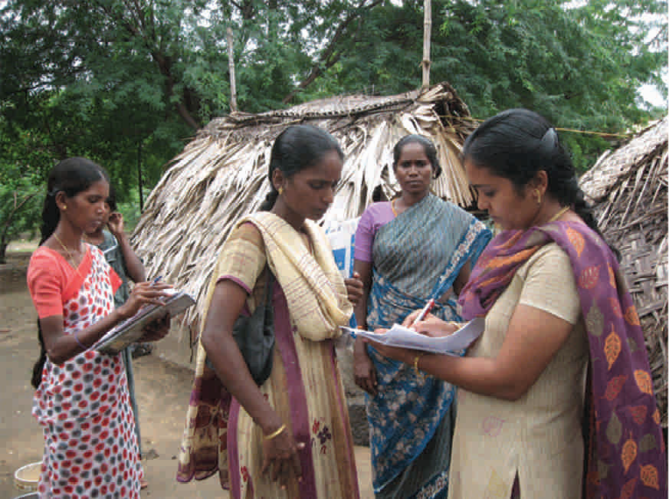
Ensure monitoring and evaluation processes are gender-sensitive
Gender-responsive M&E systems will help identify the gendered dimensions of REDD+ strategies
- and promote effective programme implementation
Gender-responsive M&E systems should:
  Disaggregate data by sex
  Create gender indicators
Notes:
-M&E systems inform decision-making, promote transparency and accountability.
-Implementing gender-responsive M&E systems will help:
Determine gendered dimensions of resource access and use.
Detail project effects on women and men.
Identify the drivers of deforestation.
New opportunities for sustainable forest management.
Lead to more effective REDD+ project implementation.
-At a minimum all data should be disaggregated by sex. Gender specific indicators should also be created to monitor, evaluate, and track progress of REDD+ policy/programme activities and impacts
Examples: Use gender as an indicator to measure the impact of REDD+ activities
Number of women on REDD+ decision-making bodies?
Number of women directly receiving REDD+ benefits?
Number of children completing primary/secondary school?

Slide 11

Allocate adequate financial resources to ensure gender equity in REDD+
Gender equality activities require sufficient, dedicated funds throughout all phases of REDD+
Gender-responsive budgeting:
  Involves re-prioritizing of financial resources within activities rather than just increasing overall expenditures
  Helps address gender gaps in programming
Notes:
-Meaningful gender equality and women’s empowerment activities require sufficient, dedicated funds throughout all phases of REDD+.
-Gender-responsive budgeting emphasizes the re-prioritizing of financial resources within activities rather than just increasing overall expenditures.
-It is needed to help address gender gaps in policies and programming, and help ensure that gender-responsive activities have the proper financial support.

Slide 12
Involve technical social and gender expertise in REDD+ activities
  Consult with gender specialists throughout all phases of REDD+
      Partner with local gender expertise
Gender expertise can help provide technical assistance in:
  Mainstreaming gender in REDD+ strategies
  Developing measurable gender indicators
  Facilitating stock-taking of progress on gender mainstreaming milestones
Notes:
-To ensure gender is integrated fully in REDD+ programming, it is recommended that gender specialists are involved in and consulted throughout all phases of REDD+. As a way forward, it would be useful to partner with local gender expertise that can be called on to provide guidance and technical assistance.
-Technical social and gender expertise can help provide technical assistance in:
Mainstreaming of gender in REDD+ policies and programming.
Developing measurable gender indicators.
Facilitating stock-taking of progress on gender mainstreaming milestones.

Slide 13
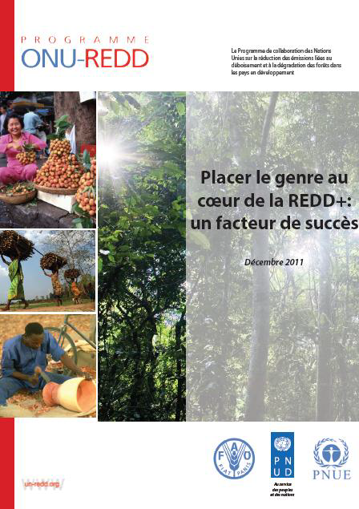
Business case for mainstreaming gender in REDD+
Published in December 2011
Demonstrates :
  Gender equality in REDD+ will create a more stable investment environment, ensure permanence, and reduce the risk of reversals for investors
  Inclusive REDD+ systems have the potential to mitigate climate change while advancing sustainable development
Notes:
While Solange has discussed why gender roles are relevant for REDD+, and Beth has explained the ‘how to’ and entry points for how we can integrate gender considerations in practice, let’s now briefly introduce UN-REDD’s work on this topic:
The UN-REDD Programme pre-released a report called Business case for Mainstreaming Gender in REDD+ at the COP 17 in Durban in December 2011:
Demonstrates that in fact, in addition to gender equality and women’s empowerment being important from a Human Rights perspective, giving consideration to gender equality in each readiness component of REDD+ makes good business sense, as it will create a more stable investment environment for forest carbon assets, ensure permanence, and thereby reduce the risk of reversals for investors
Also demonstrates that inclusive REDD+ systems have the potential to mitigate climate change while advancing sustainable development

Slide 14
Multiple benefits
As shown by this Business Case, mainstreaming gender in REDD+ can:
  Increase efficiency of REDD+
  Increase efficacy of reducing greenhouse gas emissions
  Increase sustainability
Notes:
In fact, the Business Case for Mainstreaming Gender in REDD+ report demonstrates that mainstreaming gender in REDD+ activities can help improve the efficiency, efficacy, as well as the long-term sustainability of REDD+.
For example, if REDD+ strategies are inclusive and incorporate gender considerations, they will help create ownership among local and national stakeholders (including women and IPs) as well as ensure that such strategies are planned and implemented efficiently and sustainably.
The Business Case also shows that integrating gender considerations in REDD+ processes leads to Multiple Benefits, both social and environmental.
One concrete example: Women’s Community Forestry User Groups (CFUGs) protected the forest against illegal logging. (Case Example from field trip during ‘the Scoping Dialogue on Inclusion and Exclusion of Women in the Forestry Sector’ in Nepal, Sept. 2012).
The women had been informed about sustainable management of forests and REDD+, and they had been empowered to participate in the sustainable management of the forest, which the community also received benefits from. They therefore both had understanding, interest and resources to contribute to the continuation of the sustainable management of the forest.
Other examples:
The ‘green belt’ movement in Kenya, where women have planted over 40 million trees since 1977, shows the economic and environmental impacts that organized women with access to land can achieve.
The Bolsa Floresta programme in Amazonas is one of the world’s largest REDD+ schemes. Led by the Amazonas Sustainable Foundation (FAS), the scheme centres on a deliberate choice to make payments for reducing emissions directly to women. Alongside these women-centred payments, the programme also includes investments in education and health services, which promote the active involvement of women.

Slide 15
How to integrate gender considerations in UN-REDD?
How can the UN-REDD Programme best ensure integration of a gender perspective in its activities to strengthen the sustainability of REDD+ readiness and implementation?
How to integrate gender equality and women’s empowerment principles into REDD+ strategies and processes at the country level?
Notes:
While the Business Case report addressed why gender equality and women’s empowerment is relevant for REDD+, the UN-REDD Programme is now in a process to ensure that we integrate gender considerations in the best way, to ensure that REDD+ is as effective, efficient and sustainable as it can be.
- First, we are looking at how we can ensure integration of a gender perspective in the UN-REDD Programme’s own activities.
Secondly, we will produce a Guidance Note with recommendations to countries on how it is possible to ensure more effective and sustainable REDD+ processes by integrating gender equality and women’s empowerment principles.
Beth has already outlined some ways of doing this, but we want to build on that and make a practical tool, a more comprehensive Guidance Note, on how to make REDD+ strategies more effective, equitable, and sustainable by integrating gender considerations.

Slide 16
UN-REDD gender screening process
Outputs
1. Summary of gender considerations
2. Identification of gaps
Activities
Global
Regional
Processes
Stakeholder participation
Funding selection
National
UNDP/UNEP/FAO gender policies
UN-REDD operational policies
Guidance & tools
Notes:
We have started the first process: a “gender screening’” of the UN-REDD Programme
to see the extent to which the UN-REDD Programme currently mainstreams gender considerations within its activities at the global, regional and national level.
As you can see in the diagram, this screening will consist of a process with three main input types:
Guidance and tools:
Overall policies / guidelines and tools within the UN-REDD Programme;
Gender policies / guidelines within the three UN-REDD organizations (UNDP, UNEP and FAO)
Processes:
UN-REDD processes for stakeholder participation in decision-making and technical bodies;
Funding selection and the prioritization of UN-REDD funding
Activities:
Gender-responsiveness of activities supported at the global, regional and national level
After this, we will identify entry points for where we can strengthen the gender perspective and strengthen REDD+ sustainability; and we will discuss where we can make improvements.
And finally, after this exercise, as mentioned we will also produce a Guidance Note with recommendations on how to integrate gender mainstreaming in the typical programme activities and processes.
In addition to this work, you will hear more about UN-REDD’s work on gender and REDD+ on regional and country levels- in two days, in the presentation on the 27th of October at the Policy Board .

Slide 17
Some questions for consideration...
- How has gender been relevant for REDD+ processes in your country (or other countries)?
What are the challenges to integrating gender in REDD+ processes?
Who can be partners in strengthening gender considerations in REDD+?
How do you think the UN-REDD Programme could strengthen integration of gender considerations in the Programme?
Notes:
As mentioned by Veerle in her introduction, we are very interested in hearing your experiences and your thoughts.
This is also a good time to give inputs, since we are in the process of strengthening the integration of gender considerations in the UN-REDD Programme.
So, please feel free to share whatever thoughts or questions you have regarding gender, women’s empowerment and REDD+.
Thank you!

Slide 18
Thank You!
Silje.Haugland@undp.org
Elizabeth.Eggerts@undp.org
Solange.Bandiaky@undp.org

