Slide 1
The Rabbit and the Turtle Running for REDD+ Financing
Fredrik Eriksson
Independent
Anti-Corruption Entrepreneur
k.f.eriksson@gmail.com
Notes:
Good morning friends and colleagues! Some of you I have had the honor to meet previously, some of you are new faces which I very much look forward to talk to.
I would like to first thank the organisers for inviting me to this important strategy planning event. It is an honor to be here and to spend a few days with admirable people who have made the choice to devote their time and energy to two incredibly important but also very complex matters: anti-corruption and the reduction of carbon emissions.
Climate change is probably the most significant challenge facing the world at this time. You are surely all aware of the saddening effects of climate change for us, our children and the planet. For the outlook of achieving positive development outcomes, many threats appear to come from all directions. Water shortages, large scale migration patterns and urbanisation can be expected to cause severe strains on governments. According to UNDOC, transnational crime markets will likely benefit from this. But good forces like yourself are already addressing these harmful developments. From that aspect, I have been asked to provide you with a brief overview of the REDD+ financing situation and how that relates to the concerns of corruption. I will also try to ask some provocative questions, which have already begun to surface in certain quarters. I believe we need to take them seriously or risk being sidelined.

Slide 2

Notes:
You all know the story of the rabbit and the turtle. The turtle challenged the fast running rabbit to race him. The rabbit was overconfident, took a nap half way, and when he woke up, the turtle had crossed the finish line. We too often are confronted with a similar situation. The public sector and governance change is slow, burdensome and non-competitive. The private sector is fast, knows how to get things done and have much stronger muscles than the public sector in terms of economic clout. But where time is of essence, do fast solutions always present the best options? And where change is slow, what are the lost opportunities? How do we calculate the costs in order to make the right trade-offs when our climate and future wellbeing are under serious threat?
Is the anti-corruption agenda in this context different? I will return to this at the end of my presentation but first, I will present a brief overview of REDD+ financing.

Slide 3
Project Financing
Start up costs:
private finance, multilateral, bilateral
or NGO funding.
Emission reduction credits (verified carbon reduction meeting certain standards) can later be sold on the voluntary carbon market where companies can buy credits to offset their own emissions. This provides further finance/profit to carbon reduction projects.
Notes:
We have heard mentioned here the largely unsuccessful project approach in comparison to the planned approach of much larger scale when governments, together with stakeholders, develop the phased approach of REDD+. Where projects have been set up, they first need to find funding to get them up and running. At the Forest Carbon Portal you can find more information about REDD+ projects and what they look like. The aim of each such project is to achieve emission reduction credits, which can then be sold on the voluntary carbon market to corporations that wish to offset theit own carbon emissions. The profits made from selling those credits is what provides the economic incentives to invest in this from an economic rational viewpoint. But before such credits can be awarded a carbon emission reduction project there are a number of safeguards and other standards that need to be met.

Slide 4
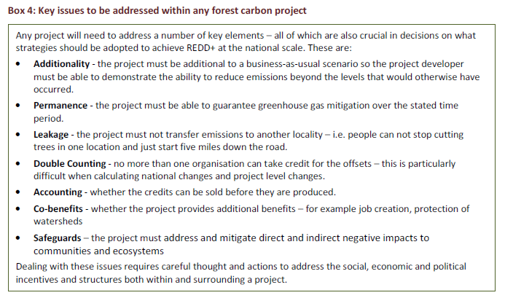
Standards to meet for accessing REDD+ funds
(Source: TI, A Manual for Assessing Integrity in the Development and Implementation of Forest Carbon Projects and National REDD+ Strategies (Berlin: Transparency International, 2011), p. 24.)
Notes:
Forest carbon standards refer to a set of rules and guidelines that a forest carbon sequestration or emission
reduction project should comply with to ensure that it is generating real and measurable net carbon gains.
The standards governing projects in the voluntary market are most often set up and enforced by recognized
professional organisations or through consensus for voluntary adoption.
There are now numerous standards and guidance for forest project development available to project
developers and stakeholders. These standards can cover either the way in which emission reductions are
measured and monitored, or the way in which the project is developed including what co-benefits it brings,
or both. Overall, standards are aimed at providing guidance to developers and piece of mind to buyers that
the key challenges of additionality, permannce, leakage, double counting, accounting and co-benefits have
been addressed (TI REDD+ Manul, 2011, p. 26).
These differ vastly in the voluntary market. However, the significance of the voluntary market is limited. In 2010 the voluntary carbon market represented less than 0.1% of the share of the global carbon market with the remainder (99.9%) being made up by compliance markets which are driven by regulatory caps –for instance those created by the Kyoto Protocol.
Standards have yet to be finalised but the UN-REDD Programme is developing social and environmental
principles, and FCPF are developing safeguards and now include a requirement to abide by World Bank safeguards.
But there is also reason for concern here. In my area of work, anti-corruption and illicit financial flows, the word naïve is constantly mentioned. It is felt that the phased approach of REDD+ is simply incredibly disconnected from all experience from governance initiatives over the last 15 years. To believe that one would fix all the relevant governance weaknesses in REDD+ countries with a brief ‘REDD+ readiness’ phase is simply unacceptably unrealistic and are by many perceived as amounting to nothing more than wishful thinking.
And the higher the eventual standards are set, the more unrealistic this becomes.

Slide 5
Standards to meet for accessing REDD+ funds
Massive funding gap to meet the needed scale of emmission reductions appears to hinge on the certainty of a ’compliance market’ (access to large scale capital depends on reliable risk calculations for returns)
If standards too stringent and subsequently lower the prospects for approved carbon credits, access to capital will be more difficult –are PPPs a response to that risk? What does that say about the need for independent verification?
Notes:
As you have been shown yesterday, multilateral and bi-lateral financial support for getting started is directed particularly at national level governance and approaches, as well as at national strategy development. Private or third party finance often sought for pilot projects.
But there is a substantial funding gap to get the idea of establishing the incentives for a different development path, which does not rely on traditional agricultural prodction, up and running.
There is no market yet for national level emission reductions but there are moves for them to be included
within a future agreement and thus a compliance market. Private sector investors keep repeating that that is an absolute condition to make large scale private sector investment available which can meet the estimated funding needs.
But, given the sentiments of the experienced governance practitioners, the eventually required standards set for investors to eventually get their emission reduction credits may be set too high. The criteria for when it is set ‘too high’ is of course when it becomes close to impossible to achieve the standards, due to all sorts of governance weaknesses that are the responsibilities of national governments to ‘fix’. If that happens, indeed, REDD+ has confirmed that it is indeed naïve.

Slide 6
The Estimated Extent of Capital Needed
EliaschReview: halving emissions from the forest sector by 2030 could total US$17 –33 billion per year.
IWG: US$ 20 billion needed by 2015 to cut deforestation by 25%, plus US$ 4 billion for reduction of emissions from forest degradation.
Current funding is approximately US$ 1.5 billion per year during the fast start period.
Notes:
Read screen.

Slide 7
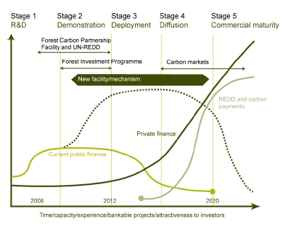
Projected Financing Needs
(Source: Forum for the Future (2009), Forest Investment Review)
Notes:
Explain screen.

Slide 8
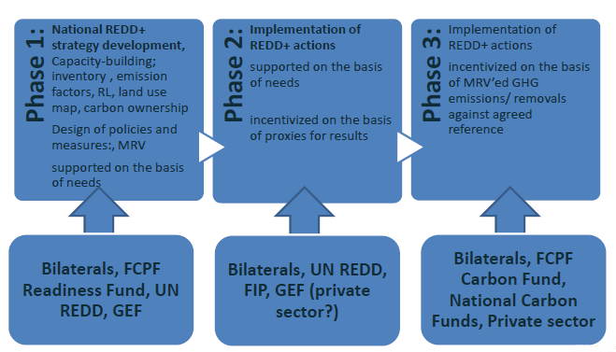
Sources
Bilateral & multilateral financing makes up 90% of the funding to date, and focuses mainly on readiness activities
Current pledges might be enough to support Phase 1
Private finance is crucial for Phase 2 & 3 –the ‘funding gap’
(Source: Gledhill, R.; “Towards Building a Governance Framework for REDD+ Financing”, presentation Sept 2011, Panama)

Slide 9
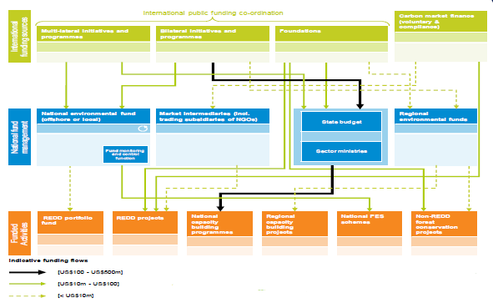
Financial Flows
(Source: PwC (2010), National REDD+ funding frameworks and achieving REDD+ readiness - findings from consultation, Report for the Conservation Finance Alliance)
Notes:
Yesterday, we discussed the corruption risks in REDD+ and the risk that this becomes the new ’resource curse’, similar to what happens to governance patterns in countries with weak governance capacities when natural resource extraction introduces massive flows of funds.
In a recent study by U4 based on case studies from DRC, Kenya and Tanzania as well as a literature review, this concern is confirmed:
”[T]he financial resources associated with REDD could create additional incentives and opportunities for corrupt activity. The concern here is that public officials, for example, may engage in corruption to extract rents from REDD resource flows in a similar manner to which rents can be derived from windfall resources such as oil or precious minerals.”
(U4 Report; REDD Integrity: Addressing governance and corruption challenges in schemes for Reducing Emissions from Deforestation and forest Degradation (REDD), February 2011 No 1, p. 13 )
Explain screen.

Slide 10
Standards and Mechanism Still Missing or Emerging for REDD+ Financing
Standards for Accessing Funds in Various Financing Mechanisms | -Need to represent trade-offs between the need for large scale private sector funding; the lack of time and various ’safeguards’ -’Best fit’ rather than blanket ’best practice’ (risk: too much slack due to conflicts of interest) -Risk mitigation required to politically defend ’legitimacy of aid’ -Each financing mechanism has its own Mgt structures
Coordination Mechanism for Various Funding Mechanism | -Accessible project database -Transparency standards for funded projects -Private and public funds
Standards for Assessing and Verifying Financial Governance Standards Standards for Financial Reporting | -Monitoring mechanism: focus on risk prevention for various types of leakages in relation to intended beneficiaries (conflicts of interest and transparency standards to avoid capture) -Auditing (risk: as with MRV, conflicts of interest make audits weak) -National level/project level
Accountability Standards and Mechanisms when Standards are Breached | -More sophisticated than current ’zero-tolerance’-policies -Allows donors to embrace risk but satisfy responsible management of risks. -Accountability for private sector? Denied credits; criminal offences (legal/physical persons); accounting regulations; beneficial ownership must be assured (FATF 40+9); jurisdiction in other countries (OECD Convention?).
Notes:
Procedures, processes and rules are still poorly developed but work is progressing. The worry here is of course to what extent law can be relied upon as an instrument for ensuring required governance standards, as defined in REDD+. Yesterday, you all identified that law as an instrument for governance is generally very weak in South Asia and the South East Asian region.
If standards become too unrealistic, we can expect that potential investors will back out or find investment opportunities where regulatory standards are less stringent. We also know that heavy regulatory burdens in the face of potential access to large funds provides an incentive to pay for cutting through ’red tape’.
In Norway, we are getting many mixed signals, as policies understandably still lack coherence. An obvious example of this is the rather unsophisticated ’Zero-tolerance’ policy against economic mismanagement and corruption. Particularly in this area, donor policies need to embrace risk rather than being risk averse. And as mentioned, time is of essence if the idea of offering an alternative route to development is to keep its attractiveness.
Explain screen.

Slide 11
Time for Change and Trade-offs
What do we know of how long governance change takes to achieve at national level?
Can we wait for standards to be met while the attractiveness of the alternative development route fades away as a political option?
In weak governance contexts with strong regimes (elites), change can be effectuated by those who wield power.
How do we relate to various types of governance regimes, where the instrument of law have very different effectiveness and the informal institutions cannot be separated from the formal?
In personalistic governance regimes, rent-creation or corruption is not simply a method of lining the pockets of the dominant coalition of elites –”it is the essential means of controlling violence” (North, Wallis and Weingast, 2009, p. 113)
Is ’national ownership’ and ’leadership’ the right approach in all contexts for all governance aspects where the political-economic conditions for change are bleak? Is there anything to learn from pre-modern tools of governance and custodianship? Do we have sufficiently urgent arguments for that yet?
Notes:
Read screen.

Slide 12
Time for Change and Trade-offs
Sovereignty is a concept which arrived at the birth of modernity in the 16th Century. It can be seen as Janus-faced in that it turns both inward at the population as supreme authority, but also outward at other countries as independent although never supreme. (Jackson, R.; Sovereignty (Cambridge: Polity, 2007), p. 11.)
In an increasingly globalized world, where chains of actions transgress sovereign nations, but ‘government’ –the action or manner of governing- still only exists at national level, the situation could be referred to as an international governance deficit. What does the emergence of a post-modern and perhaps post-sovereign world mean –a global economy, a transnational civil society, a transnational underworld –that escape from the authority and the regulation we associate with the sovereign state, as well as the states system of sovereign states. (Jackson, R.; Sovereignty (Cambridge: Polity, 2007), p. 141.)
The principle of state sovereignty has taken international public interests hostage, such as addressing global climate change issues. No effective global governance system exist to govern international public interests, but all depends on the political will of sovereign states. But when that will is missing and moral persuasion is futile? Is all written in stone? No choice?
Notes:
As you all are aware, when we talk of the need for ’national ownership’ with reference to the Paris Agenda and the Accra Action Plan, that is of course an extention of the principle of state sovereignty in the international legal order. It also fits with the lesson learnt from how and when effective goverance change happens: when there is a political will at the top of the national power structures to effect such change. If not, all will come to an effective halt.
The principle of state sovereignty has taken international public interests hostage, such as addressing global climate change issues. No effective global governance system exist to govern international public interests, but all depends on the political will of sovereign states. But when that will is missing and moral persuasion is futile? Is all written in stone? No choice?

Slide 13


Do we need to change the route of the race, find a new vehicle or change the finish line, or risk...
Notes:
Explain screen.
Håkan Björkman showed us a very interesting option yesterday, which shows us a precedent already and which also offers the UN a role that it both has the legitimacy to take on, and which effectively takes it into filling the void of effective global governance, but with a custodian approach. It offers a way out from the fears of naïvety that we have discussed in terms of the quick ’governance fixes’ envisaged in the phased REDD+ approach.

Slide 14
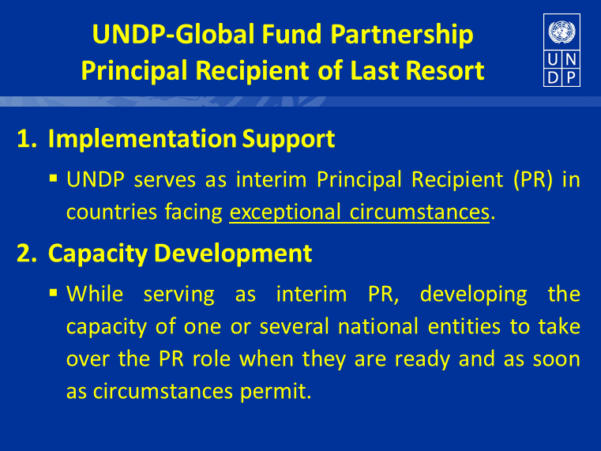

Slide 15
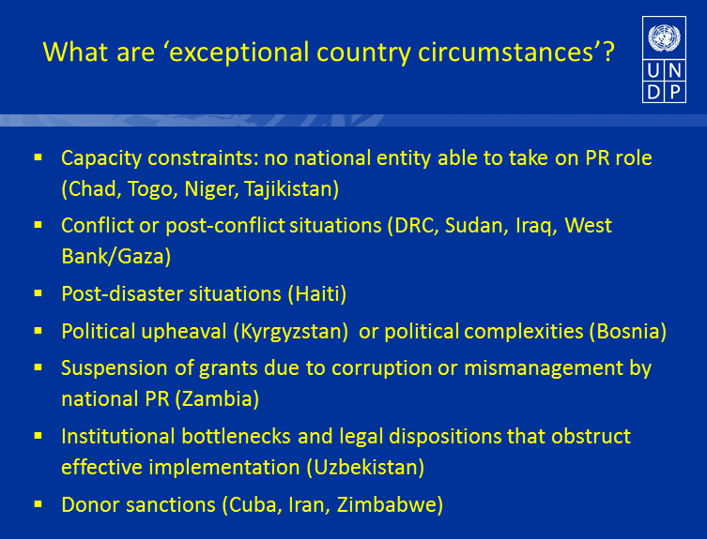

Slide 16
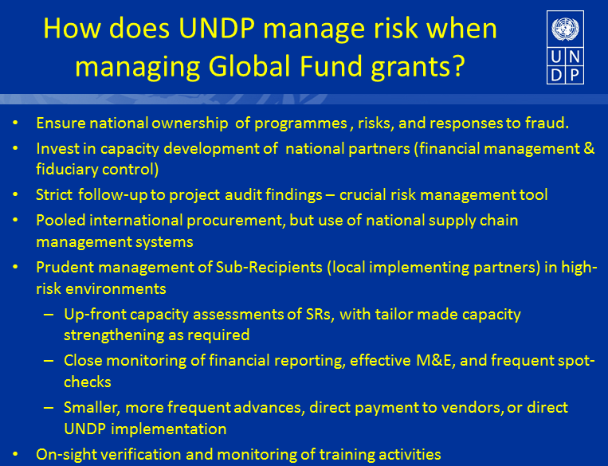
Notes:
Given that the recommendations of thh High-Level Panel for the Global Funds can be effectively addressed, this offers a model which meets many of the concerns expressed by governance partitioners, academic literature and donor evaluations. It further addresses many political headaches, such as experienced in Norway.
The world has entered a new and very serious stage of development. It requires of us to take a critical look at the threats identified and the political-economic obstacles blocking the way for effectively counteracting those threats. I believe that the legacy of past politics does not translate into a straight jacket, effectively tying our hands due to existing principles of the international legal order.
The management of risks through this type of ’governance custodianship’, while aiming to remedy weaknesses of capacity and political will in order to satisfy international public interests is indeed promising. It should definitely be a model to explore further. Given the clearly stated national benefits of the REDD+ scheme, any mindless arguments of neo-imperialism can easily be rebutted. And from an international public interest perspective, the harmfulness of government inaction and lacking political will can be construed as undermining a sovereign states legitimacy in the international legal order.
What do you think? Is not this worth exploring immediately? Thank you!

Slide 17
Thank you!

