Slide 1
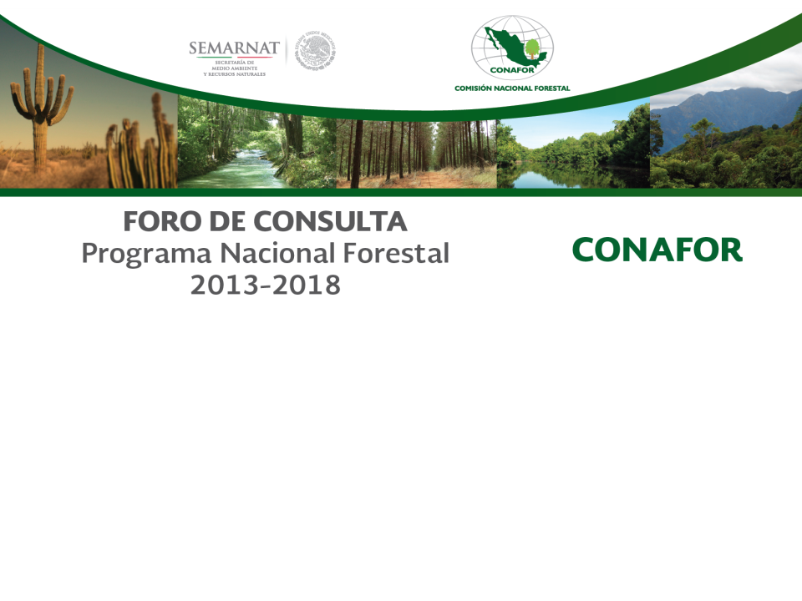
National REDD+ Financial Architecture
Mexico
October 2013
Septiembre 2013

Slide 2
Financial mechanisms for REDD+:
Multiple sources, flexible, gradual and efficient
Facilitate permanence of environmental and socioeconomic benefits in the long term
Aligned with national financial mechanisms (General Climate Law)

Slide 3
Principles for the REDD+ financial mechanism:
The initial investment comes from different sectors, FIP and other initiatives in the country.
The emission reductions result from a collective effort in a region. Transfer the resources to pay for the collective effort resulting in emission reductions.
Process where the transfer of funds between different instruments and scales does not result in decreased funds.
The resources from results-based payments should go directly to the territory. Institutions will assume the operational costs.
The financial mechanism should reward both the actors that have conserved forest areas as well as those changing practices to reduce deforestation and degradation.

Slide 4
The payments should not be converted to subsidies but rather complement existing programs (i.e PES).
Creation/strengthening of deliberative platforms to select the type of actions that are necessary to advance in a low carbon rural development. Should promote broad participation, collaborative actions between communities and institutions. Allow the creation of good governance structures.
Accessibility to resources to implement and develop the strategic actions towards sustainable rural development.
Local agent for implementation.

Slide 5
