Slide 1
Transparency, integrity and accountability for REDD+
Estelle Fach, UNDP
Inception Workshop, REDD+ Financing and Drivers
Kathmandu, Nepal, 25 March 2013

Slide 2
Why focus on governance and integrity issues in REDD+ ?
The big picture
  Impact of corruption and illicit financial flows on human rights and development
National frameworks and international agreements
  Cancun safeguards
  United Nations Convention Against Corruption
  OECD/ADB Initiative on Anti-corruption in Asia and Pacific
  Corruption Prevention Act
The pragmatic reasons : effectiveness, efficiency, equity, sustainability of REDD+
Notes:
The big picture:
In an interim report presented at the current twenty-second session of the UN Human Rights Council, Independent Expert on foreign debt Mr Cephas Lumina said that it is estimated that, on average, developing countries lost between US$783 billion and US$1,138 billion in illicit financial outflows in 2010.
“Corruption is an enormous obstacle to the realization of all human rights, in practical terms – civil, political, economic, social and cultural, as well as the right to development” the High Commissioner for Human Rights
2. International agreements
Cancun safeguards : countries shall respect and promote 7 safeguards, one of which is the “effective and transparent forest governance measures”
UNCAC : Nepal

Slide 3
Lack of integrity in REDD+ would:
Undermine effectiveness
Undermine efficiency
Undermine equity
→ sustainability of REDD+

Slide 4
Lack of integrity in REDD+
1. Existing corrupt practices that enable/enhance deforestation and forest degradation
Turning a blind eye on illegal logging (felling, transport, certification) in exchange for a bribe
Falsely and illegally issued logging licenses and concessions
Elite capture of forests resources and benefits
Deliberate information retention about forest resources and harvest
Notes:
1. Drivers

Slide 5
Lack of integrity in REDD+
1. Existing corrupt practices that enable/enhance deforestation and forest degradation
Turning a blind eye on illegal logging (felling, transport, certification) in exchange for a bribe
Falsely and illegally issued logging licenses and concessions
Elite capture of forests resources and benefits
Deliberate information retention about forest resources and harvest
2. New corruption risks brought about by REDD+
Risks related to decisions about land rights or land use that can favor one powerful group over a marginalized group
Risks related to fund management (embezzlement)
Risks related to distribution of benefits at local level (informal taxes, embezzlement)
Fraud related to MRV
Money laundering of REDD+ assets
...
Notes:
These two streams tie in with the two studies that we’re launching today : the study on drivers, that will touch on these transparency, accountability and integrity issues; and the study exploring options for the management of funds, where transparency and access to information safeguards/standards/criteria will be key.

Slide 6
REDD+ also presents opportunities to strengthen transparency and accountability – in the forest sector and in fund management
Transparent, inclusive, balanced, multi-stakeholder decision-making processes can mitigate the risk of back-door deals
Timely, usable access to relevant information about REDD+ processes, decisions and systems can enhance oversight, effectiveness and trust
Technical “transparency” tools can be developed to instill transparency in the movement of funds
Well-maintained and accessible REDD+ project registries can be turned into important transparency tools
Inclusive monitoring, social audits and ‘early warning’ dialogues systems can enhance trust, responsiveness and rapid remedial actions
Clear tenure rights can mitigate small scale illegal logging
Safeguard information systems can include strong transparency indicators
Free prior and informed consent
Notes:
1. “Sunlight is the best disinfectant”. Article 13 of UNCAC can be used as a platform for CSOs to advocate to government that they should be closely involved in the development, implementation and oversight of REDD+ programmes. For example, CSOs in a number of countries have already been very useful in conducting “social audits” of government welfare programmes.
2. Timely and usable information means it is in an accessible language and format – for example having a website is a good start but not a panacea !
Access to information: Nepal has a 2007 bill of “Right of Access to Information”, which is deemed “quite strong” by the Global Right to Information Rating Project. At a practical level, this can be supported through the enactment of FOI legislation and the implementation of FOI/records management policies which promote proactive disclosure of key government information. Concretely, there are lessons that can be learned by REDD+ from proactive disclosure programmes which have already been implemented in many countries to promote transparency in the payment of welfare subsidies.
3. Online platforms that automatically track the flow of funds - (Brasil)
4.
Of course this requires increased capacity but the benefits go beyond REDD+

Slide 7
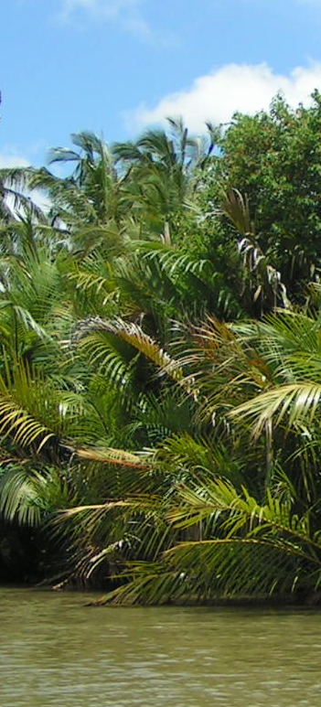
Who are the actors of integrity in REDD+ ?
REDD+ units
Civil society and indigenous organizations
Anti-corruption commissions
Law enforcement, justice system or special courts
Media
Parliamentary commissions and legislators
Neighbour countries
International partners
Notes:
1.REDD units : in designing transparent and inclusive REDD+ strategies, providing accessible information, receiving and addressing feedback (responsiveness)
2.CSO and IPs : acting as social auditors in the planning, implementation and monitoring phases – not solely watchdogs, but also partners
3. Anti corruption commissions
Investigations
Development of AC strategy : In countries which already have a NACS, REDD+ stakeholders can and still should engage with the agency responsible for coordinating/monitoring implementation to identify entry points for highlighting REDD+ anti-corruption issues within the government’s overall AC strategy. Likewise, in countries which are developing their NACS and/or NACS implementation plans, REDD+ stakeholders should engage as active participants in any working group / stakeholder group which is tasked with developing the NACS.
4. Justice system
5. Parliaments: At a concrete level, political will can be strengthened by direct advocacy/engagement with members of the national (and sub-national) legislatures which will be responsible for passing/amending REDD-relevant legislation and utilising committee oversight powers to review implementation of REDD+ programmes
6. Neighbour countries in enforcement coordination
7. International partners for technical support

Slide 8
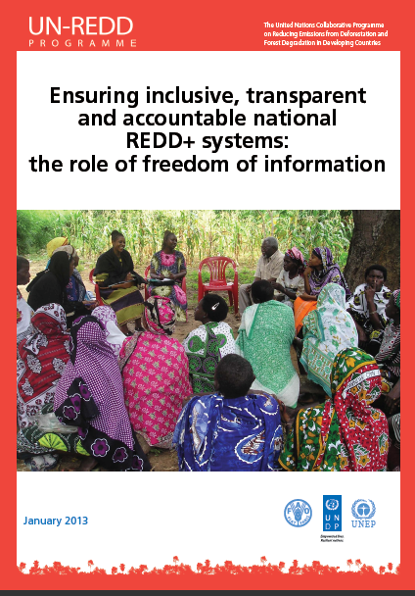
Some references
The role of freedom of information in REDD+
Guidance on Conducting REDD+ Corruption Risks Assessment
Transparency International’s “Keeping REDD + Clean”

Slide 9
Estelle Fach
estelle.fach@undp.org
Thank You
Website: http://www.un-redd.org

