Slide 1
The UN-REDD Programme’s
Support to Governance
Awareness – Raising Meeting on Anti-Corruption for REDD+
Bangkok, Thailand, October 2011
Estelle Fach, Programme Analyst, UNDP
UN-REDD Programme

Slide 2
Outline
Rationale and Mandate
Guidance, tools and approaches
Links to anti-corruption?
Practical examples

Slide 3
Importance of governance for REDD+
Governance is key to the success of REDD+
  To achieve mitigation outcome
  To avoid adverse effects
This has been recognized in the Cancun Decision through guidance for developing and implementing REDD+ strategies and action plans and with the adoption of REDD+ safeguards.
The Cancun REDD+ safeguards are directly or indirectly contingent on credible, inclusive national governance systems.

Slide 4
UN-REDD Programme and (social) Safeguards
Based on :
  UN Human rights mandate
  UN-REDD Programme 2011-2015 Strategy
  Cancun Agreements, Annex I:
    2(b) Transparent and effective national forest governance structures (...)
    2(c) Respect for the knowledge and rights of indigenous peoples and members of local communities
    2(d) The full and effective participation of relevant stakeholders, in particular, indigenous peoples and local communities (…)
    2 (e) Actions are (...) used to (...) enhance other social and environmental benefits (...)
Notes:
the destructive relationship between corruption and human rights

Slide 5
UN-REDD Programme and Safeguards
Highlight the importance of safeguards for national REDD+ systems to ensure that potential negative impacts are assessed, identified and managed.
Provide guidance as to how the potential multiple benefits of REDD+ can be enhanced and optimized.
Reflect the UN-REDD Programme’s responsibility to UN conventions, treaties and declarations.

Slide 6
UN-REDD Programme and Safeguards
Minimum requirements for National Programmes assessed by external reviewers:
  Goverment ownership
  Coherence with national strategies, policies and development planning processes
  Operational guidance for engagement of Indigenous Peoples and Other Forest Dependent Communities
  Level of consultation, participation and engagement
Programme guidelines for stakeholder engagement in REDD+, jointly with the World Bank (revision)
FAO & WB ‘s Framework for assessing and monitoring forest governance
What has been done so far

Slide 7
UN-REDD Programme and (social) Safeguards
What’s under development
UN-REDD Social and Environmental Principles and Criteria
- Point to UN-REDD further operational guidance on stakeholder engagement and guidelines, Free, Prior and Informed Consent and gender guidance
Help determine overall governance risks that can be further assessed through a Participatory Governance Assessments
Can feed information into developing information systems for REDD+ safeguards

Slide 8
UN-REDD Programme
National REDD+ systems
UN-REDD Social and Environmental Principles and Criteria
Cancun Safeguards
Notes:
UN-REDD Programme:
Supports countries in implementing safeguards and providing information on how the safeguards are being addressed
Ensures that the UN-REDD Programme activities respect the REDD+ safeguards.

Slide 9
UN-REDD Social and Environmental Principles and Criteria
Draw from and are consistent with the Cancun safeguards
Objectives, as proposed to the Policy Board (13- 14 October):
  i) assisting countries in formulating national REDD+ programmes and initiatives for which they seek UN-REDD support;
  ii) reviewing national programmes prior to submission for a UN-REDD Policy Board decision on funding and
  iii) assessing national programme delivery
Notes:
Draft opened for comments for 2 months. 393 comments
Progress update to be presented to Policy Board in October 2011
Public consultation in October- December 2011

Slide 10
Principles and Criteria
Promote benefits
Mitigate risks

Slide 11
Principles and Criteria
Objectives, as proposed to the Policy Board (13- 14 October):
  i) assisting countries in formulating national REDD+ programmes and initiatives for which they seek UN-REDD support;
  ii) reviewing national programmes prior to submission for a UN-REDD Policy Board decision on funding and
  iii) assessing national programme delivery
Notes:
Draft opened for comments for 2 months. 393 comments
Progress update to be presented to Policy Board in October 2011
Public consultation in October- December 2011

Slide 12
Principles and Criteria
7 Principles : overarching, fundamental, active statements about the achievement of a desired outcome
Under each principle, criteria are the conditions that need to be met by UN-REDD Programme funded activities to contribute to the achievement of the Principle.
For each criterion, the Risk Identification and Mitigation Tool
- elaborates questions to assist UN-REDD Programme staff, national counterparts and other stakeholders to identify issues to be addressed in order to minimize the risks and enhance the multiple benefits from UN-REDD Programme supported readiness activities
- creates concrete linkages between the Principles and Criteria, relevant Multilateral Agreements (including UNCAC), and issue-specific UN-REDD Programme policies and Operational Guidance

Slide 13
Example : Principle, Criteria, Risk identification
Principle 1 – Apply norms of democratic governance, including those reflected in national commitments and Multilateral Agreements
Criterion 1 – Ensure the integrity and transparency of fiduciary and fund management systems
Has the country ratified UNCAC?
Has the country been assessed to have a high level of perceived/ experienced corruption?
Is corruption known or likely to be common in the country’s forestry and other natural resources sectors?
Does the national REDD+ strategy make provisions to link REDD+ to the country’s anti corruption bodies?
Does the national REDD+ strategy identify how REDD+ revenues will be administered in a manner that is transparent and accountable?

Slide 14
Criteria related to corruption/anti-corruption
Principle 1 – Apply norms of democratic governance, including those reflected in national commitments and Multilateral Agreements
  Criterion 1 – Ensure the integrity and transparency of fiduciary and fund management systems
  Criterion 2 – Ensure accountability and legitimacy of all bodies representing stakeholders, including through establishing responsive national feedback, complaints and grievance mechanisms, amongst others
  Criterion 3 – Ensure transparency and accessibility of all information related to REDD+, including active dissemination among relevant stakeholders
  Criterion 4 – Ensure the full and effective participation of relevant stakeholders, in particular, indigenous peoples and other forest dependent communities, with special attention to the most vulnerable and marginalized groups
  Criterion 5 – Promote coordination, efficiency and effectiveness, including cooperation across sectors and in the enforcement of laws
  Criterion 6 – Ensure the rule of law and access to justice

Slide 15
Criteria related to corruption/anti-corruption
Principle 2 – Respect and protect stakeholder rights, including human rights, statutory and customary rights, and collective rights
  Criterion 7 – Respect and promote the recognition and exercise of equitable land tenure and carbon rights by indigenous peoples and other local communities
  Criterion 9 – Seek free, prior and informed consent of indigenous peoples and other forest dependent communities and respect and uphold the decision taken (whether consent is given or withheld)
Principle 3 – Promote and enhance forests’ contribution to sustainable livelihoods
  Criterion 12 – Ensure equitable, non-discriminatory and transparent benefit sharing and distribution among relevant stakeholders with special attention to the most vulnerable and marginalized groups
Corruption could undermine all safeguards

Slide 16
Legal Preparedness for REDD+
Develop generic recommendations to support countries in strengthening their legal capacity for REDD+ implementation (Output 2.2)
Studies of existing REDD+ legislation and regulations in Mexico, Vietnam and Zambia to identify legal and institutional needs
The studies build on UNDP’s background analysis of REDD+ regulatory frameworks (UNDP and Terrestrial Carbon Group 2009)
Close coordination with UNEP’s REDD+ Legal Study
Notes:
Objective of the LEGAL PREPAREDNESS initiative/ project
In implementation
Plans to coordinate with UNEP (tbc)

Slide 17
Participatory Governance Assessments for REDD+ (PGAs)
The PGAs contribute to the development of national safeguards information systems through:
  a consultative and inclusive multi-stakeholder process
  capacity building on the demand and supply side of accountability
The PGAs develop a set of governance indicators
building on:
  UNDP Oslo Governance Centre’s existing approach and knowledge on Democratic Governance Assessments
  FAO’s expertise and experience on data collection in the forest sector
Notes:
Objective of the PGAs
Building on the agencies’ comparative advantages
The work plan for the PGAs – first submitted to PB6 as background documentation to the Global Programme Framework Document – is now updated accordingly (new version dated August 25)

Slide 18
What are the links to Anti-Corruption?
The Social and Environmental Principles and Criteria point to principles of transparency, access to information, accountability, coordination, etc that are all important in preventing and fighting corruption
Participatory governance assessments for REDD+ in Indonesia and Nigeria are including corruption risks as a theme to be examined
Multi-stakeholder consultations, engagement, full and effective participation - including in decision-making process -, FPIC are preventive measure against corruption
What is needed now?
Notes:
Growing awareness and concern
➢ Could undermine confidence in system and the delivery of emission reductions and REDD+ development outcomes
➢ Risk is acknowledged in National UN-REDD Programmes documents and RPPs, but few operational solutions – so where do we go to?

Slide 19
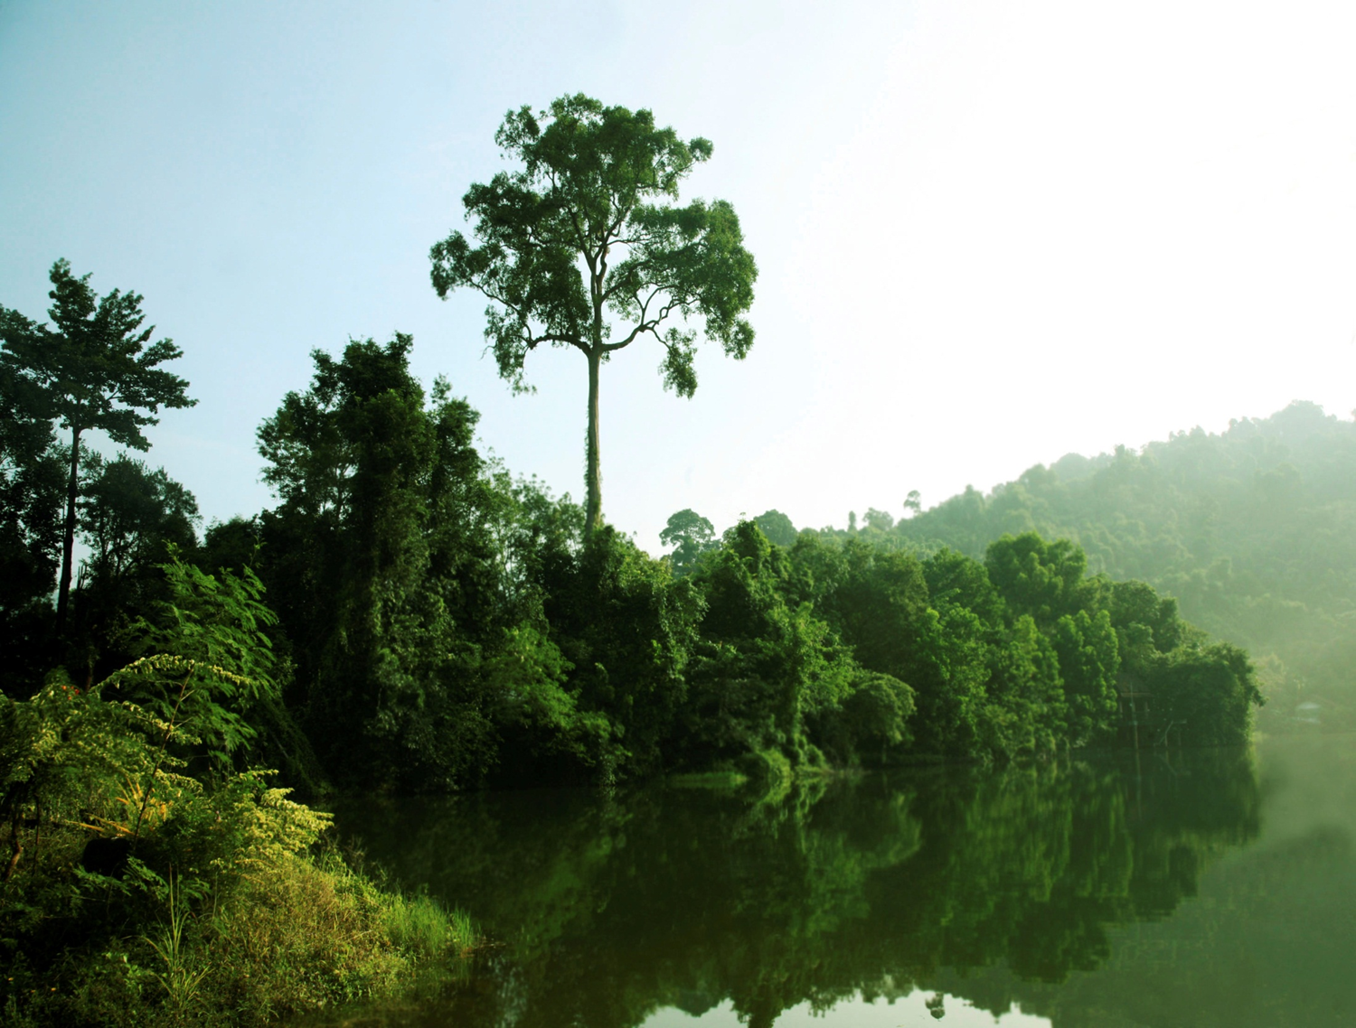

Key Messages from the Asia-Pacific Anti-corruption for REDD+ Strategy Meeting
Why do corruption risks need to be addressed now?
What are corruption risks in REDD+?
What are risk mitigation actions? What are the tools?
Who can prevent corruption in REDD+?
On 10 and 11 October 2011 a group of anti-corruption experts and practitioners from 12 UN-REDD partner countries in Asia and the Pacific comprising civil society, anti-corruption governmental bodies and the UN met in Kathmandu, Nepal to discuss how potential corruption in REDD+ can be prevented, using new and tested approaches and building on the governance support that the UN-REDD Programme provides to partner countries.
Transparent, effective, and equitable REDD+ systems
Corruption risks can be mitigated, learning from existing country experiences. For example :
For Phase 1 :
Corruption risk assessments
Political economy analyses for REDD+
- Participatory and transparent agenda-setting process
Documented decision- making based on publicly available data
Designing benefit distriution systems with few layers
Designing monitoring and grievance/recourse mechanisms
For Phase 2:
-Integrity assessment of national REDD+ frameworks
Establishing information management system
Establishing whistleblower protection mechanisms through internet, sms or other low tech means
For Phase 3:
Public expenditure tracking
Citizen budget monitoring
Transparency portals in ”citizen language” for social control over benefit distribution, such as the Brazilian example in Bolsa Familia
Addressing corruption risks in REDD+ issues requires collaborative actions. Groups discussed their respective roles and proposed:
Role of government anti-corruption practitioners in REDD+ countries:
- guarantee access to information on decisions and processes;
- openness to civil society engagement in the process;
- efforts to design time-bound policies;
- be committed to aid-effectiveness principles including an EITI-like process of transparent and accountable disbursement of funds
Role of CSOs
- Be a watchdog & monitor financial flows and distribution of benefits, impacts on biodiversity, participation and institutional performance etc.
- support recourse mechanism, provide legal aid, and document & disseminate best practices.
The UN system can support
- Strengthening national integrity systems
- Documenting and disseminating best practices and lesson learned
Corruption may occur in all phases of REDD+, but take different forms. For example:
During the design phase (Phase 1):
- undue influence by interest groups in the design of REDD+ policies
- bribery to local officials to include or exclude forest land from REDD+
- risk of undue influence in designing benefit distribution systems
- risk of influence in rezoning land
During implementation of policies (Phase 2):
- bribery to local level officials to fraudulently create land titles
- corrupt deals between villagers and companies related to selling licenses.
- loss of carbon rights for local communities
In the MRV/Performance payment (Phase 3):
- Fraud associated with technology-intense MRV systems, which could benefit the elite
- risk of embezzlement in benefit distribution systems
Challenges for anti- corruption actions for REDD+:
- There are inherent challenges in forest governance and upfront costs needed to address them
- REDD+ needs to happen within a broader enabling governance environment
- Collusion of political and business (e.g. logging, agri-business, mining) should not be underestimated
-Timing is tight and governance reform takes time, which means that innovative solutions are needed
- Capacity exists, but needs to be tapped into
- Sustained political will and buy-in are necessary
Large influxes of financial resources could increase fudiciary risks
Adressing corruption risks from the onset can help create and maintain trust and confidence among local actors and donors/investors
Corruption could impede the positive development impacts sought by REDD+
Corruption could sideline forest-dependent communities from partaking and benefiting from REDD+

Slide 20
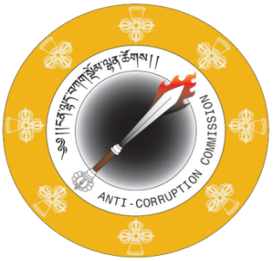

Examples from Bhutan in taking systemic measures to prevent corruption in the forest sector (post investigation)
Personnel Issues – adequate staff and regular transfers
Verification of land registration records to avoid double claims
Record keeping of In and Out flow of timber from Saw mills
Resource allocation – vehicles, equipment, infrastructure, etc
Issue of subsidy in general to be addressed by the Government
Increase the number of forest check posts
Improve documentation to avoid unauthorized claims/manipulation
Sharing experiences in fighting corruption in the forestry sector
- Presentation by Leki Dendup
Royal Govt. of Bhutan
Anti-Corruption Commission
Thimphu
Post Box 1113
Tel: + 975 2 334863 /64/66/67/68/60
Fax No: + 975 2 334865

Slide 21
Anti-corruption for REDD+
Political economy studies examining corruption
Hiring of an anti-corruption experts at REDD+ National Coordination
Building on UNDP’s anti corruption programme
  Short term : Training on investigative journalism
  Medium term : Citizen budget for citizen budget monitoring
  Longer term : Capacity strengthening of Supreme Audit Court
REDD+

Slide 22
Thank you !
All information on www.unredd.net
Summary on www.un-redd.org

