Slide 1
Transparency, integrity and accountability for REDD+ in Bangladesh
Stakeholder consultation for study
Dhaka, Bangladesh, 6 April 2013

Slide 2
Why focus on governance and integrity issues in REDD+ ?
The big picture
  Impact of corruption and illicit financial flows on human rights and development
National frameworks and international agreements
  Cancun safeguards
  United Nations Convention Against Corruption, ADB/OECD Anti-Corruption Initiative for Asia and the Pacific
  National Integrity Strategy
The pragmatic reasons : effectiveness, efficiency, equity, confidence and sustainability of REDD+
Notes:
The big picture:
In an interim report presented at the current twenty-second session of the UN Human Rights Council, Independent Expert on foreign debt Mr Cephas Lumina said that it is estimated that, on average, developing countries lost between US$783 billion and US$1,138 billion in illicit financial outflows in 2010.
“Corruption is an enormous obstacle to the realization of all human rights, in practical terms – civil, political, economic, social and cultural, as well as the right to development” the High Commissioner for Human Rights
2. International agreements
Cancun safeguards : countries shall respect and promote 7 safeguards, one of which is the “effective and transparent forest governance measures”
UNCAC : Bangladesh acceded in 2007
NIS : The Government believes that the fight against corruption cannot be won by prosecution alone, an inclusive approach based on values, morals, ethics and integrity is necessary. The NIS captures this approach to help prevent corruption and enhance transparency and accountability

Slide 3
Lack of integrity in REDD+ would:
Undermine effectiveness
Undermine efficiency
Undermine equity
Discourage investors
sustainability of REDD+
Governance challenges also lie outside the forestry sector

Slide 4
Lack of integrity in REDD+
1. Existing practices that enable/enhance deforestation and forest degradation
Turning a blind eye on illegal logging (felling, transport, certification) in exchange for a bribe
Falsely and illegally issued logging licenses and concessions
Elite capture of forests resources and benefits
Deliberate information retention about forest resources and harvest
Notes:
1. Drivers

Slide 5
Lack of integrity in REDD+
1. Existing practices that enable/enhance deforestation and forest degradation
Turning a blind eye on illegal logging (felling, transport, certification) in exchange for a bribe
Falsely and illegally issued logging licenses and concessions
Elite capture of forests resources and benefits
Deliberate information retention about forest resources and harvest
2. New risks brought about by REDD+
Risks related to decisions about land rights or land use that can favor one powerful group over a marginalized group
Risks related to fund management (embezzlement)
Risks related to distribution of benefits at local level (informal taxes, embezzlement)
Fraud related to MRV
Money laundering of REDD+ assets
...

Slide 6
Different phases of REDD+ imply different risks
Phase 1 : institutional set up and strategy-making
Phase 2 : implementation of policies and pilots
Phase 3 : MRV and performance payments
Influencing decisions to favor one group over more vulnerable ones
Turning a blind eye on non-respect of measures
Embezzlement of funds, money laundering

Slide 7
REDD+ readiness presents opportunities to tackle these risks and promote transparency and accountability – in the forest sector and in fund management
Transparent, inclusive, balanced, multi-stakeholder decision-making processes can mitigate the risk of back-door deals
Timely, usable access to relevant information about REDD+ processes, decisions and systems can enhance oversight, effectiveness and trust
Technical “transparency” tools can be developed to instill transparency in the movement of funds
Well-maintained and accessible REDD+ project registries can be turned into important transparency tools
Inclusive monitoring, social audits and ‘early warning’ dialogues systems can enhance trust, responsiveness and rapid remedial actions
Clear tenure rights can mitigate small scale illegal logging
Safeguard information systems can include strong transparency indicators
Free prior and informed consent
Notes:
1. “Sunlight is the best disinfectant”. Article 13 of UNCAC can be used as a platform for CSOs to advocate to government that they should be closely involved in the development, implementation and oversight of REDD+ programmes. For example, CSOs in a number of countries have already been very useful in conducting “social audits” of government welfare programmes.
2. Timely and usable information means it is in an accessible language and format – for example having a website is a good start but not a panacea !
3. Online platforms that automatically track the flow of funds - (Brasil)
4.
Of course this requires increased capacity but the benefits go beyond REDD+

Slide 8
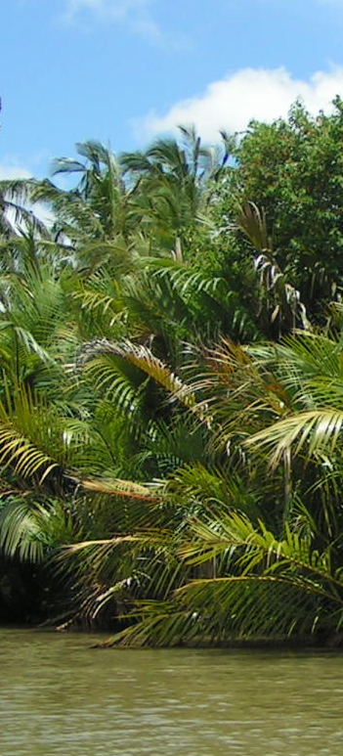
Who are the actors of integrity in REDD+ ?
REDD+ Cell, Steering and Advisory Committee
Civil society and indigenous organizations
Oversight bodies
Law enforcement, justice system or special courts
Media
Parliamentary commissions and legislators
Neighbour countries
International partners
Notes:
1.REDD units : in designing transparent and inclusive REDD+ strategies, providing accessible information, receiving and addressing feedback (responsiveness)
2.CSO and IPs : acting as social auditors in the planning, implementation and monitoring phases – not solely watchdogs, but also partners
3. Anti corruption commissions
Investigations
Development of AC strategy : In countries which already have a NACS, REDD+ stakeholders can and still should engage with the agency responsible for coordinating/monitoring implementation to identify entry points for highlighting REDD+ anti-corruption issues within the government’s overall AC strategy. Likewise, in countries which are developing their NACS and/or NACS implementation plans, REDD+ stakeholders should engage as active participants in any working group / stakeholder group which is tasked with developing the NACS.
4. Justice system
5. Parliaments: At a concrete level, political will can be strengthened by direct advocacy/engagement with members of the national (and sub-national) legislatures which will be responsible for passing/amending REDD-relevant legislation and utilising committee oversight powers to review implementation of REDD+ programmes
6. Neighbour countries in enforcement coordination
7. International partners for technical support

Slide 9
Study : REDD+ Integrity in Bangladesh
Objective : analyze risks to REDD+ and formulate practical transparency and accountability recommendations that can inform the Bangladesh readiness process, and in particular the REDD+ readiness roadmap and funding proposals.

Slide 10
Study : REDD+ Integrity in Bangladesh
Stakeholders
Anonymous questionnaire, interviews, focus group discussions
Lead
Periodic guidance and feedback
Stakeholders and information providers
Core stakeholders
REDD cell and UNDP/UN-REDD
Notes:
Wider constituency : groups identified by Danesh

Slide 11
Suggested study methodology
ASSESSMENT OF INTEGRITY GAPS AND NEEDS
Synthesis of perceptions
Focus Group Discussions and interviews
Summaries
Literature review
Questionnaire
Regional Workshops
Preliminary report
National Validation workshop
Final report and integration into national REDD+ process

Slide 12
Parameters
Enabling environment | Specific for REDD+ roadmap
Anticorruption framework | Fund management systems
Policy-making | Participation
Legal frameworks | Transparency and access to information
Fund management system | Citizen demand for accountability
Procurement policies and systems | Complaints and justice delivery
Transparency and access to information | Safeguards
Complaints and justice delivery
Governance in forest sector

Slide 13
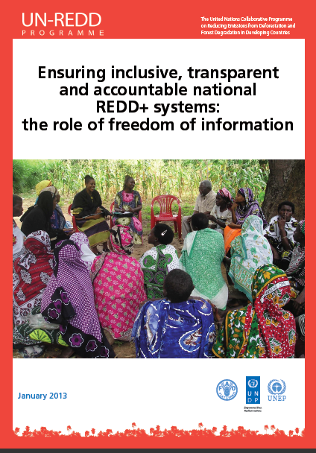
Study : REDD+ Integrity in Bangladesh
Literature review
Background and existing reports
Analysis of laws, policies and systems
    2009 Right to Information Act
    Forestry Master Plan
    Whistleblower Protection
    Existing Climate Fund management systems
    Existing benefit distribution systems (Social Forestry)
Global guidances
    The role of freedom of information in REDD+ (UN-REDD 2013)
    UN-REDD Guidance on Conducting REDD+ Corruption Risks Assessment
    Transparency International’s “Keeping REDD + Clean”

Slide 14
Study : REDD+ Integrity in Bangladesh
Anonymous survey to assess perception
Three objectives:
  As an awareness-raising tool
  To provide initial insights on the major concerns expressed by stakeholders
  To point to trends in perceptions among different stakeholder groups (such as NGOs and CSOs, private sector, women, youth, government agencies, anti-corruption bodies etc).
Similar to those conducted during a UN-REDD Regional Workshop in 2011 and in other countries (Philippines, DRC)
Sample questions :
  Evaluate the likelihood that there would be secret agreements to favour certain types of REDD+ activities (for example, SFM vs. conservation)
  Evaluate the impact that this risk would have

Slide 15
Study : REDD+ Integrity in Bangladesh
Interviews and focus group discussions
Sample questions :
  What is your knowledge of, or experience in using the Right to Information Act?
  What is your knowledge of, or experience in using feedback, grievance, conflict resolution and redress mechanisms?
  Do bodies/agencies relevant to REDD+ apply internal controls and external auditing to their fiscal spending? How effective are these?
Not the same questions to all interviewees or groups!

Slide 16
Seeking stakeholders responses
Online anonymous survey
ACADEMIA-10%
FOREST DEPARTMENT 20%
FGD
CHT
3
LOCAL GOVERNMENT
10%
CIVIL SOCIETY
30%
ADMINISTRATION
10%
SUNDARBANS
3
SYLHET
3
INDIVIDUAL INTERVIEWS
CHT
10
COX’S BAZAR
10
GREATER SYLHET
20
SUNDARBANS
10
DHAKA
20
STAKEHOLDER WORKSHOP
SUNDARBANS
1
SYLHET
1
CHT
1
SAWMILL
10%
FURNITURE INDUSTRY
10%

Slide 17
Estimated timeline
 | Estimated timeline
 | 15 April | 30 April | 15 May | 31 May | 15 June
LITERATURE REVIEW
STAKEHOLDERS RESPONSES Questionnaire study (desks + fields) FGD Individual interviews * Stakeholder workshops
INITIAL REPORT Draft Draft review * Validation workshop *
FINAL REPORT for integration into roadmap

Slide 18
Questions
Do we have the right “stakeholders” to be polled/interviewed?
  Are the areas for targeted focus group discussions appropriate, given you knowledge or REDD+ potential ?
Do you recommend particular reports/activities to look into?
General comments on methodology ?

Slide 19
Estelle Fach & Dr. Danesh Miah
estelle.fach@undp.org dansforestry@yahoo.com
Thank You.
We look forward to your recommendations

