Slide 1



UN-REDD Programme
Entry Points to Mainstream Gender
Engendering REDD Workshop
May 2009
Washington DC

Slide 2

Rationale of UN-REDD Programme
To assist forested developing countries and the international community gain experience with REDD and thereby contribute to the UNFCCC post-2012 process
To assess how REDD payments can create the incentives to ensure actual, lasting, achievable, reliable and measurable emission reductions, while benefiting people and maintaining other ecosystem services forests provide.
Notes:
The UN REDD Programme is a joint program of FAO, UNDP, UNEP – established formally on July 8, 2008 -- and publicly launched by the UN Secretary General and the Prime Minister of Norway on September 24, 2008 during the UN General Assembly heads of state ‘MDG Summit’ in NY.
Our work is a direct response to:
The UNFCCC Decision in Bali 2/CP.13 on ‘Reducing emissions from deforestation in developing countries (i.e. relevant organizations and stakeholders invited to support Party’s efforts (i) to support capacity-building, provide technical assistance, facilitate the transfer of technology to improve, inter alia, data collection, estimation of emissions from deforestation and forest degradation, monitoring and reporting; (ii) address the institutional needs of developing countries to estimate and reduce emissions from deforestation and forest degradation; (iii) undertake demonstration activities.)
Requests from the Coalition for Rainforest Nations and from other countries for support with REDD programmes
Requests from governments – and from the UN Secretary General -- for joint UN action – ‘Delivering as One UN’.

Slide 3
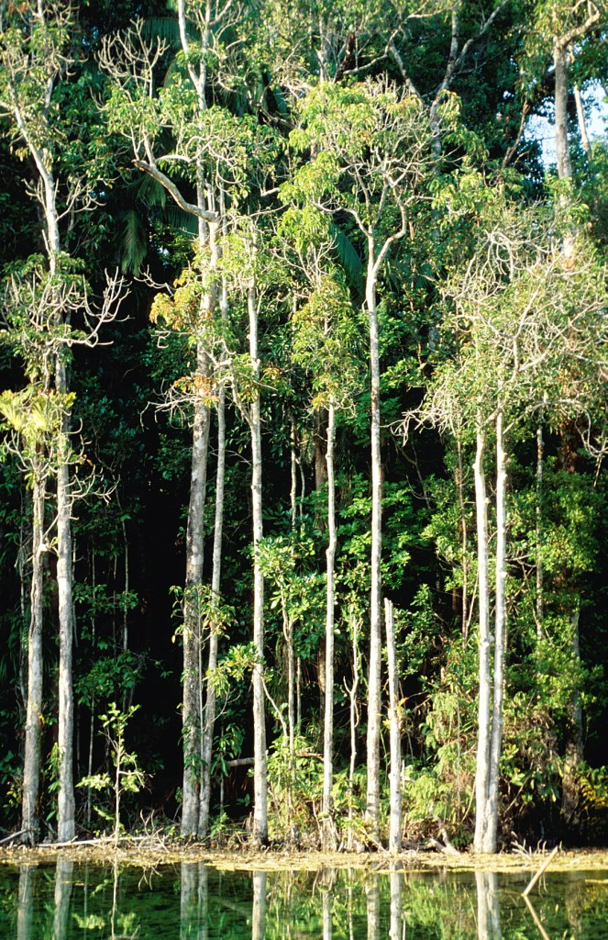
What is the UN-REDD Programme?
Partnership of FAO, UNDP & UNEP to:
Assist developing countries to address capacity development, governance, and technical needs to support effective participation for REDD
Support dialogue and consensus for methodologies for REDD:
Monitoring, Reporting, Verification
Stakeholder Engagement
Benefit Sharing
Carbon Accounting
Multiple Benefits
Payment Mechanisms
Notes:
The UN-REDD Programme responds to the Bali decision and requests from UNFCCC, donors, and developing countries – nine pilot countries are currently participating (list them…)
Methodologies include – MARV, National Carbon Accounting, Payment Mechanisms & Structuring, Stakeholder Engagement, Benefit Sharing, Multiple Benefits
The UN-REDD Programme has four outcome areas:
International and multi-sectoral coherence on key technical and operational issues (e.g. Measurement, Reporting and Verification (MRV), links to payment structures)
2) Negotiators & other stakeholders informed on REDD issues (in collaboration with the UNFCCC Secretariat)
3) Key institutions & stakeholders in pilot countries have the capacity to develop and implement participatory and equitable systems of MRV and payment structures
4) Developing countries are able to reduce risks and maximize benefits associated with generating verifiable and permanent emissions reductions

Slide 4
Pilot Countries
Africa
  Democratic Republic of the Congo, Tanzania, Zambia
  Asia & Pacific
  Indonesia, Papua New Guinea, Vietnam
  Latin America & Caribbean
  Bolivia, Panama, Paraguay

Slide 5
Key Principles
One country-driven, national program (that builds on existing processes of UNFCCC, World Bank, GEF, etc. and includes civil society and IPs)
Focus on Governance and Local Empowerment
Guided by the five inter-related principles of the UN Development Group (UNDG):
  Human-rights-based approach
  Gender equality
  Environmental sustainability
  Results-based management
  Capacity development
Notes:
Focus on Governance and Local Empowerment: Contributing to a decentralized, multi-stakeholder mechanism, that takes into account experience and knowledge local people have to make REDD work.
In addition to the consultation process, the UN-REDD Programme is carrying out other activities to ensure that co-benefits are integrated into national REDD strategies:
Developing pro-poor indicators for REDD interventions. This will build on the work of UNDP’s Oslo Governance Centre, which has developed a generic framework on building democratic governance indicators that are gender sensitive and pro poor. This framework could be applied to REDD in cooperation with sector experts.
Ensuring that negotiators and observers (especially non-governmental organizations (NGOs) representing local communities and indigenous peoples) from developing countries are fully abreast of the latest developments, and effectively participate in the negotiations, in advancing the REDD agenda is a key building block of the Bali Roadmap.

Slide 6
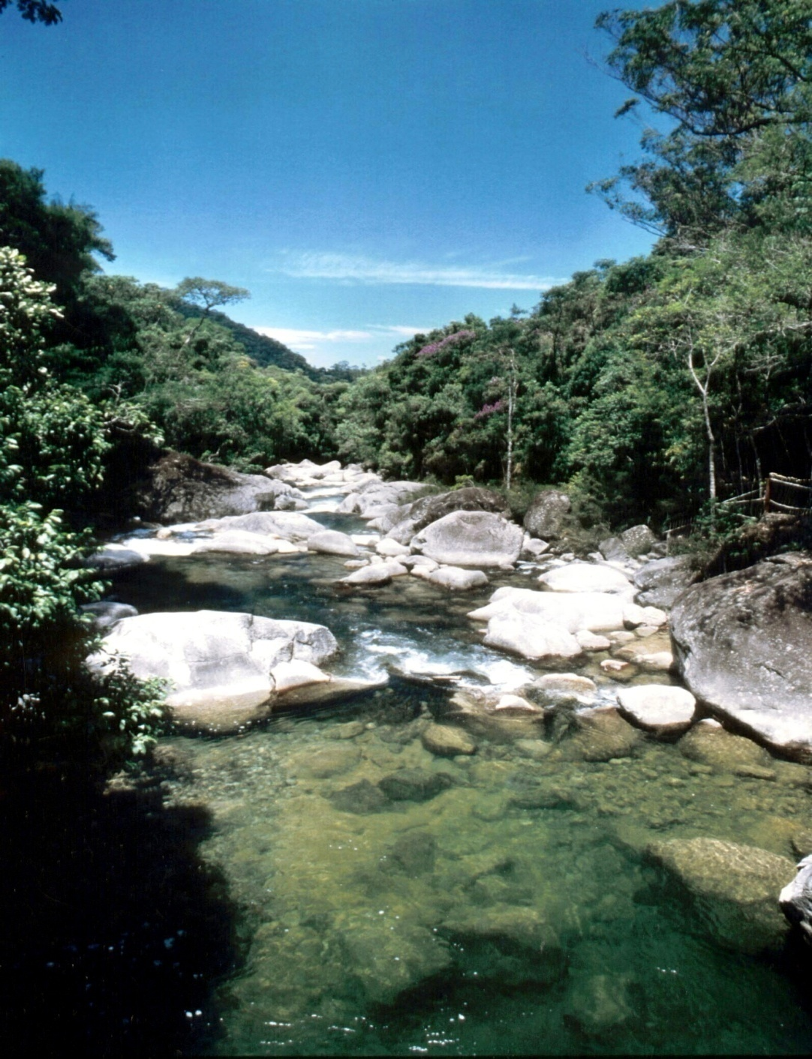
Entry Points to Mainstream Gender
Mainstreaming across ‘readiness components’:
    monitoring indicators
    Payment structuring
    Benefit sharing arrangements
    Stakeholder participation processes
  2. Operational Guidance on the Engagement of Indigenous Peoples and other Forest Dependent Communities
  3. Civil Society Advisory Group
  4. Civil Society Representatives on the Policy Board

Slide 7
REDD Action Phases
Readiness
National REDD Strategy
Capacity Building &
Institution Strengthening
Large scale
Investment Programmes
Performance-based mitigation payments

Slide 8
Components of National Readiness
Management of Readiness
REDD Implementation Framework
Stakeholder Participation
National REDD Strategy Development
Reference Scenario
National Carbon MRV System

Slide 9
Components of National REDD Readiness
MANAGEMENT OF READINESS
Line Ministries & Departments
Consultative process
Communication Plan
Statutory Bodies & Institutions
National REDD Strategy
National REDD Working Group
House of Chiefs
NGOs, CSOs, private sector
Experts, other key stakeholder
Lessons learned
Mapping of relevant initiatives
Status of information

Slide 10
Components of a national REDD regime
REDD IMPLEMENTATION FRAMEWORK
Analysis of resource and carbon ownership
Identification of REDD beneficiaries
Agreed allocation framework
Analysis of national legislative framework
Credible and transparent REDD framework
Analysis of policy and institutional arrangements

Slide 11
Components of a national REDD regime
STAKEHOLDERS PARTICIPATION
Refinement and endorsement of REDD priorities at provincial/ district level
National REDD Working Group
REDD benefit sharing
Stakeholder involvement
National REDD strategy
Baseline surveys

Slide 12
Example National Joint Programme Outcomes
Strengthened multi-stakeholder participation and consensus at national level
Successful demonstration of establishing a REL, MARV and fair payment systems based on the national REDD architecture
Capacity established to implement REDD at decentralized levels
National governance framework and institutional capacities strengthened for REDD
Improved capacity to manage REDD and provide other forest ecosystem services at district and local levels
Notes:
Objective
-State (or summarise) the Objective from the NJP
-Explain how it fits into broader REDD and/or National Development (i.e. UNDAF) goals
Outcomes
-List the NJP Outcomes
Initial NJP
-For countries only submitting an “initial” NJP (i.e. DRC, PNG and potentially Panama), make it clear here
-Clarify the duration and scope of the initial NJP
Highlights
-If there is something of particular interest or importance to note about the NJP intervention, mention it here. But not necessary to do so.

Slide 13
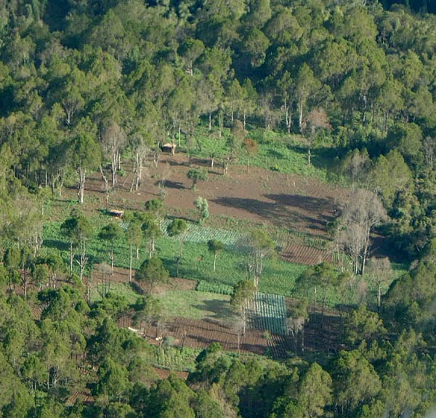
IP & Forest Community Guidelines for UN-REDD Programme
Representation
On Policy Board & National Committees
Independent Civil Society Advisory Group
Transparency & Access to Information
Access to reports & official documents
Primers & guidance for IPs on REDD
Participation in relevant IP-led conferences
Consultation documents co-developed with IPs
Distribution of annual reports to IP networks
Participation & Inclusion
Fora for IP perspectives in REDD dialogue
National participation & engagement strategy
Activities & budget allocations in national programs
Assessment of activity impact on IP rights
Accountability
Concerns & complaints addressed through Secretariat and Resident Coordinator
Notes:
Part 3: UN-REDD Programme Operational Guidelines for the Engagement of Indigenous Peoples and Other Forest Dependent Communities
The Operational Guidelines shall be followed in the development, implementation and monitoring and evaluation of all UN-REDD Programme activities that may impact the rights and livelihoods of Indigenous Peoples and other forest dependent communities.
Guidelines for Global UN-REDD Programme Activities:
Representation
1) Indigenous Peoples will be represented on the UN-REDD Policy Board by the Chair of the United Nations Permanent Forum on Indigenous Issues or by his/her designate.
2) The Chair of the Permanent Forum on Indigenous Issues will be a full and equal Member of the UN-REDD Programme Policy Board empowered to guide the direction and content of the UN-REDD Programme.
3) Indigenous Peoples and other forest dependent people will be invited to engage with the Independent Civil Society Advisory Group to the UN-REDD Programme, which is empowered to monitor activities and provide substantive advice on the Programme to the UN-REDD Policy Board. [Note: this point to be considered if the arrangement with the CSO Advisory Group is agreed upon]
Transparency & Access to Information
4) The UN-REDD Programme will publish meeting reports and official documents on the UN-REDD Programme website.
5) The UN-REDD Programme will facilitate and support the development of primers and guidance materials to build the capacity of Indigenous Peoples to fully engage on REDD and, where appropriate, be able to effectively participate in decision-making processes and activities.
6) The UN-REDD Programme will participate in international conferences and summits focused on Indigenous Peoples and other forest dependent peoples, climate change, and REDD, to report on the activities of the programme and maintain open channels of communication with a wide array of Indigenous Peoples stakeholders.
Participation & Inclusion
7) The UN-REDD Programme will provide fora for Indigenous Peoples issues to be raised and integrated into the international negotiation process on REDD.
Point to the DRC National Joint Programme formulation process as best practice - ie. Requirement to assess and reform land tenure arrangements before activities take place and to establish National REDD Committee with six national representatives and six civil society representatives
Guidelines for National UN-REDD Programme Activities:
Representation
1) Indigenous Peoples and/or other forest dependent communities shall be represented on National REDD Steering Committees or equivalent bodies, where established.
Participation & Inclusion
2) In order to be endorsed by the UN-REDD Technical Secretariat for approval by the UN-REDD Programme Policy Board, draft National Joint Programmes (NJPs) must submit minutes of a ‘validation meeting’ of National Stakeholders (where established: the National REDD Steering Committee), including Indigenous Peoples’ representative(s). The representative(s) will be:
i. Representative(s):
ｷ Selected through a participatory, consultative process,
ｷ Having national coverage or networks,
ｷ Previous experience working constructively with the government and UN system,
ｷ Demonstrated experience serving as a representative, receiving input from, consulting with, and providing feedback to, a wide scope of civil society/Indigenous Peoples organizations;
ii. Representative(s) who participated in a UN-REDD Programme scoping and/or formulation mission and sit(s) on a UN-REDD Programme consultative body established as a result of the mission, or;
iii. Individual(s) recognized as legitimate representative(s) of a national network of civil society and/or Indigenous Peoples organizations (e.g. the GEF Small Grants National Steering Committee or National Forest Programme Steering Committee)
3) The ‘validation meeting’ shall be one step of a wider consultation and engagement strategy which should be documented as an annex to the Programme Document.
4) The National Joint Programme consultation and engagement strategy should effectively involve Indigenous Peoples and other forest dependent communities, and civil society organizations in all stages, including program design, implementation, and monitoring and evaluation, adhering to the same guiding principles as mentioned above in Part 2. In countries that are also developing programs under the Forest Carbon Partnership Facility (FCPF), it is encouraged that the UN-REDD Programme and FCPF undertake one collaborative consultation process. See Annex 1 of the Operational Guidance on Best Practice for Consultation.
5) National Joint Programs should include activities and resources to support ongoing consultation, engagement and partnership to ensure that national UN-REDD activities take into account current priorities and concerns articulated by representatives of Indigenous Peoples and other forest dependent communities.
6) National Joint Programs are encouraged to assess the impact of UN-REDD Programme activities on land rights and other rights of Indigenous Peoples as contained in the UN Declaration on the Rights of Indigenous Peoples prior to taking decisions on such activities, strictly following FPIC procedures.
Transparency & Accountability
7) Outcome documents from consultations such as meeting minutes, reports, work plans, and roadmaps for implementation should be circulated to Indigenous Peoples’ organizations for an assessment of their accuracy, should be publicly accessible, and reflected, as appropriate, in National Joint Program Documents, on the UN-REDD website, and submitted to the Policy Board annually.
8) The Resident Coordinator shall distribute annual reports on UN-REDD Programme activities to Indigenous Peoples and civil society networks through the Indigenous Peoples representative on the National UN-REDD Steering Committee in order to ensure transparency and accountability.
9) The Resident Coordinator is responsible for ensuring that the National Joint Program abides by the UN’s Standards and Declarations. As an additional safeguard, a complaint mechanism (to be elaborated in more detail and build upon existing grievance mechanisms, where they exist) will be established by the Technical Secretariat to ensure that activities supported by the UN-REDD Programme do not result in the violation or erosion of the rights of Indigenous Peoples and other forest dependent communities. The procedure and contact information for making complaints will be posted on the UN-REDD Programme website

Slide 14
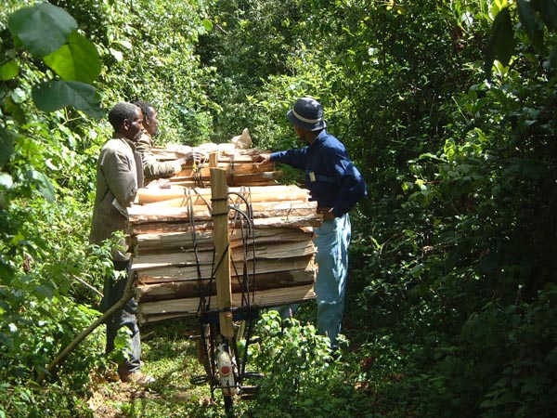
UN-REDD Programme Governance
Policy Board made up of 9 participating countries, donors, agencies, Indigenous Peoples, CSOs & observers
Policy Board decisions made by consensus among members
Informed by Independent Civil Society Advisory Group
Supported by UN-REDD Programme Secretariat, staffed by partner agencies
Notes:
The UN-REDD Programme Policy Board is made up of representatives of the participating countries, the partner agencies, the donor governments, Indigenous Peoples, CSOs, and observers
The Policy Board takes decisions by consensus among members
The Policy Board is supported by a UN-REDD Programme Secretariat to ensure implementation

Slide 15
Civil Society & IPs on the Policy Board
Indigenous Peoples & Forest Dependent Communities:
  One full member (Chair of UNPFII – invited)
  Three observers (one from each region), as selected by the regional caucuses to the UNPFII
Civil Society:
  One full member
  Three observers
  Representatives will be from each of the three regions and one ‘northern’ NGO.
  To be selected via a self selection process TBD
Notes:
Measures to provide incentives to developing countries to slow down their rates of deforestation and forest degradation to reduce emissions of greenhouse gases.
Industrialized countries make financial transfers to developing countries to compensate them for costs of avoiding deforestation.

Slide 16
Civil Society Advisory Group
To provide independent advice and guidance to the UN-REDD Programme in response to issues raised by civil society
Initial membership:
Committee of Conference on Rights, Forests and Climate (October 2008)
(RRI, RFN, Tebtebba, Forest Peoples Prog, and others)
Activities:
Advice on self-selection process for civil society representatives to the policy board
Host panel discussion on governance indicators at next policy board meeting (June)
www.rightsandclimate.org
Notes:
Part 3: UN-REDD Programme Operational Guidelines for the Engagement of Indigenous Peoples and Other Forest Dependent Communities
The Operational Guidelines shall be followed in the development, implementation and monitoring and evaluation of all UN-REDD Programme activities that may impact the rights and livelihoods of Indigenous Peoples and other forest dependent communities.
Guidelines for Global UN-REDD Programme Activities:
Representation
1) Indigenous Peoples will be represented on the UN-REDD Policy Board by the Chair of the United Nations Permanent Forum on Indigenous Issues or by his/her designate.
2) The Chair of the Permanent Forum on Indigenous Issues will be a full and equal Member of the UN-REDD Programme Policy Board empowered to guide the direction and content of the UN-REDD Programme.
3) Indigenous Peoples and other forest dependent people will be invited to engage with the Independent Civil Society Advisory Group to the UN-REDD Programme, which is empowered to monitor activities and provide substantive advice on the Programme to the UN-REDD Policy Board. [Note: this point to be considered if the arrangement with the CSO Advisory Group is agreed upon]
Transparency & Access to Information
4) The UN-REDD Programme will publish meeting reports and official documents on the UN-REDD Programme website.
5) The UN-REDD Programme will facilitate and support the development of primers and guidance materials to build the capacity of Indigenous Peoples to fully engage on REDD and, where appropriate, be able to effectively participate in decision-making processes and activities.
6) The UN-REDD Programme will participate in international conferences and summits focused on Indigenous Peoples and other forest dependent peoples, climate change, and REDD, to report on the activities of the programme and maintain open channels of communication with a wide array of Indigenous Peoples stakeholders.
Participation & Inclusion
7) The UN-REDD Programme will provide fora for Indigenous Peoples issues to be raised and integrated into the international negotiation process on REDD.
Point to the DRC National Joint Programme formulation process as best practice - ie. Requirement to assess and reform land tenure arrangements before activities take place and to establish National REDD Committee with six national representatives and six civil society representatives
Guidelines for National UN-REDD Programme Activities:
Representation
1) Indigenous Peoples and/or other forest dependent communities shall be represented on National REDD Steering Committees or equivalent bodies, where established.
Participation & Inclusion
2) In order to be endorsed by the UN-REDD Technical Secretariat for approval by the UN-REDD Programme Policy Board, draft National Joint Programmes (NJPs) must submit minutes of a ‘validation meeting’ of National Stakeholders (where established: the National REDD Steering Committee), including Indigenous Peoples’ representative(s). The representative(s) will be:
i. Representative(s):
ｷ Selected through a participatory, consultative process,
ｷ Having national coverage or networks,
ｷ Previous experience working constructively with the government and UN system,
ｷ Demonstrated experience serving as a representative, receiving input from, consulting with, and providing feedback to, a wide scope of civil society/Indigenous Peoples organizations;
ii. Representative(s) who participated in a UN-REDD Programme scoping and/or formulation mission and sit(s) on a UN-REDD Programme consultative body established as a result of the mission, or;
iii. Individual(s) recognized as legitimate representative(s) of a national network of civil society and/or Indigenous Peoples organizations (e.g. the GEF Small Grants National Steering Committee or National Forest Programme Steering Committee)
3) The ‘validation meeting’ shall be one step of a wider consultation and engagement strategy which should be documented as an annex to the Programme Document.
4) The National Joint Programme consultation and engagement strategy should effectively involve Indigenous Peoples and other forest dependent communities, and civil society organizations in all stages, including program design, implementation, and monitoring and evaluation, adhering to the same guiding principles as mentioned above in Part 2. In countries that are also developing programs under the Forest Carbon Partnership Facility (FCPF), it is encouraged that the UN-REDD Programme and FCPF undertake one collaborative consultation process. See Annex 1 of the Operational Guidance on Best Practice for Consultation.
5) National Joint Programs should include activities and resources to support ongoing consultation, engagement and partnership to ensure that national UN-REDD activities take into account current priorities and concerns articulated by representatives of Indigenous Peoples and other forest dependent communities.
6) National Joint Programs are encouraged to assess the impact of UN-REDD Programme activities on land rights and other rights of Indigenous Peoples as contained in the UN Declaration on the Rights of Indigenous Peoples prior to taking decisions on such activities, strictly following FPIC procedures.
Transparency & Accountability
7) Outcome documents from consultations such as meeting minutes, reports, work plans, and roadmaps for implementation should be circulated to Indigenous Peoples’ organizations for an assessment of their accuracy, should be publicly accessible, and reflected, as appropriate, in National Joint Program Documents, on the UN-REDD website, and submitted to the Policy Board annually.
8) The Resident Coordinator shall distribute annual reports on UN-REDD Programme activities to Indigenous Peoples and civil society networks through the Indigenous Peoples representative on the National UN-REDD Steering Committee in order to ensure transparency and accountability.
9) The Resident Coordinator is responsible for ensuring that the National Joint Program abides by the UN’s Standards and Declarations. As an additional safeguard, a complaint mechanism (to be elaborated in more detail and build upon existing grievance mechanisms, where they exist) will be established by the Technical Secretariat to ensure that activities supported by the UN-REDD Programme do not result in the violation or erosion of the rights of Indigenous Peoples and other forest dependent communities. The procedure and contact information for making complaints will be posted on the UN-REDD Programme website

Slide 17
Making REDD work for Gender Equity
International REDD negotiations and schemes must ensure compliance with international and national commitments on gender equality and equity, including CEDAW
Ensure full participation and integration of women, from local and indigenous communities, in policy design processes
Equitable access to, and distribution of, the economic benefits derived from forest services provided to mitigate climate change
Promote equal access of women to land ownership and other resources
Both women and men must be trained in methods to increase carbon sequestration through forestry technologies, etc.
Notes:
Recommendations
• International negotiations or regimes in relation to REDD must ensure compliance with international and national commitments on gender equality and equity, including the Convention on the Elimination of All Forms of Discrimination against Women (CEDAW).
• From the onset, ensure full participation and integration of women, from local and indigenous communities, in policy design processes (international and national) as well as in the broad-scale implementation of REDD.
• Forestry projects used to mitigate and adapt to climate change require a gender-based approach that captures the socially-defined differences between women and men, i.e. gender-based differences in roles and responsibilities, problems, needs and priorities, and knowledge of, and access to and control over forest and tree resources.
• Promote systematic attention to the participation of women in forestry development in policies, strategies and capacity-building efforts related to the conservation and sustainable development of forests and trees and their use.
• There should be equitable access to, and distribution of, the economic benefits derived from forest services provided to mitigate climate change. Programmes should also promote equal access of women to land ownership and other resources necessary for effective socio-economic participation in forest management and climate mitigation strategies (e.g., land, capital, technical assistance, technology, tools, equipment, markets and time).
• Afforestation, reforestation, or forest preservation projects that receive payment for ecosystem services, such as carbon sequestration, should mainstream gender. Women should be included in the design and implementation of the projects, as well as in the distribution of benefits.
• Both women and men must be trained in methods to increase carbon sequestration through new forestry technologies, including nursery techniques, site selection, and selection of species, land preparation, planting, weeding, and maintenance.
• Responses to global climate changes should avoid a narrow criterion that leads to environmentally and socially harmful consequences. These responses should have broad goals that aim to reduce climatic change, protect natural resources, improve social well-being, promote equality, and recognise that women are key agents in climate change processes.

Slide 18
Thank you!
www.un-redd.net

Slide 19
Gender Concerns: REDD
Market Mechanisms Can Exacerbate
Existing Inequalities
Women earn less, own less, have fewer capital assets, less land and fewer inheritance rights.
Therefore they have less to sell and are less likely to be compensated for environmental services
Notes:
An analysis of several India and Nepal community forest groups highlighted the fact that, in most cases, cash is not distributed equally and funds are commonly invested in resources or activities from which women were unlikely to benefit, such as club repair, purchasing community utensils, rugs, drums, etc. (Agarwal, 2002).

Slide 20
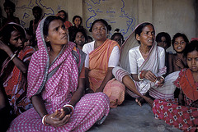
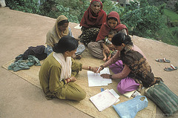
Gender Concerns: REDD
Market Mechanisms Demand Skills and Education
Women also have less access to formal education than men and thus fewer formally acquired skills (e.g. languages), making it much harder for them to:
    Engage in technical and legal negotiations on REDD
    Have sufficient education to benefit significantly from REDD projects

Slide 21
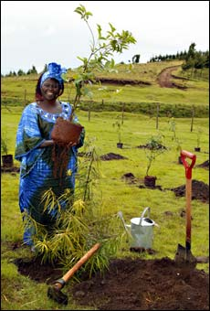
REDD Opportunities:
Gender Equity
Women are powerful agents of change, as well as innovators in relation to environmental changes
When women are supported to be active participants in response efforts, their role within family and community has been used to great advantage for communities
Notes:
Within the complexity of the services that forests provide for climate change mitigation, it is crucial to understand women’s role in these processes. Strategies are now turning to: understanding and taking into account the different benefits that women and men derive from forestry services; recognising gender differences in access to, control and knowledge of forest resources; and identifying the significant differences in access of women and men to forest-related decision making, institutions, and economic opportunities.
When half of the population is not included or is prevented from participating in decisions, institutions, and programmes relating to climate change mitigation, they are unlikely to feel “ownership” of forestry sector policies. Mitigation strategies represent a unique opportunity to include women in forestry programmes and acknowledge that gender relations will influence many aspects of forest management and governance proposed for reducing greenhouse gases.

Slide 22
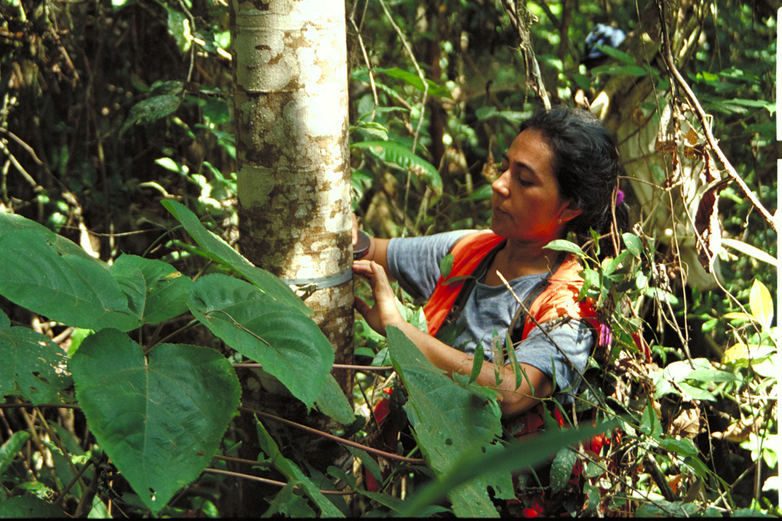
REDD Opportunities:
Gender Equity
Reward women for their biodiversity stewardship, especially regarding saving seeds and nurturing trees through targeted and
effective public governance measures
Ensure the effective enforcement of the UN Convention for
the Elimination of All Forms of Discrimination against Women

Slide 23
Recommendations:
Making REDD Work for Women, Indigenous Peoples
& the Poor

Slide 24
UNDP Mandate: Civil Society
    The United Nations Charter (1945) -- “We the people…”
    Agenda 21 commitment to Major Groups (1992)
    UN Millennium Declaration (2000)
    UNDP and CSOs: a policy of Engagement ( 2001 )
    UNDP Policy on Engagement with Indigenous Peoples (2001)
    UN World Summit (2005)
    UNDP and CSOs: a Toolkit for Strengthening Partnerships (2006)
    UN Declaration on the Rights of Indigenous Peoples (2007)
    UN Development Group (UNDG) Guidelines, Action Plan (2008)
    UNDP CSO Advisory Committee and Liaison Committee on Indigenous Peoples (2001-2008)
    Upcoming UNDP Global Strategy to Strengthen Civil Society and Civic Engagement: “Voice and Accountability for Human Development (2008)
Notes:
The United Nations Charter gives UNDP a clear mandate to work with civil society organizations (CSOs). Chapter X provides that the ECOSOC should arrange consultation with NGOs. This mandate was reaffirmed in the UN Millennium Declaration in 2000, which encourages agencies “…to develop strong partnerships with the private sector and with civil society organizations in pursuit of development and poverty eradication.” This was reinforced at the UN World Summit in 2005 where the UN Secretary General’s “In larger freedom” report recommended a greater engagement of the United Nations with civil society and emphasized its critical role in poverty eradication.
Agenda 21 commitment to Major Groups including women, NGOs, local authorities and indigenous peoples (1992)
From a human rights perspective, UNDP, along with Member Governments, bears duties and obligations towards the poor and excluded who are denied internationally recognized entitlements. To fulfill these obligations, UNDP must engage with and involve a range of civic actors in its programmes.
UN Declaration on the Rights of Indigenous Peoples, adopted by the General Assembly on 13 September 2007. The Declaration is a powerful policy document that obliges states to consult with indigenous peoples to obtain free and informed consent prior to any project affecting their lands, territories or resources.
The UNDG Guidelines on Indigenous Peoples Issues of February 2008 further mainstreams indigenous issues in UN Country Teams. The UNDG has prepared and sent out a Resource Kit for the UN Declaration on the Rights of Indigenous Peoples.
The 2001 UNDP Policy on Engagement with Indigenous Peoples provides staff with a framework to guide their work in building sustainable partnerships with indigenous peoples and their organizations.

Slide 25
UNDP Mandate: Gender
3 Decades of UN agreements addressing the links between environment, human rights and gender
Since the 1979 Convention on the Elimination of All Forms of Discrimination Against Women (CEDAW)
And most recently, the 2007 Global Gender and Climate Change Alliance (GGCA) [by UNDP, IUCN, UNEP, and WEDO]
Notes:
Equality of rights for women is a basic principle of the United Nations.
The Convention on the Elimination of All Forms of Discrimination against Women (CEDAW), adopted in 1979 by the UN General Assembly, is often described as an international bill of rights for women. Consisting of a preamble and 30 articles, it defines what constitutes discrimination against women and sets up an agenda for national action to end such discrimination.
The Global Gender and Climate Change Alliance (GGCA) which was formally launched on December 11, 2007 in Bali, Indonesia. Joint collaboration between UNDP, IUCN, UNEP, and WEDO.
Sustainable development and environment agreements that contribute to the global policy framework on climate change and gender equality include:
Johannesburg Plan of Action (2002)
Millennium Declaration (2000)
World Summit for Social Development (1995)
International Conference on Population and Development (1994)
Convention to Combat Desertification (1994)
Convention on Biodiversity (1992)
Agenda 21 (UN Conference on Environment and Development 1992)
Human rights agreements that contribute to the global policy framework on climate change and gender equality include:
UN Declaration on the Rights of Indigenous Peoples (2007)
World Conference on Human Rights (1993)
International Covenant on Economic, Social and Cultural Rights (1966)
International Covenant on Civil and Political Rights (1966)
Universal Declaration of Human Rights (1948)
Gender equality agreements and resolutions that contribute to the global policy framework on climate change and gender equality include:
Review and Appraisal of the Beijing Declaration and Platform for Action (Commission on the Status of Women 2005)
ECOSOC Resolution 2005/31
Beijing Platform for Action (4th World Conference on Women 1995)
Convention on the Elimination of All Forms of Discrimination against Women (1979)

Slide 26
UNDP Mechanisms to Advance Gender Equity
1995 HDR GDI (gender-related development index) and the GEM (gender empowerment measure)
UNDP Gender Programme Team
UNDP close partnership with the UN Development Fund for Women (UNIFEM)
Notes:
UNDP follows two complementary approaches to achieving gender equality: mainstreaming gender and promoting women’s empowerment.
UNDP applies the concrete tools for measuring gender discrimination through the GDI (gender-related development index) and the GEM (gender empowerment measure)
UNDP has a special responsibility to help upscale and expand innovative models that are developed and tested by UNIFEM — through its global network and through its role of UN co-ordinator.

Slide 27
Making REDD Work for the Poor
Poverty-Environment Partnership (PEP) Recommendations:
Information provision and access
Provision of upfront payment to encourage participation
Use of ‘soft’ enforcement and risk reduction measures
Prioritize ‘pro-poor’ REDD policies and long time horizons
Provide technical & legal assistance to national & local government, NGOs, and the private sector
Maintain flexibility in design of REDD mechanisms
Clear definition and equitable distribution of carbon rights
Development of social standards & application of existing standards to REDD systems
Apply measures to improve equity of benefit distribution
Alignment with international and national development strategies

Slide 28
What is REDD?
REDD = Reducing Emissions from Deforestation and (forest) Degradation
An international financial mechanism providing payments for reducing greenhouse gas emissions associated with deforestation and degradation in developing countries
UN-REDD Programme = A Collaborative Partnership between FAO, UNDP and UNEP
Notes:
Stern Report (2006) – review commissioned by UK – 20 % of current annual GHG emissions is due to land use change – mostly deforestation in developing countries. Report suggested that reduced deforestation measure should be included in post-2012 commitment period under Kyoto Protocol.
In fact, it is now impossible to stabilize global average temperatures within 2 degrees centigrade without emission reductions from the forest sector.
In addition, since controlling deforestation could be one of least expensive ways to reduce emissions, REDD has become central to global/national mitigation measures.
UNFCCC COP13 decision 2/CP13 calls on parties and relevant organizations to support capacity building, technology support, and demonstration activities to test methodologies and iron out technical and social difficulties associated with REDD to inform the negotiation of a post 2012 climate regime.

Slide 29
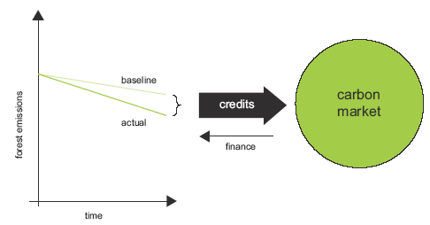
Hypothetical REDD Payments

