Slide 1
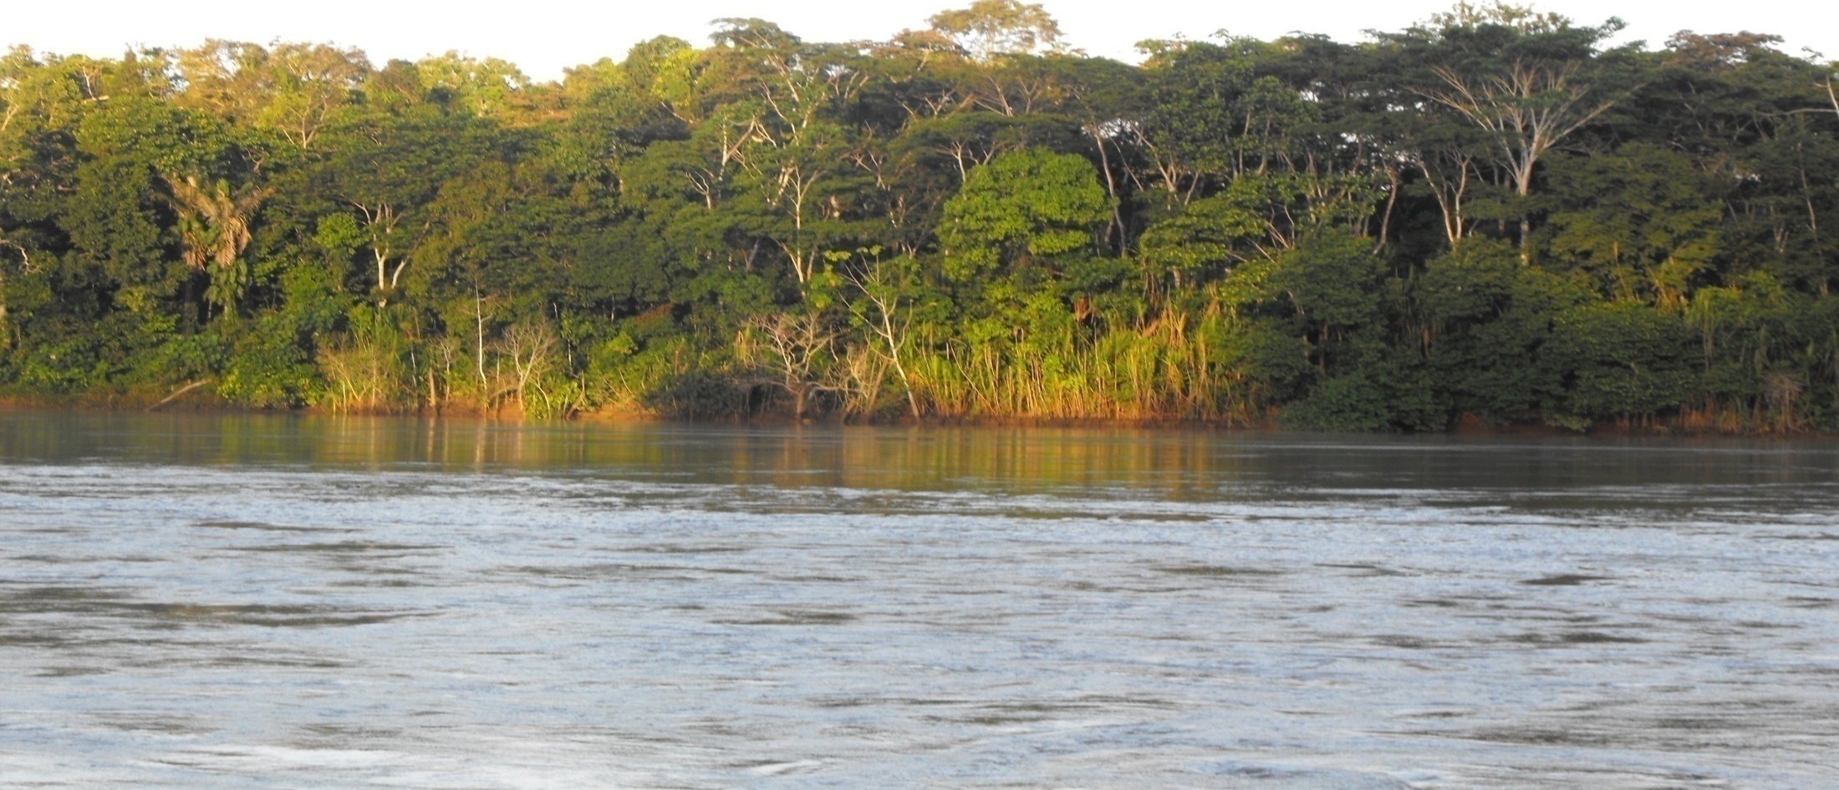
Country Experiences in the development and prioritization of REDD+ Policies and Measures
Joint FCPF – UN-REDD Programme Knowledge Exchange Day
8 de noviembre, 2015
San José, Costa Rica

Slide 2
Prioritization of REDD+ Policies and Measures
Main drivers of deforestation and its projections based on scenarios of development
Identification of potential social and environmental benefits
Legal, political and institutional framework

Slide 3
Prioritization of REDD+ policies and measures
Identification and analysis of drivers in territory and deforestation hotspots
Identification of policy measures and actions against DD
Analysis of potential social and environmental benefits associated
Economic feasibility studies
Alignment of the measures and actions with national priorities and REDD + (safeguards)
Validation and prioritization of measures and actions

Slide 4
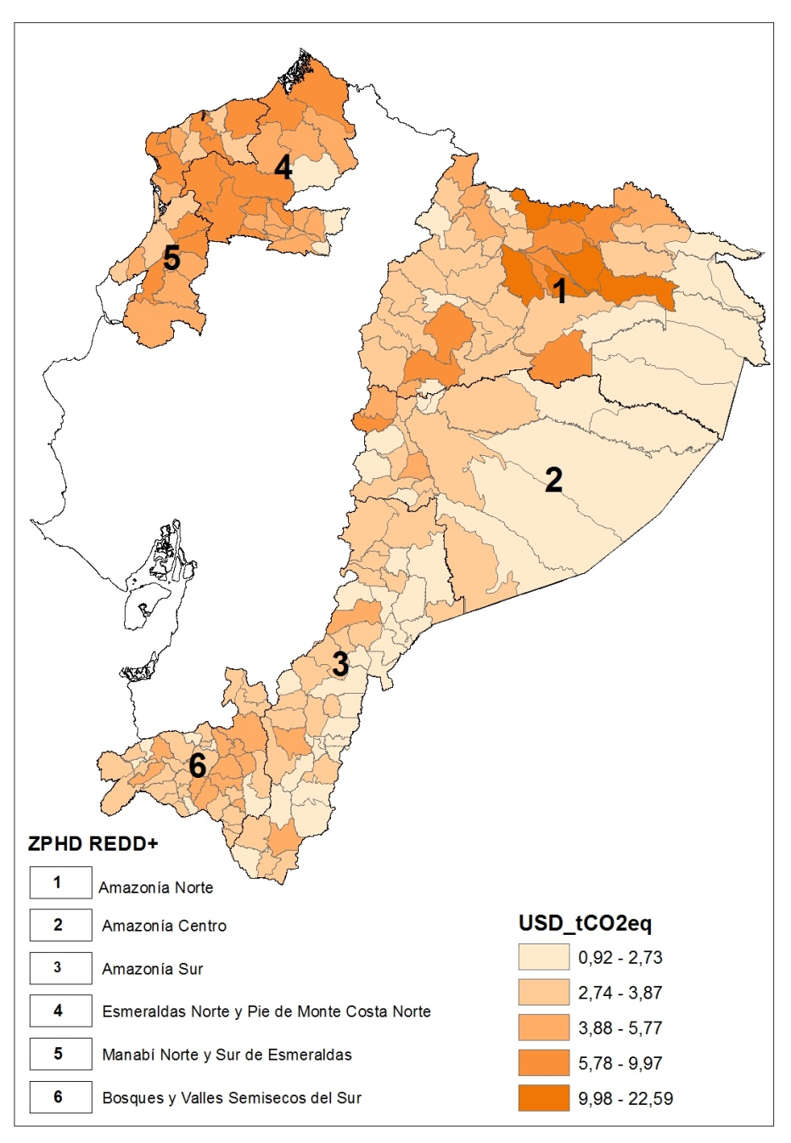
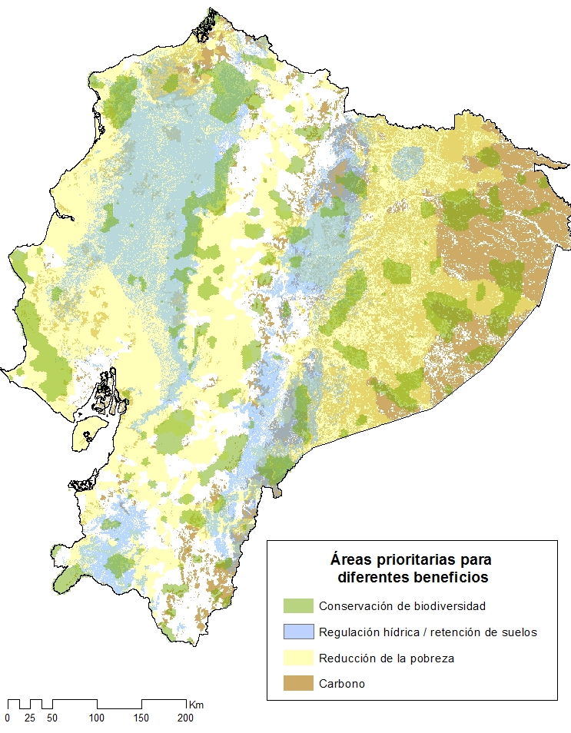
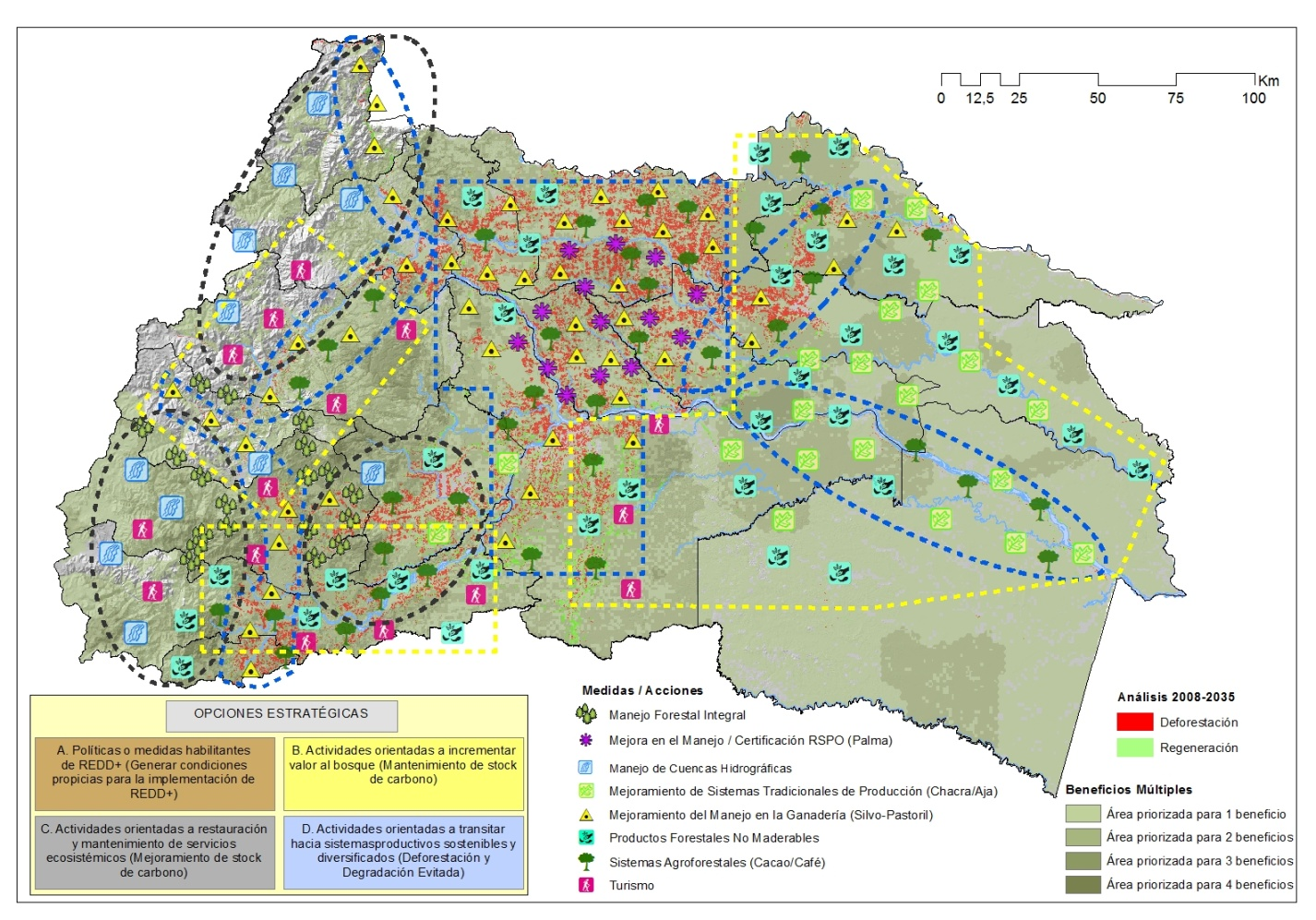
Prioritization Criteria

Slide 5
REDD+ Action Plan of Ecuador
Components Strategic Options | Regional Strategies | Prioritized Measures
C1: Enabling Policies | It has an effect on the development of all strategies | Institucional and political articulation for REDD+ policies and measures implementation Land use planning, zoning and land legalization
C2: Transition to sustainable production systems | Changing production to avoid deforestation Direct incentives to avoid deforestation | Traceability , certification and responsible purchasing policies Productive transformation and transition to sustainable production systems
C3: Increase value in Forest | Changing production to promote regeneration Direct incentives to promote regeneration | Sustainable Forest Management and bioindustries Traceability , certification and responsible purchasing policies
C4: Restoration, conservation and connectivity | Direct incentives to avoid deforestation Direct incentives to promote regeneration | Connectivity and conservation gaps Restoration and maintenance of ecosystem services
C5: Monitoring, safeguards and knowledge management | Supporting the development of regional strategies | Monitoring and Reference Emisssion Level Safeguards Capacity building and knowledge management Comunication
Fuente: PNC ONU REDD+ Ecuador. MAE
Notes:
El Plan de Acción REDD+, consolida los estudios realizados y propone un conjunto de estrategias territoriales compatibles con las 5 opciones estratégicas para intervención dentro y fuera de bosque, con 7 medidas priorizadas
El diseño de las Medidas y Acciones, su priorización e implementación promueve la equidad territorial, cultural, social y de género, tomando en cuenta las condiciones socioeconómicas y biofísicas de los territorios y respetando las estructuras de gobernanza y toma de decisiones existentes.
Queda por definir cómo se implementarán las medidas y acciones a nivel local, lo que se hará con el apoyo específico de ONU REDD, que constituye la transición desde la fase de preparación hacia la implementación del Plan de Acción REDD+ y pagos basados en resultados.
Se espera la oficialización del Plan de Acción REDD+ durante el primer trimestre del 2016

Slide 6
Financial and Operational Planning for PAMs Implementation as part of the national policy framework

Slide 7
Prioritizing cost-effective measures and actions in terms of emissions reductions
Tendencias de deforestación y restauración
Costos de oportunidad e implementación
Reducción de la pobreza y beneficios ambientales
Áreas prioritarias REDD+
Potential areas of intervention of 3,458,872 hectares

Slide 8
Intersectorial , inter-institutional and multi-level management

Slide 9
REDD+ Policies and measures articulation with National Policy
Climate Change as a state policy
Objectives and priorities for productive transformation
Objectives and policies for the conservation and restoration of forests
Priorities for change of the energy matrix
Priorities for poverty eradication

Slide 10
Financial Planning

Slide 11
Financial Planning
Implementation costs analysis
Financing Gap
By 2044, REDD+ implementation would have an approximate total cost of USD 347.5 million
In the absence of other financial sources (international or private), it should be covered by fiscal resources.

Slide 12
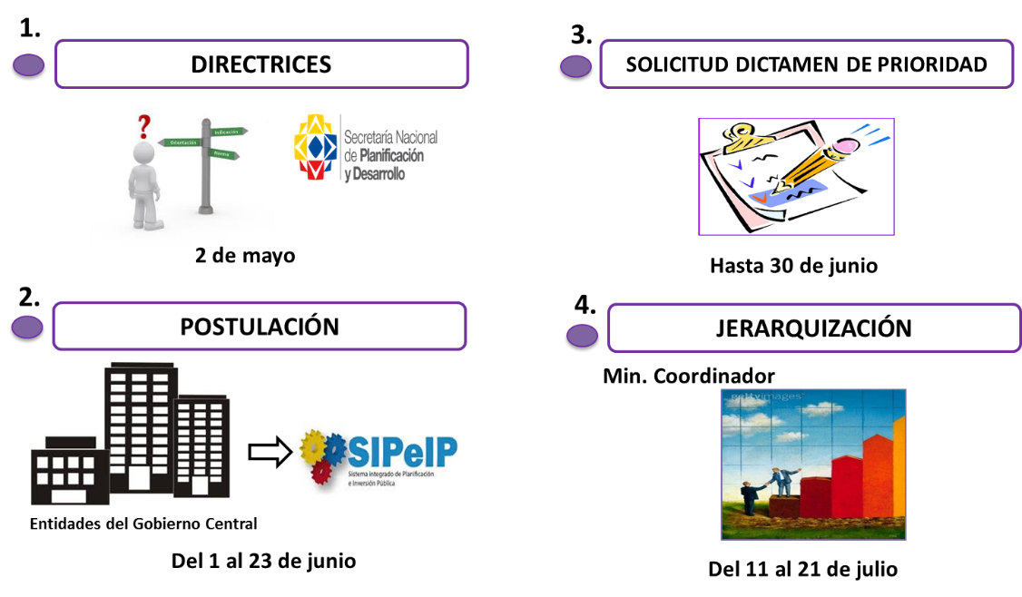
Financing the implementation with public funds

Slide 13
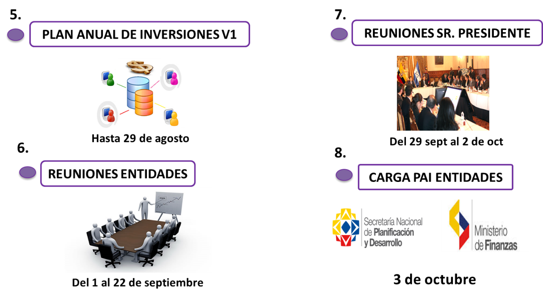
Financing the implementation with public funds

Slide 14
Benefits of the process:
Ensures consistency with the action plan as part of the national public policy
The Action Plan REDD + installs as an official policy (institutionalization)
Allows leverage public resources for REDD+ implementation (operational and administrative expenses).
Facilitates coordination and articulation among relevant stakeholders.

Slide 15
Gracias!
Patricia Serrano
Asesora Técnica Principal TS ONU REDD
pserrano@pnc-onureddecuador.org.ec

