Slide 1
Knowledge Management and Communication
How can it support the design
of REDD+ strategies

Slide 2
What is Knowledge Management?
There are countless definitions for KM
Definition of the term is not important
Need to start by identifying the knowledge challenges that organizations try to solve
Knowledge Management and Information Management
→ Whatever an organization does to solve these challenges
falls under the business discipline “Knowledge Management”

Slide 3
Knowledge Management (The Basics)
Knowledge Management is not a technology, a solution or a piece of software, but a business practice or strategy that needs to align with the goals of an organization
Successful Knowledge Management is all about delivering the right info to the right people at the right time so it can be effectively applied
Often we are already doing so without realizing it. By participating in a workshop for example, sharing personal experiences of what worked and what did not in a particular country or within a specific thematic area, we are passing our knowledge on to others.

Slide 4

Major KM principles
Explicit knowledge can be captured, written down and presented
in documents and databases.
Tacit knowledge
Is the knowledge in
our heads. It is much
less concrete and
more difficult to
document and measure,
however, it is more valuable
because it provides context.
Tacit knowledge requires personal contact and trust to share effectively.
What does this picture have to do
with knowledge management?

Slide 5
Do these quotes sound familiar?
“I can’t find the strategy I need!”
“I don’t know how to do that task!”
“Why didn’t we know about this before? We could have
saved ourselves a lot of work!”
“I did all the work and now it’s not needed!”
“I can’t get in touch with someone fast when I need
to know something!”
“The colleague left the team, and now nobody
knows how to do it!”
“I have to do it all over again on my own!”
→ It is for experiences like these that we realize that we need something like “Knowledge Management”

Slide 6
What do we all want?
Avoid repeating past mistakes
Highlight good practice to be replicated elsewhere;
Make our work more relevant, effective and accessible;
Compare experiences and draw out common issues and challenges;
Influence policy and strategic thinking by rooting them in experience;
Make lesson-learning, and thereafter capacity-building, a conscious and habitual process within a team and/or an organization; and
Help develop strong networks among people.
Find experts, share insights and innovation
Keep learning from high quality content

Slide 7
Major KM principles
Three pillars of KM:
People
Processes
Technology

Slide 8
Knowledge Management and Communication
Knowledge Management – is about harnessing and generating knowledge , responds to WHAT- (What knowledge to manage)
Communication- producing and disseminating information about both the experiences from REDD+ and the partnership initiative itself (flagging REDD+ specific agenda); is a conduit getting the message across; responds to HOW (how info is tailored to each various audiences)
There are areas of connection between knowledge management and communication, but they are not the same thing.

Slide 9
How can UNREDD+ help?
REDD+ information resides with various government, civil society and private sector stakeholders: thus it is essential we have strategic results based KM Regional Strategy to ensure coordinated efforts and avoid fragmentation of knowledge and information
Generate and Manage Knowledge- develop useful REDD+ knowledge products anchored in addressing country needs
Share and Aggregate Knowledge- establish and strengthen REDD+ knowledge networks; aggregate and synthesize issues of interest into an information base/repository of tools/standards
Raise the visibility of REDD+ Agenda- use of resource libraries
Social Media Outreach- use of social media ( Twitter, FB, blogs) to reach out

Slide 10
Generate and Manage Knowledge
Systematically capture, share and apply lessons learned from experiences- lessons from the in-country readiness process are systematically captured to help inform proceses in other FCPF countries
      Integrate knowledge management practices into targeted Support to respond to country needs (establish a roaster of experts) and KM activities to be integrated with the strategic plans and activities at the national level
Identify a series of priorities knowledge products for development, linked to REDD+ thematic areas, based on country preferences and identified gaps

Slide 11
Share and Aggregate Knowledge
Communities of practice established connecting partners-in order to engage in discussions, pose questions and receive advice, or work collaboratively on projects of mutual benefit
Hold lessons learned events to support knowledge exchanges amongst countries and organizations, and to capture knowledge and lessons learned about high priority REDD+ topics
Face to face/virtually and process document dialogues; aggregate and synthesize issues of interest into an information base/repository of tools/standards

Slide 12
Raise the visibility of REDD+ Agenda
Visibility is continuously being updated/raised through the UN-REDD Programme Knowledge resources (reservoirs of information/ AKA Libraries). There are two principle resource libraries-the UN-REDD Programme + Website and the Workspace – www.un-redd.org
Both are currently being overhauled to keep up with the evolving nature of REDD+ and the UN-REDD Programme, as well as growing sophistication of technology.
UN- REDD Programme Newsletter- a monthly e-magazine
UN-REDD Workspace - Specifically to inform the Forest related community
Social media: Facebook/Twitter and Blogs

Slide 13
Raise the visibility of REDD+ Agenda
Integrate more national content into UNREDD programme communication tools and social media platforms
Resources (publications, web content) for translation into French and English based on country needs
Also being considered is the need for visual resources and photographs to illustrate the UN-REDD Programme’s work

Slide 14
REDD+ Academy
REDD+ Academy – is the coordinated REDD+ capacity development initiative led by the Programme and EETU - seeking to match the scale of the global climate change mitigation challenge and enable systematic, focused learning to deliver REDD+ on the ground.
The first Africa-wide REDD+ Academy is kindly being hosted by Nigeria, and will take place sometimes in 2015

Slide 15
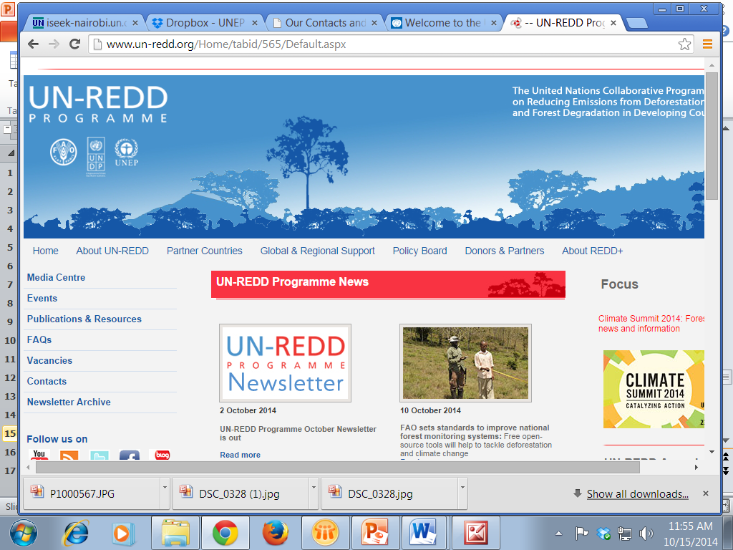
UN-REDD Programme Website

Slide 16
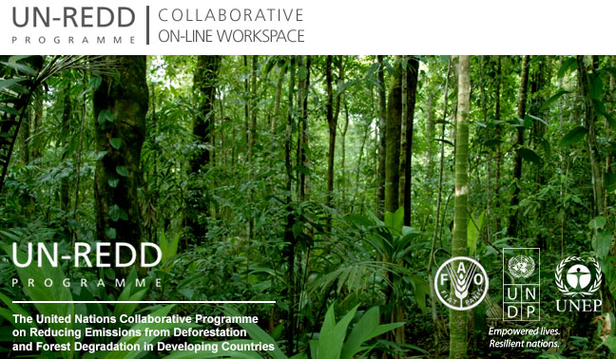
Collaborative On-line Workspace

Slide 17
Surveys
KM Needs Survey
Evaluation Questionnaire

