Slide 1


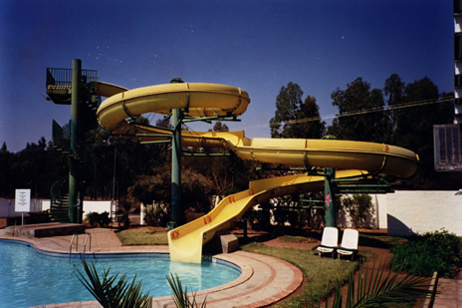
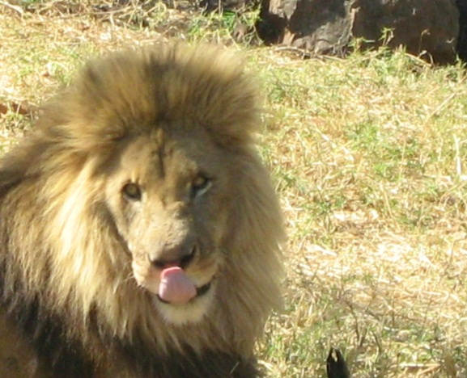
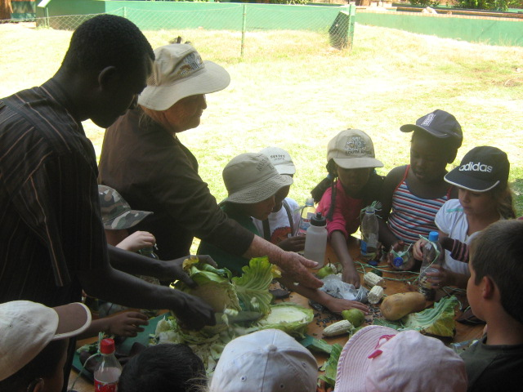
Community Green Empowerment Program

Slide 2
Partners:
Zambian Wildlife Authority (ZAWA)
Environmental Management Agency (Council of Zambia ECZ)
Wildlife Environment Conservation Society of Zambia (WECSZ)
United Nations International Children’s Education Fund (UNICEF)
Youth Environment Network (YEN) Zambia
Environment Association of South Africa (EASA)
Zambian Network for Environmental Educators and Practitioners (ZNEEP)
Knowledge Beat
Lusaka City Council
Peace Corps of America
Botanical Gardens International BGCI

Slide 3
Environmental Education through Hands on
is a process aimed at developing a world population that is aware of and concerned about, the total environment and associated problems.

Slide 4
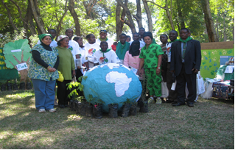
Addressing climate change and other environmental problems require significant efforts in many areas. The education and community green empowerment is one major key to realizing a green future for all.

Slide 5
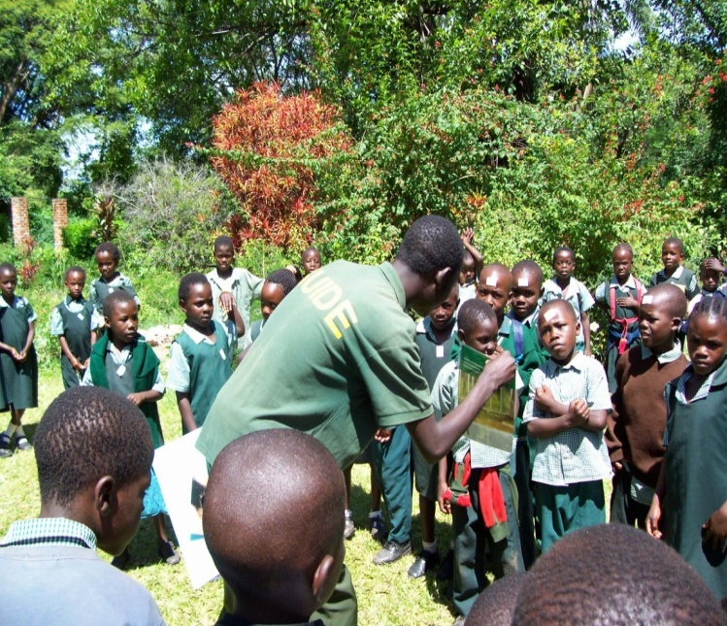
Related REED+ Initiatives
Children looking at habitat loss due to human activities

Slide 6
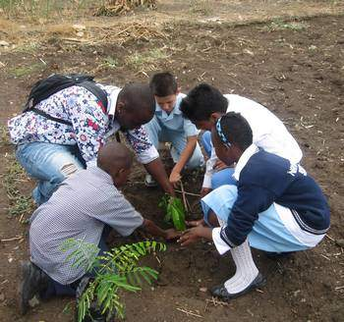
Tree Planting
Support for development of community and school tree nurseries by Green Clubs and community members
• Support for planting of trees in areas of deforestation
To encourage families to practice perma- culture roosting sites for birds, and are a food source for animals and people.
.

Slide 7
Forest reserves Visit

Slide 8
Empower communities with green skills and materials
Rain Water Harvesting
Energy-efficient stove
Cookers
Improved braziers,
Rain water harvest
Conservation farming
Tree planting, agro-forest biogas
Horticulture

Slide 9
4Rs
Recycle
Rot
Reduce
Reuse

Slide 10
Reduce ……decrease or trim down
Reuse………reclaim, reprocess, use again or recycle!
Recycle………reuse, reprocess, salvage, recover
Rot……..decompose and decay!

Slide 11
Teacher training workshops
  Ecology of: Woodlands, Wetlands, Grasslands
  Trees are Tremendous
  Ecosystem Analysis
  Environmental Education Program Design
Sustainable Use of Natural Resources

Slide 12
1. REDUCE PACKAGING – buy only products with less packaging carry a bag when going shopping
2. REUSE – what you can………
3. RECYCLE – the rest…………
4. ROT- make a compost manure from decomposed things.

Slide 13
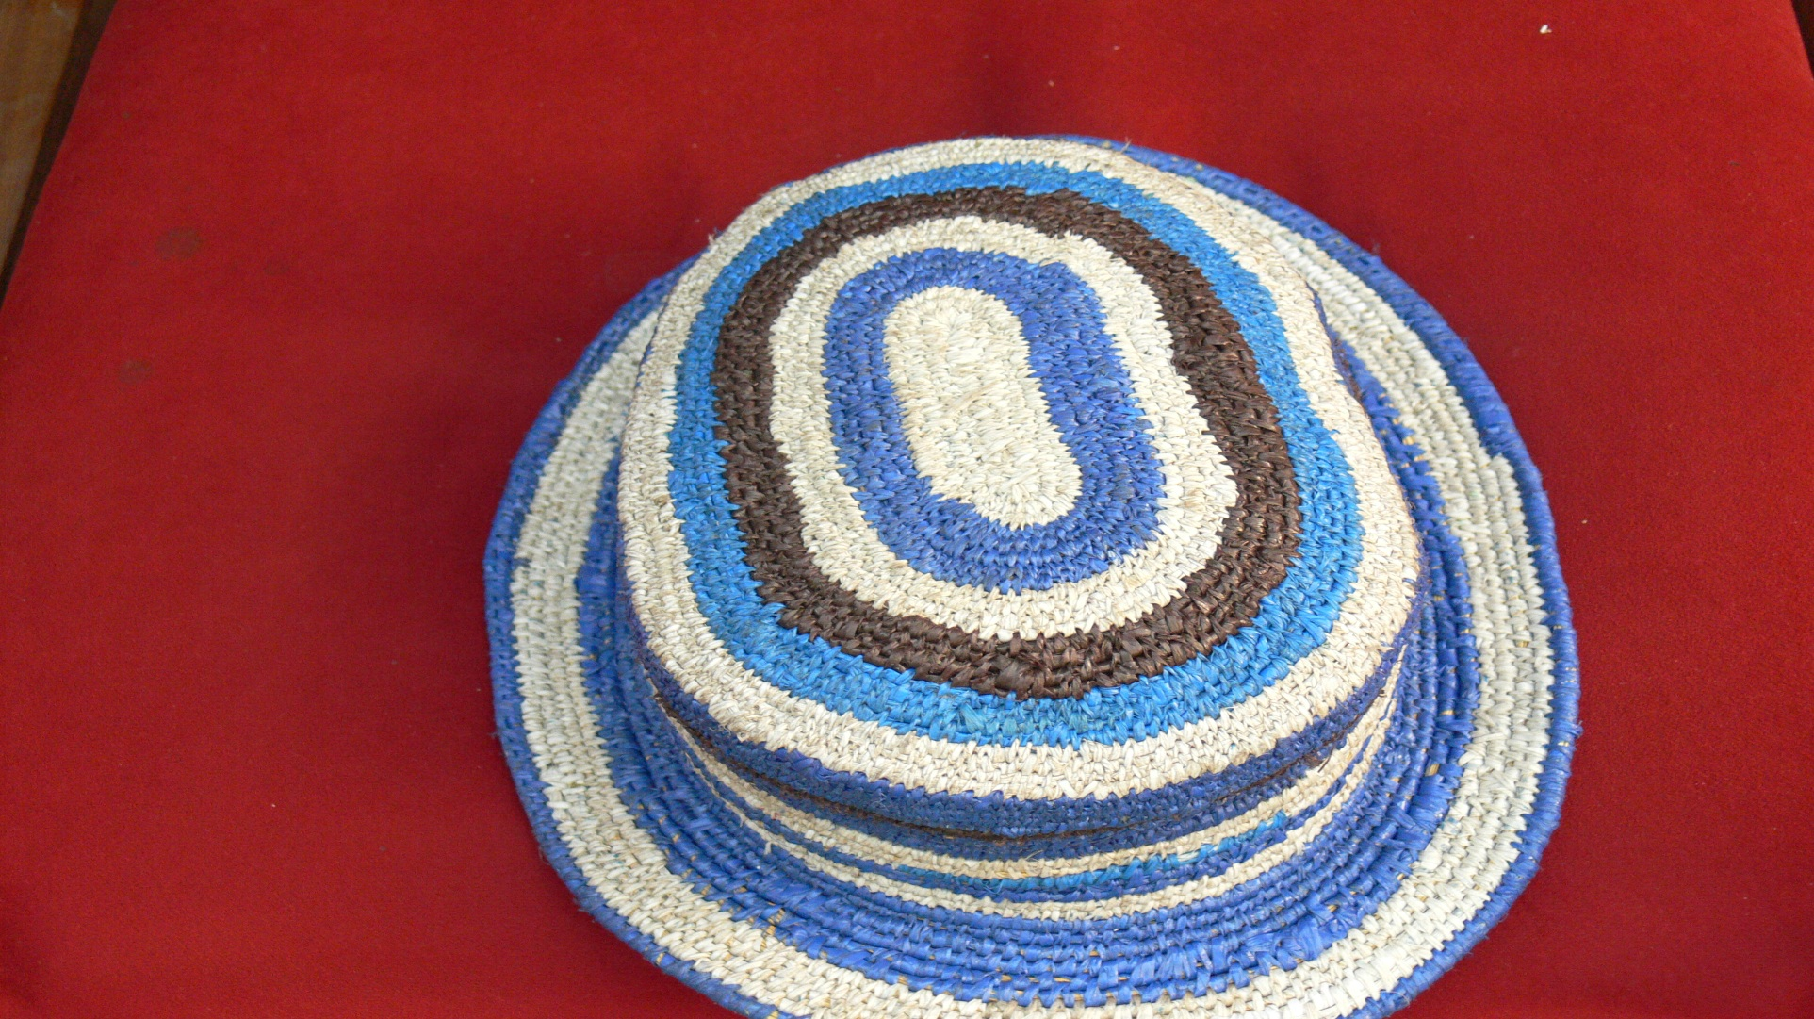

Slide 14
Recycle the past
Reuse the present and
Save the future…..

Slide 15
60000 children have been trained on green activities and 4000 teachers
More than 4000 trees have been planted in schools and communities

Slide 16

I can’t help feeling guilty, because I belong to the generation that completed the destruction of our environment by simply not taking seriously any of the warnings ... and there were so many of them!
I belong to the last generation who could have made a difference, but who chose not to act.

Slide 17

How I wish I could go back in time and get the Human race to understand this ...
... at a time when it was still possible for us to do something to save our planet Earth!

Slide 18
Supporters
British High Commission
Danish Embassy
David Shepard Wildlife Foundation
Born Free Foundation
Germany Embassy
Dutch Embassy
Local companies, including National Milling, Lafarge Cement, Ross Breeders, and many others!

