Slide 1
Communications Strategy UN-REDD National Programme
Fourth UN-REDD Programme Executive Board meeting
28 March 2013
Cambodiana hotel, Phnom Penh
Presented by Kao Sosatya (10 minutes)

Slide 2
Activity: Communication Strategy
First draft has been developed for UN-REDD Programme only.
It was shared among technical staff and key stakeholders to review and comment.
Comments have been consolidated and shared back to the relevant stakeholders.
Notes:
CS: Shall be Cambodia Programme or UN-REDD?

Slide 3
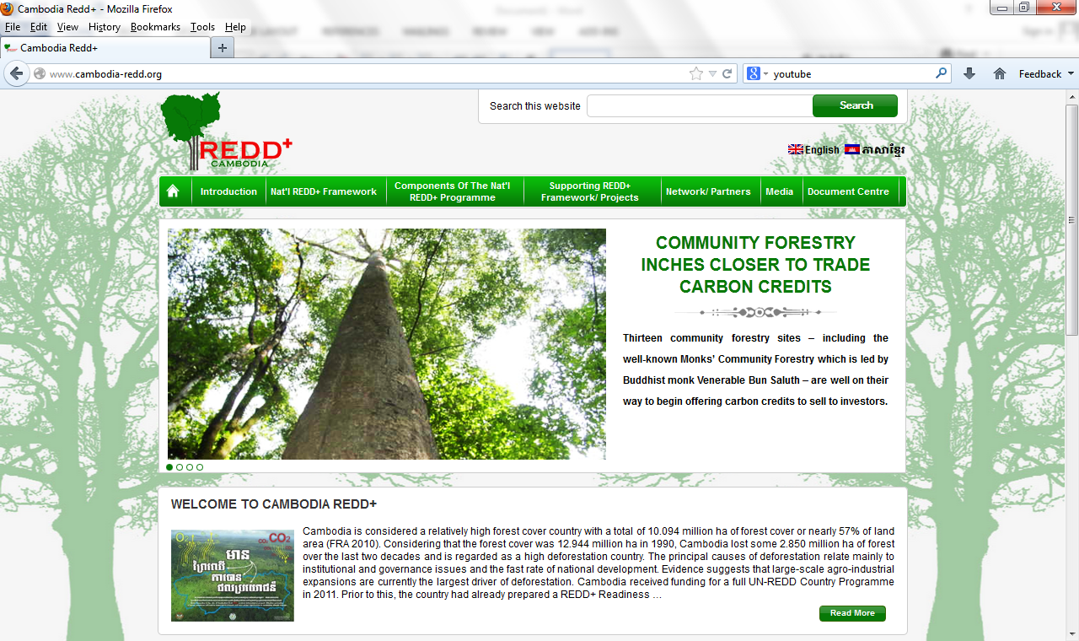
Activity: Website development of “Cambodia REDD+ Programme”
Layout has been discussed.
Main sections to be displayed have been consulted among relevant stakeholders.
Now contents need to be filled in.
It is temporarily hosted under www.cambodia-redd.org
  Username: redd
  Password: redd123
Photo: Home page of the Website

Slide 4
Activity: Publications and Videos translation
Video: Voiceover video clip of introduction to REDD+ was done and is now being used during the reselection process of IPs representatives. (Play the video)
Publications (in progress and plan):
  Lessons Learned booklets: produce lessons learned booklets for information sharing among relevant stakeholders
  Fact-Facts/Event flyer: give a macro-level, snapshot/introduction to who we are and what we do
  Newsletter: release 3 newsletters annually, for which focus is on the Programme progress
  Programme leaflet/brochure/poster: produce for its own programme in align with programme implementation.
  Video booklet: extracted from the video clip
Photo competition: will be conducted in Q3
Notes:
-Newsletter: Cambodia Programme or UN-REDD?

Slide 5
Activity: UN-REDD website (workspace: FPIC repository)
Coordination and information sharing with UN-REDD line agency (regional and global)
Workspace is one of the top priority required to be uploaded/updated, in which one section on FPIC repository will be the center of all documents on FPIC (from different countries who implement UN-REDD Programme and/or REDD+ Programme).
Articles, events, activities plans, documents will be uploaded/updated into the websites as indicated below:
www.unredd.net (open)
www.unredd.org (open)
Notes:
2nd bullet: make reference to the fact that the idea originated in Cambodia, so this is a contribution by the CAmbodia programme to improve regional and eventually global programmes

Slide 6
Thank You!!

