Slide 1
Photo Album
BDS Piloting by Huyen, UN-REDD Viet Nam
In Lam Ha – Di Linh, Lam Dong, Viet Nam
December 2011

Slide 2
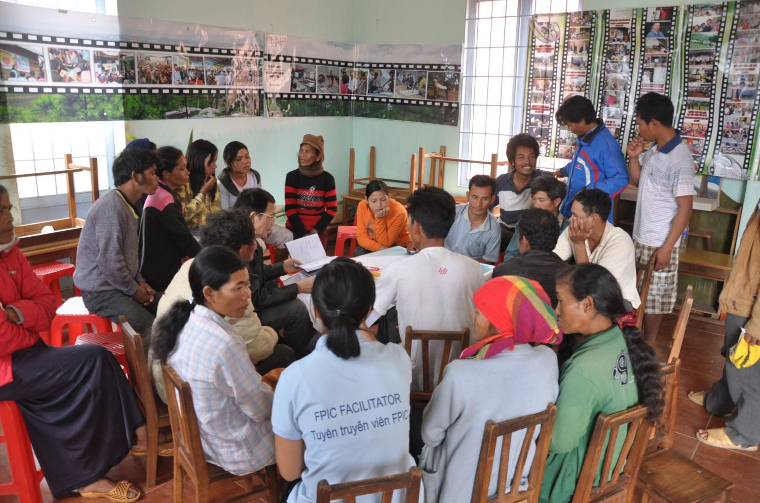

Slide 3
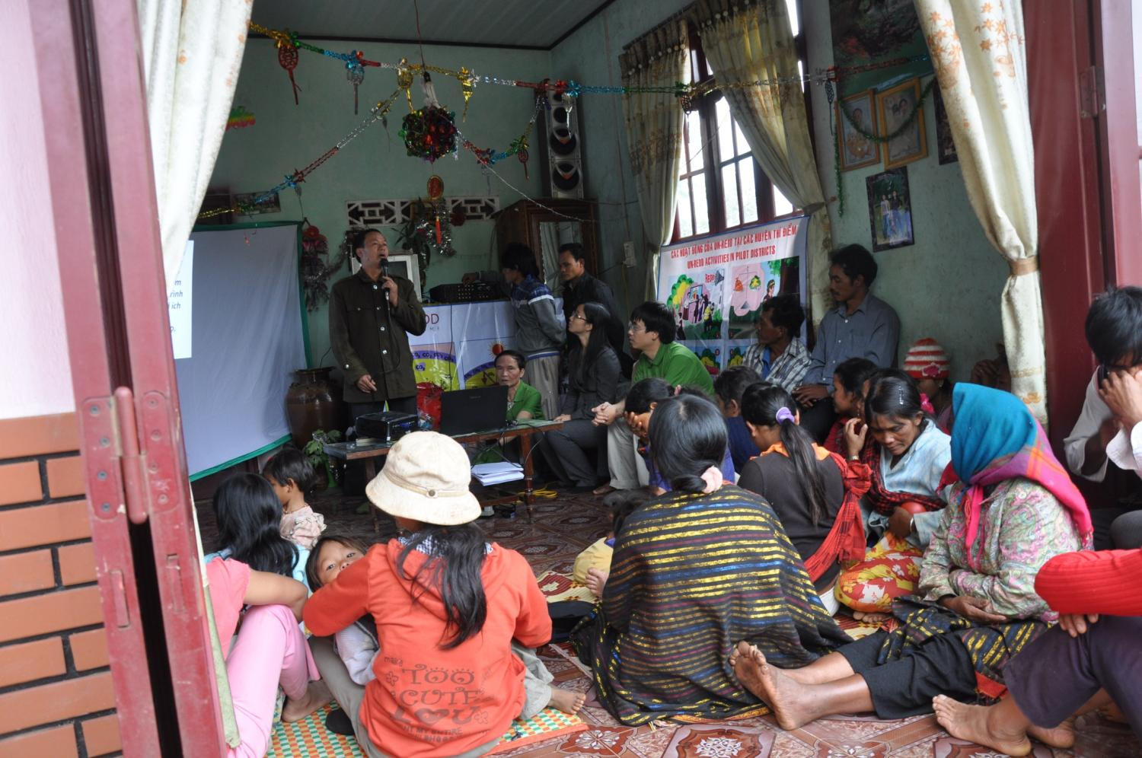

Slide 4
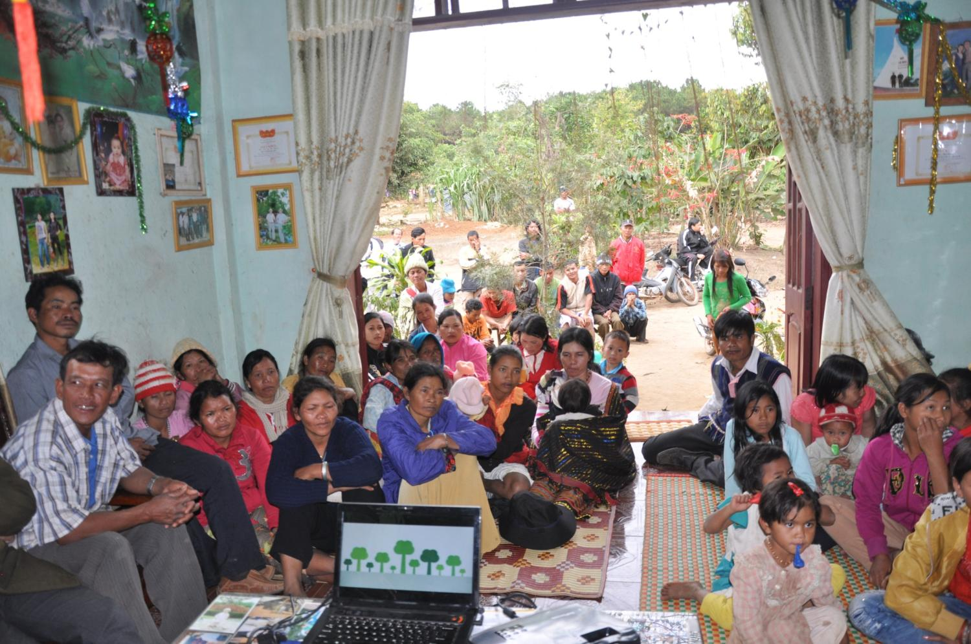

Slide 5
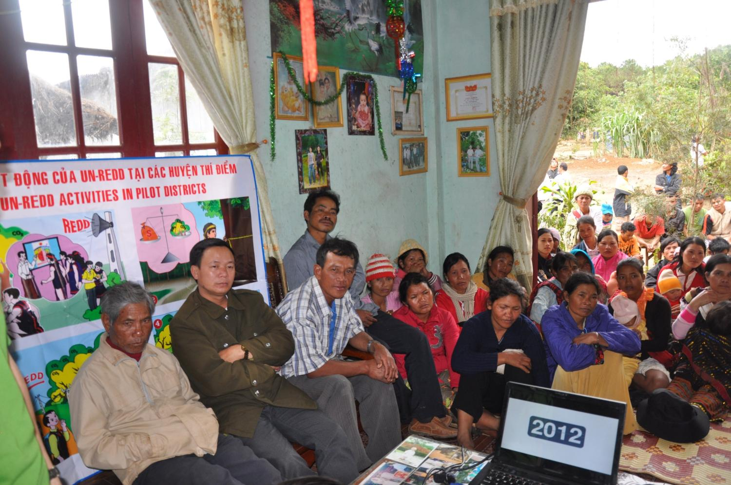

Slide 6
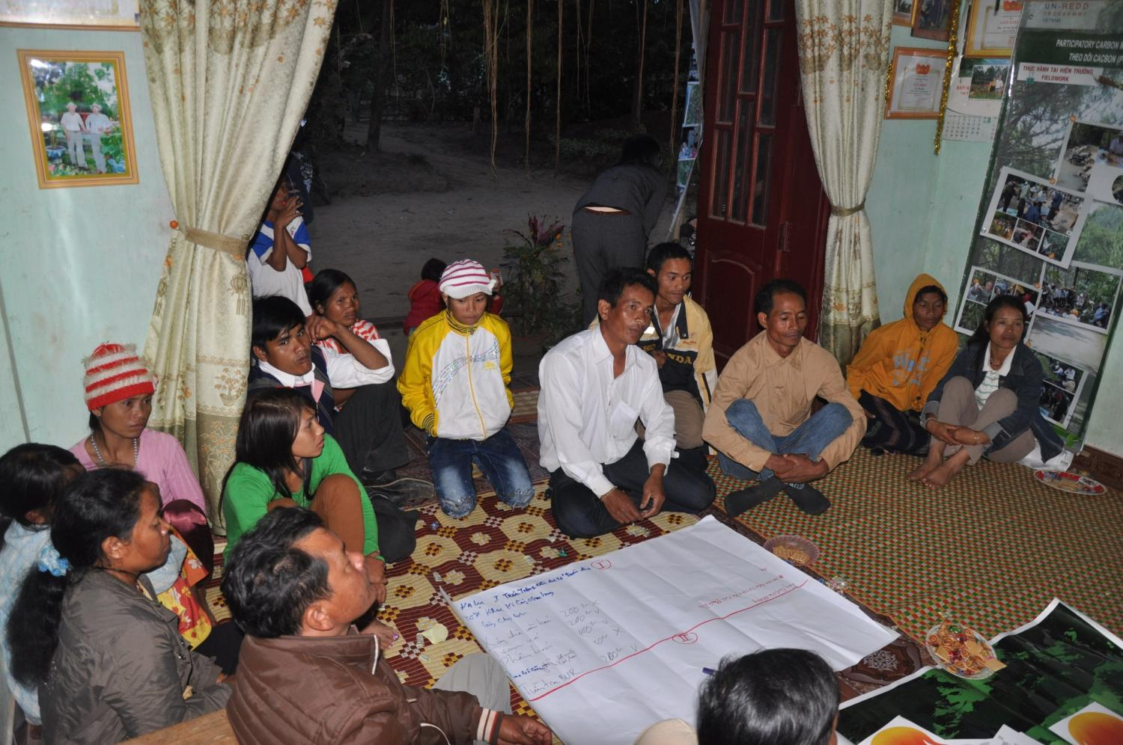

Slide 7
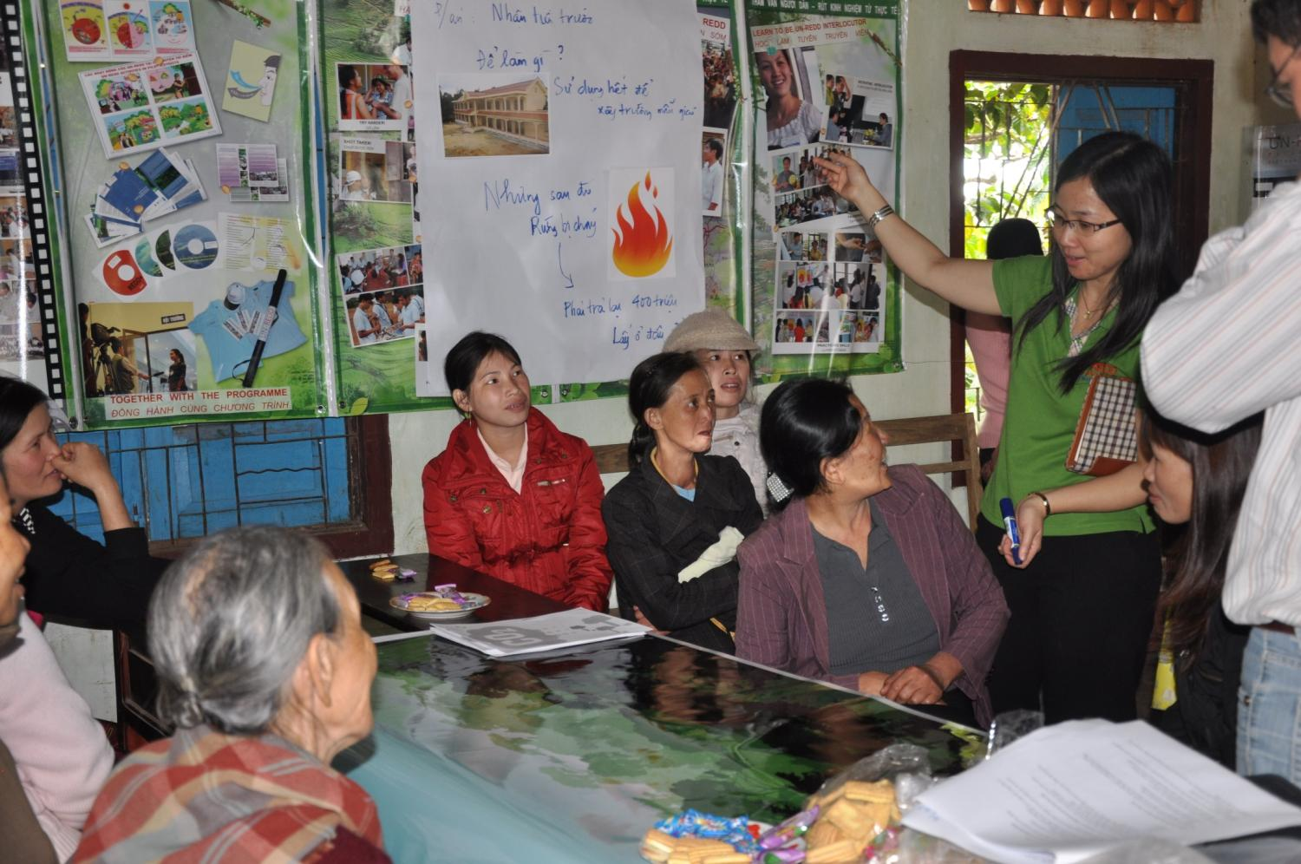

Slide 8
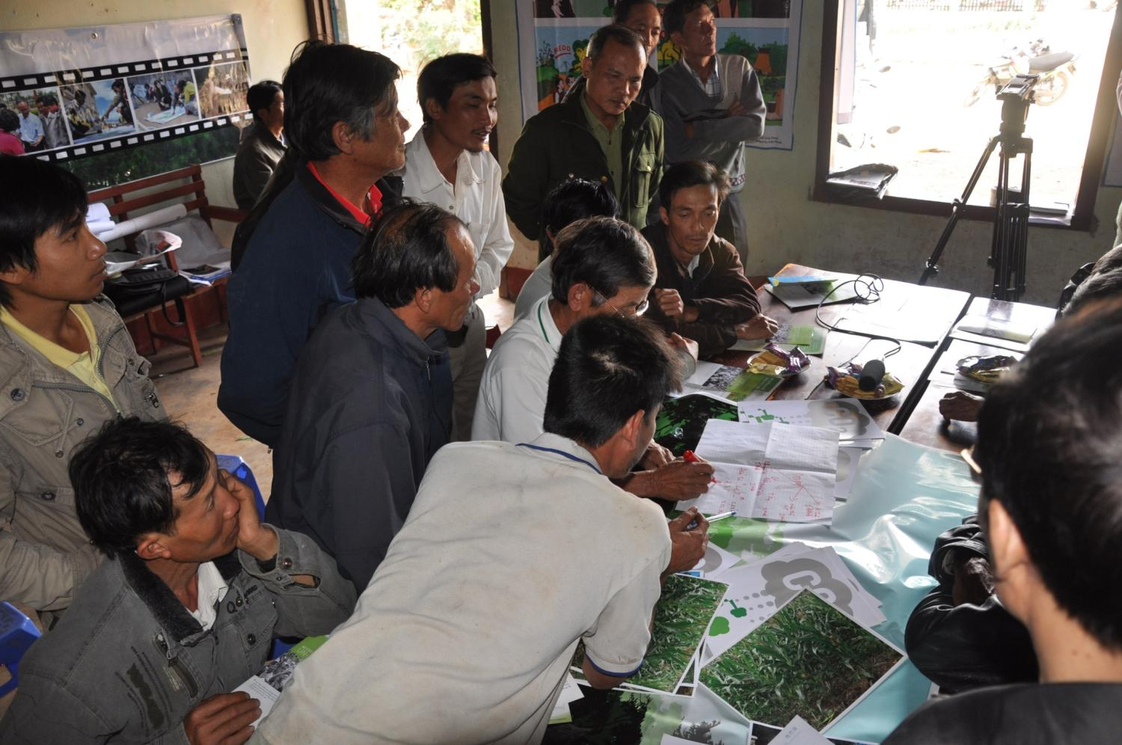

Slide 9
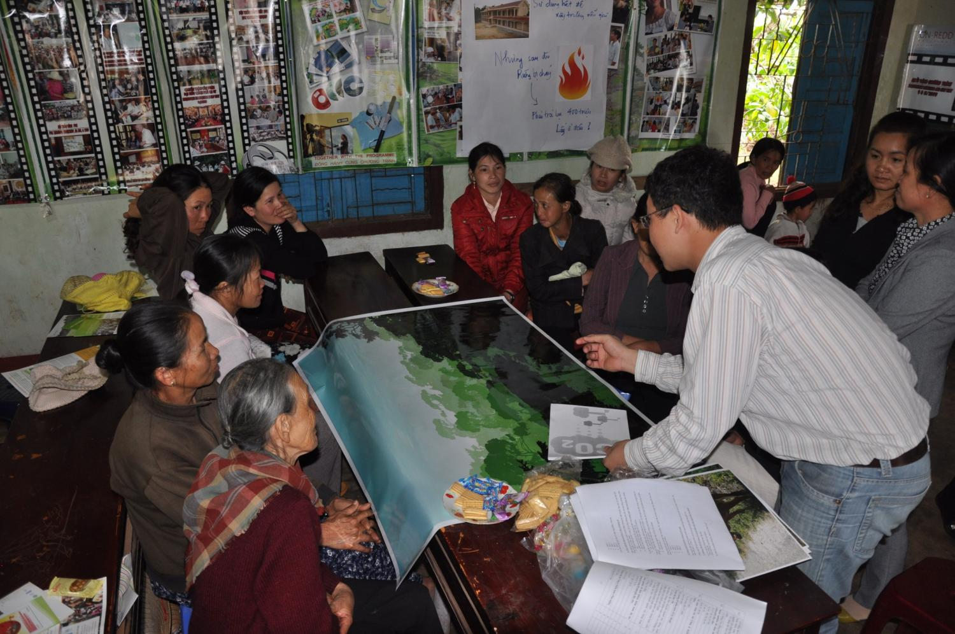

Slide 10
