Slide 1
Amazon Fund: Disbursement Modalities
Leticia Guimarães
REDD+ Focal Point
Ministry of Environment, Brazil
South-South Knowledge Exchange on National REDD+ Funds Architecture
Oslo, Norway, 28 October, 2013

Slide 2
Outline
Amazon Fund: Overview
Disbursement Modalities (2009-2012)
Disbursement Modalities (2013 – 2014)
Lessons Learnt
Next Step
Questions for Discussion

Slide 3
The Amazon Fund - Overview
Approval and monitoring of projects
BNDES
Calculation of deforestation rates
INPE
Independent Audit
Emissions reductions accounting
Ministry of Environment
Validation of the accounting
CTFA
Fundraising based on the limits defined
Project implemen-tation
Aimed at raising donations for non-reimbursable investments in efforts to prevent, monitor and combat deforestation, as well as to promote the preservation and sustainable use of forests in the Amazon Biome.
Up to 20% of the Amazon Fund’s resources can be used to develop deforestation monitoring and control systems in other Brazilian biomes and in tropical forests in other countries.
Guidelines and investment criteria defined periodically by the Guidance Committee of the Amazon Fund (COFA)

Slide 4
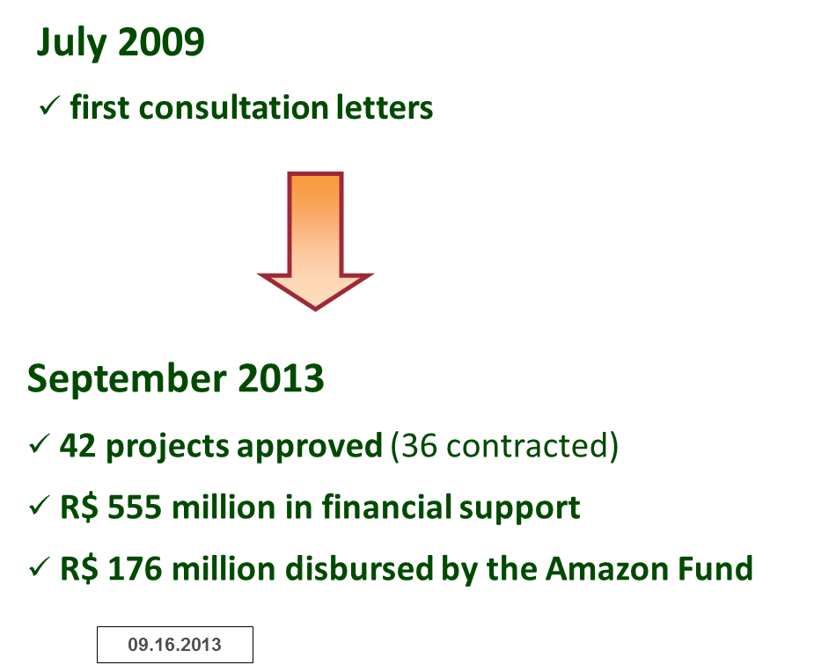
Disbursement Modalities (2009-2012)
Projects in the following thematic areas:
  Management of public forests and protected areas;
  Environmental control, monitoring and inspection;
  Sustainable forest management;
  Economic activities created with sustainable use of forests;
  Ecological and economic zoning, territorial arrangement and agricultural regulation;
  Preservation and sustainable use of biodiversity; and
  Recovery of deforested areas.

Slide 5
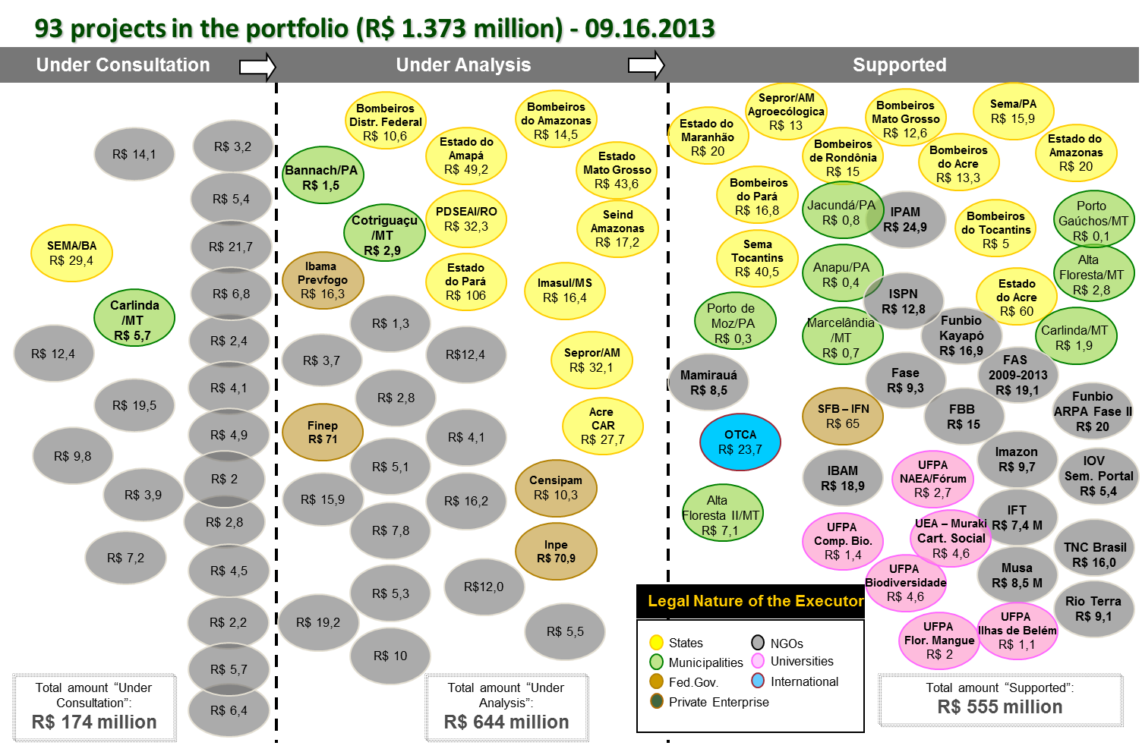

Slide 6
Disbursement Modalities (2013- 2014)
Modalities for Resource Allocation
Modalities of Projects
Public Call-to-Submission
Structuring projects:
  Contribute for the implementation of a public policy.
  Resolve the diagnosed problem-situation
  Meet the territorial scale where efforts will be developed
Fostering conservation and sustainable production activities
Structuring and integrating environmental monitoring and control systems
Land-use planning and land tenure
Scientific and technological development

Slide 7
Lessons Learnt

Slide 8
You should invest in transparency

Slide 9
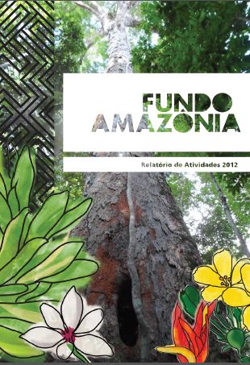
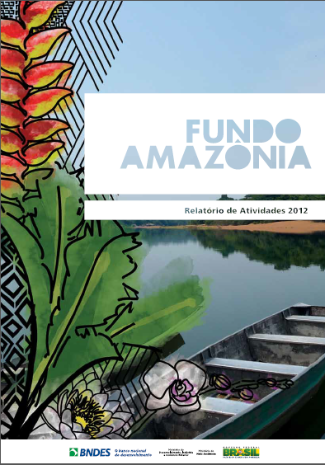

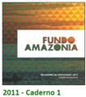

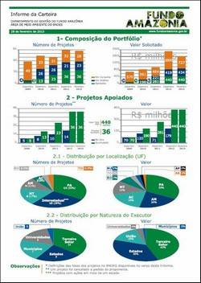


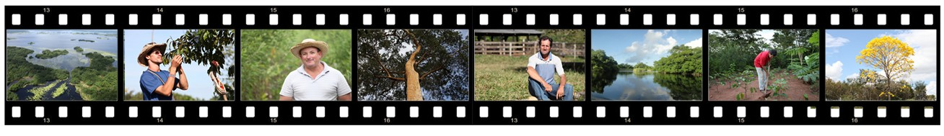
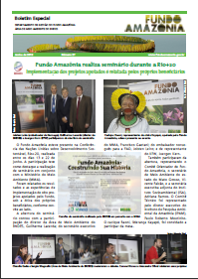
Communication and Transparency
40 News bulletins
64 Portfolio reports
4 Annual Reports (Portuguese and English)
2 Films produced
Over 350 messages: fundoamazonia-faleconosco@bndes.gov.br

Slide 10
You should foster the active participation of stakeholders

Slide 11
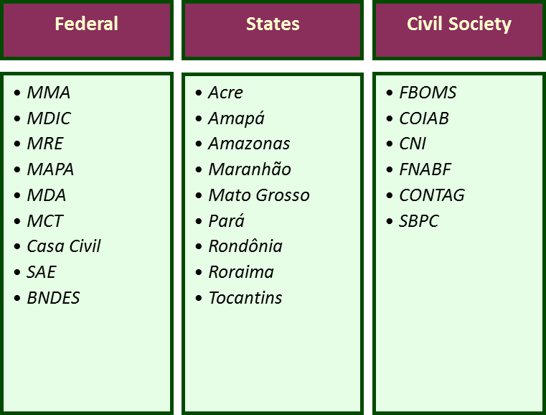
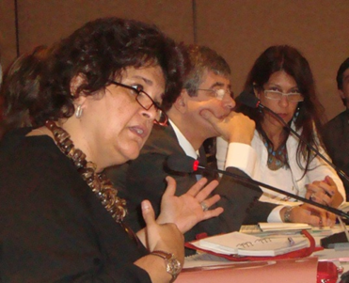

Amazon Fund Guidance Committee - COFA
Define guidelines, criteria and priorities to apply resources
Approve account rendering and Annual Report (financial and compliance audit reports
Participative Governance

Slide 12
You should have effective and transparent forest monitoring and MRV systems
Based on this information, you should create a simple system for Fund operations

Slide 14
You should periodically revise your Guidelines and Investment Criteria
From time to time, it is recommended that the Fund goes through a technical analysis to assess the effectiveness, efficiency and equity of the disbursement of resources:
Effectiveness
Efficiency
Equity
E.g. Initiatives' contribution for the implementation of public policies
E.g. Average time spent for the approval of a project and/or initiative
E.g. Geographic and social distribution (by area and proponent type) of investments made

Slide 15
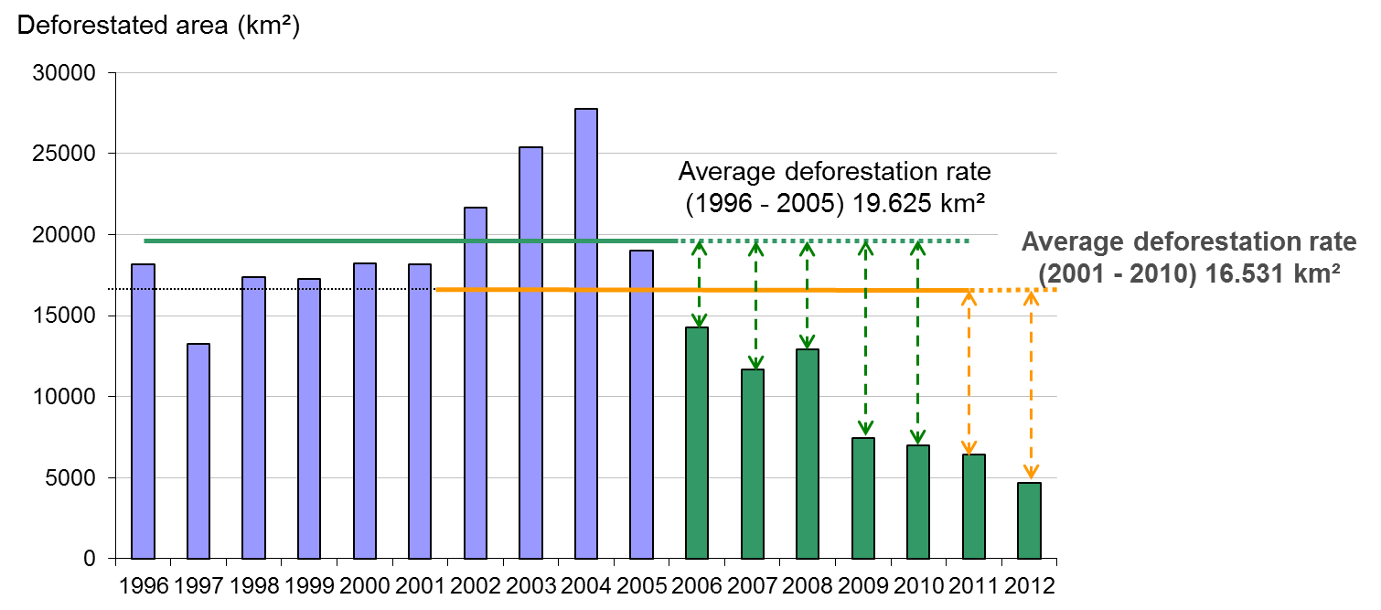
Next Step
We need to develop an effective fundraising strategy!

Slide 16
Questions for Discussions
Does your fund allow for investments in projects from the private sector? Is sustainable development the main goal of your fund? How do you ensure the long-term effectiveness of the initiatives that are financed by your fund?
Most countries that are now creating their own national funds are also part of initiatives from multilateral organizations (UN-REDD and FCPF). Will national funds compete with multilateral funds for REDD+ resources? What will be the relationship between these entities after national funds become fully operational?

Slide 17
For more information: http://www.amazonfund.gov.br/FundoAmazonia/fam/site_en
Thank you!
leticia.guimaraes@mma.gov.br

