Slide 1





Developing an Archiving System
Eleanor Milne
In support of the
U.S. Environmental Protection Agency
REGIONAL AFRICAN WORKSHOPS ON REDD+ NATIONAL FOREST MONITORING SYSTEMS AND GREENHOUSE GAS (GHG) NATIONAL INVENTORY SYSTEMS

Slide 2






The Six Templates of the Template Workbook
Institutional Arrangements
Source-by-Source Background Document
Description of QA/QC Procedures
Description of Archiving System
Description of Archiving System
Key Category Analysis
National Inventory Improvement Plan
Notes:
The six EPA templates all focus on key elements related to managing the development of GHG inventories.
In this talk, I’ll be discussing the fourth template, the description of an archiving system.
Before I go any further, I would like to stress that all of the templates relate to each other in some way. More explicitly, each on of these steps depends on institutional arrangements (the first template) in some capacity. For example: if no agency or person has been delegated the task of archiving documents, estimates, data, etc.. then it is unlikely a complete archive will be kept to aid the inventory development process in the future.

Slide 3


The Archive
Archiving System
Notes:
Archives refers to a collection of records, and where these records are kept.
Your archives will include all materials created and used during the development of the inventory (references, methodological choice, expert comments, revisions, etc.).
Archiving is the important step for making sure that your inventory is consistent and reproducible from one inventory cycle to the next.
An example of bad archiving -- we had a project we were working on recently, where we were updating an analysis that had been completed 4 or 5 years earlier. The analysis involved a lot of complicated spreadsheet calculations, but we could only find some of the spreadsheets from the previous version, and those we could find were not always the final or complete versions. It made the project a lot more complicated and time-consuming.

Slide 4

A Starting Point For Future Inventories
  An archive will help the inventory team:
Access previous records
Easily reproduce estimates
Ensure credibility
Respond to government, expert, or public inquiry
More easily review estimates
Safeguard against loss of information
An archive:
Need not be expensive or complicated.
Can be electronic and/or hard copy
Notes:
So why is an archive so important?
-------------------
This will help the inventory team:
Be able to easily access all electronic and paper records from the previous inventory.
Easily reproduce estimates
Ensure that the inventory estimates are credible
Reference any relevant files in order to respond to public and/or expert inquiry, and to answer questions about methodologies.
More easily review estimates and conduct QA/QC procedures
Safeguard against loss, such as database failures, theft, or fire.
The system need not be expensive or complicated. Archive may be electronic and/or hard copy, and ideally both.

Slide 5

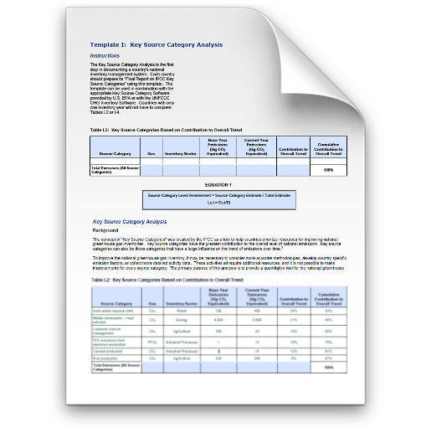
The EPA Template Workbook Can Guide Archive Development
Notes:
We’ve put together a series of national inventory system templates to help guide your GHG inventory process.
We have created these templates based on the lessons we have learned from working with other countries, an understanding of their circumstances, reviews of their data and systems, and our own experience developing the US Inventory.
Each template, when complete, can become a chapter of a report to describe your National Inventory System.
Each completed template will document a key area of inventory development, and will assist in developing a step-wise approach to developing an inventory system.

Slide 6
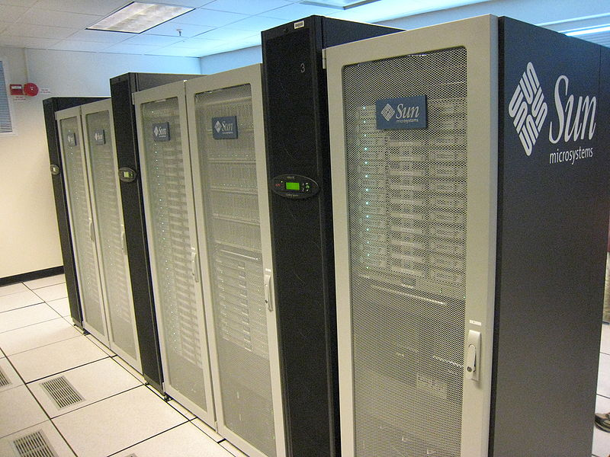
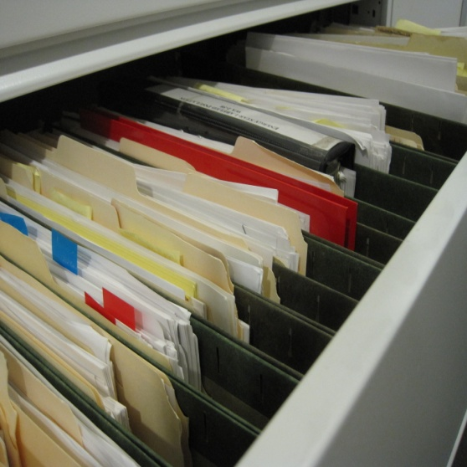
How The Template Workbook Can Help
The archiving template will assist countries:
  Assess past archiving system
  Guidance to develop an archiving system (e.g. procedures)
  Establish roles/responsibilities /procedures consistent with inventory schedule
  Future improvements
Applying and completing the template will help the inventory team:
  Access previous records
  Easily reproduce and review estimates
  Ensure credibility
  Respond to inquiries
  Safeguard against loss of data/information
Notes:
How can the template workbook help your archiving system?
--------------------
In the archiving template, there are 4 key sections that assist countries in the following tasks:
Assess past archiving system
Guidance to develop an archiving system (e.g. procedures)
Establish roles/responsibilities consistent with inventory schedule
Future improvements
Applying and completing the template will help the inventory team:
Access previous records
Easily reproduce estimates
Ensure credibility
Respond to inquiries
More easily review estimates
Safeguard against loss of data/information
The template provides key components for a draft inventory plan. Countries need to customize procedures, roles, and update them and communicate them to staff.

Slide 7

What Should Be Archived
List and Copies of References
Expert Jugement
  (Documentation, Contact Information)
Key Category Analysis
Uncertainty Analysis
QA/QC Measures
Changes & Recalculations
Improvement Plan
Archiving Plan
Review Findings And Responses
Templates for Future Work
Results, Analyses, Plans, Measures
CO₂, CH₄, N₂O
Activity Data
Uncertainty
Key Categories
  For EACH Submission Year
Notes:
Keep saved copies of documents instead of URL links, these will change (EASY TO SAVE AS PDFs these days)
There is also a difference between static and active archives (some information is static, while others, spreadsheets, or report text is updated, revised on ongoing basis)
This is a list of some things you will probably want in your archive

Slide 8





What Should Be Archived
Process Descriptions
How to prepare the inventory, meeting materials, instructions for those to follow in your footsteps
Activity Data
Sources of information, contact persons, other contact information
Methods and Emission Factors
Sources/references, reasoning for methodological choice, spreadsheets, models, instructions
Final inventory products
National Communication, National Inventory Report, Common Reporting Format, other materials submitted to the UNFCCC
Archive All Materials by Inventory Year for Easy Retrieval
Notes:
So – what should be archived?

Slide 9
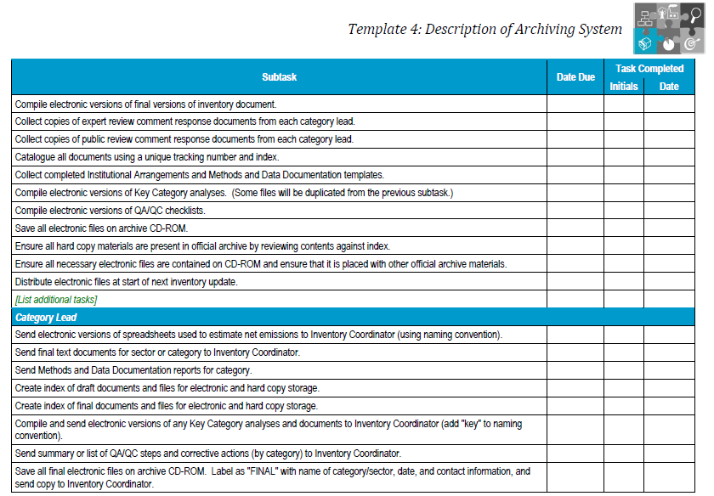
An Example from the Archive Template
Notes:
This is a screenshot of one of the sections in the archiving template. This table lists many of the tasks that inventory teams often do for archiving. You can start with the examples provided in the template, and customize them to your country’s need and circumstances.
---------------------
For example…
All information used to create the inventory should be archived in a single location through electronic and/or paper storage.
Archived information should include all disaggregated emission factors, activity data, and documentation of how these factors and data have been generated and aggregated for the preparation of the inventory (such as the MDD template).
This information should also include internal documentation on QA/QC procedures, external and internal reviews, documentation of annual key sources and key source identification, and planned inventory improvements.
If possible, a copy of all archive documents should be kept in another location to reduce the risk of losing all records due to theft or disaster (e.g., fire, earthquake, or flooding, IT system failure).

Slide 10



Sample File Management Procedures
Naming Conventions:
Organization:
Biomass_2000. 23_05_2001.xls
IPCC Category Name
Date the File was Modified
Inventory Year
Agriculture Sector Spreadsheets
Agriculture Folder
Notes:
File names are important for finding data later and also finding the most recent files.
For example: Save files with IPCC category name and inventory year, and track the file version by including the date the file was last saved. Clearly establish and communicate the file management procedures and naming conventions for version control.

Slide 11

U.S. GHG Inventory Archive
Archive manager (Data and Document manager)
Designate an Archive Coordinator
Source Lead responsibilities should be communicated in the kickoff memo so each source has a point person
Document Retention | Comment/Response | Data Retention
References, Publications | Comments From Public Review | Calculations, Spreadsheets
Notes:
Who does the archiving, and what do they archive?

Slide 12

Review Guidelines for An Effective Archiving System
Information should be stored in a single location.
Both electronic and paper storage.
Include all emission factors, activity data, and documentation of how these factors and data have been generated and used (e.g., MDD template).
Documentation of QA/QC procedures, reviews, key categories, and planned inventory improvements (e.g. use QA/QC template)
Multiple copies, just in case!
12
Notes:
The template includes suggestions for building an effective archiving system. For example…
--------------------
All information used to create the inventory should be archived in a single location through electronic and/or paper storage.
Archived information should include all disaggregated emission factors, activity data, and documentation of how these factors and data have been generated and aggregated for the preparation of the inventory (such as the SBS template).
This information should also include internal documentation on QA/QC procedures, external and internal reviews, documentation of annual key sources and key source identification, and planned inventory improvements.
If possible, a copy of all archive documents should be kept in another location to reduce the risk of losing all records due to theft or disaster (e.g., fire, earthquake, or flooding).

Slide 13
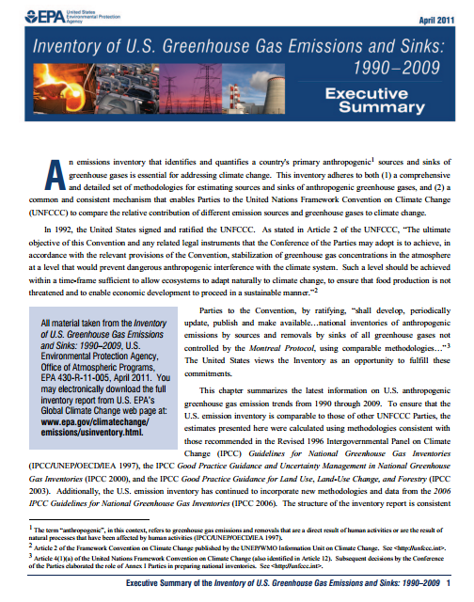


U.S. GHG Inventory Document Retention
  Archive of the Published Inventory Book
The Annual U.S. GHG Inventory book is formatted and printed in color
Copies are stored in the National Service Center for Environmental Publications (NSCEP) warehouse in Cincinnati, OH
Inventory of U.S. GHG Emissions and Sinks
Notes:
We store copies of the final inventory report in a warehouse, and also provide them online
---------------------
Copies of all reports are archived and stored through National Service Center for Environnemental Publications (NSCEP) warehouse in Cincinnati, OH. We also maintain an electronic archive and electronic copies on our website at www.epa.gov/climatechange/emissions. Copies of the document are sent to members of the public upon request.

Slide 14


U.S. GHG Inventory Document Retention
  Docket of Source Materials
Hard Copy System | Electronic System
Each reference used in the GHG Inventory is printed and placed in the docket and Tracking numbers are assigned to each component of the docket | Each reference used in GHG Inventory is either scanned or converted to Adobe PDF and placed in an electronic docket
  You need both.
Notes:
In the U.S., we keep files in both hard-copy format and digital format.
We keep these copies in multiple locations to keep them safe. This is our “docket”.
------------------------------------------
A docket serves as the repository for documents or information related to all parts of the inventory activities. A Docket is like a bibliography for the Inventory and includes references but also other important inventory records such as QC forms. Each year’s docket contains the new references used in the report.
Files are kept in both hard-copy format and digital format. At ICF, we keep several sets of the files on CD and printed copies of all documents stored in the docket with tracking numbers. These are required occasionally and thanks to keeping files organized, we have access to them when we need them. EPA also has their own set of files and CDs. These are kept together in one place.
Partly for redundancy, the printed inventories are kept in multiple places. Always keep multiple copies of digital files since it is so easy to duplicate them and they are so vulnerable to loss because of a dead hard drive or other loss. Keep everything together in one place but keep backups stored offsite somewhere else if possible.
Located at 1310 L Street, NW, 7th Floor, Across from Cubicle 747B, CD contains full electronic versions of full references

Slide 15
U.S. GHG Inventory Document Retention
  Archiving Various Types of Source Materials
Books, Databases or Large Reports:
  Print and scan cover/title page
  Print and scan relevant pages of the book/report or screenshots of the database showing the actual source data
Small Reports, Websites, Spreadsheets:
  Print and scan entire report, full website, or spreadsheet ensuring all source data is included
Personal Communications/Interviews with Experts:
  Create a log listing the expert, interview date, mode of communication (email, in person interview, phone), and the experts contact information
  Include as much detail as possible from the expert source, including all source data
  Print and scan the log
Notes:
How do you archive various types of source materials?

Slide 16
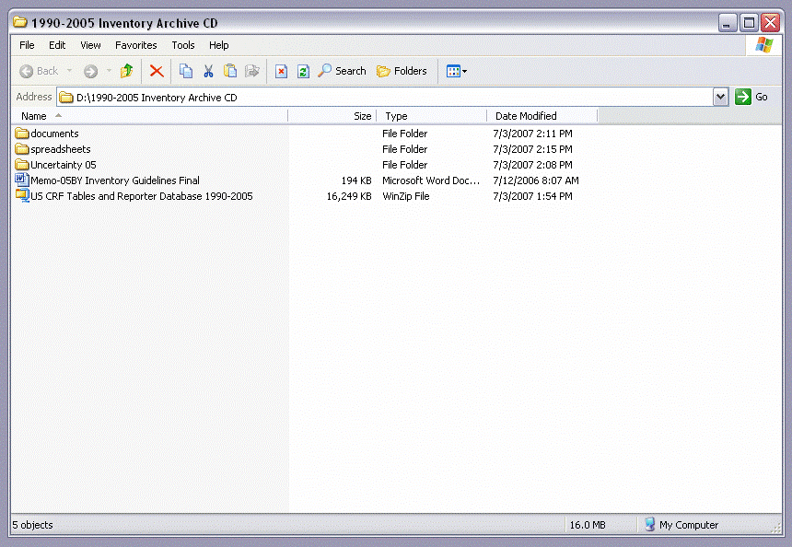
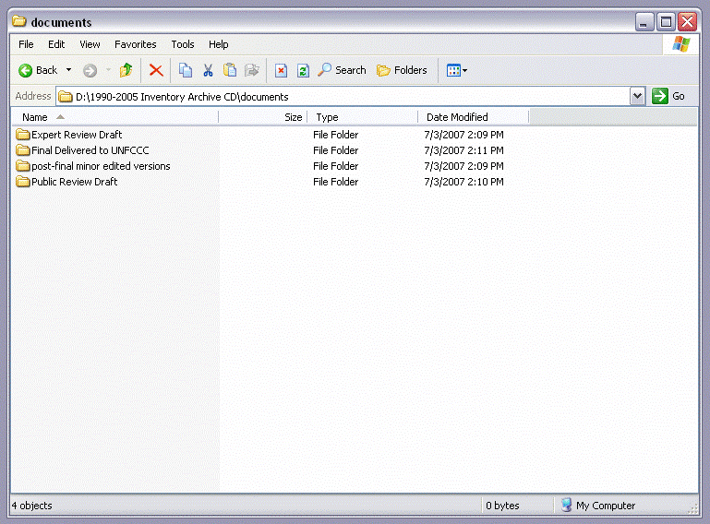
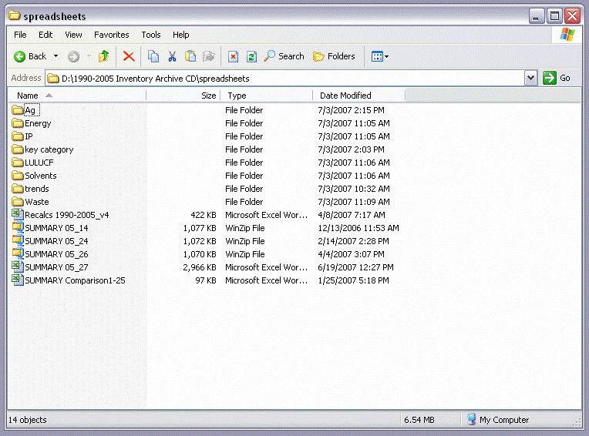
Archive File Systems on CD
  Each New Inventory Has its Own Archive CD
Notes:
[ANIMATES AUTOMATICALLY]
Each new inventory has it’s own archive CD, that contains:
Electronic copies of all versions of NIR (Expert Review Draft, Public Review Draft, Final Submission NIR)
All spreadsheets used to compile estimates (Individual source calculations from Source Leads, Summary data sheets)
Electronic version of CRF Tables
Comments & Responses to Reviews

Slide 17

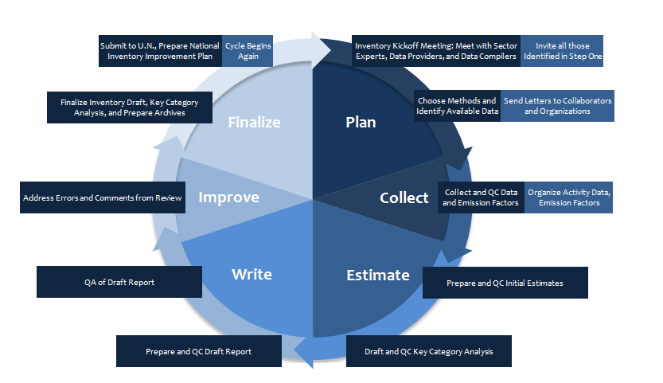
Where does Archiving fit into the National Inventory Cycle?
National Inventory Schedule
Notes:
I wanted to touch briefly upon a national inventory schedule, as defining where archiving fits into this schedule is a key part of the planning process with all institutions involved. This slide shows a sample schedule that might occur over two years – but you would adapt to your national circumstances.
As you can see, the national inventory schedule is a cyclical process. After each inventory and national communication is submitted to the UN, archiving should talk place. The documents, files, and arrangements from the previous inventory should serve as the foundation for the next one making the process more fluid and institutionalized in years to come.

Slide 18

Audience Participation
Question:
After hearing Archiving described, what systems do you have? How does your current archiving system handle: Data retention? Document retention? Storage mechanisms? Do you have lessons learned from past experiences? What could be improved and what systems might work best for your country?

Slide 19





Thanks For Your Attention!
Eleanor Milne
Eleanor.milne@colostate.edu
U.S. EPA Inventory Preparation Tools
http://www.epa.gov/climatechange/EPAactivities/internationalpartnerships/capacity-building.html
Notes:
Thanks for your attention!

