Slide 1

DRC National REDD+ Fund
Linkages between national programs and national funds and aligning disbursement with strategic objectives
République Démocratique du Congo
Ministère des Finances
Comité Technique de suivi et évaluation des Réformes (CTR)
Jean Paul BOKETSU & John MULOBA
Experts, Ministry of Finance
Bonn, Mai 2013

Slide 2
DRC REDD+ Fund
National Fund established in Nov. 2012, by the signature of a MOU between the Government and the Administrative Agent ad interim (MPTF/UNDP) with the TOR.
Governance Structure :
  Steering Committee (MOF acting as President; MECNT as Dep.President)
  Technical Committee (to ensure independant selection of projects)
  Technical Secretariat
  Direct Access : Internat. Participating Organizations & National Entities
  Roadmap towards the Operationalization of the Fund by the end 2013 :
  Fund Investment Plan ➔ Sept. 2013
  Operations Manual ➔ Sept. 2013
  Fund capitalization

Slide 3
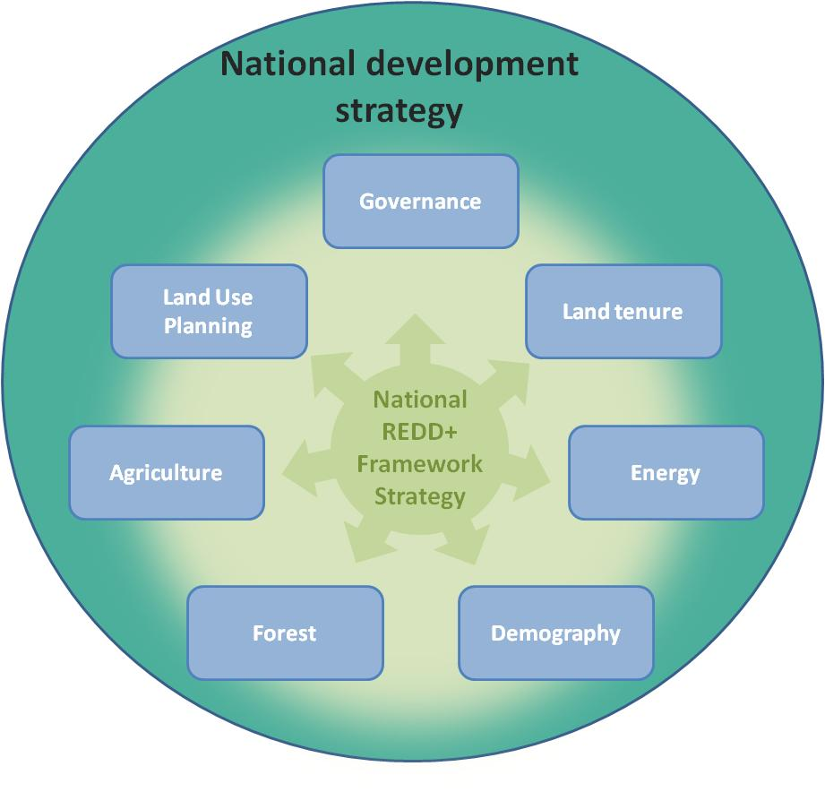
REDD+ Programmatic framework for design of the Fund Investment Plan
National REDD+ Strategy :
Based on analyses of drivers of DD
Approved in Council of Ministers headed by Prime Minister in Nov. 2012
REDD+ Strategy
Strategic Paper
1st draft available
Fund Investment Plan

Slide 4
Fund Investment Plan : Agreed Principles
Phased & progressive approach, to ensure proper capacity building
Large-scale programmes
Multipartners
Strong synergies to be ensured with the National Growth Poles Programme (5 areas) & existing REDD initiatives (e.g FIP)
Special attention paid to economic growth sectors in DRC (Mines & Hydrocarbures) to mitigate their impact on DD ;
Balance between enabling & sectoral investments

Slide 5
Fund Investment Plan : Programmatic cycle
3 years period : 2013-2015
200 Millions $ for about 6 large-scale programmes
2013
Prog 1 -> 15 Millions
Prog 2 -> 10 Millions
Prog 3 -> 5 Millions
Prog 4 -> 5 Millions
2014
Prog 2 -> 5 Millions
Prog 3 -> 5 Millions
Prog 4 -> 5 Millions
Prog 5 -> 25 Millions
2015
Prog 3 -> 5 Millions
Prog 4 -> 5 Millions
Prog 6 -> 25 Millions

Slide 6
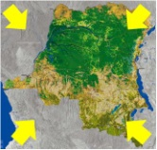
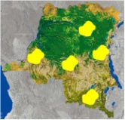
Fund Investment Plan : Programmatic framework
Enabling Activities
Sectoral Activities
Thematic approach
Prog 1
Prog 2
Agriculture
Prog 2
Energy
Land Use
Planning
Prog 3
(…)
Fund Investment Plan
Enabling Activities
Sectoral Activities
Prog 7 (Bandundu)
Geographic approach
Agriculture
Energy
Forest
Governance
Demography
LUP
Land tenure
Prog 8 (Katanga)
Agriculture
Energy
Forest
Governance
Demography
LUP
Land tenure

Slide 7
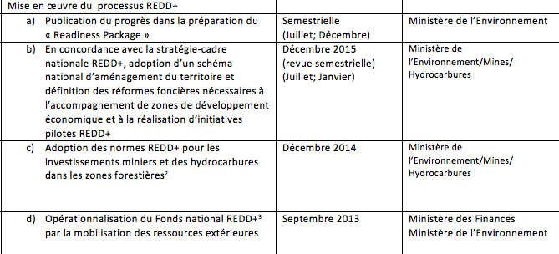
Governance Matrix : Integration of REDD+ Enabling Activities (Reforms)
La Matrice de Gouvernance Economique (Adoption le 3 Mai 2013 par la Troika Politique) comprend 6 groupes de mesures portant sur les domaines suivants:
Industries extractives minières
Gestion des entreprises publiques
Gouvernance forestière et préparer la RDC aux financements REDD+
Gestion des ressources naturelles
Gestion des finances publiques
Secteur pétrolier
LAND TENURE
LAND PLANNING
MINING & HYDROCARBURES
Cadre de programmation et de suivi multi-sectoriels de la mise en œuvre des Réformes habilitantes pour la REDD+

Slide 8
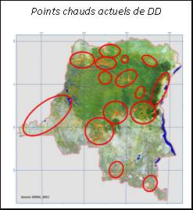
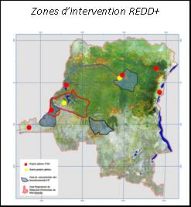
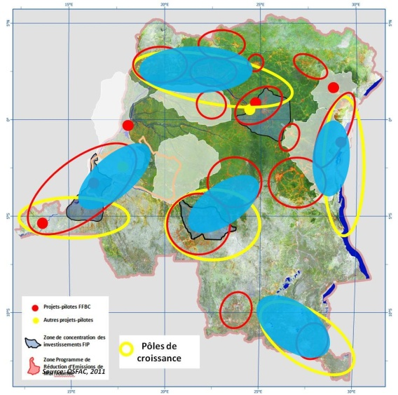
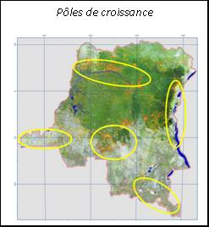
Area-based approach: identification of the priority areas based on the key National Growth and REDD+ programmes

Slide 9
Fund Investment Plan : Logical Framework
Produit 1 .1
Prog. 1
Resultat immediat
Objectif Specifique 1
Effet
Produit 1.2
Prog. 2
Resultat immediat
Objectif Global
Impact
Prog. 3
Produit
2.1
Objectif Specifique 2
Resultat immediat
Effet
Prog. 4
Produit
2.2
Resultat immediat

Slide 10
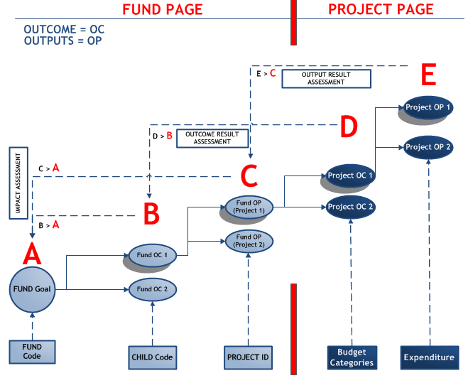

Slide 11
Thank you
11
Notes:
La reprise de la croissance mondiale est fragile au regard des risques.

