Slide 1
The future of REDD+
Heru Prasetyo
REDD+ Beyond 2015
UN-REDD PB 12 Meeting
Lima, Peru, 7 July 2014

Slide 2

UN-REDD Programme
Vision, Mission and 2011-2015 Objective
Vision:
Developing countries have significantly reduced their forest and land-based emissions, as a result of incentives from a performance-based REDD+ mechanism, while achieving national developmental goals in a sustainable and equitable manner
Mission:
To support countries’ efforts to reduce emissions from deforestation and forest degradation through national REDD+ strategies that transform their forest sectors so as to contribute to human well-being and meet climate change mitigation and adaptation aspirations.
2011-2015 Objective:
To promote the elaboration and implementation of National REDD+ Strategies to achieve REDD+ readiness, including the transformation of land use and sustainable forest management and performance-based payments.
MRV & Monitoring
National REDD+ Governance
Stakeholder Engagement
Multiple Benefits
Transparent, equitable and accountable management
Sector Transformation

Slide 3
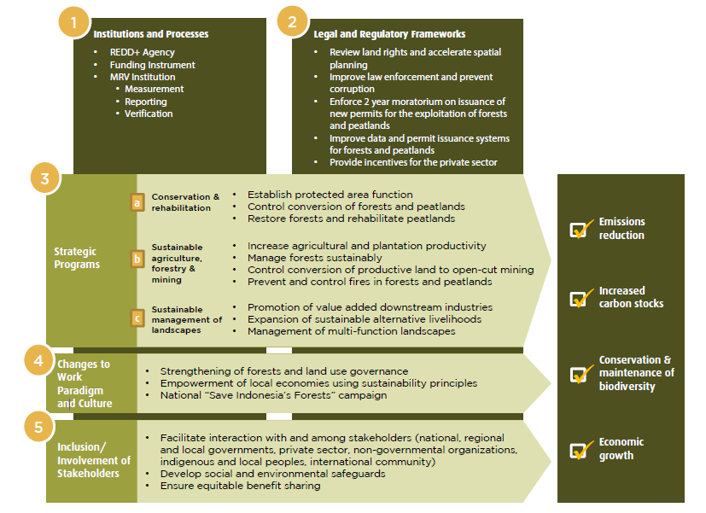
The REDD+ National Strategy
1
2
Institutions and Processes
Legal and Regulatory Frameworks
3
Strategic Programs
4
Paradigm and Work Culture Change
5
Multi Stakeholders Approach

Slide 4
Connecting UN-REDD Programme with National Programme
UN-REDD Programme in Indonesia 2010 - Oct 2012
Facilitating the multi-stakeholder process of drafting the National REDD+ Strategy
Supporting early efforts concerning MRV and FPIC
Working with the Provincial Government of Central Sulawesi to develop an early model and path for the evolution of large-scale REDD+ programmes in Indonesia
After Oct 2012 ?

Slide 5
A transformational phase towards full implementation : impacts to be seen & felt by the end of 2016
Phased Approach on REDD+ Full Implementation
Phase
Preparation Phase
Transformation Phase
Performance Based Payment Phase
Task
Design
Transform
Implement
Expected impacts of Transformational Phase
Indonesia is institutionally and operationally ready to enter into REDD+ Phase 3;
Indonesia reports initial verified GHG emissions reduction from three major sources in the LULUCF sector (i.e. deforestation, peat decomposition and peat fire) through REDD+ programmes
Indonesia has made significant progress toward achieving national mitigation objectives
Agency
REDD+ Task Force
UKP4
REDD+ Agency
2010
30 June 2013
Present
End of 2016
Notes:
Expected impacts of Transformational Phase
Indonesia is institutionally and operationally ready to enter into REDD+ Phase 3;
Indonesia reports initial verified GHG emissions reduction from three major sources in the LULUCF sector (i.e. deforestation, peat decomposition and peat fire) through REDD+ programmes
Indonesia has made significant progress toward achieving national mitigation objectives

Slide 6
UN-REDD Programme in the Future
Global Programme
National Focus
National Implementation?
Regional Facilitation?
ASEAN
ECOWAS
SAARC
Notes:
Perjalanan Kebijakan Global Pembangunan Berkelanjutan

Slide 7
The future of REDD+
Heru Prasetyo
REDD+ Beyond 2015
UN-REDD PB 12 Meeting
Lima, Peru, 7 July 2014

