Slide 1
Experiences with Stakeholder Engagement and Benefit Distribution in the UN-REDD Programme
Tim Boyle; UN-REDD/UNDP Regional Coordinator
timothy.boyle@undp.org

Slide 2
Outline of Presentation
Experiences with Stakeholder Engagement, especially FPIC
Experiences with Benefit Distribution

Slide 3
Roadmap preparation in Cambodia
A plan for how the Cambodian Government wants to move ahead with REDD+ Readiness
The Roadmap is linked to a UN-REDD National Programme Document (NPD), for $4.4 million and the basis for a prposal to the World Bank Forest Carbon Partnership Facility for $3.6 million
Intended to provide a harmonized framework for action
Step 1: Write the Roadmap
<2010>
Step 2: Implement the Roadmap
<2010 – 2015?>
Step 3: Participate in REDD+
<2015? onwards>

Slide 4
Roadmap preparation in Cambodia
Where are we now?
What are the key issues?
Roadmap activities
Goal
- Stakeholder input through REDD+ Advisory Group and Technical Units
Activities undertaken throughout programme implementation include consultation with relevant stakeholder groups and follow principles listed in Roadmap
Development of comprehensive national validation process for REDD+ Strategy
Training and capacity-building events
Knowledge-sharing mechanisms (e.g. websites) established
Initial Stakeholder mapping completed
Stakeholder coordination mechanisms identified
Principles for stakeholder consultation established
How will non-Government stakeholders provide be consulted on the REDD+ Readiness process?
Overall understanding and capacity is low
Stakeholders are engaged in the REDD+ Readiness process

Slide 5
Religious Leaders’ Consultation in Indonesia
UN Agencies, and their partners can raise awareness of hundreds, or thousands of people
Religious leaders communicate with tens of millions
Roundtable involving ~70 leaders of Islam, Christianity (Catholic/Protestant), Buddhism, Hinduism, Confucianism
Declaration signed “to join hands with the government for making REDD+ a success in Indonesia.”

Slide 6
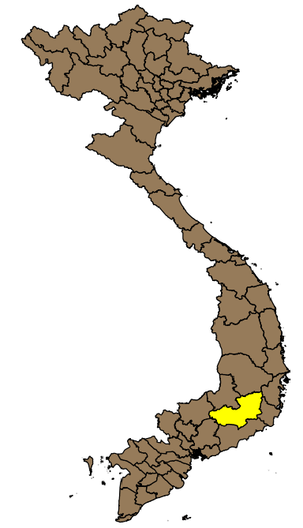
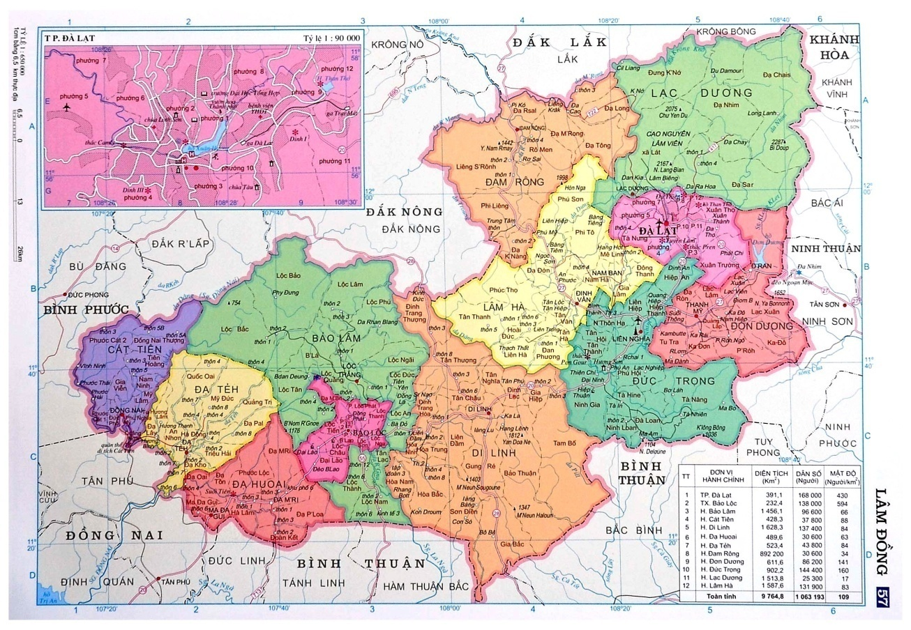
FPIC in Viet Nam
Piloting district-level REDD implementation in two districts of Lam Dong province, south central Viet Nam
About 30 ethnic minorities live in the two districts of which 6 are native
FPIC is conducted in about 80 villages which have scope for REDD interventions
Lam Ha District
Di LinhDistrict

Slide 7
Law on “Grass-roots Democracy”
Ensure public order and social stability
Respect the RIGHTS of people to know, comment, decide, implement and monitor
Protect lawful interests of the State, organizations and individuals.
Promote transparency and information disclosure
Ensure the leadership of the Party and management role of the State.

Slide 8
The RIGHT to decide or to comment
Construction, investment, etc.: DECIDE
Draft of SEDP, land use plans, development programmes, etc.: COMMENT
People comment on the draft ➔ approval by authorities ➔ people know the final plans.

Slide 9

Applying UN-REDD Guidelines
8 steps:
Legal/policy review and preparation of materials
Awareness raising at all levels
Recruitment of interlocutors
Training of interlocutors
Organization of village events by interlocutors
Implementation of village events
Recording of results
Independent verification (and evaluation in the case of UN-REDD)

Slide 10

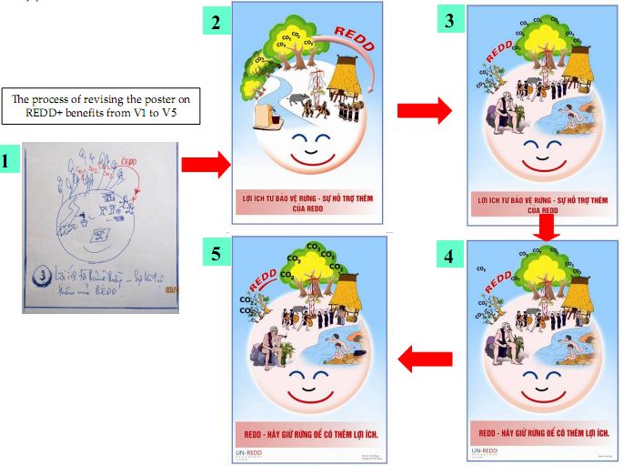
Development of Communication Materials
Posters designed and tested with villagers – their comments used to refine and improve designs

Slide 11
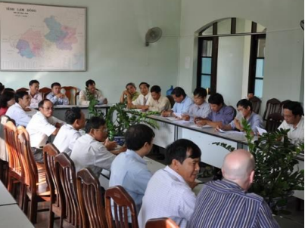
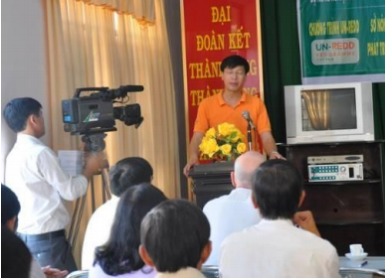
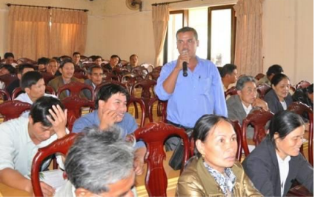
Viet Nam FPIC: Awareness Raising Events
Awareness raising: central, provincial, district, commune

Slide 12

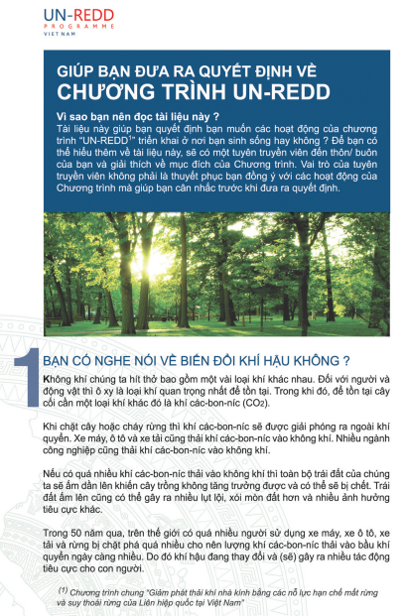
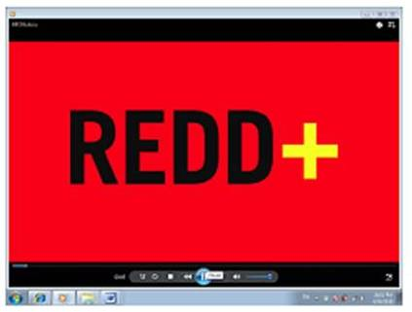
UN-REDD/Viet Nam FPIC
Development of Communication Materials
Brochures (left) and Video (right) also used; produced in 2 languages

Slide 13
Interlocutors
Engagement with ethnic groups in the villages was done by people from those same ethnic groups
  Language proficiency
  Cultural sensitivity
  Knowledge of protocols and customs
Interlocutors were mostly young people with knowledge of environmental issues

Slide 14
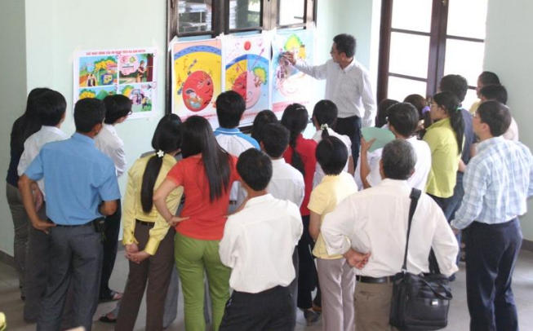
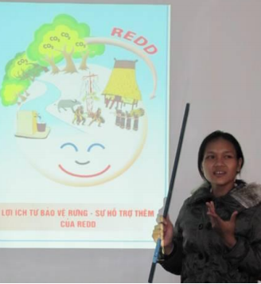
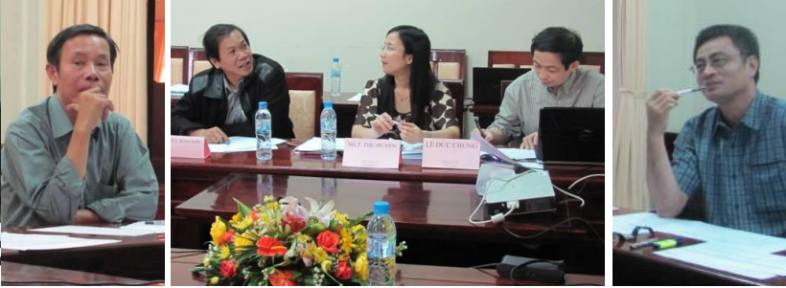
Interlocutors recruited, trained
24 recruited: 11 women; 8 IPs; mainly from local university and National Park Service

Slide 15
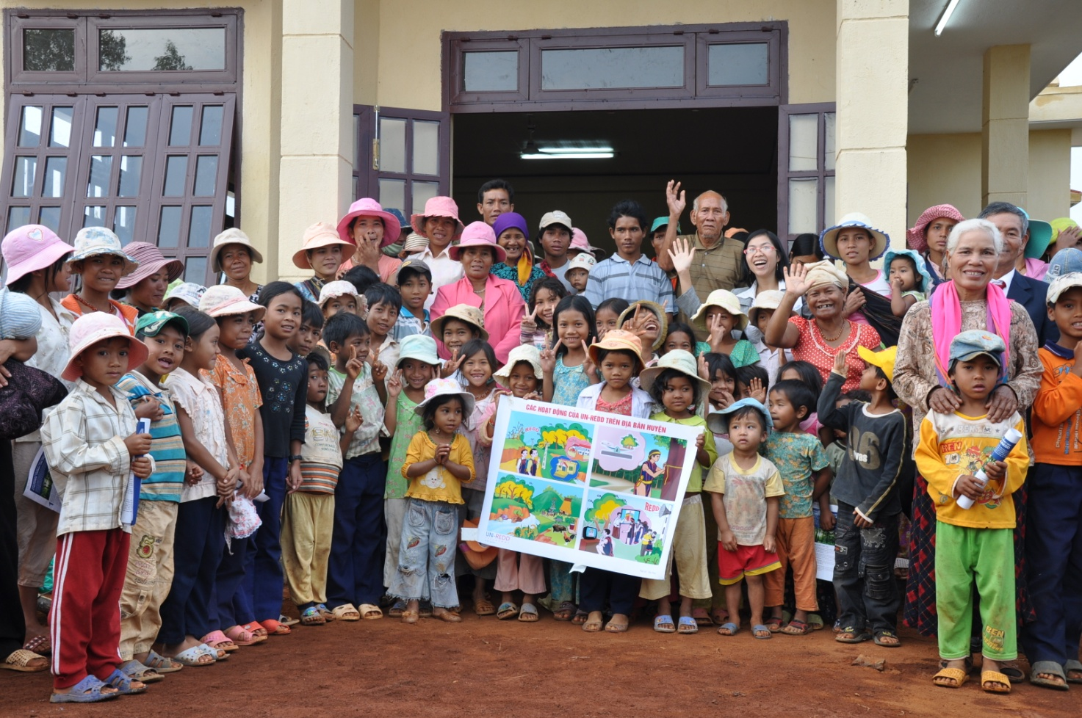
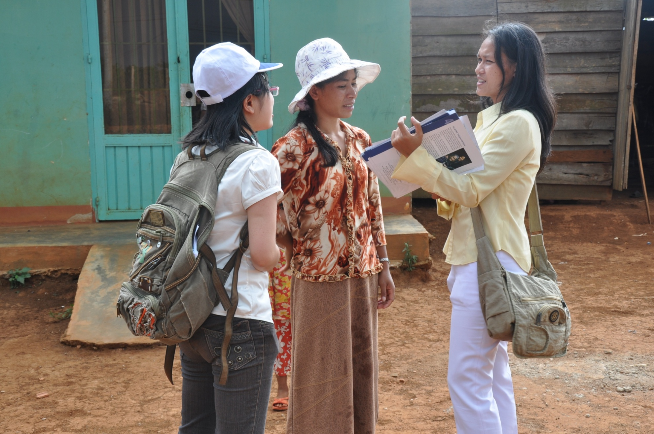
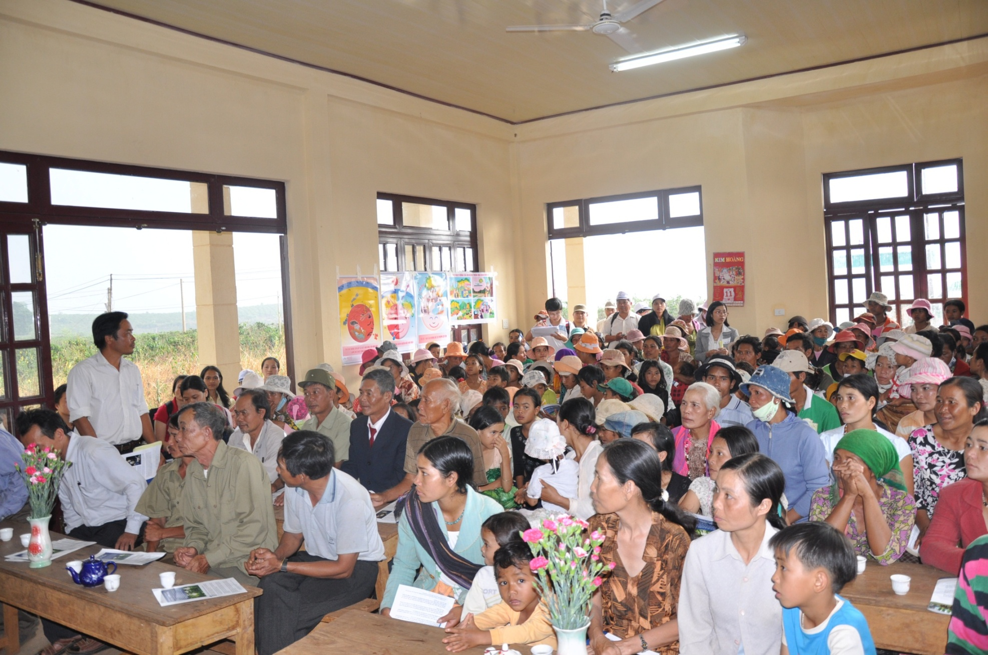
Viet Nam FPIC: Implementation

Slide 16
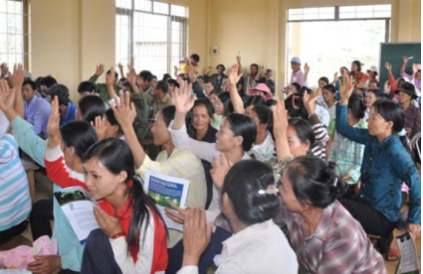
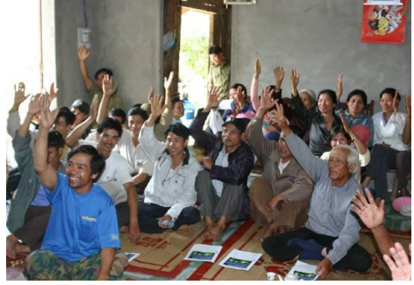
Viet Nam FPIC: Decision Making
Note: In Phase 1, villagers preferred a show of hands (do not like to sign names on paper). However, in later phases secret balloting used

Slide 17
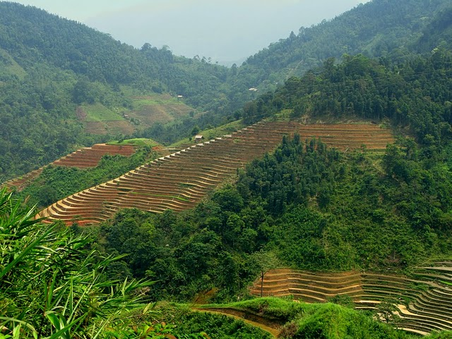

Benefit Distribution Analysis
Team of 7 experts hired through UN-REDD funds
Additional 3 experts hired with GTZ co-financing
IUCN contracted to manage process
Total 4 national, 6 international
Sub-teams working on legal issues, governance, payment structuring, monitoring
Work started October, finished November; cost: $70k

Slide 18
BDS Outputs
Initial set of 17 Policy Recommendations
Further analyses on specific policy issues
Stakeholder consultations at national and local level
Revised set of 17 Policy Issues (not all the same – some merged, some added)

Slide 19
Basic BDS System
Performance payments from international sources (fund or market)
Central Government:
Revenues received
National assessment of performance
Disbursements
Revenues retained by Central Government
Disbursements to sub-national bodies
Sub-national assessment of performance
Disbursements
Revenues retained by sub-national bodies
Disbursements to local bodies and beneficiaries
Local (and participatory) assessment of performance

Slide 20
17 POLICY DECISIONS
Covering …
Design and governance of Fund
Eligibility of beneficiaries
Multi-level management of revenues
Payment structuring and timing
Monitoring (4 types)
Recourse mechanism

Slide 21
POLICY DECISION #1:
LEGAL FRAMEWORK FOR REDD
Recommendation:
  Pilot REDD in a number of provinces for 2-3 years
  Prepare REDD-specific decree covering rights, and revenue management, etc. and incorporating lessons from pilots

Slide 22
POLICY DECISION #2:
REVENUE MANAGEMENT
Recommendation:
  A) Establish sub-fund of existing FPDF Fund, if legal basis can be modified to allow participatory governance
  B) If (A) is not possible, a new REDD Fund with participatory governance structures

Slide 23
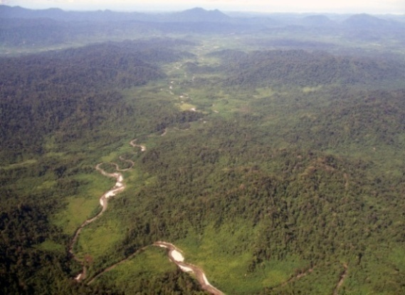
POLICY DECISION #6:
PAYMENT STRUCTURING
Recommendation:
  Devolve decision making to local authorities, but with strong checks and balances
  Design “R-coefficients” to account for local circumstances during piloting

Slide 24
POLICY DECISION #8:
LAW ENFORCEMENT AND BENEFIT DISTRIBUTION
Recommendation:
  Assess experiences with community-based law enforcement and translate into national regulations
  Strengthen law enforcement, with a focus on compliance, a key component REDD+ pilots

Slide 25
POLICY DECISION #10:
CREDIBLE RECOURSE MECHANISM
Recommendation:
  Commit to establishing an effective recourse mechanism
  Undertake an analysis of the institutional structure for a participatory recourse mechanism

