Slide 1
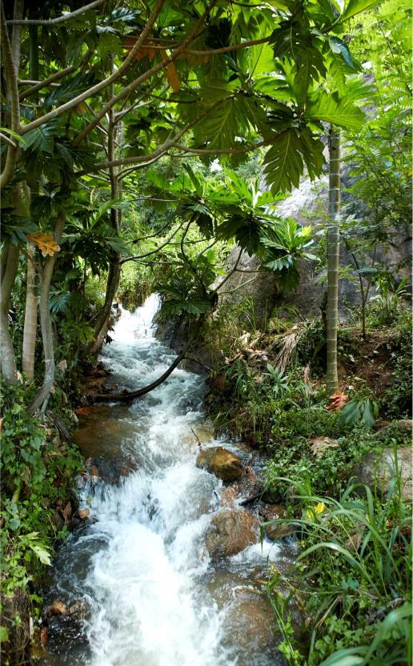
Summaries of safeguards information:
Requirements, key considerations and lessons so far
Steve Swan
13 June 2018 | Accra

Slide 2
Contents
UNFCCC requirements
GCF requirements
Progress and lessons
Notes:
STRUCTURE – options suggested by country, donor and civil society informants during stakeholder consultations for (2015) UN-REDD SIS paper: -
a narrative summary;
a summary of information by indicator;
a detailed principles, criteria and indicator framework
any combination of the above
LINKS TO SIS – as above

Slide 3

UNFCCC guidance – overview
STRUCTURE? - no UNFCCC-required structure
CONTENT ? - guidance recently been adopted by CoP21 (next slide…)
WHEN? - summaries should be submitted with national communications (every 4 years)
- directly to the UNFCCC REDD+ web platform on a voluntary basis (whenever)
- commencing upon implementation of REDD+ actions
LINKS TO SIS? - no explicit requirement for summaries of information to be outputs of the SIS
- many countries stated that, once operational, national-level SIS should inform summaries
Notes:
STRUCTURE – options suggested by country, donor and civil society informants during stakeholder consultations for (2015) UN-REDD SIS paper: -
a narrative summary;
a summary of information by indicator;
a detailed principles, criteria and indicator framework
any combination of the above
LINKS TO SIS – as above

Slide 4
Information on national circumstances relevant to addressing and respecting the safeguards
Description of each safeguard in accordance with national circumstances
Description of existing systems and processes relevant to addressing and respecting safeguards
Information on how each of the safeguards has been addressed and respected
Any other relevant information
Information on which REDD+ activities are included in the summary of information
Improving information taking into account a stepwise approach
4.
UNFCCC Guidance on summaries
Decision
17/CP.21 (Paris)
5.a
5.b
5.c
5.d
6.
7.
Notes:
Red - Countries ‘should’’ provide this information
Orange - Countries are ‘strongly encouraged’ to provide this information
Green - Countries are ‘encouraged’’ to provide this information
Colour coding used throughout in slide titles

Slide 5

Phase III - safeguards requirements
for results-based payments
SIS developed
designed?
Most recent summary of information
demonstrating safeguards addressed and respected…throughout REDD+ implementation…
operational?

Slide 6

Phase III- safeguards requirements
for results-based payments
Eligibility criteria
SIS and summary of information
Categories
RBP proposals categorized to determine type of assessment report
Information disclosure
summary of information provided by countries
env. and soc. assessment provided by accredited entities
Assessment
scorecard for summary of information (following 17/CP.21)
Scorecard for RBP proposal (how RBAs comply with ESS)
Use of proceeds
RBPs should be reinvested in line with, inter alia, GCF ESS
countries must provide a plan to reinvest the proceeds

Slide 7

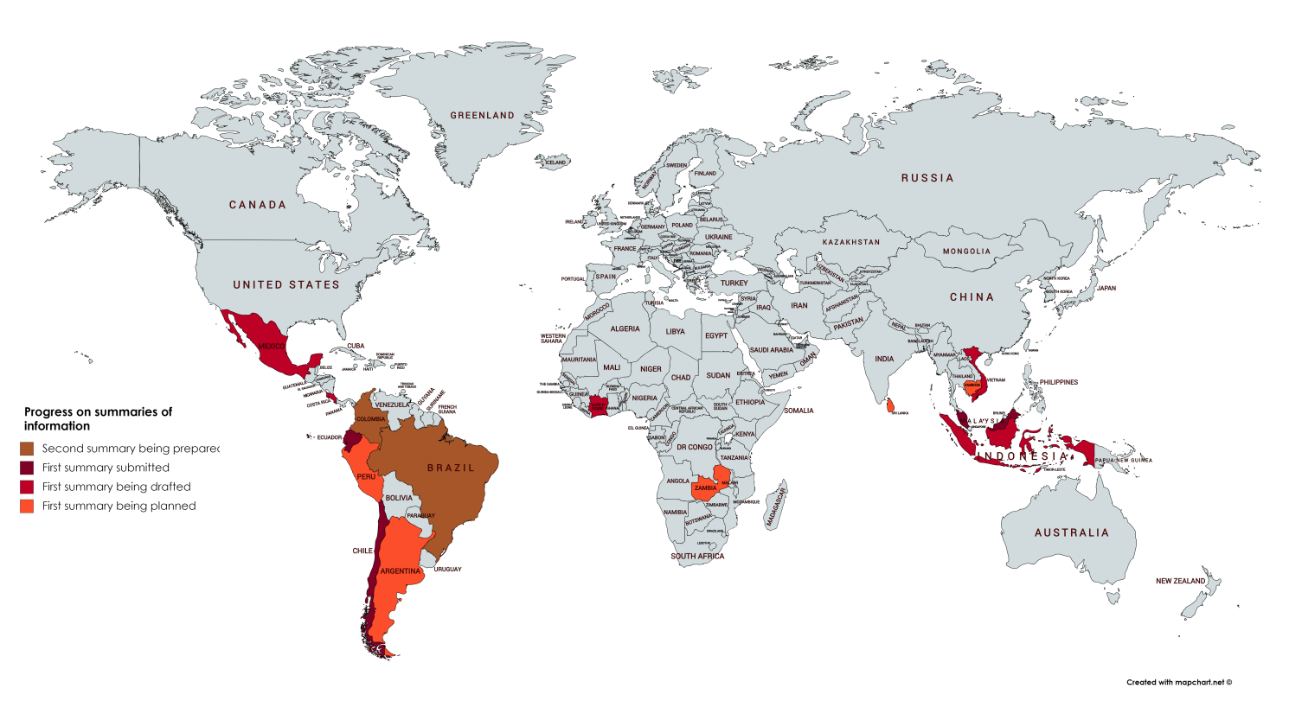
Progress on summaries of information

Slide 8
Lessons from ‘first generation’ summaries of information
Focus on readiness phase – original purpose of summaries of information is to demonstrate performance in implementation phase
Although the distinction made between addressing and respecting limited information on respecting (especially outcomes)
Action plans of gap-filling measures, on how the safeguards will be addressed/respected, often overlooked
SIS design descriptions weak in general, especially on links to NFMS, and how SIS will inform future summaries when it comes to implementation
No mention of GCF in any summary submitted to UNFCCC thus far; no country anticipated requirements for results-based payments

Slide 9

Thank you!
Steve Swan | steven.swan@un-redd.org
Connect with us online:
www.un-redd.org
www.unredd.net

