Slide 1
Mobilizing private sector finance for zero deforestation agriculture: the case of Côte d’Ivoire
Adeline Dontenville
EU REDD Facility
UN REDD Regional Knowledge exchange
Bangkok, 11 October 2017

Slide 2
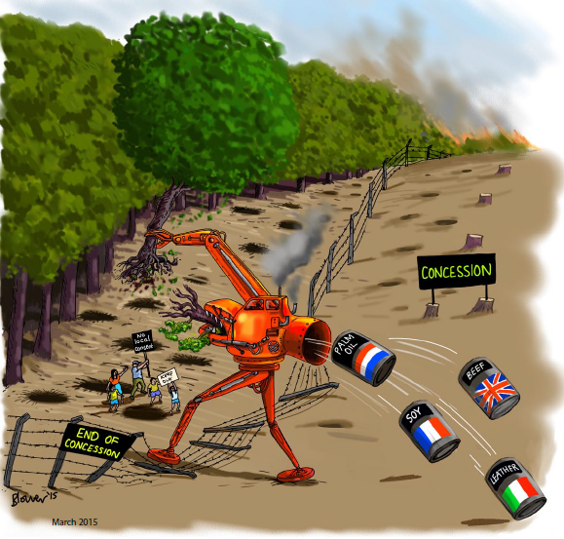
The cocoa momentum
Notes:
40% world production of cocoa
40% of cocoa production in classified forests,
Momentum:
NY Declaration
NDC committments
Consumers Good Forum
Public-Private working groups
Cocoa & Forest Initiative
Civil society pressure
Main barriers are (i) the paucity of business information available (ii) relatively large transaction costs and (iii) limited guarantees that prevents financial actors (and to a lesser extent downstream actors) from deploying tailored and risk-adjusted solutions.
Another main barrier is that the business case for sustainable cocoa production is still not clear enough to foster capital deployment at scale. It will however greatly benefit from the careful economic and financial analysis of the ongoing pilots and a systematic compilation of their findings
The different pilots initiated by supply chain actors suggest that for low-investment strategies (e.g. pesticides and fertilizers), solutions can emerge organically from within the supply chains. It will nonetheless take time and concerted effort.
For more ambitious strategies, such as grafting, replanting and plantation rehabilitation, the scale of the investment and the risk it entails will necessitate the active involvement of governments (to legalize land, secure land tenure) with multilateral donors acting as catalysts

Slide 3
A step-wise approach to engage the private sector
Demonstrate the business case of decoupling cocoa production from deforestation
Support high level leadership
Public-private plateforms
Provide and test tools
Notes:
CB analysis – after 6 years zero deforestation scenario generates more benefits. Challenge to engage PS beyond BAU intensification activities, into agroforestry, replanting
NY declaration, high level engagement, revision of forest code, national dialogue on zero deforestation policy, forest definition, REDD+ strategy
Role of CCC, climate WG, commodities dialogue and roundtable
Provide tools for PS to engage: eg PES

Slide 4
Who is financing?
Government
Mondelez
Zero Deforestation Agreement
?
‘Forest-friendly’ territories (PES)
Traceability and HCS mapping
Sustainable intensification
Independent monitoring
Notes:
PES: 4 eligible activities in the rural domain:
Forest conservation
Reforestation
Natural regeneration
Agro-forestry
Collective PES contracts can combine all four modalities in a local land use plan (‘PDL’ for the administration in charge of planning)
Private sectr recognizing the need for collaboration with govt
First to seek recognition
Government need to proactively set the rules, clarify
Tripartite agreement
Finding the right mix of private and public finance in this context

Slide 5
Looking ahead
Challenges remain to upscale from pilot to supply chain-wide zero deforestation investments
Supply chain approach needs to be backed by territorial approach and regulatory framework
Convene other key supply chain actors around front-runners
Sustain commitments and encourage collective action through market visibility
Notes:
GCF proposal on zero deforestation agriculture: 60% from private sector, some contributing to enabling environment (tenure)

Slide 6
More information: http://www.euredd.efi.int/publications/engaging-with-smallholder-cocoa-farmers
adeline.dontenville@efi.int
Notes:
If you would like to learn more about the approach and/or the example of Côte d’Ivoire, don’t hesitate to look at our results or get in touch.
Thank you for your attention and I’ll be happy to answer questions, if any.

