Slide 1
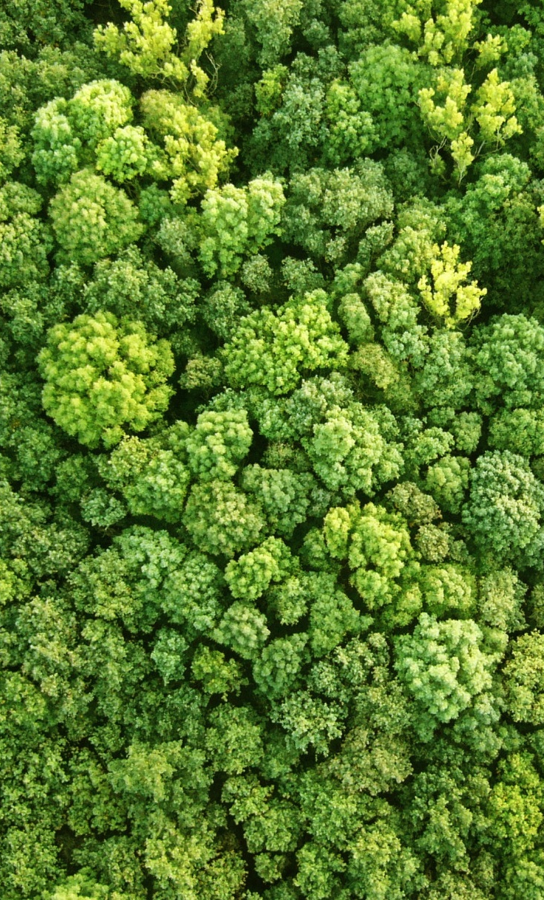
How can private capital contribute to REDD+ implementation?
Ivo Mulder
Finance and Private Sector Coordinator
11 October 2017 | Bangkok, Thailand

Slide 2
Do you engage the private sector in your national REDD+ process?
Not at all
A bit, but not enough
Yes, we engage the private sector actively
Notes:
Regulation (we collectively agree – through the Paris agreement at COP 21 last year – to burn fewer fossil fuels
Declining costs related to renewable energy (with the prospect of this declining further

Slide 3
How well do you understand these concepts?
“Zero net deforestation” commodity production
YES NO
Green bonds
YES NO
Carbon markets
YES NO
Notes:
Regulation (we collectively agree – through the Paris agreement at COP 21 last year – to burn fewer fossil fuels
Declining costs related to renewable energy (with the prospect of this declining further

Slide 4
How do you think the private sector should contribute to reduce deforestation?
(Co)fund REDD+ implementation (e.g. taxes, domestic carbon market)
Reduce deforestation on private land / concessions (through regulatory or economic incentives
The private sector should not contribute at all
Notes:
Regulation (we collectively agree – through the Paris agreement at COP 21 last year – to burn fewer fossil fuels
Declining costs related to renewable energy (with the prospect of this declining further

Slide 5
Agenda
2.20 – 2.50 | Zero (net) deforestation commodity production: Opportunities and challenges Adeline Dontenville, European Forestry Institute (EFI) / EU REDD Facility: Towards zero net deforestation cocoa production in Cote d’Ivoire. Fabien Monteils, UNDP: Private sector engagement in Viet Nam: what is happening and how can it lead to REDD+ objectives?
2.50 – 3.10 | Tropical Landscapes Finance Facility (TLFF): stimulating sustainable landscapes management through concessional long-term finance in Indonesia. Lisa Genasci, CEO, ADM Capital Foundation: How does it work and how does it benefit REDD+?
3.10 – 3.20 | Taking stock: what are some key elements that emerge from these presentations? What have you learned? How can you apply this in your own country? Ivo Mulder, UN Environment (UNEP)

Slide 6
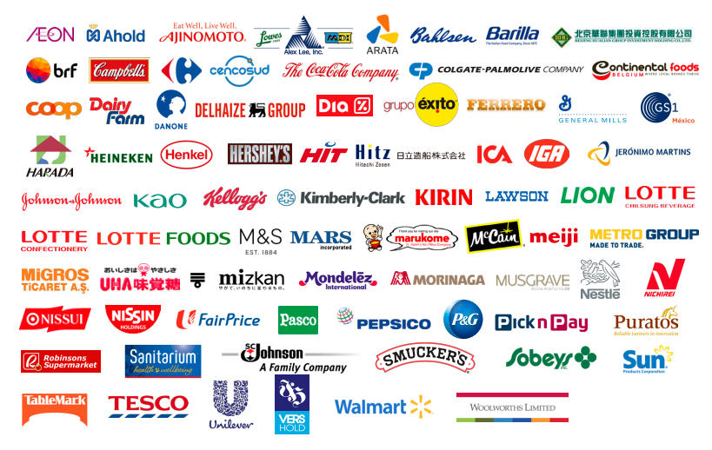
USD 3,000,000,000,000
(combined sales companies Consumer Goods Forum. This is similar to GDP of Germany)
Emissions: 24% AFOLU / Paris
Conservation: CBD Aichi targets
Restoration: 150m ha by 2020
(Bonn Challenge) / 350m ha by 2030
Investment: USD 30–200 billion/yr
Population: 9 billion (2050)
Food production: ↑ 60% (2050)
Investment: USD 83 billion/yr
in agriculture in developing
countries (FAO)
Notes:
400 large consumer goods companies, united in the Consumer Goods Forum, represent USD 3 trillion in sales

Slide 7
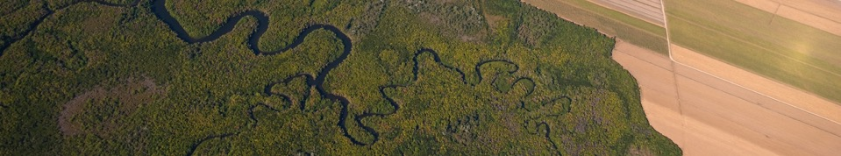
Financing sustainable land use in context
Investments in
soft commodity
production
USD 5,8 billion
USD 92-137 billion
USD 1.7 trillion
Budget land use-related
climate finance (2014)
Annual export
trade soft
commodities
Notes:
Chance to reduce deforestation & restore degraded land through public climate finance alone?
So why we need to focus on enlarging ’green finance’ it is also as much about ensuring that ’conventional’ finance is less impactful than it has been to date.
Challenges:
Enabling environment (fiscal policies, trade tariffs, land tenure, etc)
Costs involved in transition / scale up production on existing land or degraded land
Supply chain tracking and transparency (production → processing → trade → retail)
Limited knowledge and awareness banks, politicians, smallholders about business models sustainable land use

Slide 8
Taking stock on private finance in context REDD+
Private sector will not directly finance REDD+ implementation in most cases
(apart from e.g. project developers / investors in voluntary carbon projects or the aviation industry in the future)
Agriculture is the main driver of deforestation in many countries, but a growing number of companies want to reduce/neutralize their forest & climate impact (”zero net deforestation”).
However, there are often no incentives to change agricultural business practices. A combination of regulatory and/or economic incentives are needed to positively stimulate agribusinesses to “decouple deforestation from commodity production”
Private finance – in this event - needs to be seen in the context of: how can companies contribute to reduce deforestation and help countries achieve their REDD+ objectives.

Slide 9
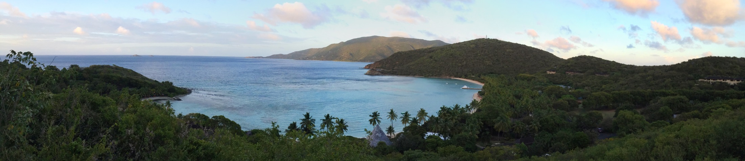
Thank you!
Connect with us online:
www.un-redd.org
www.unredd.net

