Slide 1

Monitoring and Evaluation for REDD+ Implementation
(Indonesia’s case)
Bangkok, 10-12 October 2017

Slide 2
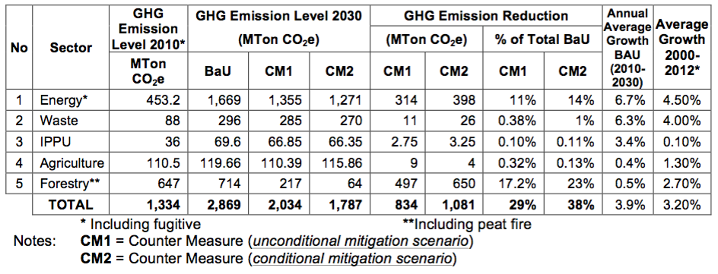
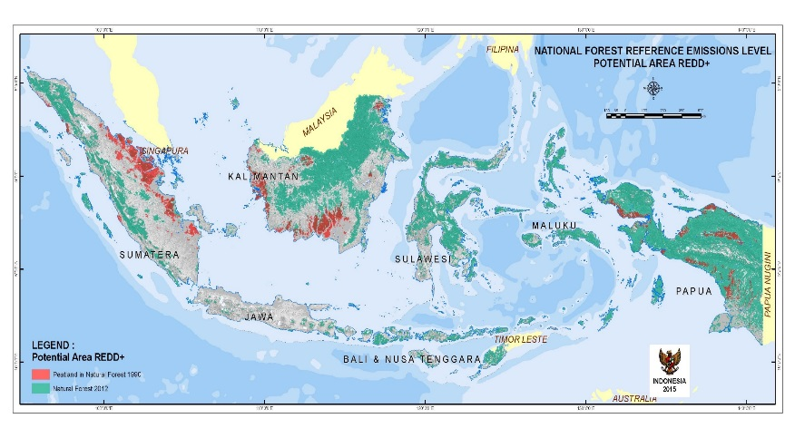
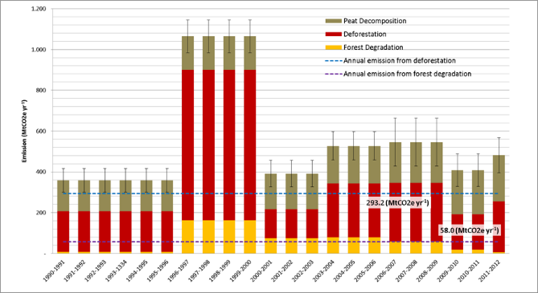
REDD+ Indonesia as important part of NDC from forestry sector
Map of Area for Performance Evaluation for REDD+ in Indonesia
REDD+ Indonesia : mitigation action from forestry sector with policy approach and positive incentive, an important component to achieve contribution target in Indonesian NDC from land-based sector, and inline with the direction of sustainable development
Result-based payment activities :
Emission reduction and/or avoiding deforestation
NCBs
Supporting activities :
Cap.building
REDD+ related policy/instruments strengthening/
R&D
Other enabling conditions
Through activities :
reducing emission from deforestation
reducing emission from forest degradation
role of conservation
sustainable management of forests
enhancement of forest carbon stocks
National FREL as reference to establish sub national FREL

Slide 3

REDD+ Indonesia architectures and M&E framework
Readiness Preparation
implementation/piloting
Full implementation
(result based payment)
Nat. Strategy
REL/FREL
(Dec. COP 15, COP-17, COP-19 )
NFMS-MRV
(Dec. COP-15, COP-19)
SIS-REDD+
(Dec. COP 17, 19)
FINANCE
(Dec. COP 16, COP-17, COP 18, COP-19 )
Indonesia National REDD+ Strategy
NFMS
MRV System for REDD+
Registry system
National FREL
SIS-REDD+ Indonesia
REDD+ Funding
instrument
Prov REDD+ strategy
11 provinces
Sub National FREL
Operating the systems in sub national level
Operating SIS-REDD+ in sub national level
development process is underway
wide multistakeholders involved : national govt, local govts, universities, technical team, experts, NGOs
Monitoring & Evaluation of REDD+ implementation

Slide 4
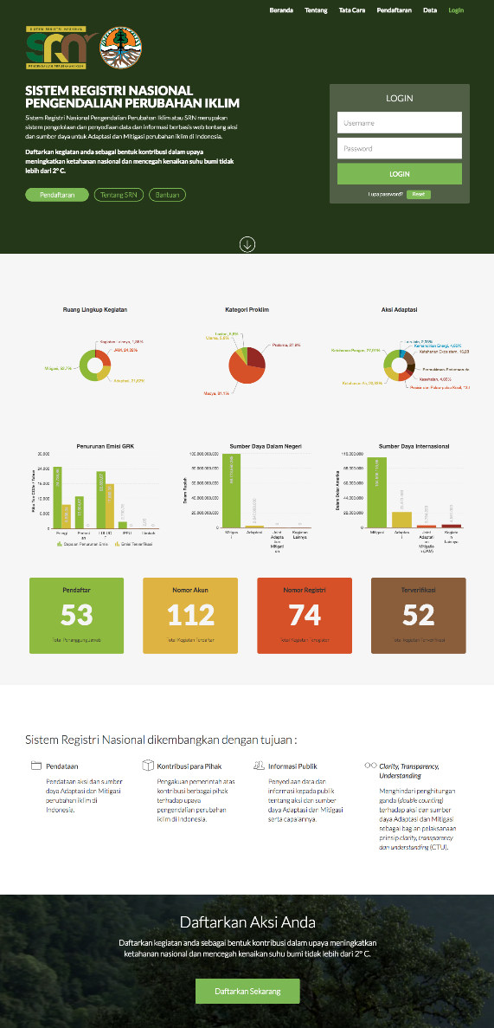
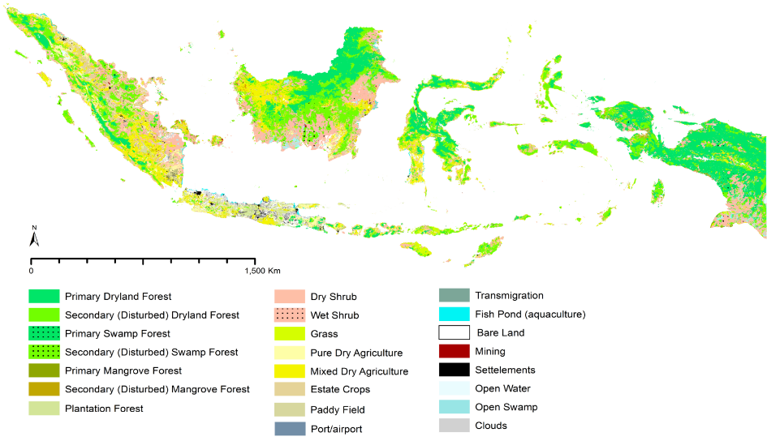

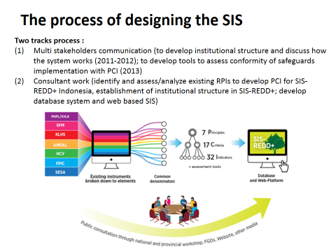
National Registry System
MRV System for REDD+
Systems to support Monitoring & Evaluation of REDD+ Implementation in Indonesia
National Forest Monitoring System
SIS-REDD+

Slide 5
Thank You

