Slide 1
Setting-up an Environmental Fund including REDD+
(Indonesia’s Concept & Experience)
Indonesian Team
Regional Knowledge Exchange : “Operationalizing and financing National REDD+ Strategies : from programming and financing implementation to Result-ased payments”
Bangkok, 10-12th October 2017

Slide 2
Environment Economic Instrument
Planning for Development and Economic Activities
Environment Funding
Incentive and/or Dis-incentive
(national financing instituion to manage the fund)
Environment restoration guarantee fund
environmental degradation and/or pollution measures fund
Conservation trust fund/grant
Other funding window
Other funding window
Funding window for climate
REDD+

Slide 3
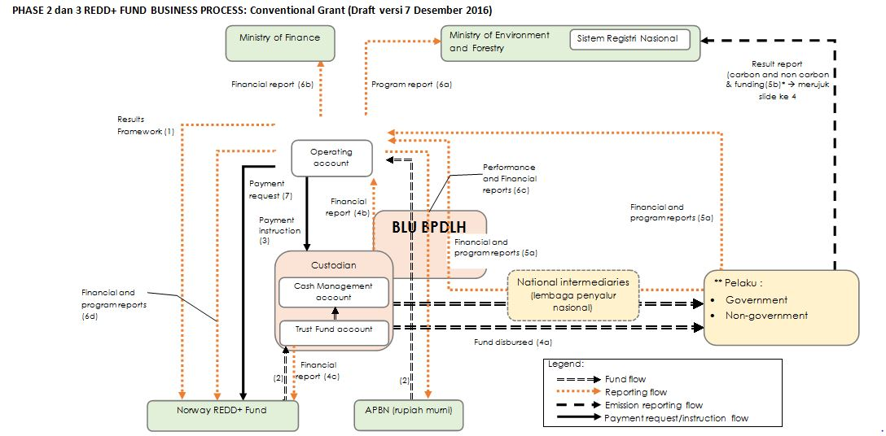
BUSSINESS PROCESS OF CLIMATE FUND
INCLUDING FOR REDD+ (case of Indonesia)
International Sources
Domestic Sources

Slide 4
Requirement for BLU development :
BLU Governance
Strategic Plan for BLU Business & Program Investment for REDD+
Manual for Service Standard
Financial Reporting
Basic Principles in developing
Mechanism for Fund Management :
Transparent
Efficient
Effective
Proportional
Accountable
Some Challenges :
Coordination with other sectors
Time frame
Sustainibility

Slide 5
THANK YOU

