Slide 1
Cambodia REDD+ Safeguard Information System (Cam-SIS):
Lesson Learnt and Challenges
  By Kim Sokha
  Fishery Administration, Cambodia
  E-mail: ksokha168@gmail.com

Slide 2
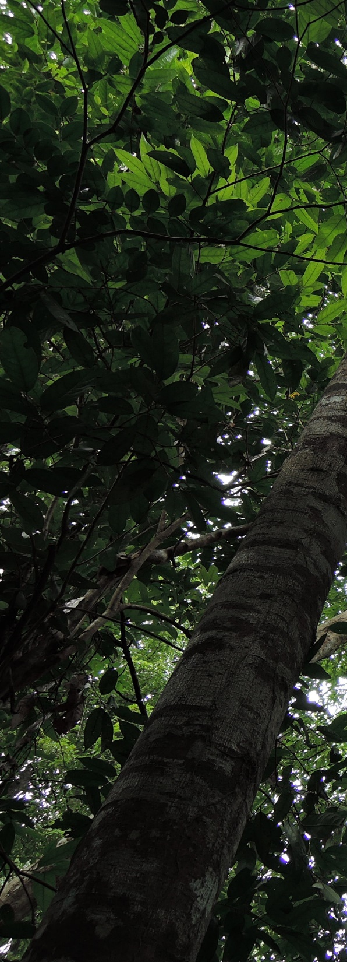
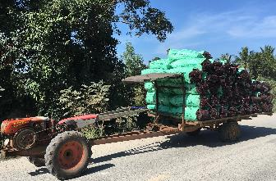
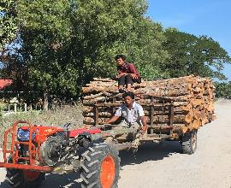
Table of Contents:
1. Processes
2. Challenges
3. Opportunities
4. Lessons Learnt

Slide 3
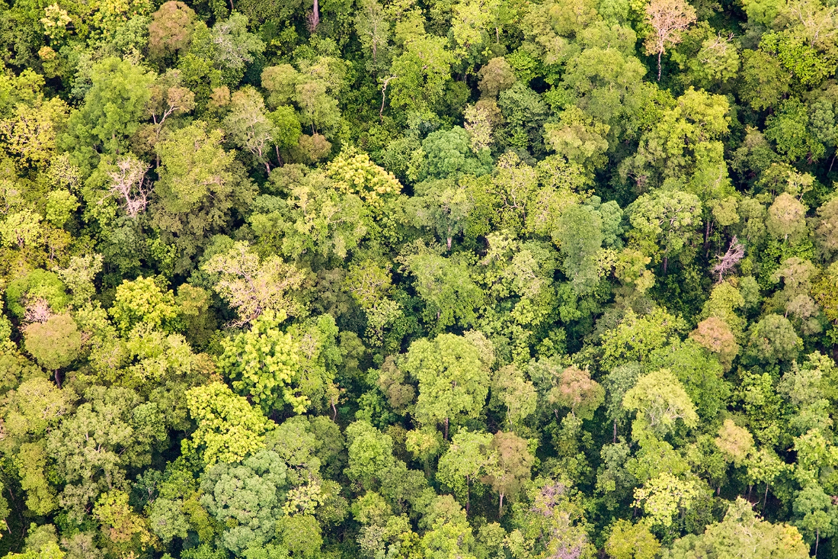
1. Process
Formulated the Cambodia REDD+ Technical Team, REDD+ Consultation Group, and Gender Group
Conducted existing government Policy/Laws/Regulation review associated with REDD+ safeguard
Translated 7 Cancun REDD+ safeguard to Cambodia-REDD+ safeguards
Formulated Cambodia REDD+ Safeguards “Principle, Criteria and Indicators” (PCIs).
Draft- Cambodia REDD+ SIS, and developed plan for Cambodia SIS operationalization
Formulated- draft safeguard Summary of Information- which was planned to submit to UNFCCC-REDD+ information hub, to be integrated into National Communication and Biannual Report.

Slide 4
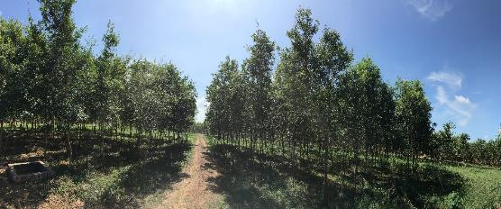
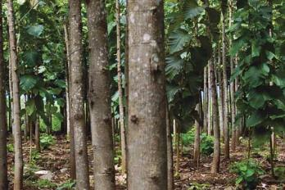
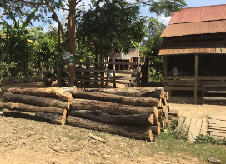
3. Challenges
PCI approach is overly lengthy and complicated in collecting information, management and analysis at the beginning phase.
Confusion re; different procedures and modalities on SIS development – (i.e. Green Climate Fund, FCPF-Carbon Fund, Joint Credit Mechanism, and World Bank/IFC..)
Limited capacity of national safeguard staff in translating national REDD+ safeguard policy into on the ground action (i.e. community awareness raising on REDD+ safeguards)

Slide 5
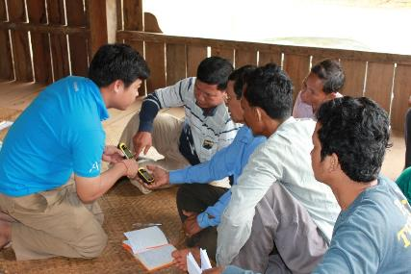
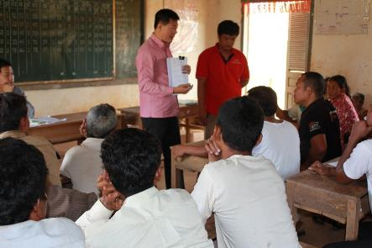
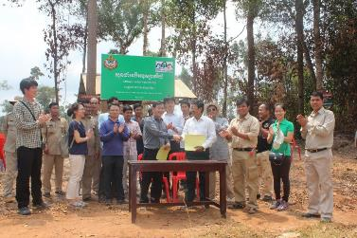
3. Opportunity
Use the FCPF-Readiness Fund (additional support-US$5 million) to strengthen and complete the current Cambodia SIS
Most of the existing PLRs in Cambodia could address 5 among 7 Cancun safeguards
REDD+ safeguards are clearly highlighted in the Cambodia REDD+ strategy- this is one of the most effective policy interventions that enable future SIS improvements

Slide 6
4. Lessons
During SIS development, should consider taking out the C&I at the begin phase, it could be used for future requirements, or to fill the need of specific donor or REDD+ investors.
On-going capacity building of stakeholders i.e. staff in charge of national REDD+ safeguards, and improving the development of community REDD+ awareness raising materials.
Should use existing institutional coordination mechanisms in collecting REDD+ safeguard information, and based-on the piloting phase-country could assess gaps and come up with strategy for improvement

Slide 7
Photo used in this PPT provided by the Cambodia Korea REDD+ Joint Project-Cambodia
Thank you !

