Slide 1
Utilizing governance arrangements to ensure REDD+ activities are carried out in consistency with Cancun Safeguards
Army Hotel, Hanoi, Vietnam
26th October, 2017

Slide 2
2012
Developing of social and environmental safeguards (SES) relating to REDD+ (FPIC)
A sub-technical working group on safeguards was formed (TWG - SES)
What did PNG do?
2013
Realignment of safeguards (2015 – present):
Gap analysis of REDD+ safeguards prior to 2015 → Roadmap
Capacity building toolkit for REDD+ safeguards
Revised TOR for the TWC SES (under review with CCDA)
Legal gap analysis report
Draft clarification of the UNFCCC REDD+ safeguards in accordance with national context and circumstances
Draft identification of national information systems and reporting mechanisms, relevant for the design of SIS
Recommendations for the design of a SIS in PNG.
Information needs on demonstrating how safeguards are being addressed and respected
Reviewed existing policies, laws and regulations (PLRs),
1. Gap Analysis of Existing Policies, Laws and Regulations,
2. Policy-to-Practice Roadmap, and
3. REDD+ Social and Environmental Principles, Criteria and Indicators for Papua New Guinea.
2014
Start of FCPF Project – PNG adopted a Country Approach to Safeguards (CAS)
Climate Change Management Act
2015
2016
Launch of National Forest Inventory
Transition from OCCD to CCDA
2017
Submission of National Forest Reference Level
Endorsement of National REDD+ Strategy
REDD+ development has been an ongoing process and NRS draws on this experience and information.

Slide 3
REDD+ Action Areas and Policies and Measures
Action Areas | Policies and Measures (PAMs)
Strengthened land-use and development planning | Strengthened and coordinated national level development and land use planning (DNPM and DLPP) Integrated subnational planning (DPLGA and DNPM)
Strengthened environmental management, protection and enforcement | Strengthening climate change legislation, financing and management (CCDA) Strengthening forest management and enforcement practices (PNGFA) Strengthening environmental management, enforcement and protection (CEPA) Strengthen access to information and recourse mechanisms
Enhanced economic productivity and sustainable livelihoods | Development of a sustainable commercial agriculture sector (DAL and DNPM) Strengthened food and security and increased productivity of family agriculture (DAL and FPDA)

Slide 4
Challenges | What needs to be done
Breadth and focus of NRS relies on strong and continuous inter-sectoral coordination | Elaborate PAMs identified Continue to build on sectoral planning sessions for connectivity Strengthen CCDA’s coordinating role
2. Continuous effort to ensure consistent implementation of policies, laws and regulations related to PAMs and safeguards | CCDA to coordinate and manage REDD+ GRM centrally CCDA to support sector agencies to strengthen their GRM
3. Capacity to implement safeguards measures horizontally (key sectors) and vertically (all levels of government) | Build capacity of provincial, district, local government to implement safeguards measures Engage all partners/stakeholders (govt agencies, institutions, etc)
4. Lack of data sharing arrangements and instruments between the core government agencies | To be formalized between CCDA and other these agencies: type of data/information needed, formats for providing information, frequency of providing information, etc.
5. General lack of adequate information systems as well as lack capacities to manage such data systems | Consider a central data processing unit (line agencies to feed it with information) CCDA to identify and work with agencies on data provision

Slide 5
Opportunities
Strengthen dialogue on sustainable development between all sectors – i.e., through sector retreats and Technical Working Committees.
Review existing relevant sector policies, legislations and regulations (PLRs) to ensure alignment with SDGs.
Access to funding to strengthen and build capacity within REDD+ existing national and sub-national agencies.
Empowerment of Women (Gender Equality) at the community level.
Empowerment of Civil Based Organisations and build networks at the community level.

Slide 6
Emerging Lessons
Bringing in relevant sectors and development partners early in the process to develop PAMs helps build ownership and will facilitate better identification and implementation of safeguards.
Gap analysis of existing PLRs helps to identify where alignment between key sectors is required.
Improvement required for consistent gender-based awareness within key REDD+ sectors.
Clear and consistent REDD+ information targeted at key audiences at the right time is needed to ensure the right levels of participation.
The draft REDD+ social and environmental Principles, Criteria and Indicators helped to kick start understanding of safeguards, but would need to be re-evaluated against the PAMs.
Notes:
Several activities have been implemented in PNG to meet the safeguards related requirement to date. The main activities included:
The gap analysis reviewed 19 existing polices, 29 laws and 11 regulations and identified a number of key gaps both in the content of existing legislation, but also in the way in which laws were practically implemented on the ground. These “implementation gaps” were further discussed, elaborated and clarified at four regional workshops conducted with provincial government staff, civil society and private sector stakeholders across the country in May and June 2014.
Building on the legal gap analysis, a ‘policy to practice roadmap’ was developed with the purpose of “summarising practical actions for the government of Papua New Guinea regarding the implementation of social and environmental safeguards for the national REDD+ programme.” The report identified three areas for action with regard to safeguard development:
1. The need to address key legal and implementation gaps in the implementation of key laws and policies to strengthen the application of social and environmental safeguards in PNG;
2. The development of principles, criteria and indicators with which positive impacts of the national REDD+ programme can be assessed and through which the negative impacts can be mitigated and reported;
3. Undertaking Strategic Environmental and Social Assessment (SESA).
Based on the PLR gap analysis and policy to practice roadmap examined above, it was concluded that social and environmental ‘standards’ should be developed to ‘monitor’ the gaps identified in the PLRs in practice.
.

Slide 7
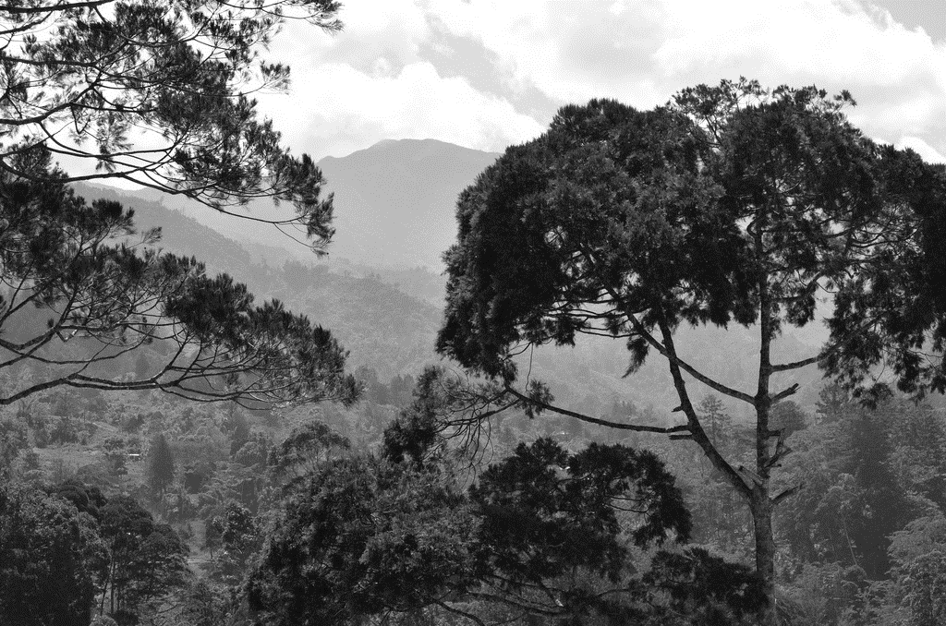
Thank you
Sonia Baine
Senior REDD+ Officer
Climate Change & Development Authority
Email: bainesonia65@gmail.com

