Slide 1
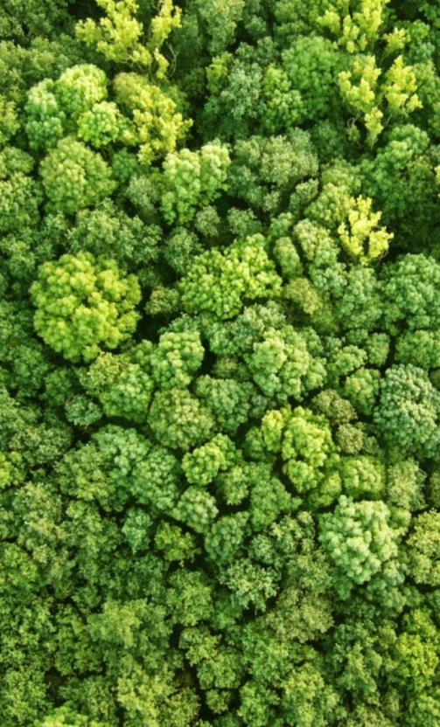
UNFCCC SAFEGUARDS REQUIREMENTS
Global progress overview
Charlotte Hicks, UNEP-WCMC
26 October 2017 | Hanoi
Notes:
Guidelines:
Limit text as much as possible, in favour of visuals, graphics (clean and simple), and photos that highlight your speaking points, rather than repeat them. If people are busy reading, they won’t be listening to your presentation!
Powerpoints should add value to your presentation. If information isn’t relevant or important, don’t include it.
Create your powerpoint with your live audience in mind, not as a publication for sharing afterwards. This will keep you from filling it up with too much information/text.
If you are going to insert charts, make sure they will be quickly and easily understood. Many times, complicated visuals are only meaningful to those who created them.
Avoid using animations or other outdated ‘special effects’. Keep your presentation clean and professional (i.e. no drop shadow lettering, 3D text, spinning transitions etc.)
Choose powerful images that illustrate your work. If you don’t have original photos, check out the UN-REDD Photo Bank on Flickr, or use creative commons photos (try pixabay.com for example).

Slide 2

Outline
UNFCCC safeguard requirements
The Cancun safeguards
Safeguards information systems
Summaries of information

Slide 3
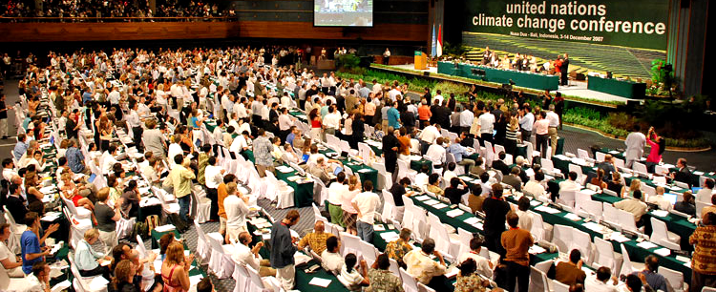
UNFCCC Safeguards Requirements
2
  Countries promote & support the Cancun Safeguards throughout REDD+ implementation
  Safeguard information system (SIS) to provide information on how the country is addressing and respecting the Cancun safeguards
  Summary of information on how the Cancun safeguards are being addressed and respected submitted before results-based payments
1
3
Notes:
These are the three key messages to remind us that there is more to UNFCCC safeguard requirements than the SIS
Requirement no. 1 – safeguards need to be operationalised throughout the implementation of REDD+ activities – is often overlooked and eclipsed by the tangible outputs of the other two key requirements: SIS and summary of information

Slide 4
Decision 1/CP.16 (Cancun)
a. Policy alignment (national & international)
g. Reduce displacement of emissions
b. Forest governance (transparency & effectiveness)
f. Address risk of reversals
The
Cancun Safeguards
e. Natural forest, biodiversity, social & environmental benefits
c. Knowledge & rights of indigenous peoples & local communities
d. Full & effective participation of relevant stakeholders, in particular IP & local communities
Notes:
COP16 (Cancun) in 2010 agreed that a set of seven safeguards, commonly referred to as the Cancun Safeguards, should be promoted and supported when undertaking REDD+ activities. The safeguards in Appendix 1 of decision 1/CP.16 indicate that when undertaking activities referred to in paragraph 70 of decision 1/CP.16, the following safeguards should be promoted and supported (promouvoir et adherer):
a) Nécessité de veiller à ce que les activités viennent en complément des objectifs des programmes forestiers nationaux et des conventions et accords internationaux pertinents ou soient compatibles avec ces objectifs;
b) Structures nationales transparentes et efficaces de gouvernance forestière tenant compte de la législation et de la souveraineté nationales;
c) Respect des connaissances et des droits des peuples autochtones et des membres des communautés locales, en tenant compte des obligations internationales pertinentes et des situations et législations nationales, et en notant que l’Assemblée générale des Nations Unies a adopté la Déclaration des Nations Unies sur les droits des peuples autochtones;
d) Participation intégrale et effective des parties prenantes concernées, en particulier des peuples autochtones et des communautés locales, aux activités visées aux paragraphes 70 et 72 de la présente décision;
e) Mesures qui soient compatibles avec la préservation des forêts naturelles et de la diversité biologique, en veillant à ce que les activités visées au paragraphe 70 de la présente décision ne se prêtent pas à une conversion des forêts naturelles mais incitent plutôt à protéger et à conserver ces forêts et les services rendus par leurs écosystèmes, ainsi qu’à renforcer d’autres avantages sociaux et environnementaux10;
f) Mesures visant à prendre en compte les risques d’inversion;
g) Mesures visant à réduire les déplacements d’émission

Slide 5
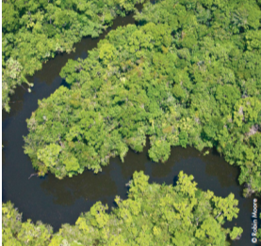
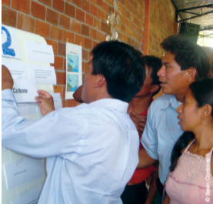
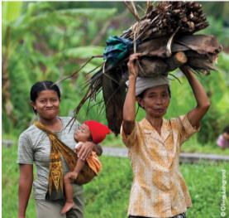
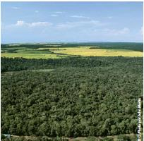
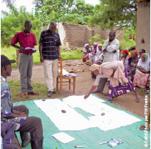
How are Cancun Safeguards Applied?
Applied to What?
How?
When?
All REDD+ actions in the National Strategy or Action Plan as defined by the government
Through application of policies, laws, regulations, and institutions to implement/enforce them
Throughout implementation of REDD+ actions
Notes:
REDD+ actions = policies and measures (PaMs), comprising the national strategy/action plan (NS/AP), identified and implemented to tackle the drivers of deforestation and forest degradation, as well as barriers to more effective and/or extensive ‘plus’ activities of REDD+
Important to note the link between PaMs in the NS/AP and the country approach to safeguards, which is explored in more detail in Module 2

Slide 6
The Cancun Agreements also…
… requested Parties implementing REDD+ to ‘develop a system for providing information on how the Cancun safeguards are being addressed and respected throughout the implementation of the REDD+ activities’,
Safeguard Information
System (SIS)
Notes:
The Cancun Agreements (COP 16, 2010) and subsequent decisions adopted in Durban (COP 17, 2011) request Parties implementing REDD+ to ‘develop a system for providing information on how the Cancun safeguards are being addressed and respected throughout the implementation of the REDD+ activities’, or a Safeguard Information System (SIS)
Un systeme pour la communication des informations relatives a la maniere dont les garanties de Cancun sont prises en compte et respectees pendant la mise en oeuvre des activites REDD+

Slide 7
Provide transparent and consistent information that is accessible by all relevant stakeholders and updated on a regular basis
Be transparent and flexible to allow for improvements over time
Provide information on how all of the safeguards are being addressed and respected
Be country-driven and implemented at the national level
Build upon existing systems, as appropriate
Be consistent with the guidance [for policy approaches and positive incentives on issues relating to REDD+]
a)
UNFCCC Guidance for SIS
Decision 12/CP.17 (Durban)
b)
c)
d)
e)
f)
Notes:
Decision 12/CP.17 (Durban) on providing information on how safeguards are addressed and respected states that Parties undertaking REDD+ activities “…should provide a summary of information on how the safeguards in 1/CP.16 appendix I, are being addressed and respected throughout the implementation of the activities.” The decision states that this summary of information should be provided periodically and be included in national communications.
Convient que les systèmes de communication d’informations sur la manière dont les garanties visées à l’appendice I de la décision 1/CP.16 sont prises en compte et respectées doivent, compte tenu de la situation des pays et de leurs capacités respectives, et dans le respect de leur souveraineté et leur législation, des obligations et accords internationaux pertinents et du souci de l’égalité entre les sexes:
Respecter les principes énoncés au paragraphe 1 de l’appendice I de la décision 1/CP.16;
Fournir des informations transparentes et cohérentes, accessibles à toutes les parties prenantes concernées et régulièrement mises à jour;
Être transparents et suffisamment flexibles pour être progressivement améliorés
Apporter des informations sur la manière dont toutes les garanties visées à l’appendice I de la décision 1/CP.16 sont prises en compte et respectées;
Suivre une démarche impulsée par les pays et être mis en œuvre au niveau national;
S’appuyer sur les systèmes existants, le cas échéant;
Both the Cancun and Durban decisions on SIS are broad and leave considerable flexibility for Parties on how to implement them in practice
There is potential for future UNFCCC decisions to provide more detailed guidance related to SIS transparency, consistency, comprehensiveness and effectiveness, as well as the content and structure of safeguards information summaries.

Slide 8
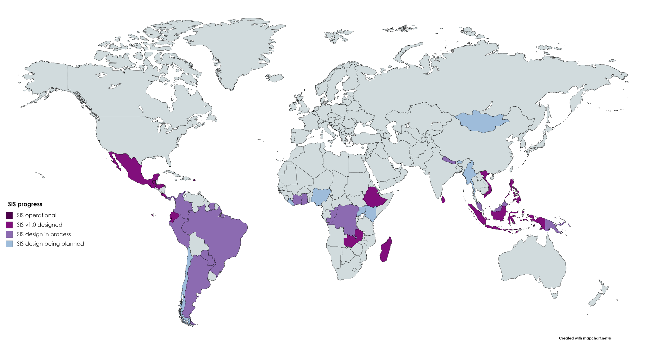
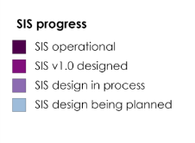
?
Progress on safeguard information systems

Slide 9
Summaries of Information
Countries are also requested to submit summaries of information on safeguards:
HOW
  To be included in National Communications
  On a voluntary basis, can also be provided via the UNFCCC web platform
WHEN
  Periodic submission of information
  Provision of 1st summary at the start of implementation of REDD+ activities
  Follow same frequency as the submissions of National Communications
Notes:
Calendrier et fréquence de présentation des résumés des informations relatives à la manière dont les garanties visées à l’appendice I de la décision 1/CP.16 sont prises en compte et respectées
… fourni de façon périodique et figure dans les communications nationales, ou être transmis par les voies de communication approuvées par la Conférence des Parties
… la fréquence de présentation des résumés ultérieurs devra être conforme aux dispositions relatives à la présentation des communications nationales

Slide 10

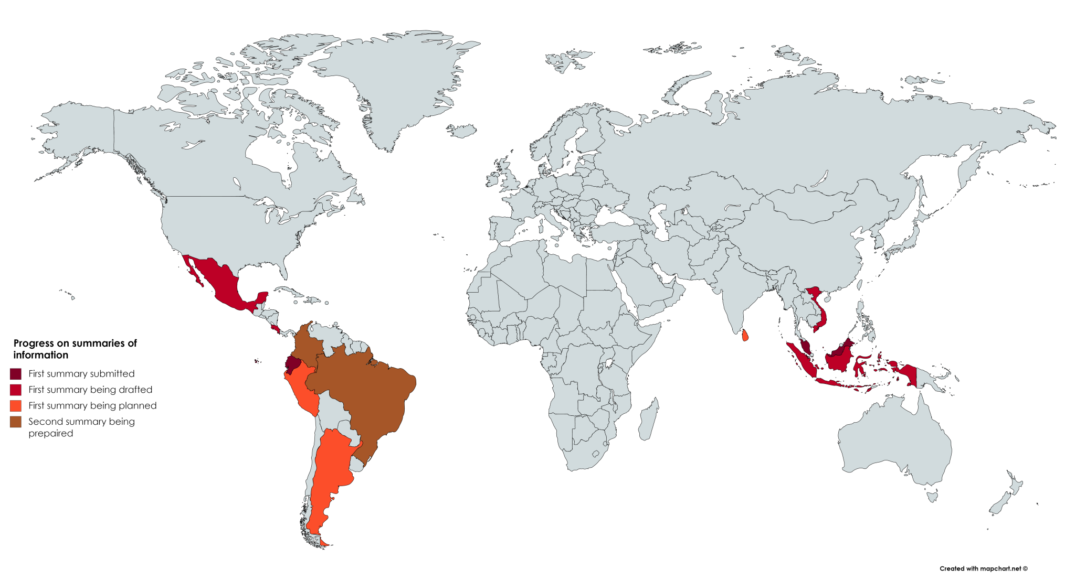

?
Progress on summaries of information

Slide 11
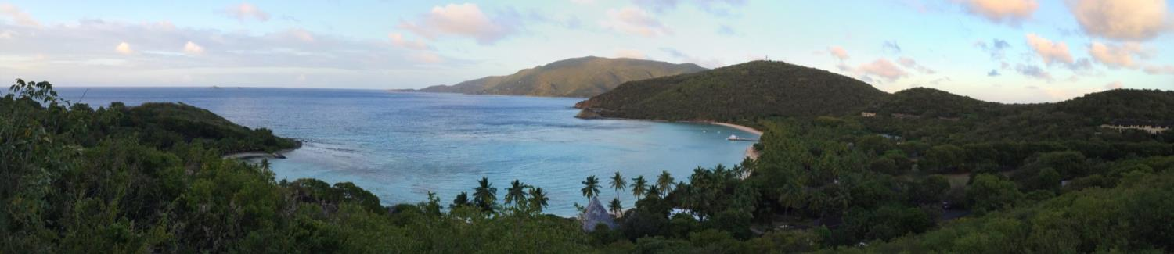
Thank you!
Charlotte Hicks | Charlotte.Hicks@unep-wcmc.org
Connect with us online:
www.un-redd.org
www.unredd.net

