Slide 1
Country Experience on
KM and Communications Work
By Khin Hnin Myint
23 August 2016

Slide 2
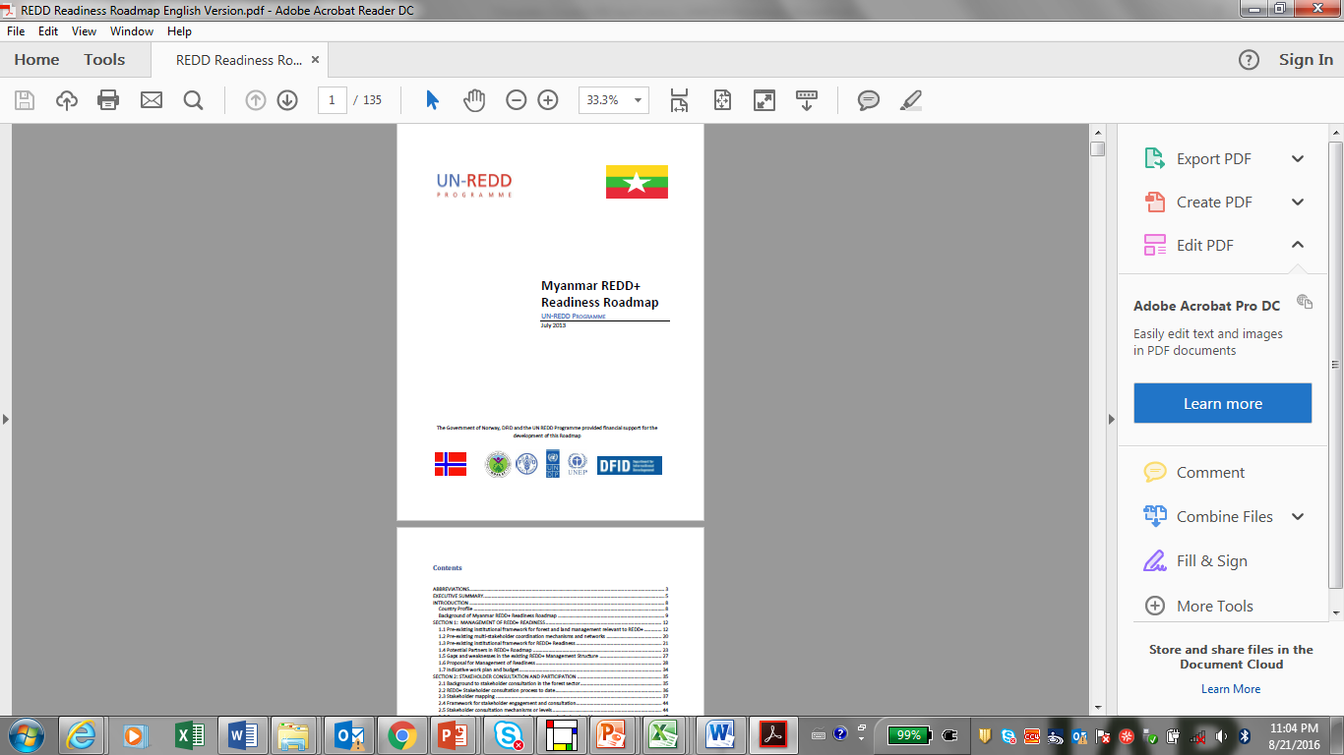
Myanmar REDD+ Programme
  REDD+ Readiness Roadmap Developed in 2012
  UN-REDD Programme Implementation started in late 2015

Slide 3
Institutional Arrangement
Environmental Conservation and Climate Change Committee
REDD+ TASK FORCE: MoNREC, MoALI MoHA and MERN
REDD+ TASK FORCE OFFICE (FD)
Other REDD+ or Development Partners’ Initiatives
UN-REDD Programme Executive Board (PEB)
UN-REDD Programme Management Unit
SE&S TWG
D&S TWG
NFMS TWG
Stakeholder Network
  TWGs are the key mechanisms of supporting at technical level
  Members are the representatives of relevant key departments, CSOs and IP organizations

Slide 4
KM and Communication Strategy
  Developed a KM & Communications Strategy covering only at the Programme (1st Q, 2016)
  Drafted by referring other advanced countries' strategies together with Regional Specialist and PMU.
  Finalized with the discussion among NPD, PMU, REDD+ Core Unit and TWG through following process:
  - Share through email
  - Discussion at TWG meetings (3 times)
  - Finalized at TWG meeting

Slide 5
KM and Communication Strategy
  Contents
  Introduction
  Goal, Objectives, and Principles
  Target Audiences/Partners
  Key Messages for Communications
  Steps in implementing the Strategy
  Coordination with other REDD+ readiness initiatives /Capacity Building Strategies in Myanmar
  Key Mediums for Communications on REDD+ / Corporate Communications Resources/Activities in 2016
  Monitoring and Evaluation

Slide 6
Challenges encountered
Knowledge Management
Knowledge generated during REDD+ readiness activities is shared effectively among all partners and informs decisions on a national REDD+ programme. | Establish a System by Identifying all relevant REDD+ readiness initiatives; Identifying a knowledge focal point within each initiative; Working with each knowledge focal point to compile all reports, work plans, ToR, etc.; Establishing an appropriate knowledge platform; Ensuring all knowledge is organized on the platform is a logical fashion; and Ensuring all knowledge is accessible through the platform and regularly updated.

Slide 7
KM and Communication Strategy
Communication
Communication of information and knowledge about REDD+ in Myanmar enhances stakeholder participation and promotes collaboration and cooperation among partners. | Produce and disseminate information relevant to each stakeholder group to enable them to play an effective and relevant role in the design and subsequent implementation of a national REDD+ programme.

Slide 8
Challenges encountered
Media Relations and Networking
Promote broad support for REDD+, including through engagement of public media | Contribute to broad-based support for REDD+ by ensuring that all media have access to accurate and balanced information about REDD+” by creating Press Release; Radio announcement; Opinion editorial; Features; Features advisories, etc.

Slide 9
Support requested from regional KM/Comms Specialist
Overall: Technical Support to the implementation of KM/Comms. Strategies
Specifically:
Intensive support before new Community Officer is on board;
Video Production: check existing video and possibility of Myanmar Version;
Support on Capturing lessons, experience, and knowledge from the programme implementation and activities
Learning journals to regional context and experiences

Slide 10
Thank You
[Khin Hnin Myint]
[khin.hnin.myint@undp.org]
website: www.myanmar-redd.org

