Slide 1
Bangladesh Country Experience on
KM and Communications Work
By Nasim Aziz
23 August 2016

Slide 2
Background of the KM and Comms Strategy
In general, the generation, storing and dissemination is done by RIMS-GIS Unit; Development planning, REDD Cell
Storing of information started with R-PP phase
No formalized KM / Comm Strategy yet
PMU to facilitate discussion, REDD Cell to decide on overall KM strategy
Some discussions at MRV-TWG on KM and dissemination
Key activities: sharing information – events / documents, translation of REDD+ materials, basic info, Geo-portal (spatial data), Bangladesh Forest Information System

Slide 3
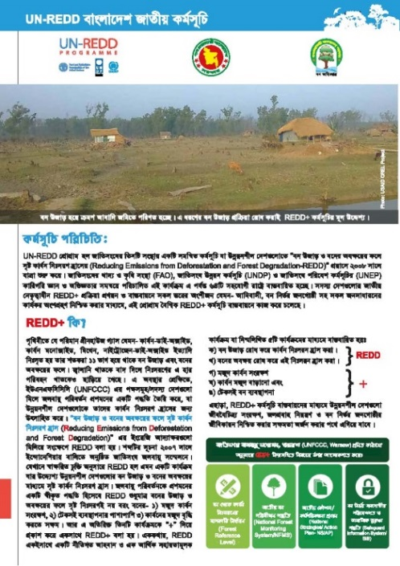
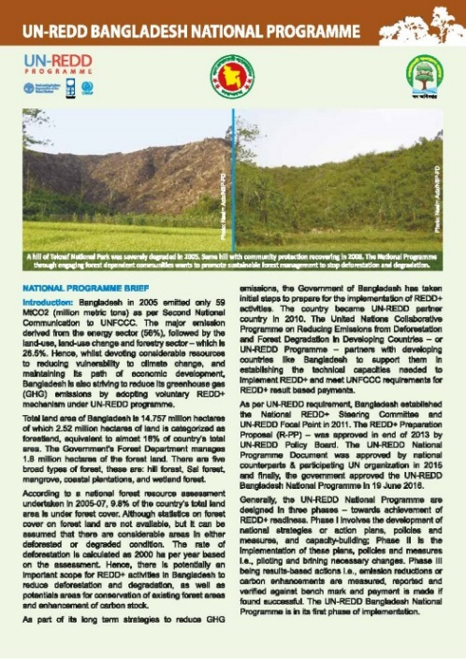

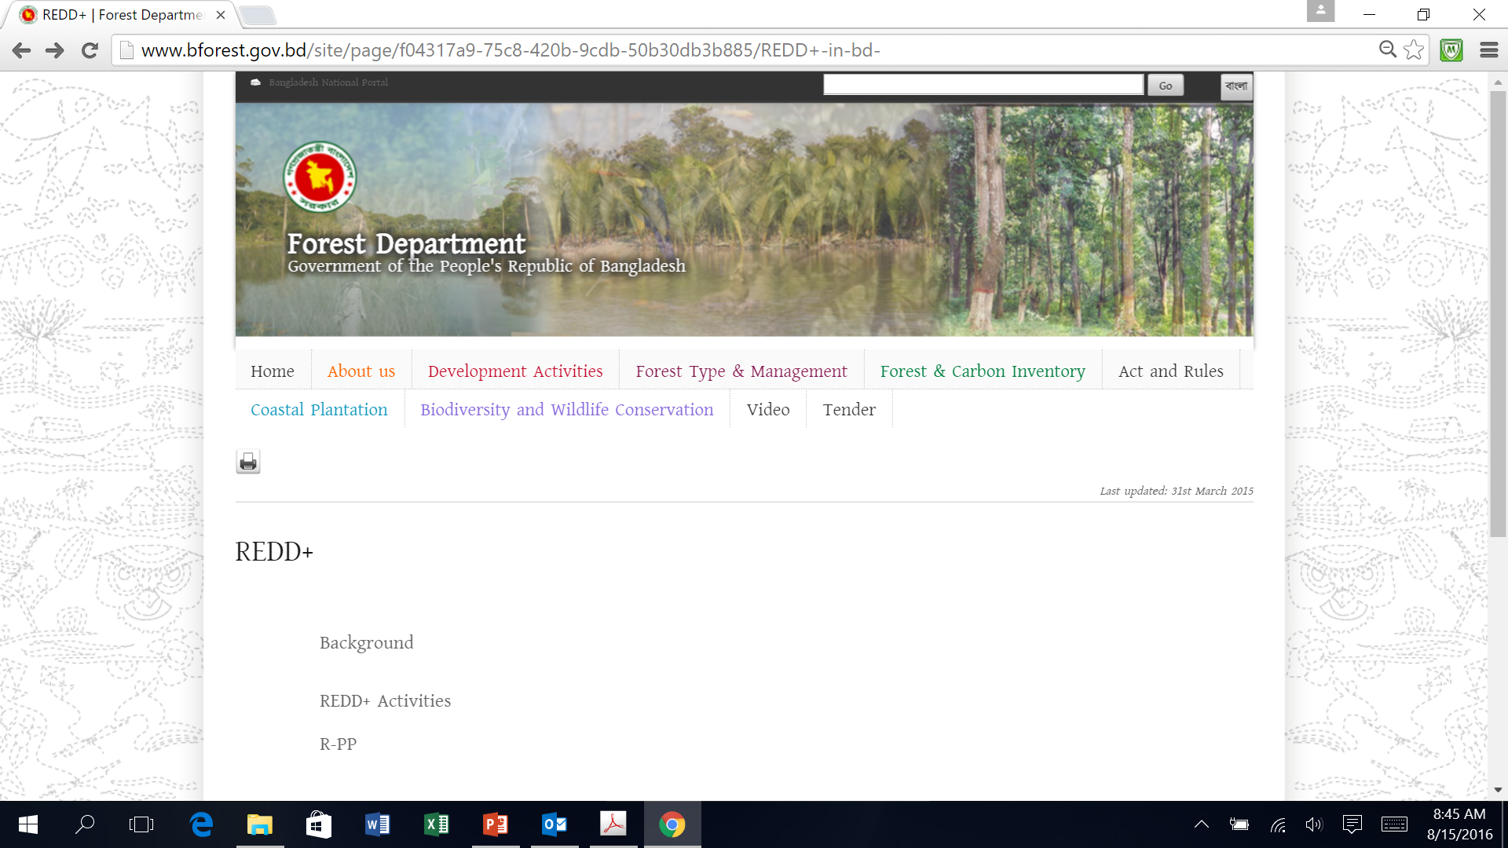
Results/progress/achievements
Bangla language brochure on importance of REDD+ & NP
NP English brochure
Folders & note book
Pipeline –Comm Strategy; translation of FAQ, Glossary, COP Decisions on REDD+,
Webpage – on going
Planning: YouTube videos with local language voice over

Slide 4
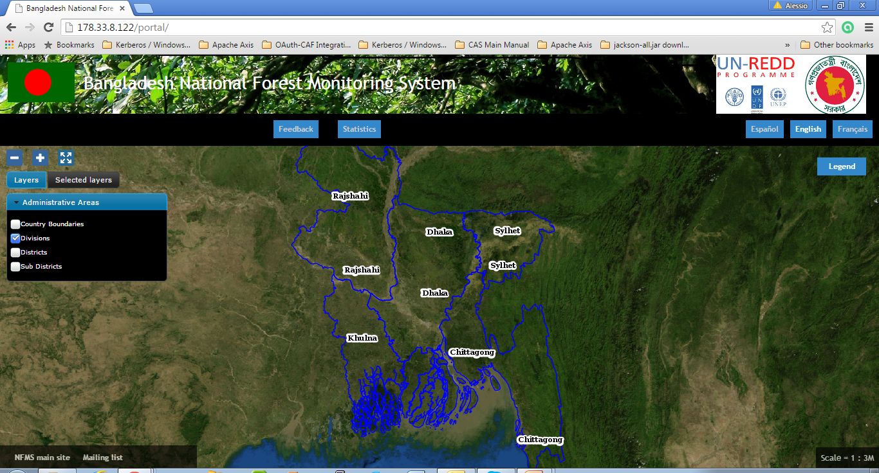
Results/progress/achievements
Geo-portal: development phase (land cover, change, forest/no forest)
BFIS – concept note, on information system for the land cover in pilot basis; data entry & report generation
Over 500 emission factors collected and integrated in a EFDB
Archiving of activity data a reference system has been developed

Slide 5
Results/progress/achievements
Harmonisation of the land cover/use information – on going
Soil carbon maps developed using available national and global datasets
Support to the TNC provided for activity data and emission factors, classification system and documentation
Several training implemented on GHG inventory preparation, integration of RS applications for monitoring forest cover, gains and losses and its integration with land cover mapping and the national forest inventory, allometric equations etc.
Proceedings of trainings and workshops are available

Slide 6
Challenges encountered
Data: availability, reliability, consistency, time series
Generation:
  Lack of data & quick generation of information
  Context: comparison, interesting or provoke thinking
  Authenticity / responsibility
  Ease of understanding – acronyms, scientific terms, etc.
  Availability of good quality, thematic pictures
Storage:
  Absence of agreed upon central depository
  Lack of proper coordination
Dissemination:
  Only approved documents via website / printed materials
  No access to raw data for further information generation
Notes:
Software; printing

Slide 7
Support requested from regional KM/Comms Specialist
All support we can get from regional KM/ Comm Specialist:
  Event news – CSO/IP, BD Inception, PEB meeting, etc.
  Documentation and dissemination at UN-REDD website
  Engaging stakeholders
  Developing ToR for SH mapping exercise and Comm strategy
  Clarifying critical issues
  Documents/videos for translation into local Bangla language

Slide 8
Thank You
Nasim Aziz
Email: nasim.aziz@undp.org
Website: www.bforest.gov.bd

