Slide 1
Potential Income from REDD+ Activities from Nepal’s Terai Arc Landscape (TAL)
Basanta Gautam
REDD+ and Sustainable Forestry Unit
Arbonaut Ltd., Finland
 | International Research Symposium on Valuation of Forest Ecosystems and their Services 18th October 2016, Colombo, Sri Lanka

Slide 2
Introduction: Study Area
Total geographic area of Nepal is 14.71 mha and forest occupies a total of 5.96 mha (40.36%);
Nepal’s ER-Program covers 12 jurisdictional Terai districts out of 75 districts of the country;
Total area under the ER-Program is 2.3 mha (about 15% of the country);
Total population of the ER-Program area is 7.35 million and constitute about 27% of total population of the country (2011 population census).

Slide 3
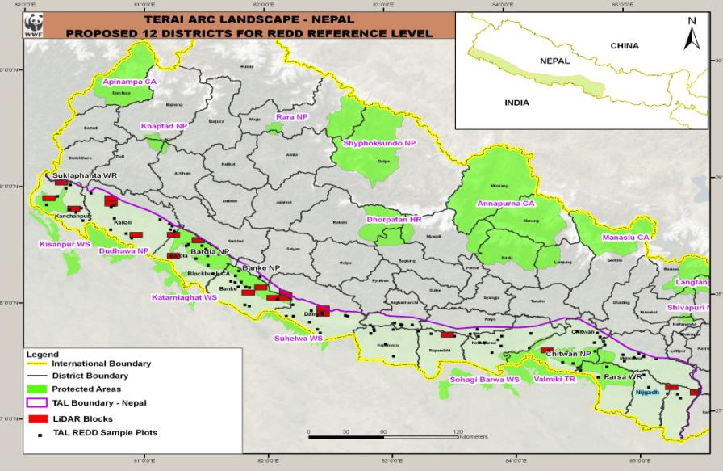
Introduction: Study Area

Slide 4
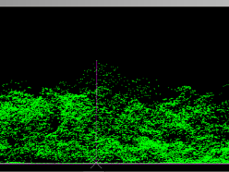
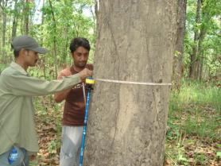
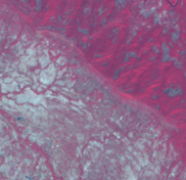
Methodology for Reference Level: LAMP
LAMP (LiDAR Assisted Multisource Programme) integrates satellite, field, and LiDAR data
Samples (5%) of LiDAR data to
calibrate satellite models;
Reference field sample plots to calibrate/validate LiDAR models;
Landsat satellite imagery for wall-to-wall biomass map.

Slide 5
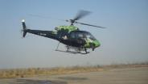
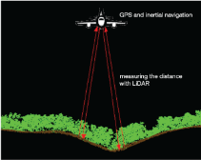
LiDAR (Light Detection and Ranging)
1st return from tree top
1st (and only) return from ground
2nd return from branches
3rd return from ground

Slide 6
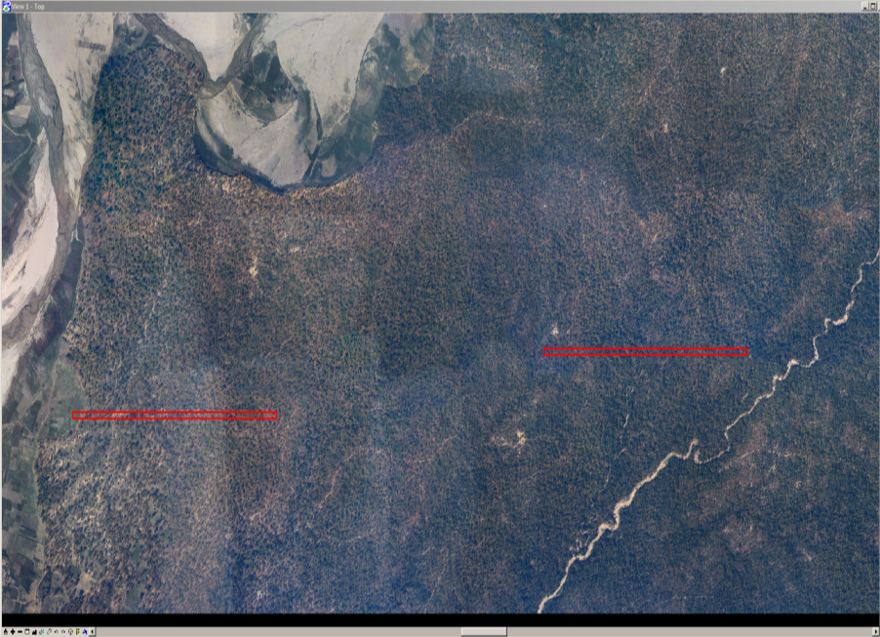

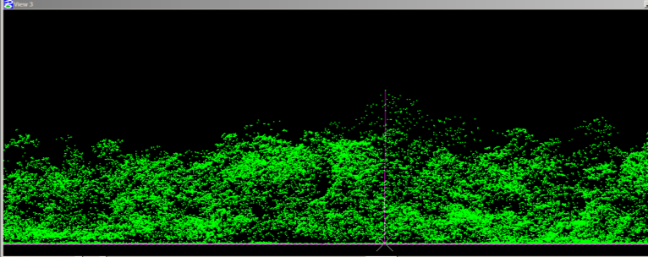
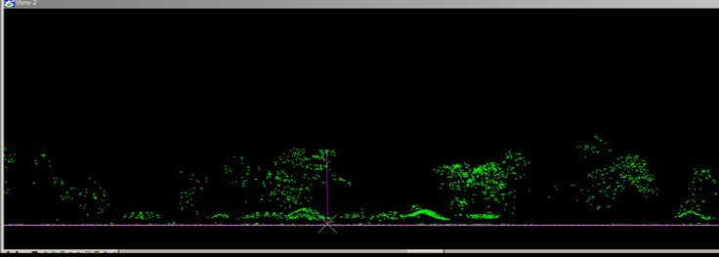

Dense forest from lidar
Near Khallagath, Kanchanpur district, Nepal
Degraded forest/encroachment from lidar

Slide 7
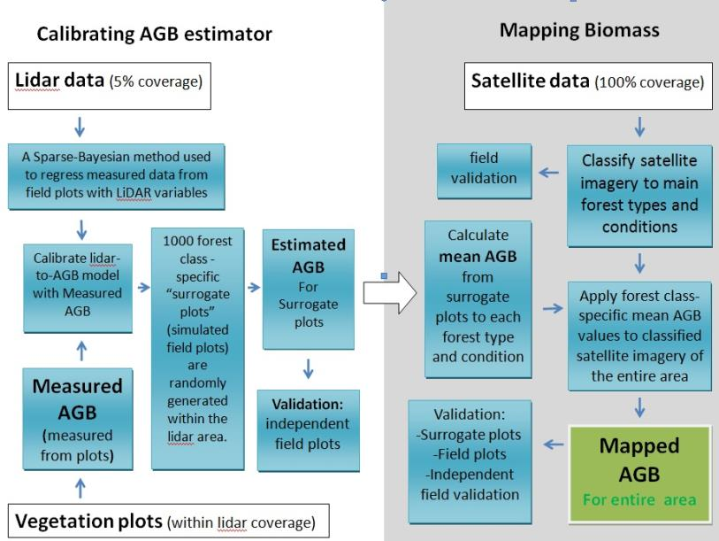
Work Flow for Reference Level: LAMP

Slide 8
Results: Historical Carbon Stock Loss

Slide 9
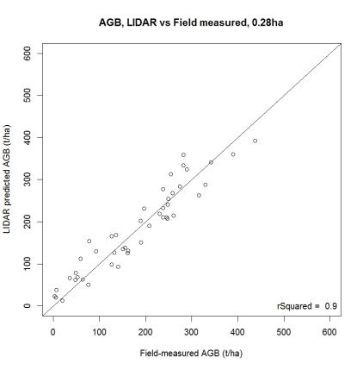
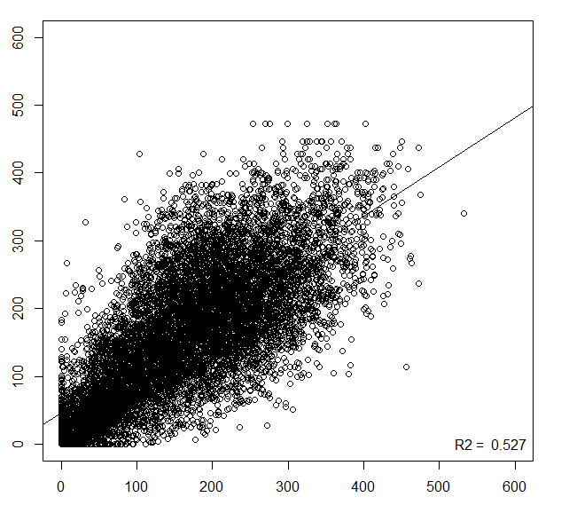
Accuracy assessment
LiDAR model
LAMP model (Landsat)
Estimated biomass (t/ha)
R² = 0.92
R² = 0.52
Field-measured biomass (t/ha)

Slide 10
Emissions reduction targets
Intervention | Cumulative emissions reduction from BAU (millions of tons CO₂e)
 | 5 years (2015 -2020) | 10 years (2015 -2025) | 15 years (2015 -2030)
Sustainable management of forests | 9.9 | 29.2 | 49.0
Installed biogas plants | 0.9 | 3.4 | 6.5
Improved cook stoves | 0.3 | 1.1 | 2.0
Land use planning | 2.8 | 8.3 | 13.9
Private forestry/tree nurseries | 0.1 | 0.7 | 1.4
Total | 14.0 | 42.7 | 72.8

Slide 11
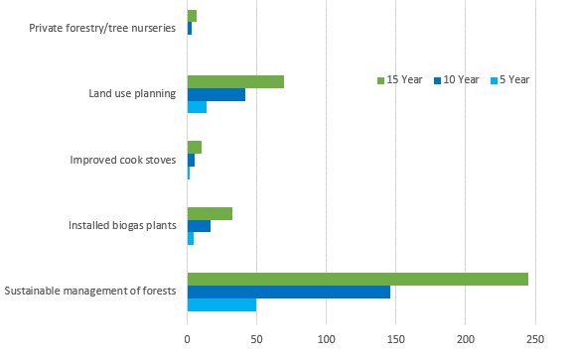
Potential Income by Activities (MUSD)

Slide 12
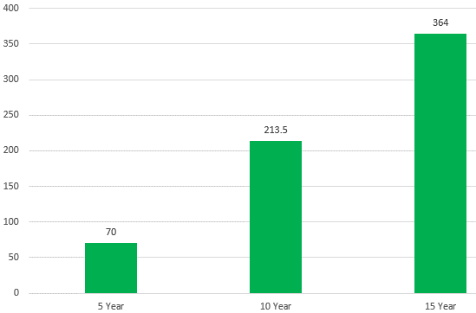
Total Potential Income (MUSD)

Slide 13
Summary and Key Strenghts
Science of carbon accounting is evolving and this method utilizes best data and scientific methods available;
Work follows the standards and guidelines of the IPCC and FCPF;
The methodology is equipped with a thorough uncertainty analysis by Monte Carlo analysis, as required by the IPCC.
Notes:
- Firmly grounded on ground truthing in both AD and EF
- Provides consistent two-year analyses of changes in AD into the past an into the future
- Quantifies forest degradation in AGB and other pools in a statistically sound fashion in the EF with LiDAR
- Both AD and EF have been validated in several separate field campaigns
- Comes equipped with a thorough uncertainty analysis by Monte Carlo methods, as required by IPCC
- Has been approved by FCPF

Slide 14
Recommendations to the GoSL
The approach could be piloted in Sri Lanka (at least at subnational level);
Sri Lanka could implement/strengthen Community Forestry and Participatory Forest Management Systems (key to success of REDD+ program);
Focus should be given to more attractive schemes, which might reward Sri Lanka for forest stewardship, NCBs, PES rather than for only emissions saved.
Notes:
forest stewardship – forest certification, governance, transparency, setting standards on products

Slide 15
References
REDD-cell. 2014. Nepal’s Emission Reductions –Program Idea Note (ER-PIN) to FCPF’s Carbon Fund.
https://www.forestcarbonpartnership.org/sites/fcp/files/2014/MArch/March/Nepal%20ER-PIN%20Annexes%20CF9%20%28Final%29.pdf
Joshi et al. 2014. An accurate REDD+ Reference Level for Terai Arc Landscape, Nepal using LiDAR Assisted Multi-source Program (LAMP). Banko Janakari, A Journal for Forestry Information in Nepal. Vol 24-1. http://report.arbonaut.com/arbo_site_uploaded_files/pdf/An%20accurate%20REDD+%20reference%20level%20for%20Terai%20Arc%20Landscape,%20Nepal%20using%20LiDAR%20Assisted%20Multi-source%20Programme%20%28LAMP%29.pdf
Gautam et al. 2013. Estimation of Forest Carbon Using LiDAR-Assisted Multi-source Programme (LAMP) in Nepal. http://report.arbonaut.com/arbo_site_uploaded_files/pdf/pdf/Estimation%20of%20Forest%20Carbon%20Using%20LiDAR-Assisted%20Multi-source%20Programme%20%28LAMP%29%20in%20Nepal.pdf
GFOI. 2013. Integrating remote-sensing and ground-based observations for estimation of emissions and removals of greenhouse gases in forests: Methods and guidance from the Global Forest Observation Initiative: Pub: Group on Earth Observations, Geneva, Switzerland, 2014. ISBN 978-92-990047-4-6. http://gfoi.org/sites/default/files/MGD_copyedited06082014.pdf

Slide 16
Thank you
Email: basanta.gautam@arbonaut.com
Website: www.arbonaut.com

