Slide 1
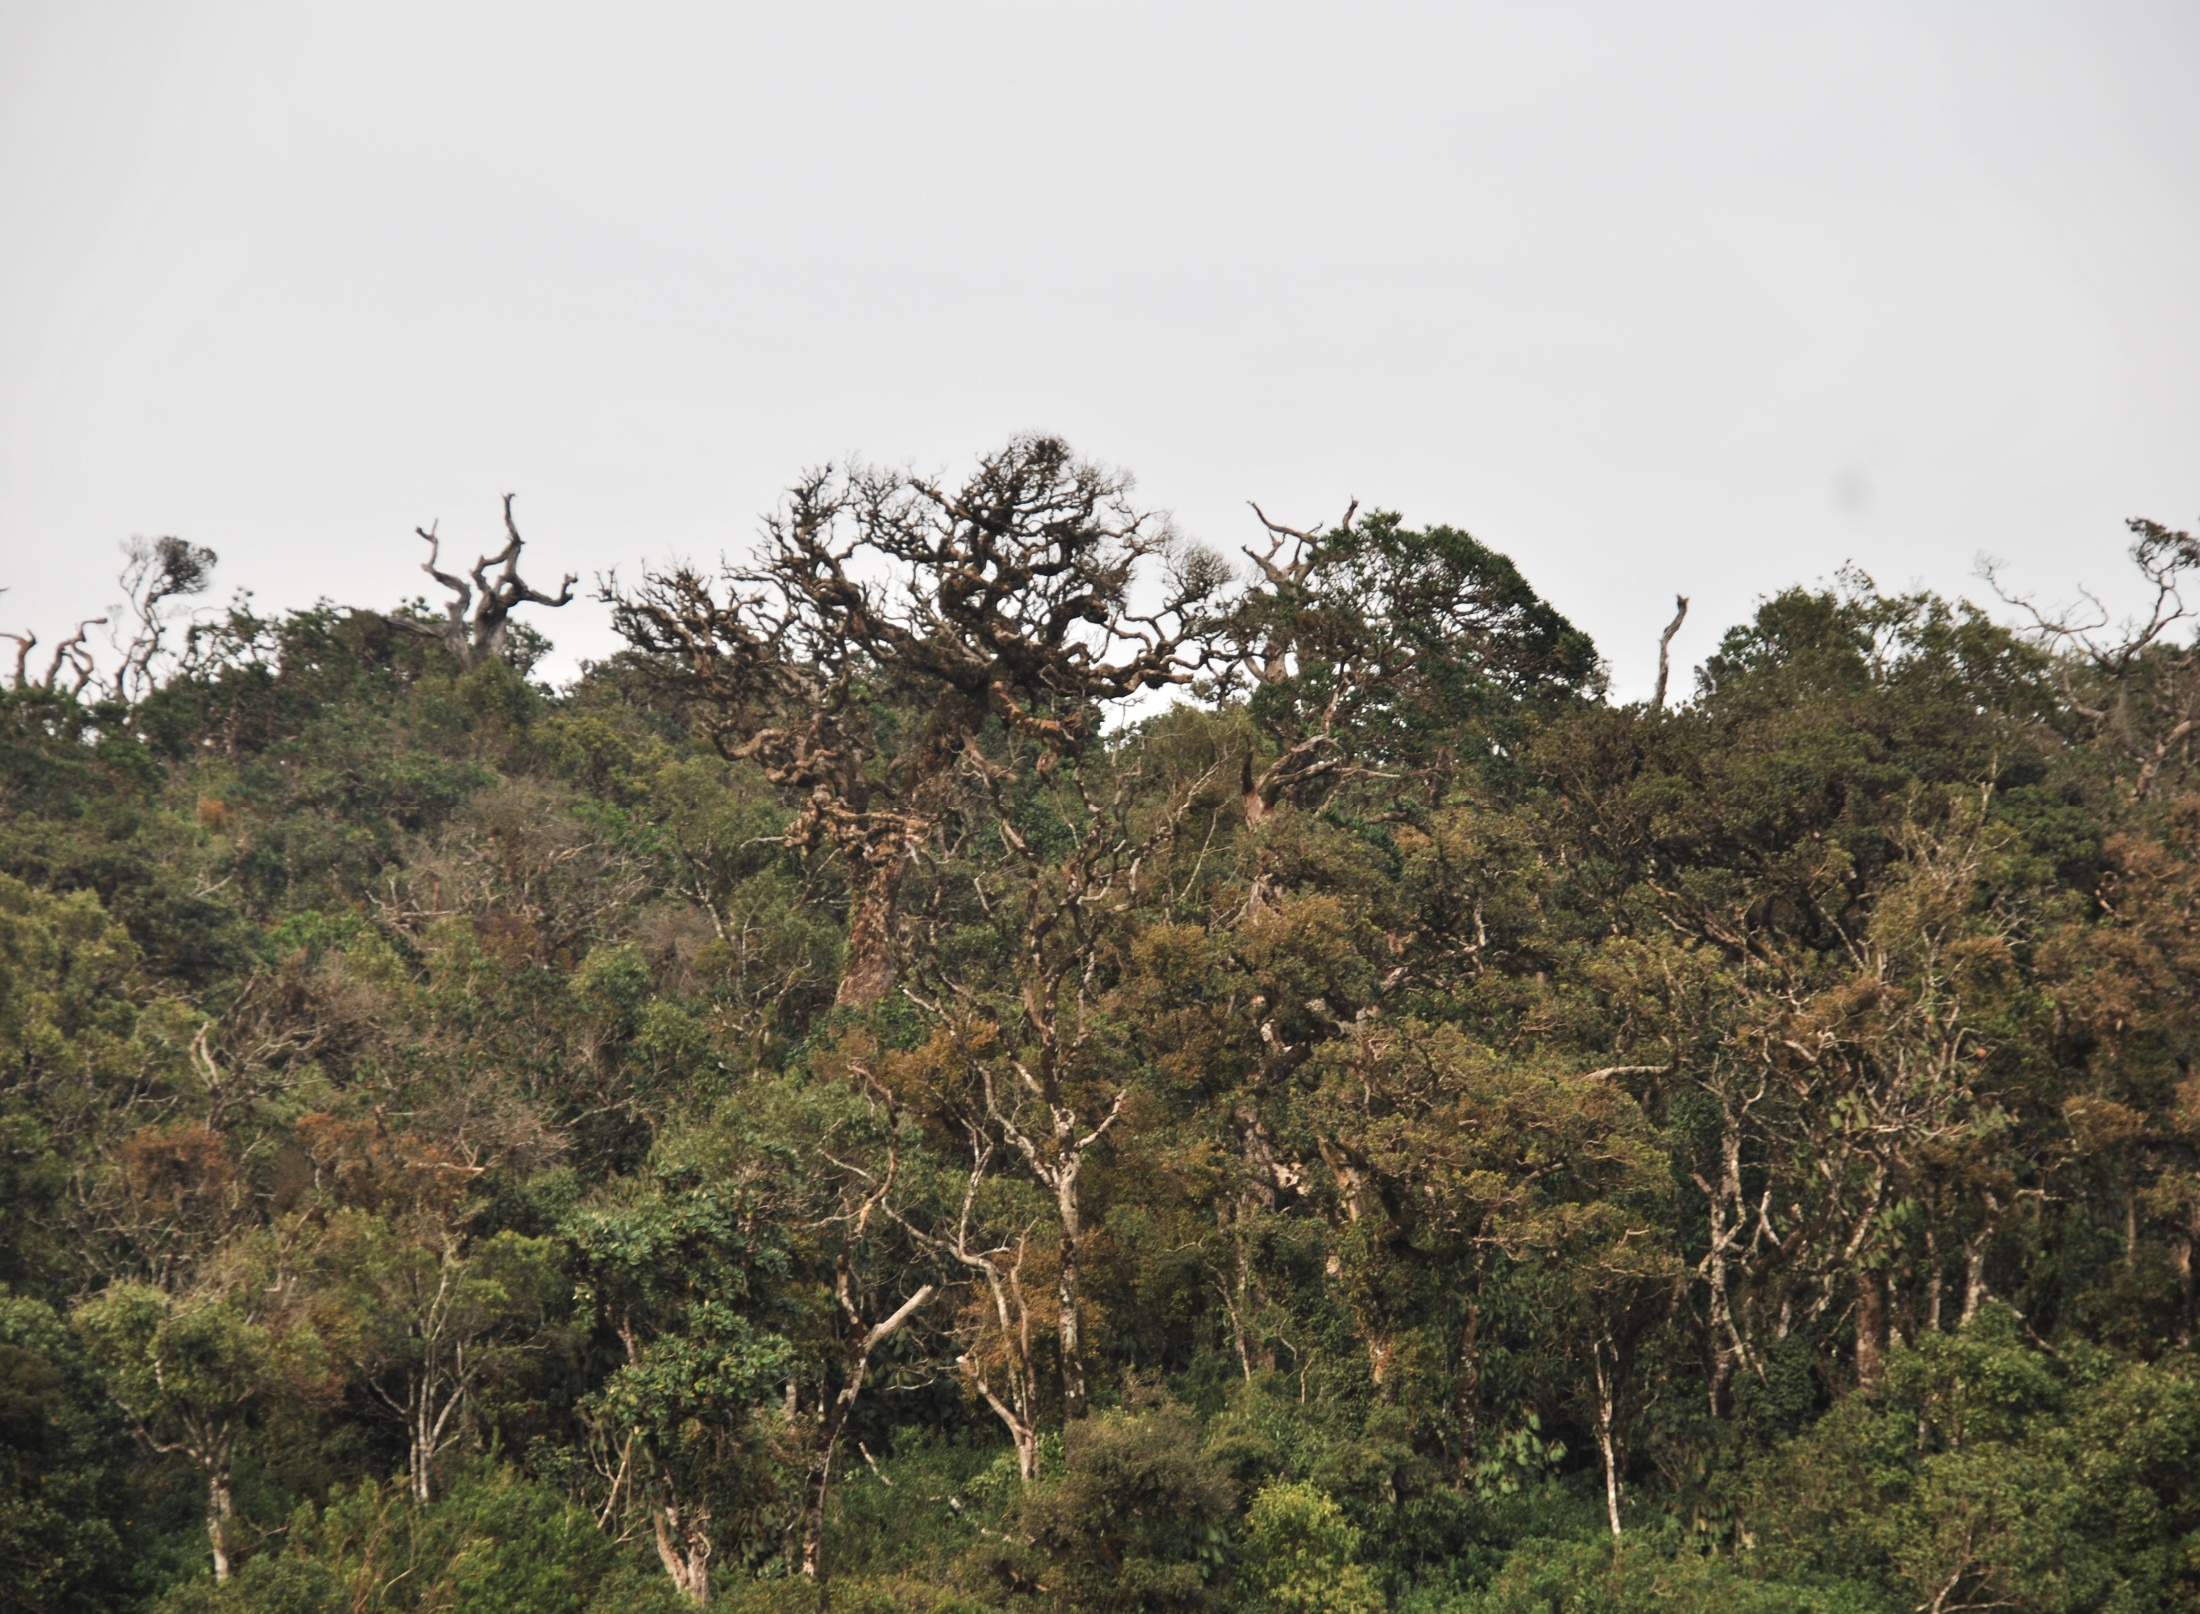
ASSESSMENT OF CANOPY DIEBACK IN HORTON PLAINS NATIONAL PARK USING MULTISPECTRAL SATELLITE DATA
Prabha Rupasinghe¹, Sisira Ediriweera², Tithira Lakkana²
1. Postgraduate Institute of Science, University of Peradeniya, Peradeniya, Sri Lanka
2. Faculty of Science and Technology, Uva Wellassa University, Badulla, Sri Lanka

Slide 2
Content
- Introduction
- Methodology
- Results and Discussion
- Conclusions

Slide 3
INTRODUCTION
- Horton Plains National Park (HPNP) is located in between 1550m - 2500m elevation range and covered by cloud forests and wet patana grassland.
- This is a unique ecosystem with more than 50% of endemic plant species.
- It is also home to many endemic birds, amphibians, butterflies, freshwater crabs, several mammals and reptiles.

Slide 4
Canopy dieback in HPNP
- First observed on the slope of Thotupolakanda area in 1978.
- Clusiaceae, Lauraceae, Simplocaceae and Myrtaceae are the families which are highly susceptible to the dieback.
- Acid rain, climate change, diseases, bark damage by Samburs, soil nutrient imbalance and toxicity
- A precise reason for dieback is yet unknown.

Slide 5
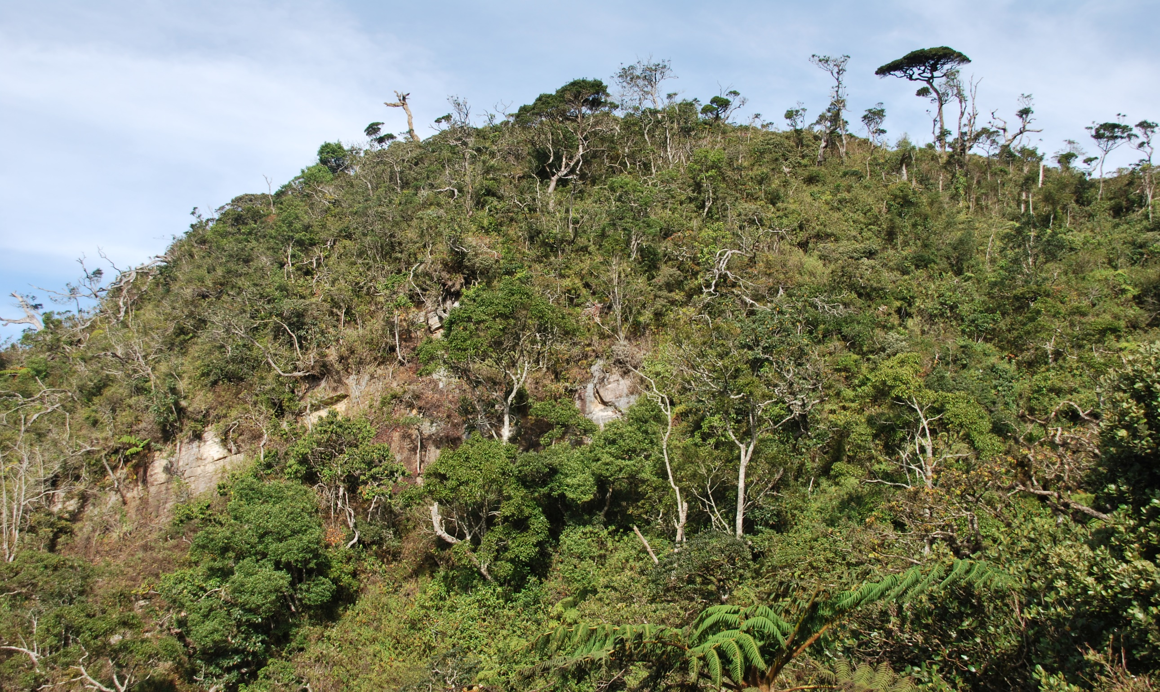

Slide 6
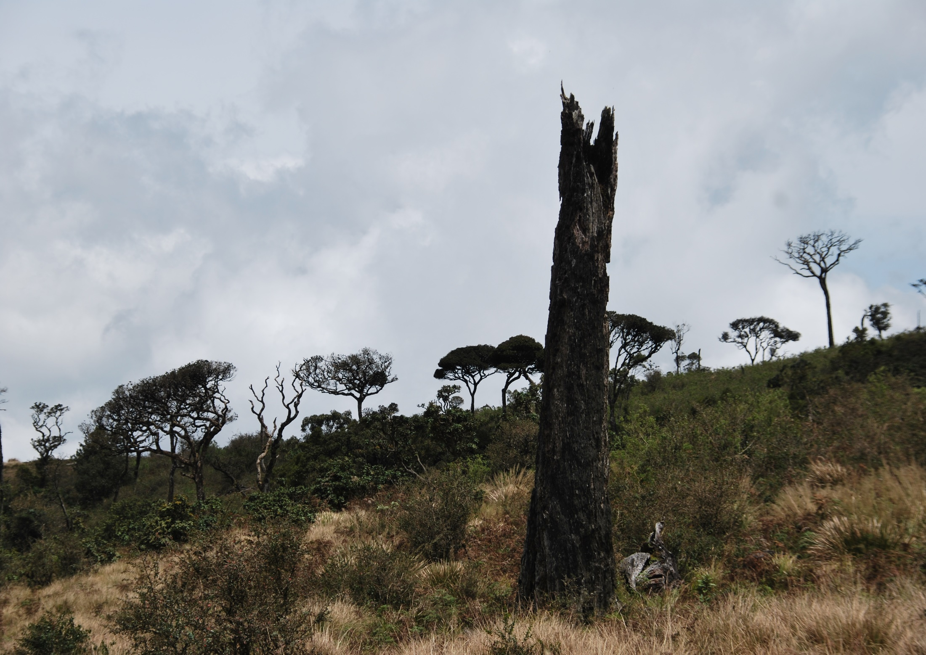

Slide 7
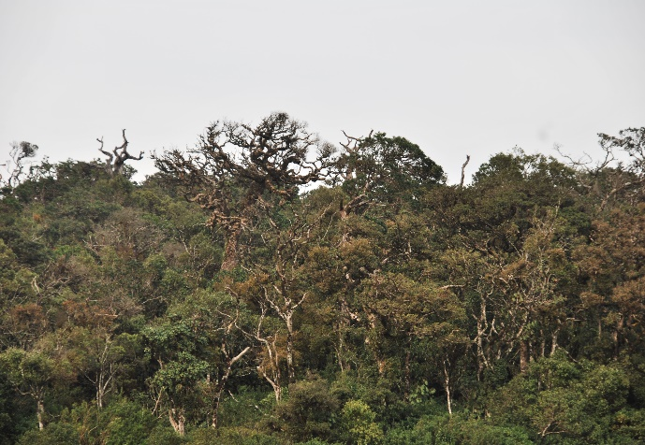
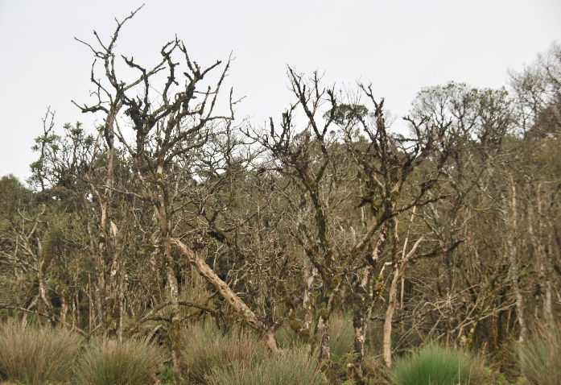
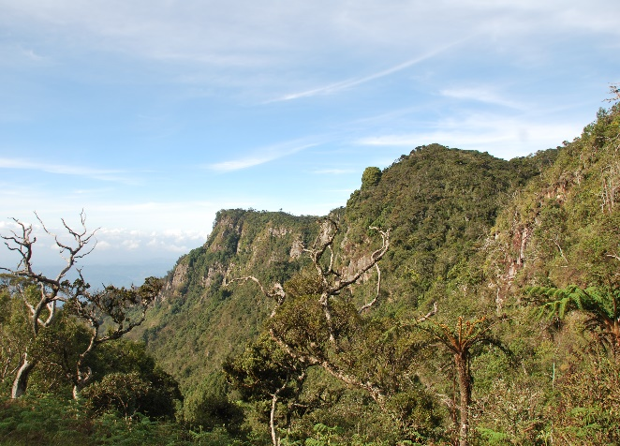
Objective
- To investigate spatial distribution of canopy dieback using remotely sensed data and in conjunction with field collected data.

Slide 8
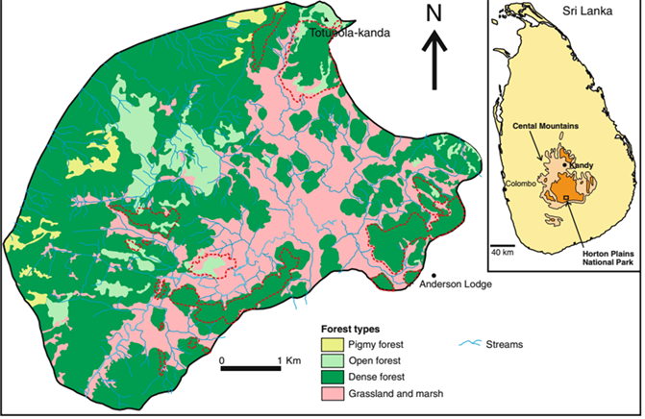
Study Area
Source: Chandrajith et al., 2009

Slide 9
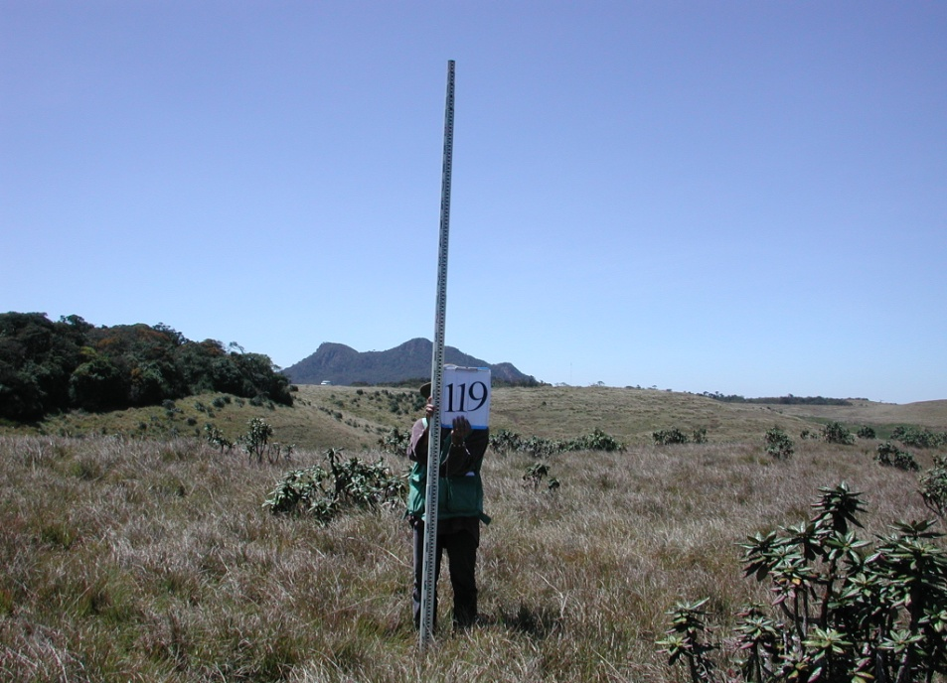
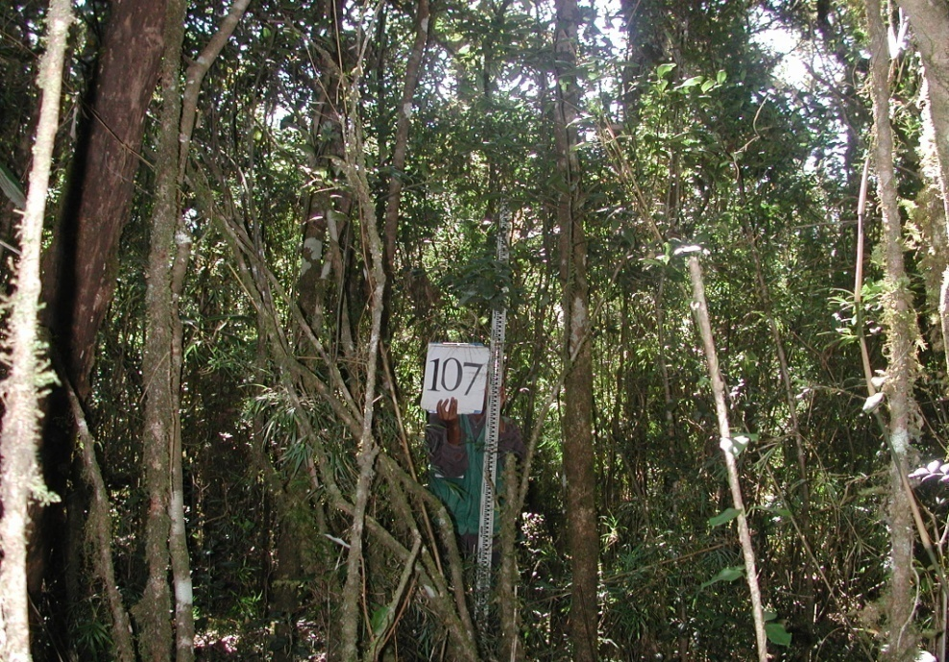
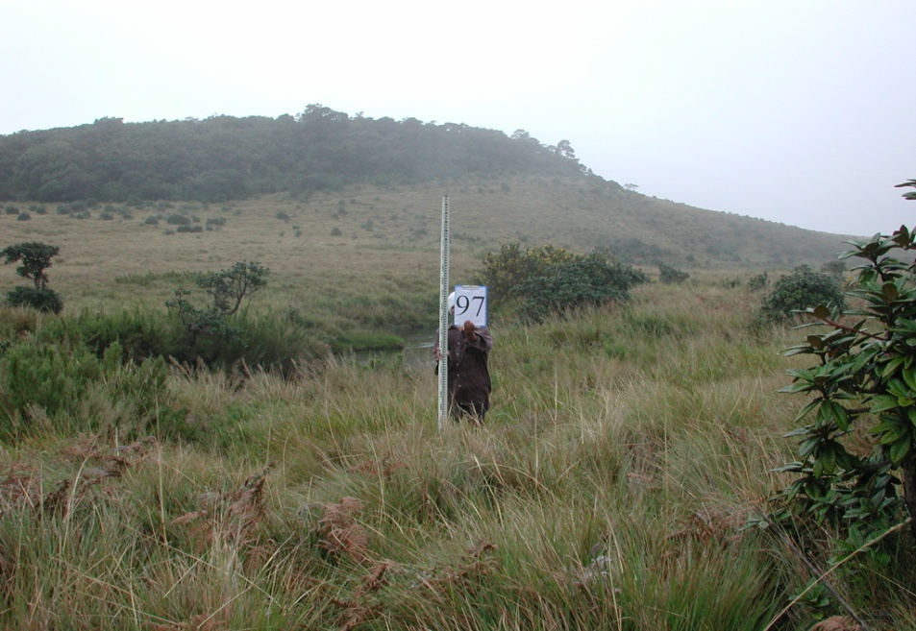
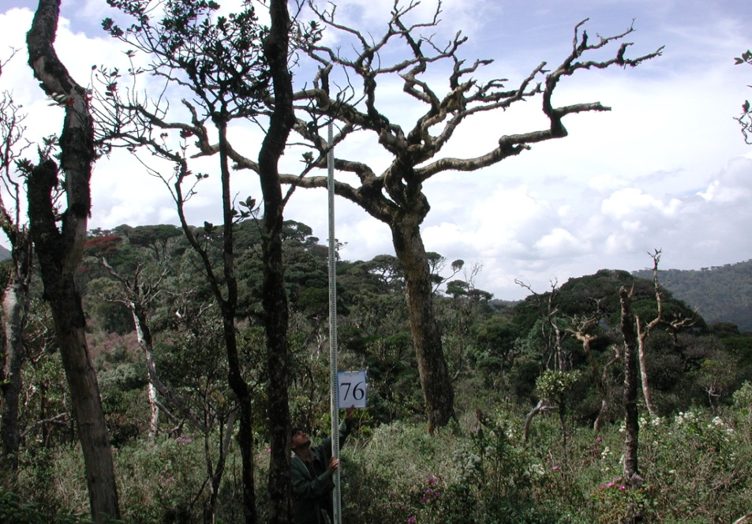
Methodology
Field data collection:
Grassland
Forested area
Dieback area
Marsh area

Slide 10
Remotely Sensed data:
      - Cloud and haze free 10 m spatial resolution ALOS (AVNIR-2) imagery was acquired.
      - 30 m spatial resolution ASTER Global DEM was downloaded.
      - ASTER DEM was resampled to 10 m spatial resolution
      - ALOS image was preprocessed:
      Radiometric calibration, atmospheric and topographic correction

Slide 11
The followings parameters were derived using DEM
- Topographic Wetness Index (TWI)
- slope and aspect
The TWI is defined as ln (a / tan β)____ Eq (1)
where a is specific catchment area (the cumulative upslope area draining through a cell divided by contour width)
β is the local slope
The TWI, given by Equation (1), define areas of saturated soil typically found in geomophologically convergent segments

Slide 12
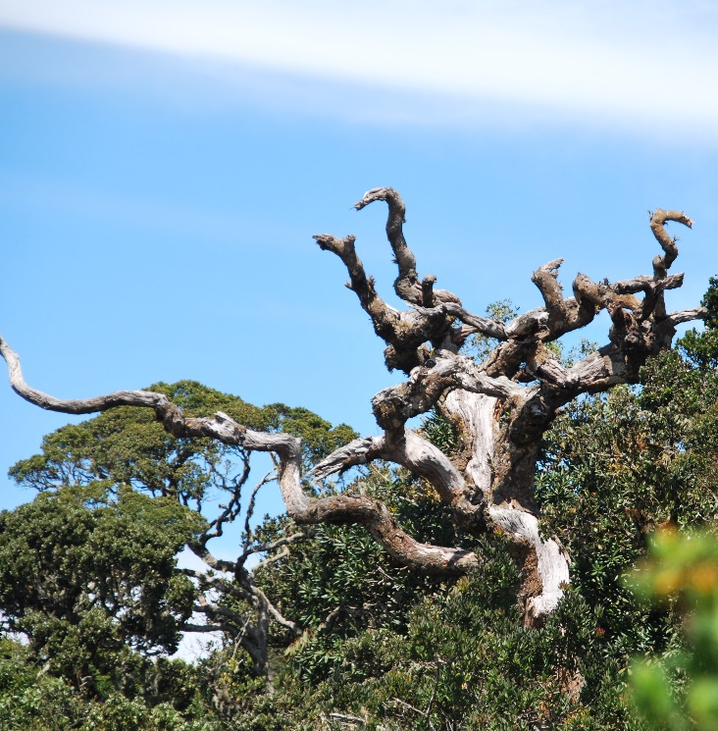


Fig-01 Flowchart of data processing and analysis

Slide 13
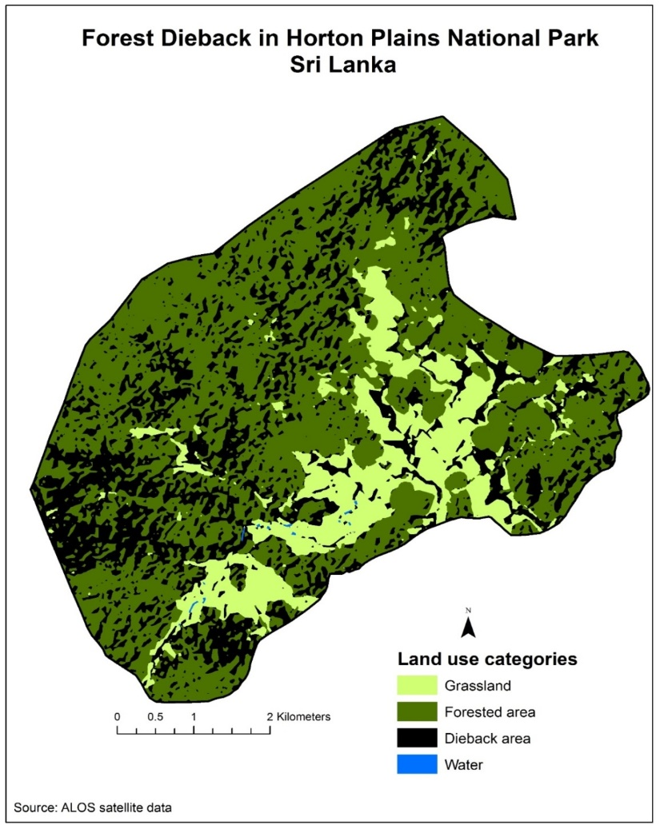
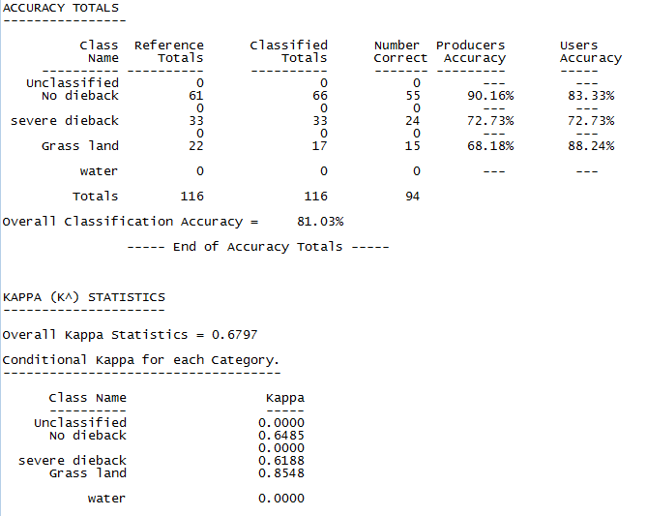
Results and Discussion
Accuracy assessment report
Classified image
Fig-02 Supervised Classification and Accuracy Assessment

Slide 14

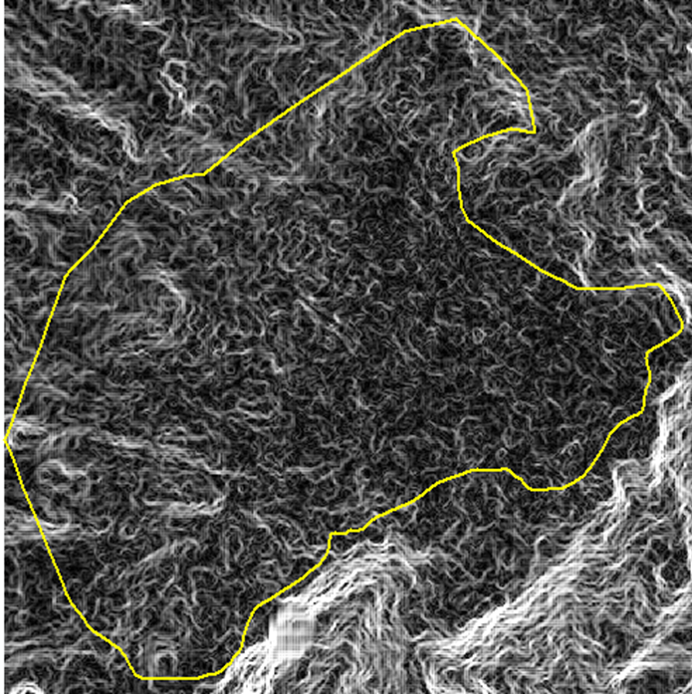

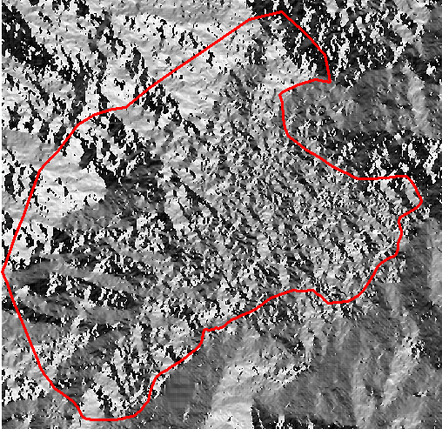
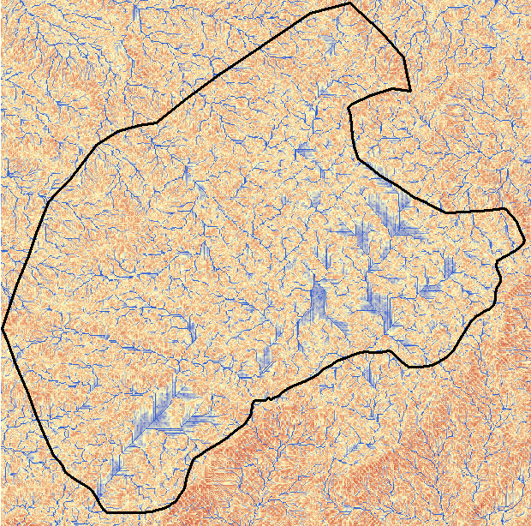
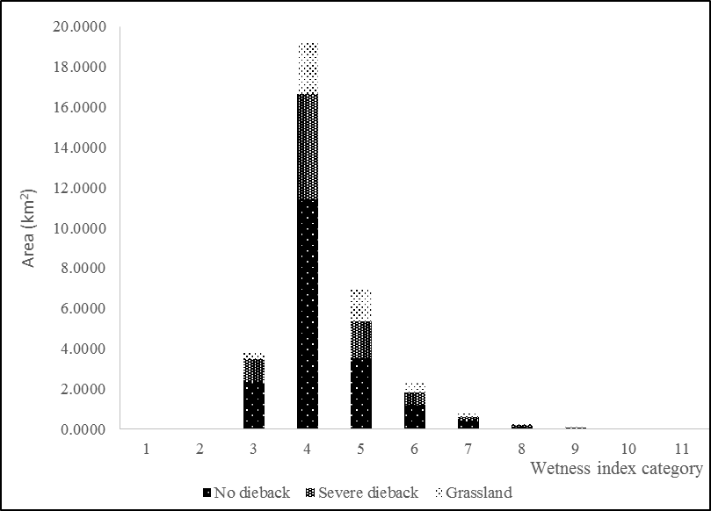


Fig-03 Slope, TWI and aspect maps

Slide 15
Multiple linear regression analysis on forest dieback occurrence with abiotic factors (slope, aspect and TWI) of the HPNP
 | canopy dieback occurrence
 | df | F | P
Slope | 1 | 90.87 | 0.000
Aspect | 1 | 3.08 | 0.080
TWI | 1 | 151.53 | 0.000
Slope x Aspect x TWI | 3 | 456.95 | 0.000

Slide 16
- Canopy dieback occurrence is negatively correlated with the TWI
- The occurrence of canopy dieback is increased with the increase of the aspect and slope.
- Results of statistical analysis showed a significant trends for TWI, aspect, and slope of the terrain with canopy dieback

Slide 17
Conclusions
- Area of 9.20 km² (27% )of the total forest reserve is subjected to the dieback.
- Dieback is significantly increased with the increase of the slope, aspect and decreased increase with TWI
- More forest dieback is observed at the S and SE facing slopes and less dieback is observed in N facing slopes

Slide 18
- Collective factor associated with the rain and wind experienced in this dieback area, the plant available soil moisture and the rate of evapotranspiration might be the possible reason for the catastrophic tree mortality

Slide 19

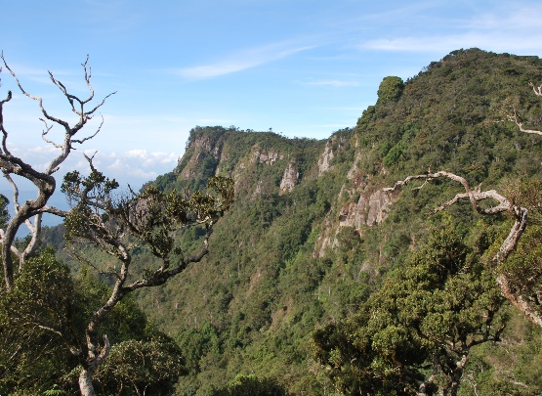
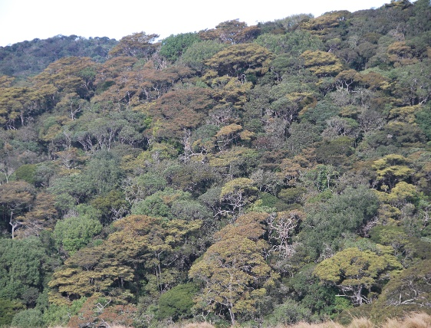
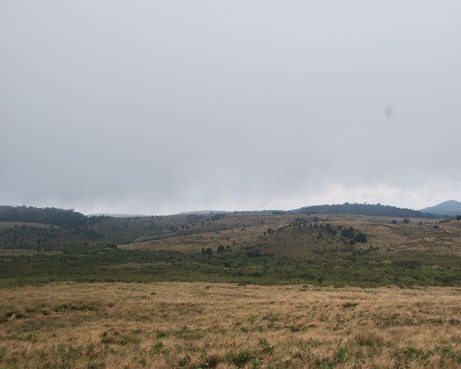
Thank you…!

Slide 20
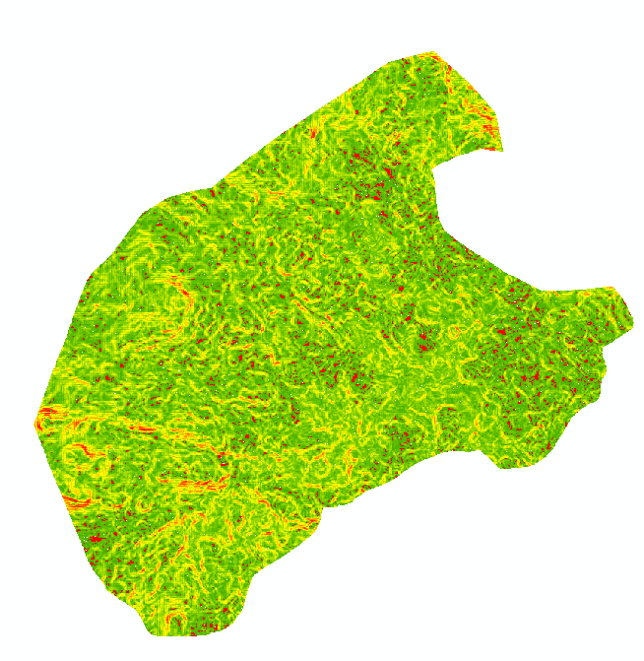
Overlay Analysis
Slope
Slope category | Forest GRIDCODE | Die-back GRIDCODE | Grassland GRIDCODE | Water GRIDCODE
0-5 | 101 | 201 | 301 | 401
5 to 10 | 102 | 202 | 302 | 402
10 to 15 | 103 | 203 | 303 | 403
15 to 20 | 104 | 204 | 304 | 404
20 to 25 | 105 | 205 | 305 | 405
25 to 30 | 106 | 206 | 306 | 406
30 to 35 | 107 | 207 | 307 | 407
35 to 40 | 108 | 208 | 308 | 408
40 to 45 | 109 | 209 | 309 | 409
45 to 50 | 110 | 210 | 310 | 410
50 to 55 | 111 | 211 | 311 | 411
55 to 60 | 112 | 212 | 312 | 412
60 to 65 | 113 | 213 | 310 | 413

Slide 21
Overlay Analysis
Aspect
Reclassification
Variable | Categories | Assigned reclassification new values
Aspect (degrees) | Flat (-1) | 0
 | N (0-22.5 and 337.5-360) | 1
 | NE (22.5-67.5) | 2
 | E (67.5- 112.5) | 3
 | SE (112.5-157.5) | 4
 | S (157.5- 202.5) | 5
 | SW (202.5- 247.5) | 6
 | W (247.5- 292.5) | 7
 | NW (292.5 – 337.5) | 8
Reclassification
Variable | Categories | Assigned reclassification new values
land use | No dieback | 100
 | severe dieback | 200
 | grassland | 300
 | water | 400
+
Raster Calculator

Slide 22
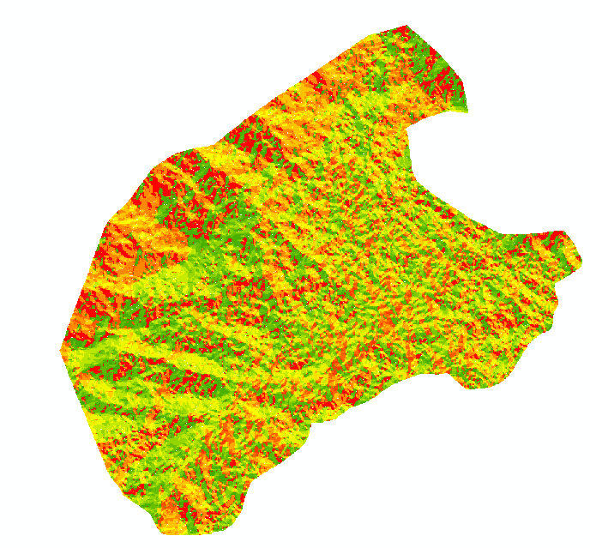
Overlay Analysis
Aspect
Aspect category | Forest GRIDCODE | Die-back GRIDCODE | Grassland GRIDCODE | Water GRIDCODE
Flat | 100 | 200 | 300 | 400
N | 101 | 201 | 301 | 401
NE | 102 | 202 | 302 | 402
E | 103 | 203 | 303 | 403
SE | 104 | 204 | 304 | 404
S | 105 | 205 | 305 | 405
SW | 106 | 206 | 306 | 406
W | 107 | 207 | 307 | 407
NW | 108 | 208 | 308 | 408

Slide 23

Overlay Analysis
Topographic Wetness Index (TWI)
Reclassification
Variable | Categories | Assigned reclassification new values
Topographic Wetness Index | 3.194771 | 1
 | 3.194771 to 4 | 2
 | 4 to 6 | 3
 | 6 to 8 | 4
 | 8 to 10 | 5
 | 10 to 12 | 6
 | 12 to 14 | 7
 | 14 to 16 | 8
 | 16 to 18 | 9
 | 18 to 20 | 10
 | 20 to 22 | 11
Reclassification
Variable | Categories | Assigned reclassification new values
land use | No dieback | 100
 | severe dieback | 200
 | grassland | 300
 | water | 400
+
Raster Calculator

Slide 24
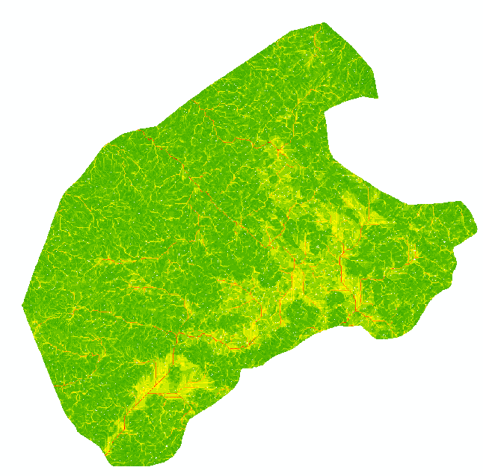
Overlay Analysis
TWI
TWI category | Forest GRIDCODE | Die-back GRIDCODE | Grassland GRIDCODE | Water GRIDCODE
3.194771 | 101 | 201 | 301 | 401
3.194771 to 4 | 102 | 202 | 302 | 402
4 to 6 | 103 | 203 | 303 | 403
6 to 8 | 104 | 204 | 304 | 404
8 to 10 | 105 | 205 | 305 | 405
10 to 12 | 106 | 206 | 306 | 406
12 to 14 | 107 | 207 | 307 | 407
14 to 16 | 108 | 208 | 308 | 408
16 to 18 | 109 | 209 | 309 | 409
18 to 20 | 110 | 210 | 310 | 410
20 to 22 | 111 | 211 | 311 | 411

Slide 25
Overlay Analysis
Land use
Slope
Aspect
TWI
categories | Assigned reclassification new values
No dieback | 100000
severe dieback | 200000
grassland | 300000
water | 400000
categories | Assigned reclassification new values
0-5 | 1000
5 to 10 | 2000
10 to 15 | 3000
15 to 20 | 4000
20 to 25 | 5000
25 to 30 | 6000
30 to 35 | 7000
35 to 40 | 8000
40 to 45 | 9000
45 to 50 | 10000
50 to 55 | 11000
55 to 60 | 12000
60 to 65 | 13000
categories | Assigned reclassification new values
Flat (-1) | 10
N (0-22.5 and 337.5-360) | 20
NE (22.5-67.5) | 30
E (67.5- 112.5) | 40
SE (112.5-157.5) | 50
S (157.5- 202.5) | 60
SW (202.5- 247.5) | 70
W (247.5- 292.5) | 80
NW (292.5 – 337.5) | 90
categories | Assigned reclassification new values
3.194771 | 1
3.194771 to 4 | 2
4 to 6 | 3
6 to 8 | 4
8 to 10 | 5
10 to 12 | 6
12 to 14 | 7
14 to 16 | 8
16 to 18 | 9
18 to 20 | 10
20 to 22 | 11
+
+
+

